Slide 1

Module 1
Introducing the DevOps Model
People, process, technology, and evidence
Cisco learning and professional development
Notes:
Purpose: Open Module 1 and establish the subject of the deck.
Explain: Introducing the DevOps Model. People, process, technology, and evidence.
Presenter cue: Briefly connect this module to the previous part of the course before discussing details.
Transition: Move to the module introduction and learning focus.

Slide 2
2
Module 1
Module introduction
This module explains how software delivery practices turn useful automation into a service that a team can review, release, and operate.
Use CALMS to examine delivery capability
Trace work through the complete lifecycle
Distinguish continuous integration, delivery, and deployment
Identify flow constraints and useful measures
Notes:
Purpose: Establish the scope of Module introduction.
Explain: This module explains how software delivery practices turn useful automation into a service that a team can review, release, and operate.
Discuss: Use CALMS to examine delivery capability Trace work through the complete lifecycle Distinguish continuous integration, delivery, and deployment Identify flow constraints and useful measures
Audience question: Which point is most familiar, and which point needs the most attention?
Transition: Introduce the first model or engineering boundary.

Slide 3
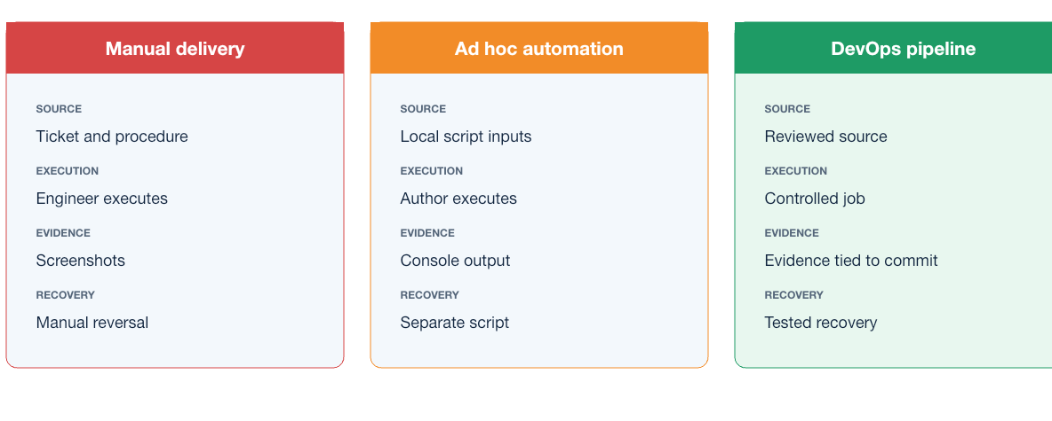
3
Module 1
Delivery models
Manual work, individually operated automation, and pipeline delivery differ in ownership, repeatability, validation, and evidence.
Notes:
Purpose: Explain delivery models through the diagram.
Reading order: Start with the main boundary or input, follow the connections, then identify the output or feedback path.
Key explanation: Manual work, individually operated automation, and pipeline delivery differ in ownership, repeatability, validation, and evidence.
Audience question: Where would a failure become visible, and which component should own the response?
Transition: Connect the diagram to the next engineering decision.

Slide 4
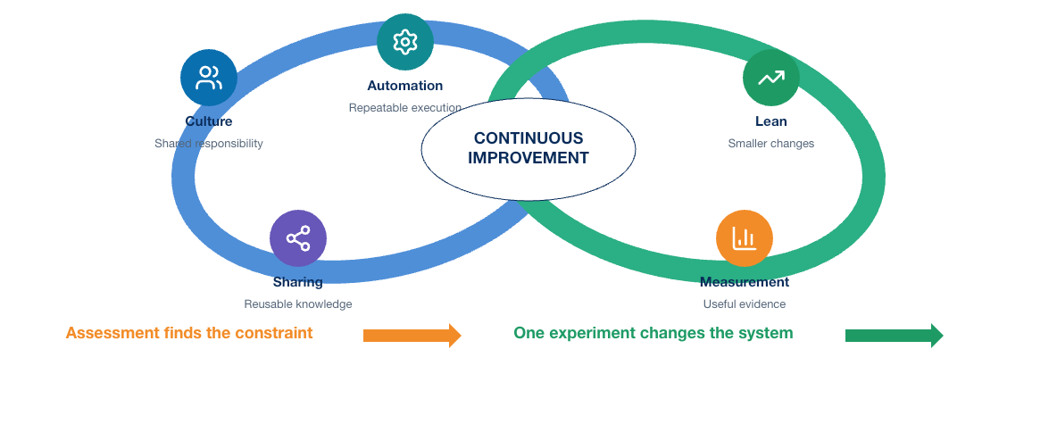
4
Module 1
CALMS model
Culture and sharing shape ownership. Automation and lean practices improve flow. Measurement shows whether the system works.
Notes:
Purpose: Explain calms model through the diagram.
Reading order: Start with the main boundary or input, follow the connections, then identify the output or feedback path.
Key explanation: Culture and sharing shape ownership. Automation and lean practices improve flow. Measurement shows whether the system works.
Audience question: Where would a failure become visible, and which component should own the response?
Transition: Connect the diagram to the next engineering decision.

Slide 5
5
Module 1
CALMS assessment
Flow and ownership
Automation and evidence
1
Who owns the service outcome?
1
Which decisions are repeatable?
2
Where does work wait?
2
Which failures stop promotion?
3
How large are typical changes?
3
What evidence supports a release?
4
How does knowledge move between people?
4
How does production feedback reach planning?
Notes:
Purpose: Compare the two sides of calms assessment.
Left side, Flow and ownership: Who owns the service outcome? Where does work wait? How large are typical changes? How does knowledge move between people?
Right side, Automation and evidence: Which decisions are repeatable? Which failures stop promotion? What evidence supports a release? How does production feedback reach planning?
Presenter cue: Explain the relationship between the columns rather than reading each line verbatim.
Audience question: Which responsibility is unclear or shared in your current environment?
Transition: Use the comparison to frame the next topic.

Slide 6
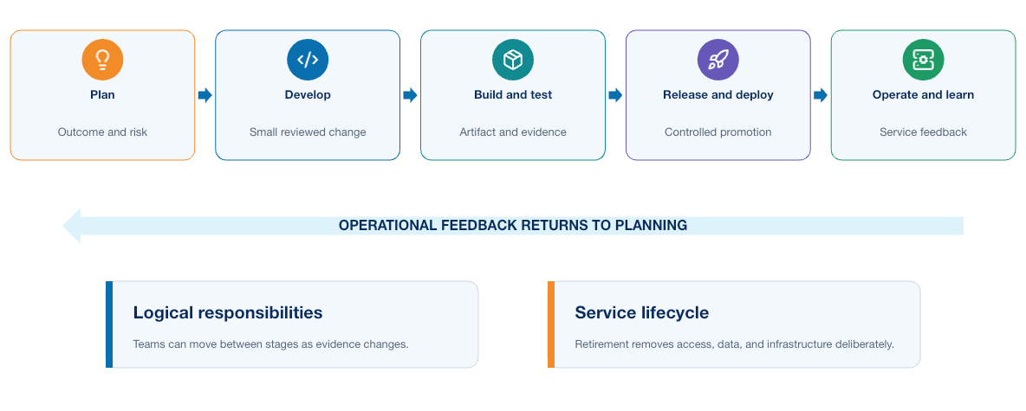
6
Module 1
Complete DevOps lifecycle
Delivery continues after deployment. Operation, observation, learning, and retirement complete the lifecycle.
Notes:
Purpose: Explain complete devops lifecycle through the diagram.
Reading order: Start with the main boundary or input, follow the connections, then identify the output or feedback path.
Key explanation: Delivery continues after deployment. Operation, observation, learning, and retirement complete the lifecycle.
Audience question: Where would a failure become visible, and which component should own the response?
Transition: Connect the diagram to the next engineering decision.

Slide 7
7
Module 1
Lifecycle responsibilities
Before release
After release
1
Define the expected outcome
1
Deploy within approved scope
2
Design interfaces and controls
2
Observe service behavior
3
Integrate small changes
3
Recover when outcomes differ
4
Build and qualify an artifact
4
Retire access and obsolete versions
Notes:
Purpose: Compare the two sides of lifecycle responsibilities.
Left side, Before release: Define the expected outcome Design interfaces and controls Integrate small changes Build and qualify an artifact
Right side, After release: Deploy within approved scope Observe service behavior Recover when outcomes differ Retire access and obsolete versions
Presenter cue: Explain the relationship between the columns rather than reading each line verbatim.
Audience question: Which responsibility is unclear or shared in your current environment?
Transition: Use the comparison to frame the next topic.

Slide 8
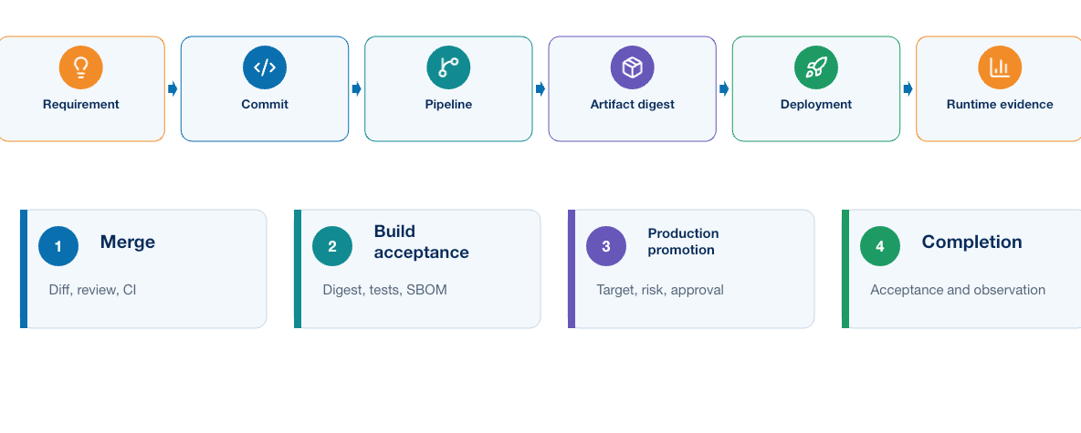
8
Module 1
Evidence chain
A release decision depends on traceable evidence that connects source, build inputs, tests, approvals, deployment, and observed outcome.
Notes:
Purpose: Explain evidence chain through the diagram.
Reading order: Start with the main boundary or input, follow the connections, then identify the output or feedback path.
Key explanation: A release decision depends on traceable evidence that connects source, build inputs, tests, approvals, deployment, and observed outcome.
Audience question: Where would a failure become visible, and which component should own the response?
Transition: Connect the diagram to the next engineering decision.

Slide 9
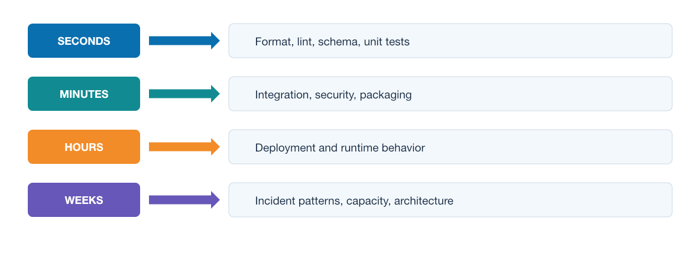
9
Module 1
Feedback speeds
Fast checks protect developer flow. Broader integration and operational feedback answer questions that local tests cannot.
Notes:
Purpose: Explain feedback speeds through the diagram.
Reading order: Start with the main boundary or input, follow the connections, then identify the output or feedback path.
Key explanation: Fast checks protect developer flow. Broader integration and operational feedback answer questions that local tests cannot.
Audience question: Where would a failure become visible, and which component should own the response?
Transition: Connect the diagram to the next engineering decision.

Slide 10
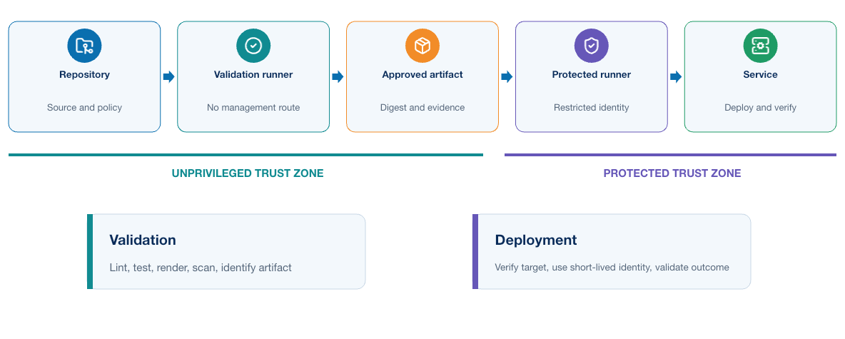
10
Module 1
Delivery architecture
Version control, runners, registries, deployment targets, and observability systems form one delivery system with distinct trust boundaries.
Notes:
Purpose: Explain delivery architecture through the diagram.
Reading order: Start with the main boundary or input, follow the connections, then identify the output or feedback path.
Key explanation: Version control, runners, registries, deployment targets, and observability systems form one delivery system with distinct trust boundaries.
Audience question: Where would a failure become visible, and which component should own the response?
Transition: Connect the diagram to the next engineering decision.

Slide 11
11
Module 1
Release evidence
Candidate identity
Qualification evidence
1
Source revision
1
Test results
2
Dependency versions
2
Security findings
3
Build environment
3
Approval record
4
Artifact digest
4
Deployment and post-check results
Notes:
Purpose: Compare the two sides of release evidence.
Left side, Candidate identity: Source revision Dependency versions Build environment Artifact digest
Right side, Qualification evidence: Test results Security findings Approval record Deployment and post-check results
Presenter cue: Explain the relationship between the columns rather than reading each line verbatim.
Audience question: Which responsibility is unclear or shared in your current environment?
Transition: Use the comparison to frame the next topic.

Slide 12
12
Module 1
CI, delivery, and deployment
Continuous integration
Release choices
1
Integrates small changes frequently
1
Continuous delivery keeps approval
2
Builds and tests every candidate
2
Continuous deployment removes manual approval
3
Returns feedback to the author
3
Both require a qualified artifact
4
Keeps the main branch releasable
4
Promotion should preserve artifact identity
Notes:
Purpose: Compare the two sides of ci, delivery, and deployment.
Left side, Continuous integration: Integrates small changes frequently Builds and tests every candidate Returns feedback to the author Keeps the main branch releasable
Right side, Release choices: Continuous delivery keeps approval Continuous deployment removes manual approval Both require a qualified artifact Promotion should preserve artifact identity
Presenter cue: Explain the relationship between the columns rather than reading each line verbatim.
Audience question: Which responsibility is unclear or shared in your current environment?
Transition: Use the comparison to frame the next topic.

Slide 13
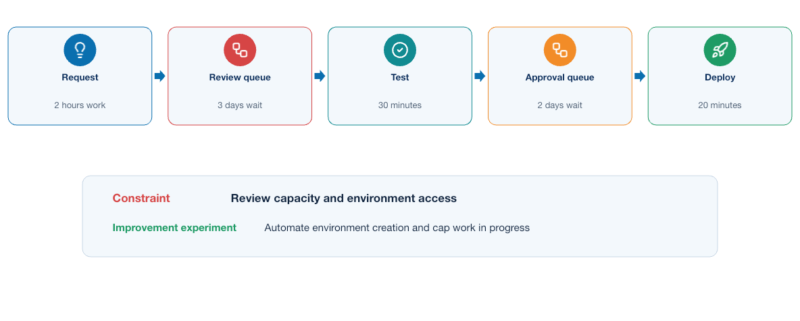
13
Module 1
Value stream
Improvement begins by measuring where work waits, where changes fail, and where teams repeat manual decisions.
Notes:
Purpose: Explain value stream through the diagram.
Reading order: Start with the main boundary or input, follow the connections, then identify the output or feedback path.
Key explanation: Improvement begins by measuring where work waits, where changes fail, and where teams repeat manual decisions.
Audience question: Where would a failure become visible, and which component should own the response?
Transition: Connect the diagram to the next engineering decision.

Slide 14
14
Module 1
Delivery measures
Flow
Stability
1
Lead time for a change
1
Change failure rate
2
Deployment frequency
2
Time to restore service
3
Time waiting for approval
3
Escaped defects
4
Time spent repeating work
4
Incomplete or missing evidence
Notes:
Purpose: Compare the two sides of delivery measures.
Left side, Flow: Lead time for a change Deployment frequency Time waiting for approval Time spent repeating work
Right side, Stability: Change failure rate Time to restore service Escaped defects Incomplete or missing evidence
Presenter cue: Explain the relationship between the columns rather than reading each line verbatim.
Audience question: Which responsibility is unclear or shared in your current environment?
Transition: Use the comparison to frame the next topic.

Slide 15
15
Module 1
Key takeaways
DevOps treats delivery as an engineering system whose output includes working software and credible operational evidence.
Shared ownership matters as much as automation
Small batches reduce review and recovery risk
Pipelines should promote an identified artifact
Feedback must reach the people who can act on it
Notes:
Purpose: Establish the scope of Key takeaways.
Explain: DevOps treats delivery as an engineering system whose output includes working software and credible operational evidence.
Discuss: Shared ownership matters as much as automation Small batches reduce review and recovery risk Pipelines should promote an identified artifact Feedback must reach the people who can act on it
Audience question: Which point is most familiar, and which point needs the most attention?
Transition: Introduce the first model or engineering boundary.

Slide 16
16
Module 1
Module 1 complete
✓
Module 1 complete
Next: Infrastructure as Code and On-Demand Environments
Review the key concepts before continuing.
Notes:
Purpose: Close Module 1.
Recap: Ask learners to state one concept they can apply and one question that remains.
Next: Next: Infrastructure as Code and On-Demand Environments
Presenter cue: Confirm the class is ready before moving to the next module.

