Slide 1

Module 2
Infrastructure as Code and On-Demand Environments
Provisioning, configuration, testing, and cleanup
Cisco learning and professional development
Notes:
Purpose: Open Module 2 and establish the subject of the deck.
Explain: Infrastructure as Code and On-Demand Environments. Provisioning, configuration, testing, and cleanup.
Presenter cue: Briefly connect this module to the previous part of the course before discussing details.
Transition: Move to the module introduction and learning focus.

Slide 2
2
Module 2
Module introduction
This module separates infrastructure provisioning from system configuration and shows how code can create short-lived test environments safely.
Explain desired state and lifecycle management
Use Terraform state without confusing it with live truth
Assign configuration work to Ansible
Design create, verify, and destroy controls
Notes:
Purpose: Establish the scope of Module introduction.
Explain: This module separates infrastructure provisioning from system configuration and shows how code can create short-lived test environments safely.
Discuss: Explain desired state and lifecycle management Use Terraform state without confusing it with live truth Assign configuration work to Ansible Design create, verify, and destroy controls
Audience question: Which point is most familiar, and which point needs the most attention?
Transition: Introduce the first model or engineering boundary.

Slide 3
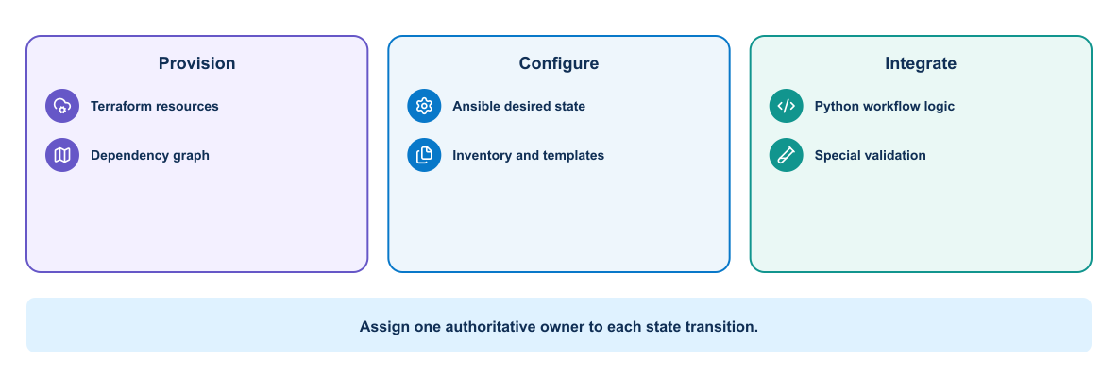
3
Module 2
Tool ownership
Terraform, Ansible, image tooling, and orchestration platforms solve different parts of the delivery problem.
Notes:
Purpose: Explain tool ownership through the diagram.
Reading order: Start with the main boundary or input, follow the connections, then identify the output or feedback path.
Key explanation: Terraform, Ansible, image tooling, and orchestration platforms solve different parts of the delivery problem.
Audience question: Where would a failure become visible, and which component should own the response?
Transition: Connect the diagram to the next engineering decision.

Slide 4
4
Module 2
Three automation responsibilities
Resource lifecycle
System behavior
1
Create and delete infrastructure
1
Configure operating systems and devices
2
Track resource identity
2
Apply policy and application settings
3
Plan topology changes
3
Verify desired behavior
4
Expose connection outputs
4
Remediate controlled drift
Notes:
Purpose: Compare the two sides of three automation responsibilities.
Left side, Resource lifecycle: Create and delete infrastructure Track resource identity Plan topology changes Expose connection outputs
Right side, System behavior: Configure operating systems and devices Apply policy and application settings Verify desired behavior Remediate controlled drift
Presenter cue: Explain the relationship between the columns rather than reading each line verbatim.
Audience question: Which responsibility is unclear or shared in your current environment?
Transition: Use the comparison to frame the next topic.

Slide 5
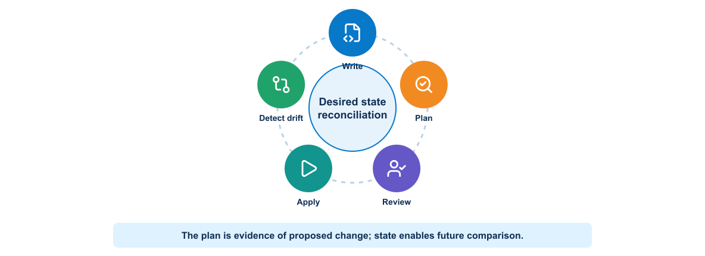
5
Module 2
Terraform lifecycle
Initialization prepares providers, planning exposes the proposed change, and apply reconciles resources with the declared configuration.
Notes:
Purpose: Explain terraform lifecycle through the diagram.
Reading order: Start with the main boundary or input, follow the connections, then identify the output or feedback path.
Key explanation: Initialization prepares providers, planning exposes the proposed change, and apply reconciles resources with the declared configuration.
Audience question: Where would a failure become visible, and which component should own the response?
Transition: Connect the diagram to the next engineering decision.

Slide 6
6
Module 2
Plan review
Review the proposal
Review the execution context
1
Resources created or destroyed
1
Workspace and state backend
2
Replacement operations
2
Provider identity
3
Address and naming conflicts
3
Variable sources
4
Unexpected provider changes
4
Approved learner resource range
Notes:
Purpose: Compare the two sides of plan review.
Left side, Review the proposal: Resources created or destroyed Replacement operations Address and naming conflicts Unexpected provider changes
Right side, Review the execution context: Workspace and state backend Provider identity Variable sources Approved learner resource range
Presenter cue: Explain the relationship between the columns rather than reading each line verbatim.
Audience question: Which responsibility is unclear or shared in your current environment?
Transition: Use the comparison to frame the next topic.

Slide 7
7
Module 2
State and drift
Terraform state
Drift
1
Maps code to managed resources
1
Appears when reality changes outside code
2
Carries sensitive operational metadata
2
Can make a plan unsafe
3
Requires controlled storage and locking
3
Requires refresh and investigation
4
Supports planning and replacement decisions
4
May lead to import, reconciliation, or replacement
Notes:
Purpose: Compare the two sides of state and drift.
Left side, Terraform state: Maps code to managed resources Carries sensitive operational metadata Requires controlled storage and locking Supports planning and replacement decisions
Right side, Drift: Appears when reality changes outside code Can make a plan unsafe Requires refresh and investigation May lead to import, reconciliation, or replacement
Presenter cue: Explain the relationship between the columns rather than reading each line verbatim.
Audience question: Which responsibility is unclear or shared in your current environment?
Transition: Use the comparison to frame the next topic.

Slide 8

8
Module 2
Drift reconciliation
A drift response begins with observation and classification before the team decides whether code or infrastructure should change.
Notes:
Purpose: Explain drift reconciliation through the diagram.
Reading order: Start with the main boundary or input, follow the connections, then identify the output or feedback path.
Key explanation: A drift response begins with observation and classification before the team decides whether code or infrastructure should change.
Audience question: Where would a failure become visible, and which component should own the response?
Transition: Connect the diagram to the next engineering decision.

Slide 9
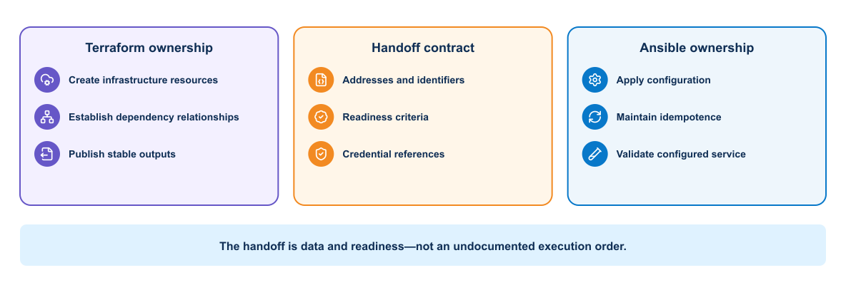
9
Module 2
Terraform and Ansible handoff
Provisioning creates the environment and exports connection data. Ansible consumes that output to configure and verify the systems.
Notes:
Purpose: Explain terraform and ansible handoff through the diagram.
Reading order: Start with the main boundary or input, follow the connections, then identify the output or feedback path.
Key explanation: Provisioning creates the environment and exports connection data. Ansible consumes that output to configure and verify the systems.
Audience question: Where would a failure become visible, and which component should own the response?
Transition: Connect the diagram to the next engineering decision.

Slide 10
10
Module 2
Handoff contract
Terraform output
Ansible input
1
Resource identifiers
1
Generated inventory
2
Management addresses
2
Connection variables
3
Topology metadata
3
Configuration intent
4
Readiness status
4
Validation scope
Notes:
Purpose: Compare the two sides of handoff contract.
Left side, Terraform output: Resource identifiers Management addresses Topology metadata Readiness status
Right side, Ansible input: Generated inventory Connection variables Configuration intent Validation scope
Presenter cue: Explain the relationship between the columns rather than reading each line verbatim.
Audience question: Which responsibility is unclear or shared in your current environment?
Transition: Use the comparison to frame the next topic.

Slide 11

11
Module 2
On-demand test environment
Temporary environments need ownership, unique naming, bounded lifetime, evidence collection, and cleanup even when tests fail.
Notes:
Purpose: Explain on-demand test environment through the diagram.
Reading order: Start with the main boundary or input, follow the connections, then identify the output or feedback path.
Key explanation: Temporary environments need ownership, unique naming, bounded lifetime, evidence collection, and cleanup even when tests fail.
Audience question: Where would a failure become visible, and which component should own the response?
Transition: Connect the diagram to the next engineering decision.

Slide 12
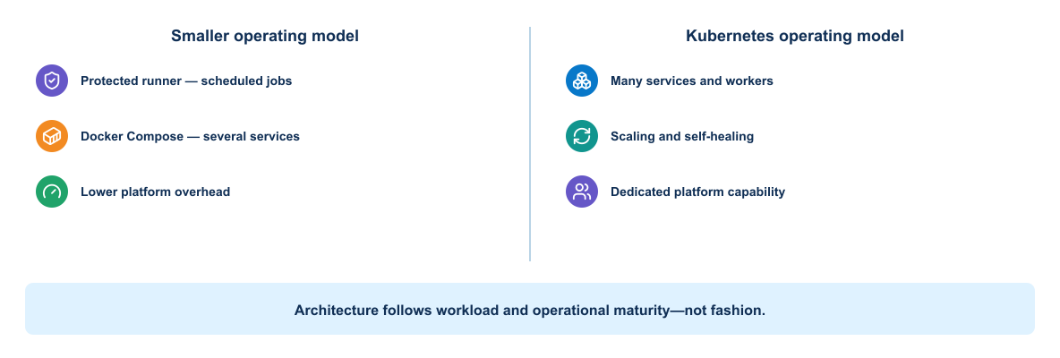
12
Module 2
Automation platform options
The environment may use simulation, virtualization, containers, or physical systems depending on fidelity and cost.
Notes:
Purpose: Explain automation platform options through the diagram.
Reading order: Start with the main boundary or input, follow the connections, then identify the output or feedback path.
Key explanation: The environment may use simulation, virtualization, containers, or physical systems depending on fidelity and cost.
Audience question: Where would a failure become visible, and which component should own the response?
Transition: Connect the diagram to the next engineering decision.

Slide 13
13
Module 2
Shared platform safeguards
Isolation
Cleanup
1
Per-learner identifiers and namespaces
1
Destroy in an always-run stage
2
Unique resource names and address ranges
2
Use time-to-live metadata
3
Concurrency limits
3
Collect logs before deletion
4
Explicit ownership labels
4
Report orphaned resources
Notes:
Purpose: Compare the two sides of shared platform safeguards.
Left side, Isolation: Per-learner identifiers and namespaces Unique resource names and address ranges Concurrency limits Explicit ownership labels
Right side, Cleanup: Destroy in an always-run stage Use time-to-live metadata Collect logs before deletion Report orphaned resources
Presenter cue: Explain the relationship between the columns rather than reading each line verbatim.
Audience question: Which responsibility is unclear or shared in your current environment?
Transition: Use the comparison to frame the next topic.

Slide 14
14
Module 2
Failure and cleanup
Failure handling
Cleanup handling
1
Preserve the failed plan and logs
1
Run after success or failure
2
Classify partial creation
2
Destroy only owned resources
3
Block unsafe reuse
3
Confirm the environment disappeared
4
Report the owning learner and pipeline
4
Escalate cleanup failures
Notes:
Purpose: Compare the two sides of failure and cleanup.
Left side, Failure handling: Preserve the failed plan and logs Classify partial creation Block unsafe reuse Report the owning learner and pipeline
Right side, Cleanup handling: Run after success or failure Destroy only owned resources Confirm the environment disappeared Escalate cleanup failures
Presenter cue: Explain the relationship between the columns rather than reading each line verbatim.
Audience question: Which responsibility is unclear or shared in your current environment?
Transition: Use the comparison to frame the next topic.

Slide 15
15
Module 2
Key takeaways
Infrastructure code creates a controlled environment boundary, while configuration automation prepares the systems inside that boundary.
Keep provisioning and configuration ownership clear
Treat state as protected operational data
Review plans before applying changes
Design cleanup as part of the workflow
Notes:
Purpose: Establish the scope of Key takeaways.
Explain: Infrastructure code creates a controlled environment boundary, while configuration automation prepares the systems inside that boundary.
Discuss: Keep provisioning and configuration ownership clear Treat state as protected operational data Review plans before applying changes Design cleanup as part of the workflow
Audience question: Which point is most familiar, and which point needs the most attention?
Transition: Introduce the first model or engineering boundary.

Slide 16
16
Module 2
Module 2 complete
✓
Module 2 complete
Next: Packaging and Operating Applications
Review the key concepts before continuing.
Notes:
Purpose: Close Module 2.
Recap: Ask learners to state one concept they can apply and one question that remains.
Next: Next: Packaging and Operating Applications
Presenter cue: Confirm the class is ready before moving to the next module.

