Slide 1
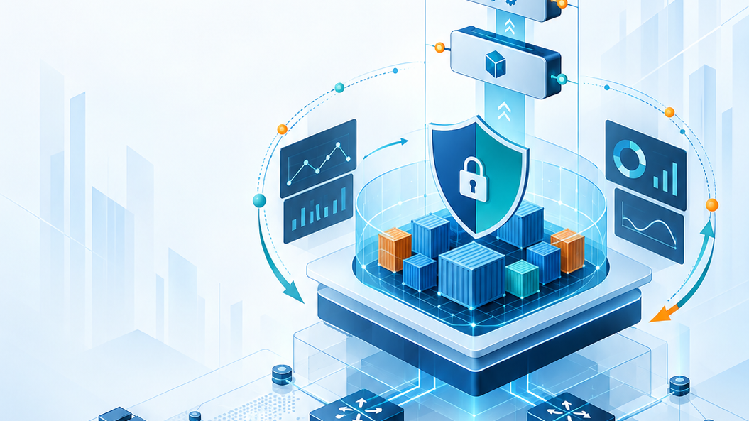
Module 3
Packaging and Operating Applications
Docker, Compose, and Kubernetes
Cisco learning and professional development
Notes:
Purpose: Open Module 3 and establish the subject of the deck.
Explain: Packaging and Operating Applications. Docker, Compose, and Kubernetes.
Presenter cue: Briefly connect this module to the previous part of the course before discussing details.
Transition: Move to the module introduction and learning focus.

Slide 2
2
Module 3
Module introduction
This module packages an automation service into containers, combines its tiers, and deploys the application on an orchestration platform.
Explain image and container boundaries
Build a secure and reproducible image
Operate a multitier application with Compose
Deploy and scale services with Kubernetes
Notes:
Purpose: Establish the scope of Module introduction.
Explain: This module packages an automation service into containers, combines its tiers, and deploys the application on an orchestration platform.
Discuss: Explain image and container boundaries Build a secure and reproducible image Operate a multitier application with Compose Deploy and scale services with Kubernetes
Audience question: Which point is most familiar, and which point needs the most attention?
Transition: Introduce the first model or engineering boundary.

Slide 3
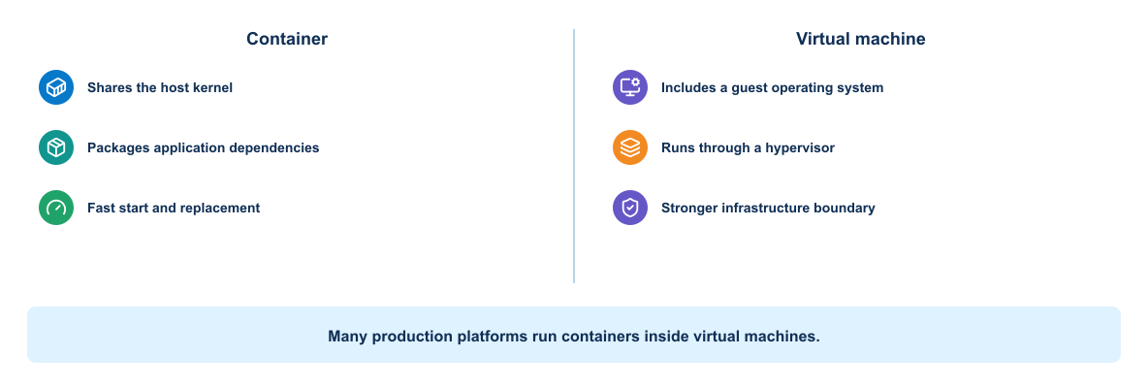
3
Module 3
Containers and virtual machines
Containers share the host kernel, while virtual machines include a guest operating system. Each model provides a different isolation boundary.
Notes:
Purpose: Explain containers and virtual machines through the diagram.
Reading order: Start with the main boundary or input, follow the connections, then identify the output or feedback path.
Key explanation: Containers share the host kernel, while virtual machines include a guest operating system. Each model provides a different isolation boundary.
Audience question: Where would a failure become visible, and which component should own the response?
Transition: Connect the diagram to the next engineering decision.

Slide 4
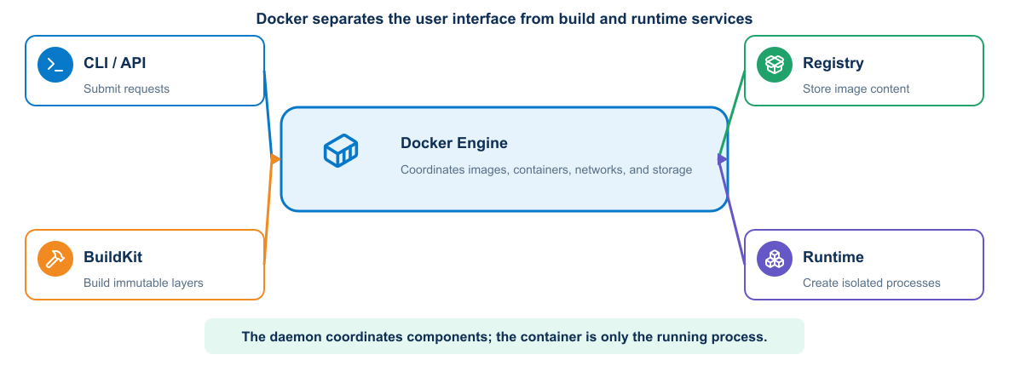
4
Module 3
Docker architecture
The client requests operations from the daemon. The daemon builds images, manages networks and volumes, and starts containers.
Notes:
Purpose: Explain docker architecture through the diagram.
Reading order: Start with the main boundary or input, follow the connections, then identify the output or feedback path.
Key explanation: The client requests operations from the daemon. The daemon builds images, manages networks and volumes, and starts containers.
Audience question: Where would a failure become visible, and which component should own the response?
Transition: Connect the diagram to the next engineering decision.

Slide 5
5
Module 3
Docker object model
Build objects
Runtime objects
1
Dockerfile
1
Container process
2
Build context
2
Network attachment
3
Image layers
3
Volume mount
4
Immutable image reference
4
Environment and secret inputs
Notes:
Purpose: Compare the two sides of docker object model.
Left side, Build objects: Dockerfile Build context Image layers Immutable image reference
Right side, Runtime objects: Container process Network attachment Volume mount Environment and secret inputs
Presenter cue: Explain the relationship between the columns rather than reading each line verbatim.
Audience question: Which responsibility is unclear or shared in your current environment?
Transition: Use the comparison to frame the next topic.

Slide 6
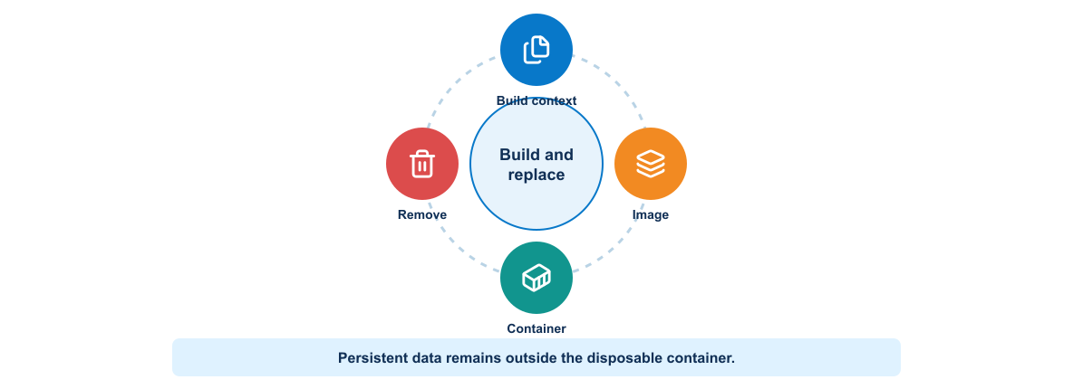
6
Module 3
Image and container lifecycle
A Dockerfile produces an image. A container is a runtime instance whose writable state should remain disposable unless data uses a volume.
Notes:
Purpose: Explain image and container lifecycle through the diagram.
Reading order: Start with the main boundary or input, follow the connections, then identify the output or feedback path.
Key explanation: A Dockerfile produces an image. A container is a runtime instance whose writable state should remain disposable unless data uses a volume.
Audience question: Where would a failure become visible, and which component should own the response?
Transition: Connect the diagram to the next engineering decision.

Slide 7
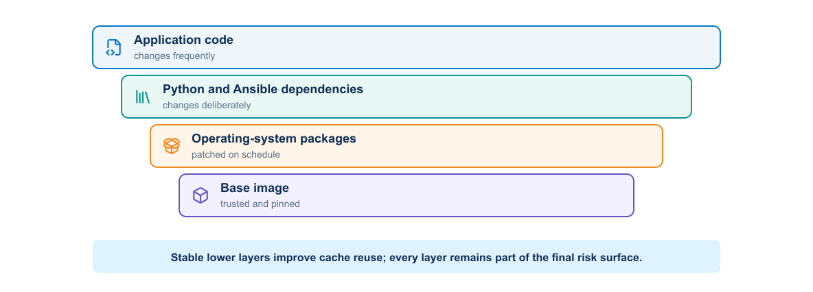
7
Module 3
Image layers and cache
Layer order affects rebuild speed and reproducibility. Stable dependencies should precede frequently changing application source.
Notes:
Purpose: Explain image layers and cache through the diagram.
Reading order: Start with the main boundary or input, follow the connections, then identify the output or feedback path.
Key explanation: Layer order affects rebuild speed and reproducibility. Stable dependencies should precede frequently changing application source.
Audience question: Where would a failure become visible, and which component should own the response?
Transition: Connect the diagram to the next engineering decision.

Slide 8
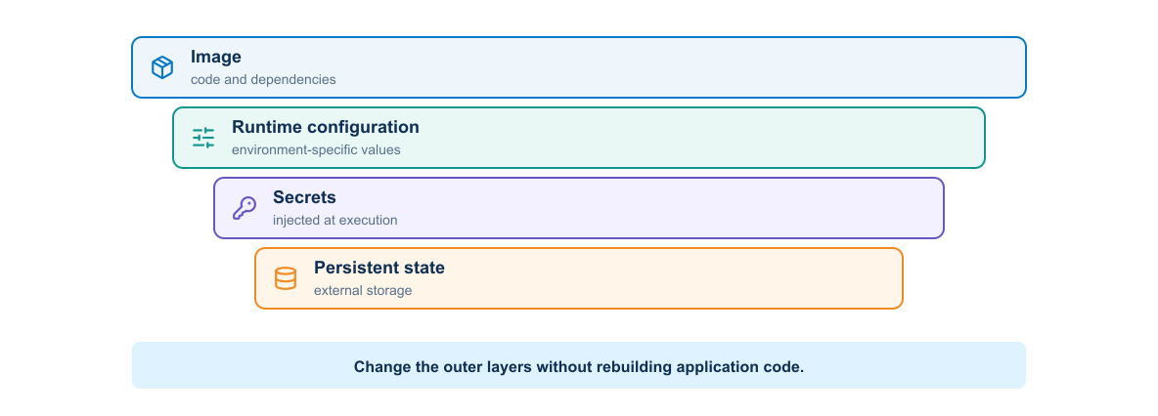
8
Module 3
Runtime boundary
Configuration, secrets, persistent data, logs, and network access cross the container boundary through explicit runtime interfaces.
Notes:
Purpose: Explain runtime boundary through the diagram.
Reading order: Start with the main boundary or input, follow the connections, then identify the output or feedback path.
Key explanation: Configuration, secrets, persistent data, logs, and network access cross the container boundary through explicit runtime interfaces.
Audience question: Where would a failure become visible, and which component should own the response?
Transition: Connect the diagram to the next engineering decision.

Slide 9
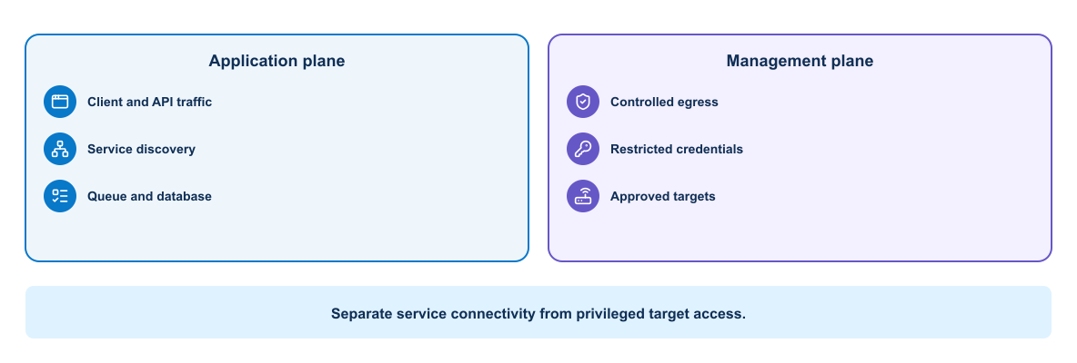
9
Module 3
Container network planes
Application traffic, management access, and external device connections have different reachability and security requirements.
Notes:
Purpose: Explain container network planes through the diagram.
Reading order: Start with the main boundary or input, follow the connections, then identify the output or feedback path.
Key explanation: Application traffic, management access, and external device connections have different reachability and security requirements.
Audience question: Where would a failure become visible, and which component should own the response?
Transition: Connect the diagram to the next engineering decision.

Slide 10
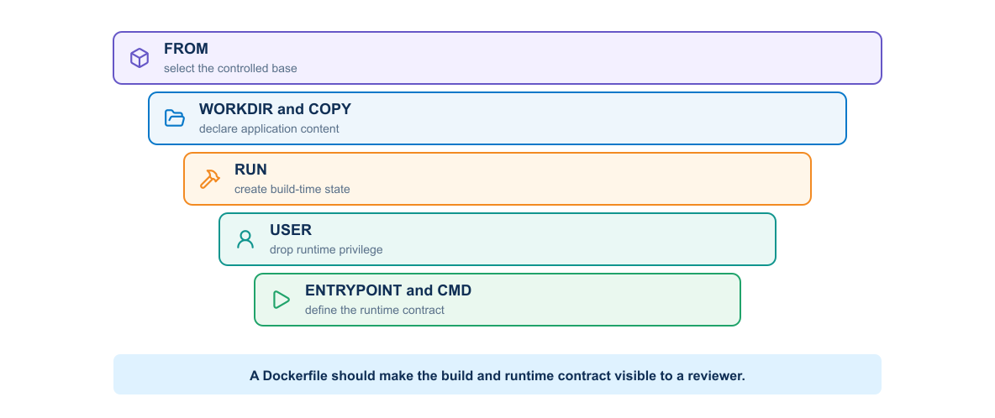
10
Module 3
Dockerfile anatomy
A useful Dockerfile selects a trusted base, installs pinned dependencies, copies only required files, sets a non-root user, and defines startup behavior.
Notes:
Purpose: Explain dockerfile anatomy through the diagram.
Reading order: Start with the main boundary or input, follow the connections, then identify the output or feedback path.
Key explanation: A useful Dockerfile selects a trusted base, installs pinned dependencies, copies only required files, sets a non-root user, and defines startup behavior.
Audience question: Where would a failure become visible, and which component should own the response?
Transition: Connect the diagram to the next engineering decision.

Slide 11
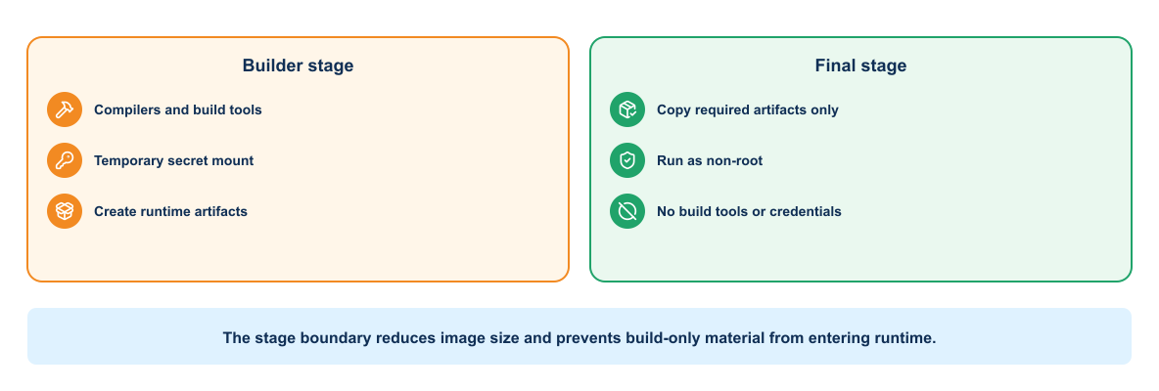
11
Module 3
Multistage build
Build tools remain in an intermediate stage, while the runtime image receives only the application and required dependencies.
Notes:
Purpose: Explain multistage build through the diagram.
Reading order: Start with the main boundary or input, follow the connections, then identify the output or feedback path.
Key explanation: Build tools remain in an intermediate stage, while the runtime image receives only the application and required dependencies.
Audience question: Where would a failure become visible, and which component should own the response?
Transition: Connect the diagram to the next engineering decision.

Slide 12
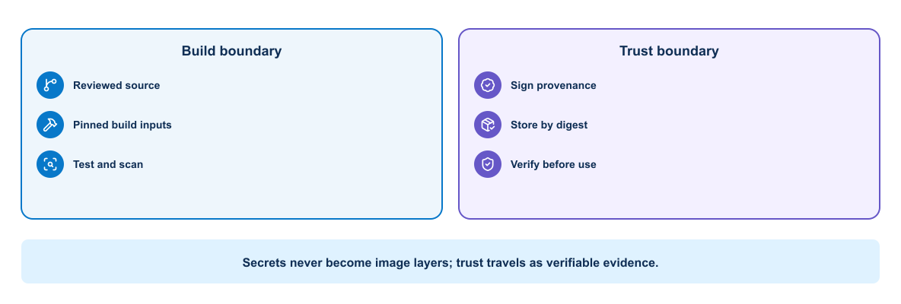
12
Module 3
Secure image supply chain
Scanning, signing, provenance, and registry policy help the platform distinguish a trusted release from an arbitrary image.
Notes:
Purpose: Explain secure image supply chain through the diagram.
Reading order: Start with the main boundary or input, follow the connections, then identify the output or feedback path.
Key explanation: Scanning, signing, provenance, and registry policy help the platform distinguish a trusted release from an arbitrary image.
Audience question: Where would a failure become visible, and which component should own the response?
Transition: Connect the diagram to the next engineering decision.

Slide 13
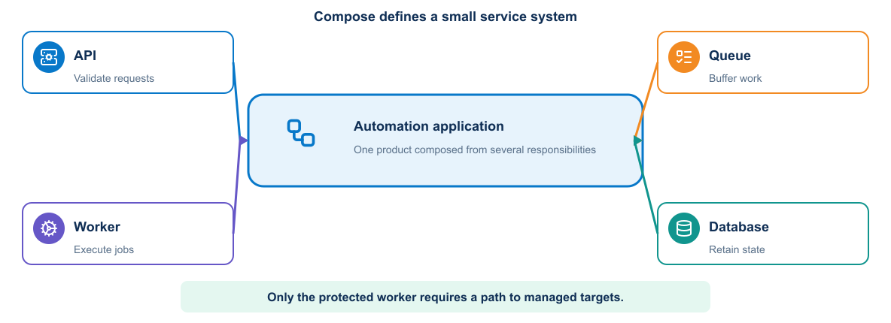
13
Module 3
Compose service model
Compose declares services, networks, volumes, health checks, and runtime inputs for a complete application on one Docker host.
Notes:
Purpose: Explain compose service model through the diagram.
Reading order: Start with the main boundary or input, follow the connections, then identify the output or feedback path.
Key explanation: Compose declares services, networks, volumes, health checks, and runtime inputs for a complete application on one Docker host.
Audience question: Where would a failure become visible, and which component should own the response?
Transition: Connect the diagram to the next engineering decision.

Slide 14
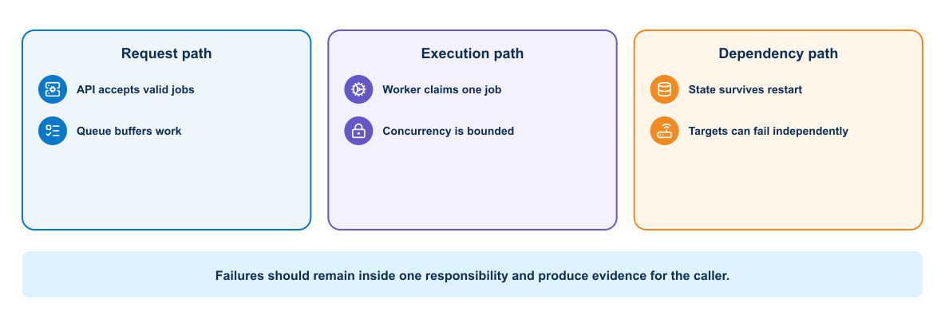
14
Module 3
Compose failure boundaries
A service failure should remain diagnosable through independent health checks, logs, restart behavior, and dependency timeouts.
Notes:
Purpose: Explain compose failure boundaries through the diagram.
Reading order: Start with the main boundary or input, follow the connections, then identify the output or feedback path.
Key explanation: A service failure should remain diagnosable through independent health checks, logs, restart behavior, and dependency timeouts.
Audience question: Where would a failure become visible, and which component should own the response?
Transition: Connect the diagram to the next engineering decision.

Slide 15
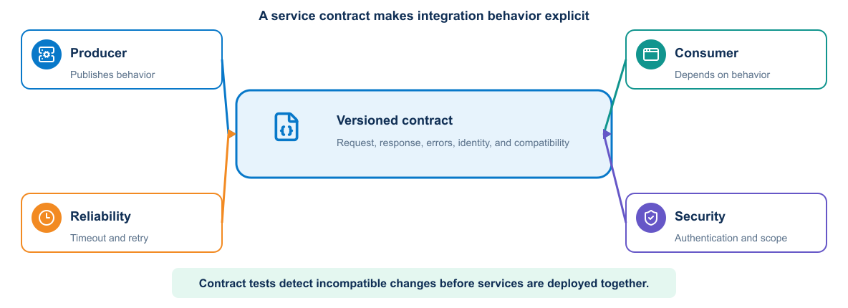
15
Module 3
Service contracts
The web, application, and database tiers depend on explicit ports, data formats, readiness signals, and failure behavior.
Notes:
Purpose: Explain service contracts through the diagram.
Reading order: Start with the main boundary or input, follow the connections, then identify the output or feedback path.
Key explanation: The web, application, and database tiers depend on explicit ports, data formats, readiness signals, and failure behavior.
Audience question: Where would a failure become visible, and which component should own the response?
Transition: Connect the diagram to the next engineering decision.

Slide 16
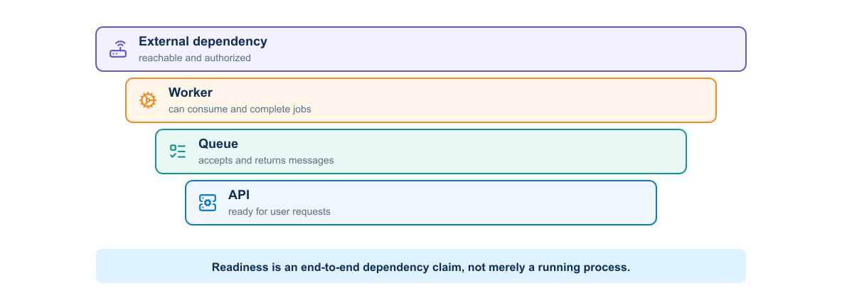
16
Module 3
Readiness chain
A running process may still be unable to serve requests. Readiness checks should reflect the next service dependency.
Notes:
Purpose: Explain readiness chain through the diagram.
Reading order: Start with the main boundary or input, follow the connections, then identify the output or feedback path.
Key explanation: A running process may still be unable to serve requests. Readiness checks should reflect the next service dependency.
Audience question: Where would a failure become visible, and which component should own the response?
Transition: Connect the diagram to the next engineering decision.

Slide 17
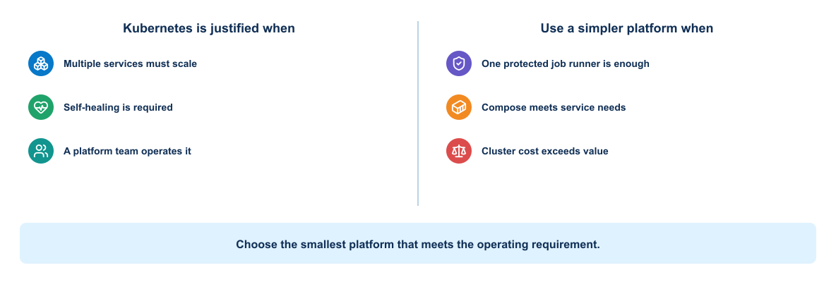
17
Module 3
Kubernetes suitability
Kubernetes adds scheduling, health reconciliation, service discovery, and scaling, but it also adds operational complexity.
Notes:
Purpose: Explain kubernetes suitability through the diagram.
Reading order: Start with the main boundary or input, follow the connections, then identify the output or feedback path.
Key explanation: Kubernetes adds scheduling, health reconciliation, service discovery, and scaling, but it also adds operational complexity.
Audience question: Where would a failure become visible, and which component should own the response?
Transition: Connect the diagram to the next engineering decision.

Slide 18
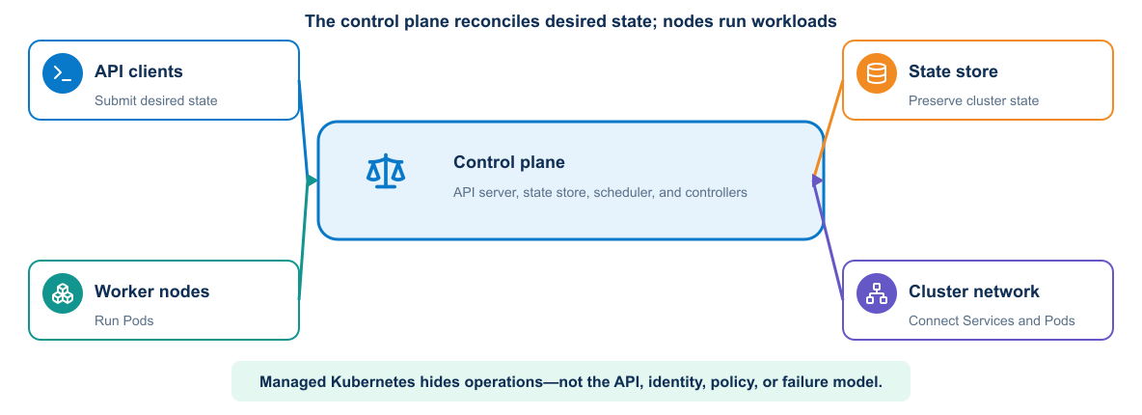
18
Module 3
Kubernetes architecture
The control plane maintains desired state while worker nodes run Pods and expose services through stable discovery and routing.
Notes:
Purpose: Explain kubernetes architecture through the diagram.
Reading order: Start with the main boundary or input, follow the connections, then identify the output or feedback path.
Key explanation: The control plane maintains desired state while worker nodes run Pods and expose services through stable discovery and routing.
Audience question: Where would a failure become visible, and which component should own the response?
Transition: Connect the diagram to the next engineering decision.

Slide 19
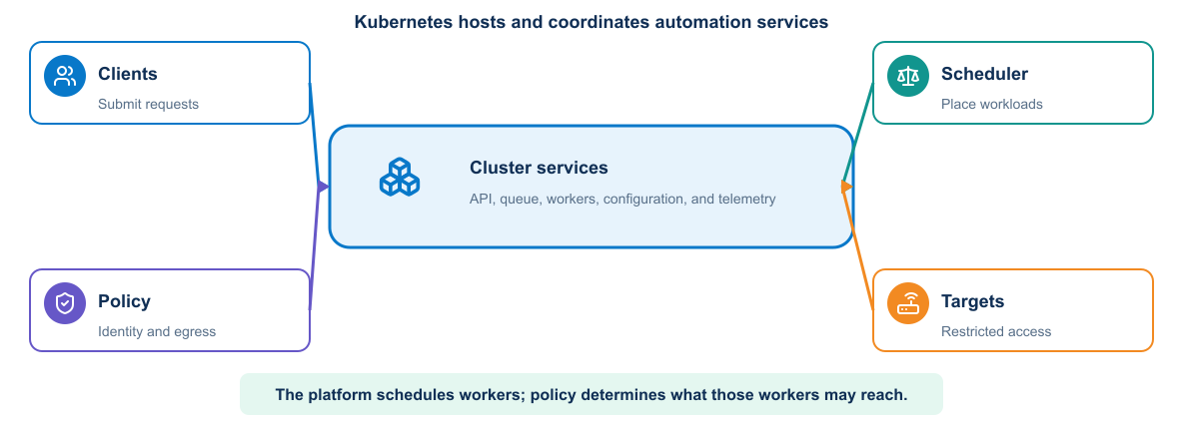
19
Module 3
Automation on Kubernetes
Deployments operate stateless application tiers, Services provide discovery, and stateful dependencies use deliberate persistence and recovery controls.
Notes:
Purpose: Explain automation on kubernetes through the diagram.
Reading order: Start with the main boundary or input, follow the connections, then identify the output or feedback path.
Key explanation: Deployments operate stateless application tiers, Services provide discovery, and stateful dependencies use deliberate persistence and recovery controls.
Audience question: Where would a failure become visible, and which component should own the response?
Transition: Connect the diagram to the next engineering decision.

Slide 20
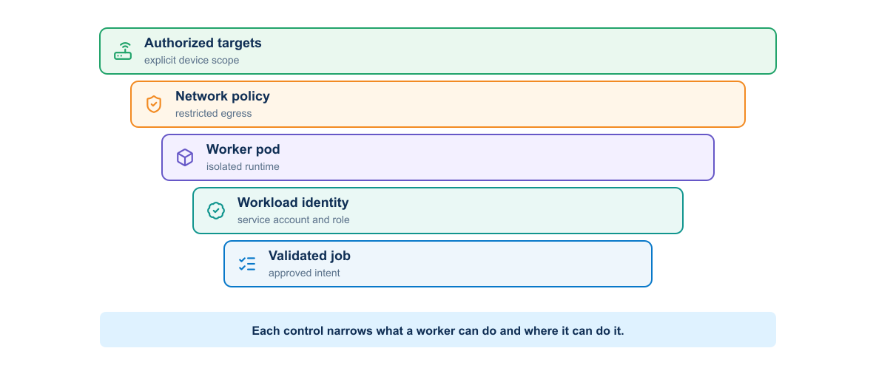
20
Module 3
Worker access to managed systems
Network reach, workload identity, secrets, and policy determine whether a Pod can reach and change an external managed system.
Notes:
Purpose: Explain worker access to managed systems through the diagram.
Reading order: Start with the main boundary or input, follow the connections, then identify the output or feedback path.
Key explanation: Network reach, workload identity, secrets, and policy determine whether a Pod can reach and change an external managed system.
Audience question: Where would a failure become visible, and which component should own the response?
Transition: Connect the diagram to the next engineering decision.

Slide 21
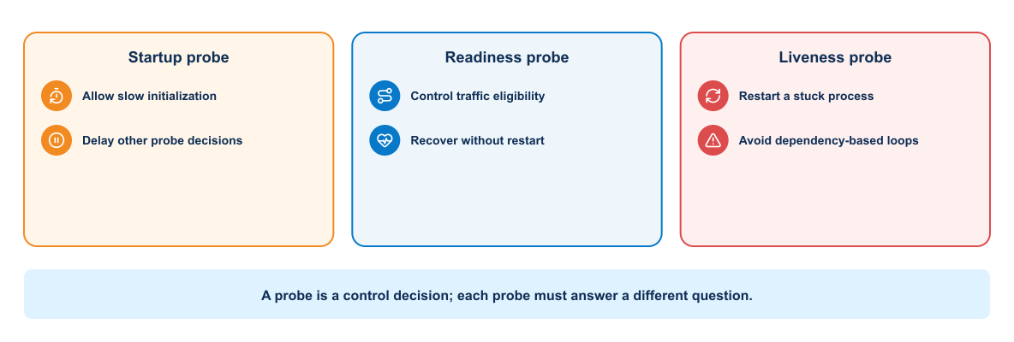
21
Module 3
Health probes and recovery
Startup, readiness, and liveness probes answer different questions and drive different recovery actions.
Notes:
Purpose: Explain health probes and recovery through the diagram.
Reading order: Start with the main boundary or input, follow the connections, then identify the output or feedback path.
Key explanation: Startup, readiness, and liveness probes answer different questions and drive different recovery actions.
Audience question: Where would a failure become visible, and which component should own the response?
Transition: Connect the diagram to the next engineering decision.

Slide 22
22
Module 3
Key takeaways
A container image packages the application. Compose connects services on one host. Kubernetes operates replicated services across a cluster.
Keep images small, pinned, and non-root
Move configuration and secrets outside the image
Design explicit service and readiness contracts
Scale stateless tiers while protecting persistent state
Notes:
Purpose: Establish the scope of Key takeaways.
Explain: A container image packages the application. Compose connects services on one host. Kubernetes operates replicated services across a cluster.
Discuss: Keep images small, pinned, and non-root Move configuration and secrets outside the image Design explicit service and readiness contracts Scale stateless tiers while protecting persistent state
Audience question: Which point is most familiar, and which point needs the most attention?
Transition: Introduce the first model or engineering boundary.

Slide 23
23
Module 3
Module 3 complete
✓
Module 3 complete
Next: Continuous Integration, Delivery, and Deployment Validation
Review the key concepts before continuing.
Notes:
Purpose: Close Module 3.
Recap: Ask learners to state one concept they can apply and one question that remains.
Next: Next: Continuous Integration, Delivery, and Deployment Validation
Presenter cue: Confirm the class is ready before moving to the next module.

