Slide 1

Module 4
Continuous Integration, Delivery, and Deployment Validation
Pipeline design, evidence, promotion, and recovery
Cisco learning and professional development
Notes:
Purpose: Open Module 4 and establish the subject of the deck.
Explain: Continuous Integration, Delivery, and Deployment Validation. Pipeline design, evidence, promotion, and recovery.
Presenter cue: Briefly connect this module to the previous part of the course before discussing details.
Transition: Move to the module introduction and learning focus.

Slide 2
2
Module 4
Module introduction
This module turns build, test, deployment, and verification activities into pipelines with clear responsibilities and promotion evidence.
Design GitLab stages and job dependencies
Choose runner boundaries and protected execution
Build once and promote the same artifact
Validate the target service and handle failure
Notes:
Purpose: Establish the scope of Module introduction.
Explain: This module turns build, test, deployment, and verification activities into pipelines with clear responsibilities and promotion evidence.
Discuss: Design GitLab stages and job dependencies Choose runner boundaries and protected execution Build once and promote the same artifact Validate the target service and handle failure
Audience question: Which point is most familiar, and which point needs the most attention?
Transition: Introduce the first model or engineering boundary.

Slide 3
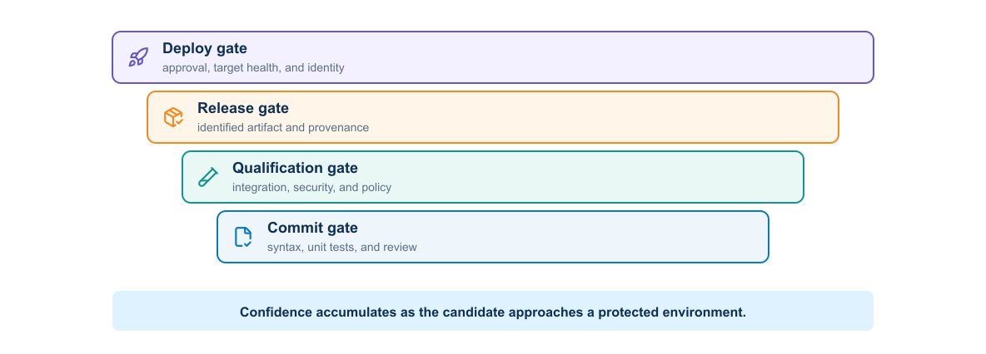
3
Module 4
Pipeline gates
Each gate should answer a specific release question and stop promotion when the evidence does not support the next action.
Notes:
Purpose: Explain pipeline gates through the diagram.
Reading order: Start with the main boundary or input, follow the connections, then identify the output or feedback path.
Key explanation: Each gate should answer a specific release question and stop promotion when the evidence does not support the next action.
Audience question: Where would a failure become visible, and which component should own the response?
Transition: Connect the diagram to the next engineering decision.

Slide 4
4
Module 4
GitLab pipeline structure
Pipeline definition
Execution context
1
Stages establish broad order
1
Runner and executor
2
Jobs define executable work
2
Container image
3
Rules select when jobs run
3
Variables and protected secrets
4
Needs express direct dependencies
4
Artifacts and environment scope
Notes:
Purpose: Compare the two sides of gitlab pipeline structure.
Left side, Pipeline definition: Stages establish broad order Jobs define executable work Rules select when jobs run Needs express direct dependencies
Right side, Execution context: Runner and executor Container image Variables and protected secrets Artifacts and environment scope
Presenter cue: Explain the relationship between the columns rather than reading each line verbatim.
Audience question: Which responsibility is unclear or shared in your current environment?
Transition: Use the comparison to frame the next topic.

Slide 5
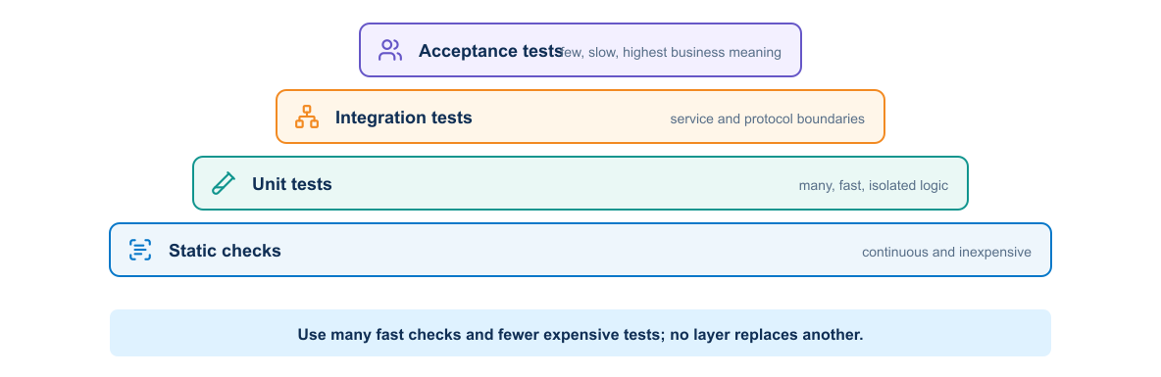
5
Module 4
Test confidence
Fast unit checks cover logic broadly. Integration and end-to-end tests cover fewer paths but provide stronger system evidence.
Notes:
Purpose: Explain test confidence through the diagram.
Reading order: Start with the main boundary or input, follow the connections, then identify the output or feedback path.
Key explanation: Fast unit checks cover logic broadly. Integration and end-to-end tests cover fewer paths but provide stronger system evidence.
Audience question: Where would a failure become visible, and which component should own the response?
Transition: Connect the diagram to the next engineering decision.

Slide 6
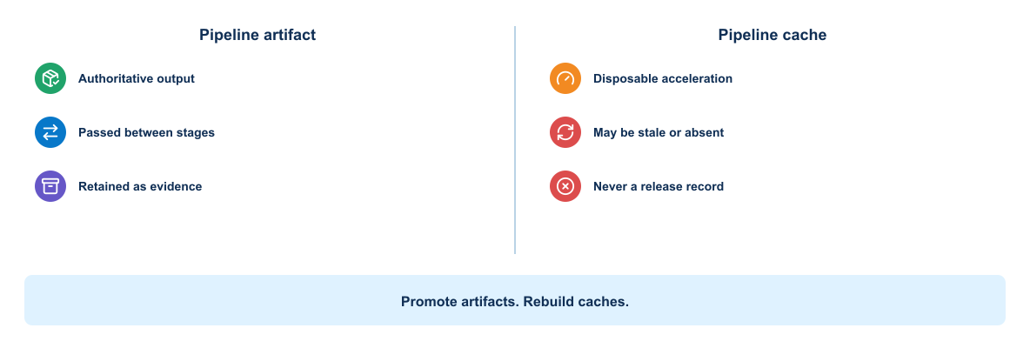
6
Module 4
Artifacts and caches
Artifacts carry identified outputs between jobs and releases. Caches accelerate work but should never determine release identity.
Notes:
Purpose: Explain artifacts and caches through the diagram.
Reading order: Start with the main boundary or input, follow the connections, then identify the output or feedback path.
Key explanation: Artifacts carry identified outputs between jobs and releases. Caches accelerate work but should never determine release identity.
Audience question: Where would a failure become visible, and which component should own the response?
Transition: Connect the diagram to the next engineering decision.

Slide 7
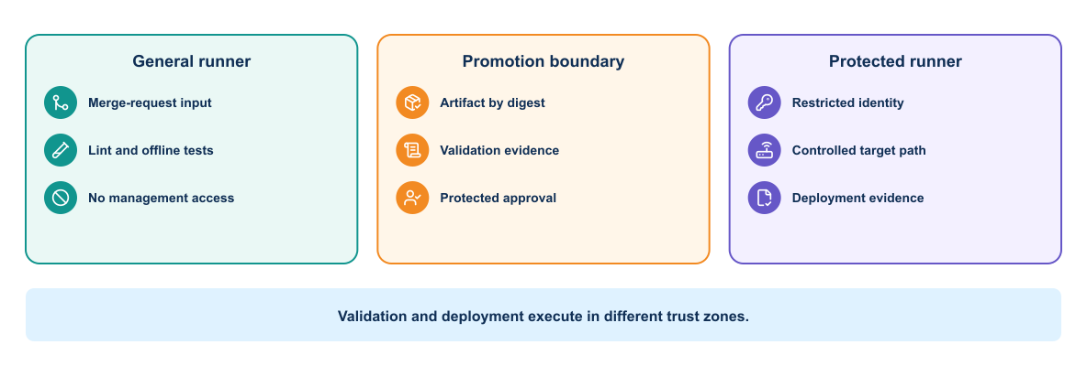
7
Module 4
Runner trust model
Runner placement, executor type, credentials, network access, and branch protection determine what a job can affect.
Notes:
Purpose: Explain runner trust model through the diagram.
Reading order: Start with the main boundary or input, follow the connections, then identify the output or feedback path.
Key explanation: Runner placement, executor type, credentials, network access, and branch protection determine what a job can affect.
Audience question: Where would a failure become visible, and which component should own the response?
Transition: Connect the diagram to the next engineering decision.

Slide 8
8
Module 4
Runner selection
General runner
Protected runner
1
Build and unit test work
1
Protected branch or tag
2
No production credentials
2
Bounded deployment identity
3
Restricted network reach
3
Restricted target access
4
Disposable execution environment
4
Enhanced audit and approval
Notes:
Purpose: Compare the two sides of runner selection.
Left side, General runner: Build and unit test work No production credentials Restricted network reach Disposable execution environment
Right side, Protected runner: Protected branch or tag Bounded deployment identity Restricted target access Enhanced audit and approval
Presenter cue: Explain the relationship between the columns rather than reading each line verbatim.
Audience question: Which responsibility is unclear or shared in your current environment?
Transition: Use the comparison to frame the next topic.

Slide 9
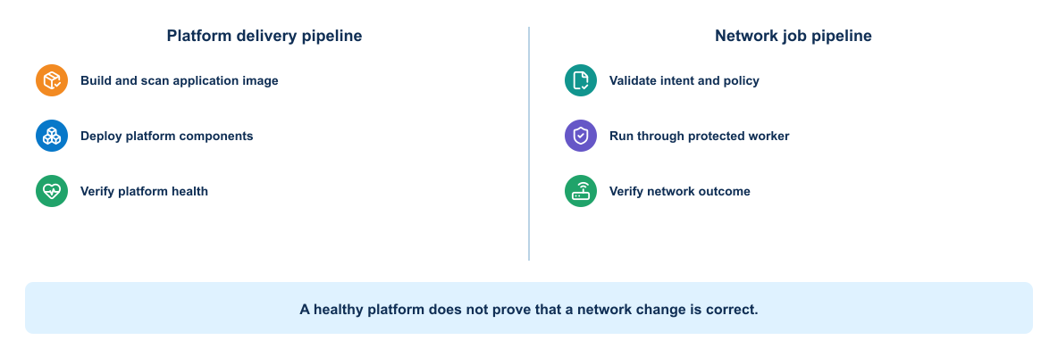
9
Module 4
Pipeline purposes
An application delivery pipeline and a network intent pipeline can share a project while retaining different triggers, stages, permissions, and evidence.
Notes:
Purpose: Explain pipeline purposes through the diagram.
Reading order: Start with the main boundary or input, follow the connections, then identify the output or feedback path.
Key explanation: An application delivery pipeline and a network intent pipeline can share a project while retaining different triggers, stages, permissions, and evidence.
Audience question: Where would a failure become visible, and which component should own the response?
Transition: Connect the diagram to the next engineering decision.

Slide 10
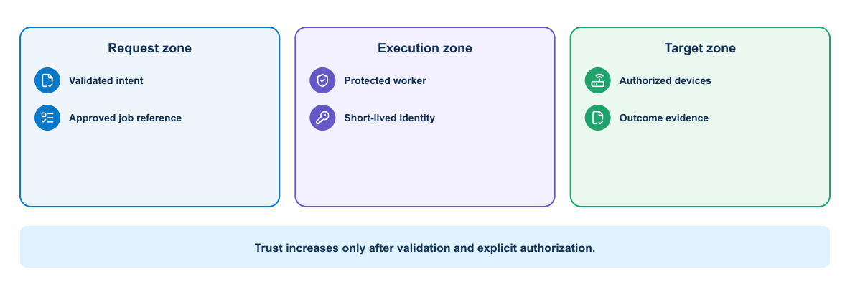
10
Module 4
Network job trust sequence
A protected network job should validate the event, resolve approved intent, obtain bounded identity, change the target, and record the outcome.
Notes:
Purpose: Explain network job trust sequence through the diagram.
Reading order: Start with the main boundary or input, follow the connections, then identify the output or feedback path.
Key explanation: A protected network job should validate the event, resolve approved intent, obtain bounded identity, change the target, and record the outcome.
Audience question: Where would a failure become visible, and which component should own the response?
Transition: Connect the diagram to the next engineering decision.

Slide 11
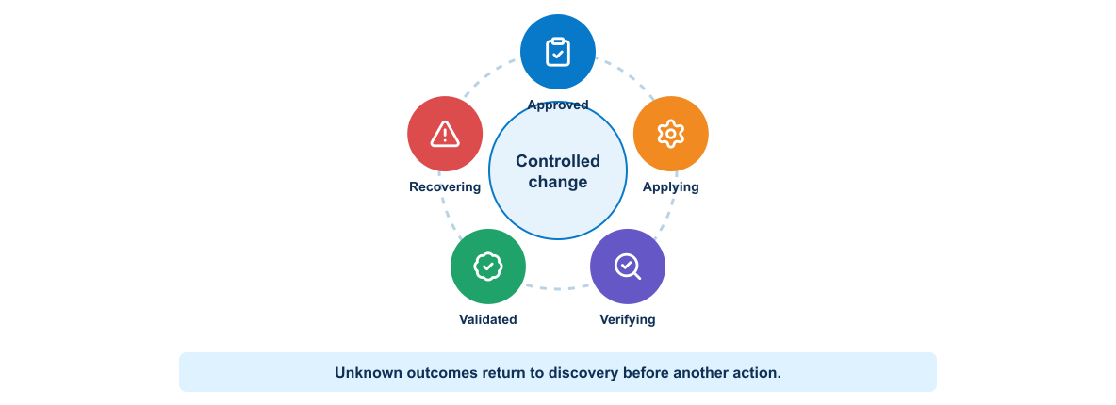
11
Module 4
Network change state
A deployment moves through preparation, application, verification, and outcome classification. Unknown outcomes require investigation before retry.
Notes:
Purpose: Explain network change state through the diagram.
Reading order: Start with the main boundary or input, follow the connections, then identify the output or feedback path.
Key explanation: A deployment moves through preparation, application, verification, and outcome classification. Unknown outcomes require investigation before retry.
Audience question: Where would a failure become visible, and which component should own the response?
Transition: Connect the diagram to the next engineering decision.

Slide 12
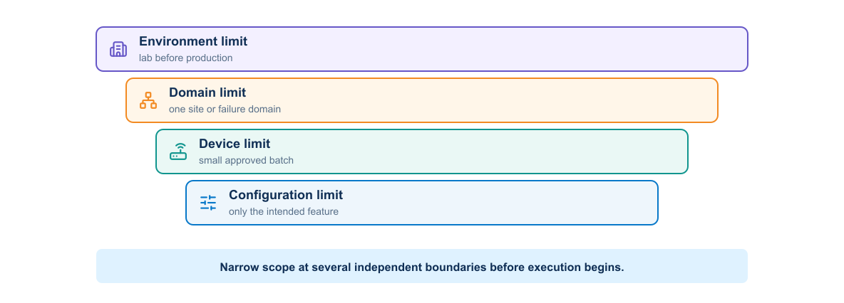
12
Module 4
Scoped deployment controls
Target limits, concurrency controls, change windows, and progressive batches reduce the effect of a failed change.
Notes:
Purpose: Explain scoped deployment controls through the diagram.
Reading order: Start with the main boundary or input, follow the connections, then identify the output or feedback path.
Key explanation: Target limits, concurrency controls, change windows, and progressive batches reduce the effect of a failed change.
Audience question: Where would a failure become visible, and which component should own the response?
Transition: Connect the diagram to the next engineering decision.

Slide 13
13
Module 4
Pre-check and post-check design
Before change
After change
1
Confirm target identity
1
Confirm configuration state
2
Measure the service baseline
2
Wait for protocol convergence
3
Compare intended and current state
3
Test service behavior
4
Prepare a recovery path
4
Compare with the baseline
Notes:
Purpose: Compare the two sides of pre-check and post-check design.
Left side, Before change: Confirm target identity Measure the service baseline Compare intended and current state Prepare a recovery path
Right side, After change: Confirm configuration state Wait for protocol convergence Test service behavior Compare with the baseline
Presenter cue: Explain the relationship between the columns rather than reading each line verbatim.
Audience question: Which responsibility is unclear or shared in your current environment?
Transition: Use the comparison to frame the next topic.

Slide 14
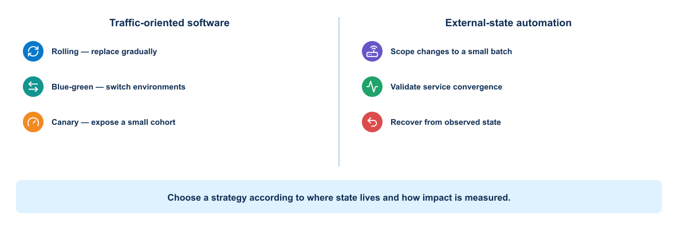
14
Module 4
Deployment strategies
The right strategy depends on state, compatibility, traffic control, rollback cost, and the fidelity of health checks.
Notes:
Purpose: Explain deployment strategies through the diagram.
Reading order: Start with the main boundary or input, follow the connections, then identify the output or feedback path.
Key explanation: The right strategy depends on state, compatibility, traffic control, rollback cost, and the fidelity of health checks.
Audience question: Where would a failure become visible, and which component should own the response?
Transition: Connect the diagram to the next engineering decision.

Slide 15
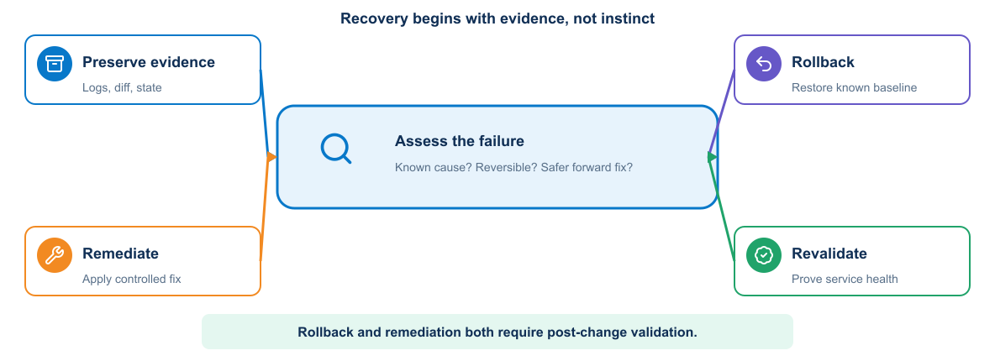
15
Module 4
Rollback decision
Rollback is one recovery option. Forward remediation may be safer when state changed irreversibly or the previous version cannot interpret current data.
Notes:
Purpose: Explain rollback decision through the diagram.
Reading order: Start with the main boundary or input, follow the connections, then identify the output or feedback path.
Key explanation: Rollback is one recovery option. Forward remediation may be safer when state changed irreversibly or the previous version cannot interpret current data.
Audience question: Where would a failure become visible, and which component should own the response?
Transition: Connect the diagram to the next engineering decision.

Slide 16
16
Module 4
GitLab pipeline design
Job contract
Promotion contract
1
Declared image and dependencies
1
Protected environment and identity
2
Specific inputs and outputs
2
Approval where risk requires it
3
Clear pass or fail condition
3
Same artifact across environments
4
Evidence retained for review
4
Post-deployment verification
Notes:
Purpose: Compare the two sides of gitlab pipeline design.
Left side, Job contract: Declared image and dependencies Specific inputs and outputs Clear pass or fail condition Evidence retained for review
Right side, Promotion contract: Protected environment and identity Approval where risk requires it Same artifact across environments Post-deployment verification
Presenter cue: Explain the relationship between the columns rather than reading each line verbatim.
Audience question: Which responsibility is unclear or shared in your current environment?
Transition: Use the comparison to frame the next topic.

Slide 17
17
Module 4
Pipeline failure categories
Candidate failures
Environment failures
1
Syntax or schema error
1
Runner or platform unavailable
2
Failed unit or integration test
2
Target baseline unhealthy
3
Vulnerable dependency
3
Deployment outcome unknown
4
Unqualified artifact
4
Cleanup incomplete
Notes:
Purpose: Compare the two sides of pipeline failure categories.
Left side, Candidate failures: Syntax or schema error Failed unit or integration test Vulnerable dependency Unqualified artifact
Right side, Environment failures: Runner or platform unavailable Target baseline unhealthy Deployment outcome unknown Cleanup incomplete
Presenter cue: Explain the relationship between the columns rather than reading each line verbatim.
Audience question: Which responsibility is unclear or shared in your current environment?
Transition: Use the comparison to frame the next topic.

Slide 18
18
Module 4
Key takeaways
A useful pipeline automates decisions only when its tests and evidence support those decisions.
Give each pipeline one operational purpose
Protect runners according to their reach
Promote one identified artifact
Treat deployment verification and cleanup as required stages
Notes:
Purpose: Establish the scope of Key takeaways.
Explain: A useful pipeline automates decisions only when its tests and evidence support those decisions.
Discuss: Give each pipeline one operational purpose Protect runners according to their reach Promote one identified artifact Treat deployment verification and cleanup as required stages
Audience question: Which point is most familiar, and which point needs the most attention?
Transition: Introduce the first model or engineering boundary.

Slide 19
19
Module 4
Module 4 complete
✓
Module 4 complete
Next: Security and Observability
Review the key concepts before continuing.
Notes:
Purpose: Close Module 4.
Recap: Ask learners to state one concept they can apply and one question that remains.
Next: Next: Security and Observability
Presenter cue: Confirm the class is ready before moving to the next module.

