Slide 1

Module 5
Security and Observability
Trust boundaries, secrets, telemetry, and operational feedback
Cisco learning and professional development
Notes:
Purpose: Open Module 5 and establish the subject of the deck.
Explain: Security and Observability. Trust boundaries, secrets, telemetry, and operational feedback.
Presenter cue: Briefly connect this module to the previous part of the course before discussing details.
Transition: Move to the module introduction and learning focus.

Slide 2
2
Module 5
Module introduction
This module protects the delivery system and makes its behavior visible enough to investigate change, performance, and failure.
Map trust boundaries across source, runners, registries, and targets
Retrieve secrets at runtime with bounded identity
Collect logs and metrics with useful context
Build alerts and dashboards that support action
Notes:
Purpose: Establish the scope of Module introduction.
Explain: This module protects the delivery system and makes its behavior visible enough to investigate change, performance, and failure.
Discuss: Map trust boundaries across source, runners, registries, and targets Retrieve secrets at runtime with bounded identity Collect logs and metrics with useful context Build alerts and dashboards that support action
Audience question: Which point is most familiar, and which point needs the most attention?
Transition: Introduce the first model or engineering boundary.

Slide 3
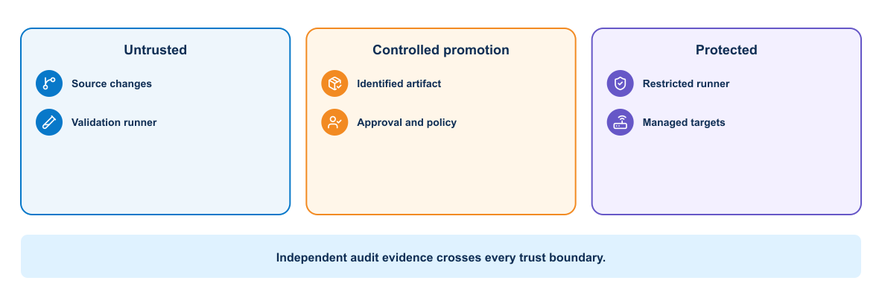
3
Module 5
Delivery trust boundaries
Every boundary changes the identity, permissions, data exposure, or network reach available to the delivery workload.
Notes:
Purpose: Explain delivery trust boundaries through the diagram.
Reading order: Start with the main boundary or input, follow the connections, then identify the output or feedback path.
Key explanation: Every boundary changes the identity, permissions, data exposure, or network reach available to the delivery workload.
Audience question: Where would a failure become visible, and which component should own the response?
Transition: Connect the diagram to the next engineering decision.

Slide 4
4
Module 5
Threat model questions
Assets and actors
Controls and response
1
Which source and artifacts require integrity?
1
How is identity verified?
2
Who can approve or trigger deployment?
2
Where is scope enforced?
3
Which identities can reach managed targets?
3
Which events require alerting?
4
Where can secrets or evidence leak?
4
How are credentials revoked?
Notes:
Purpose: Compare the two sides of threat model questions.
Left side, Assets and actors: Which source and artifacts require integrity? Who can approve or trigger deployment? Which identities can reach managed targets? Where can secrets or evidence leak?
Right side, Controls and response: How is identity verified? Where is scope enforced? Which events require alerting? How are credentials revoked?
Presenter cue: Explain the relationship between the columns rather than reading each line verbatim.
Audience question: Which responsibility is unclear or shared in your current environment?
Transition: Use the comparison to frame the next topic.

Slide 5
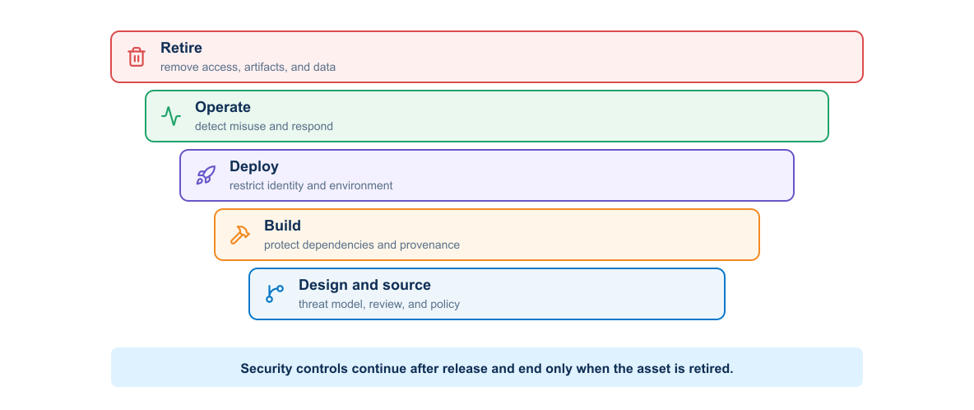
5
Module 5
Security throughout delivery
Source controls, dependency checks, artifact integrity, protected deployment, and runtime monitoring address different attack paths.
Notes:
Purpose: Explain security throughout delivery through the diagram.
Reading order: Start with the main boundary or input, follow the connections, then identify the output or feedback path.
Key explanation: Source controls, dependency checks, artifact integrity, protected deployment, and runtime monitoring address different attack paths.
Audience question: Where would a failure become visible, and which component should own the response?
Transition: Connect the diagram to the next engineering decision.

Slide 6
6
Module 5
Vault access pattern
Authentication
Secret use
1
Pipeline proves workload identity
1
Job retrieves only required values
2
Vault evaluates policy
2
Values remain masked from output
3
A short-lived token scopes access
3
Credentials live only for the task
4
Audit records identify the request
4
Revocation closes the session
Notes:
Purpose: Compare the two sides of vault access pattern.
Left side, Authentication: Pipeline proves workload identity Vault evaluates policy A short-lived token scopes access Audit records identify the request
Right side, Secret use: Job retrieves only required values Values remain masked from output Credentials live only for the task Revocation closes the session
Presenter cue: Explain the relationship between the columns rather than reading each line verbatim.
Audience question: Which responsibility is unclear or shared in your current environment?
Transition: Use the comparison to frame the next topic.

Slide 7
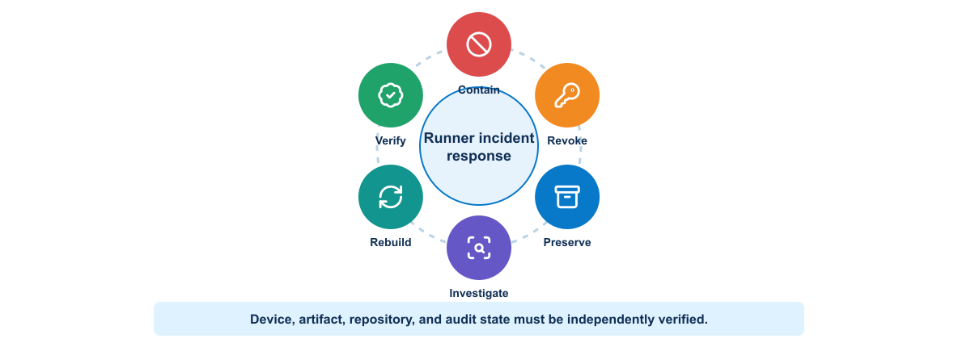
7
Module 5
Runner compromise response
Containment should revoke credentials, isolate the runner, preserve evidence, evaluate affected artifacts, and restore from a trusted baseline.
Notes:
Purpose: Explain runner compromise response through the diagram.
Reading order: Start with the main boundary or input, follow the connections, then identify the output or feedback path.
Key explanation: Containment should revoke credentials, isolate the runner, preserve evidence, evaluate affected artifacts, and restore from a trusted baseline.
Audience question: Where would a failure become visible, and which component should own the response?
Transition: Connect the diagram to the next engineering decision.

Slide 8
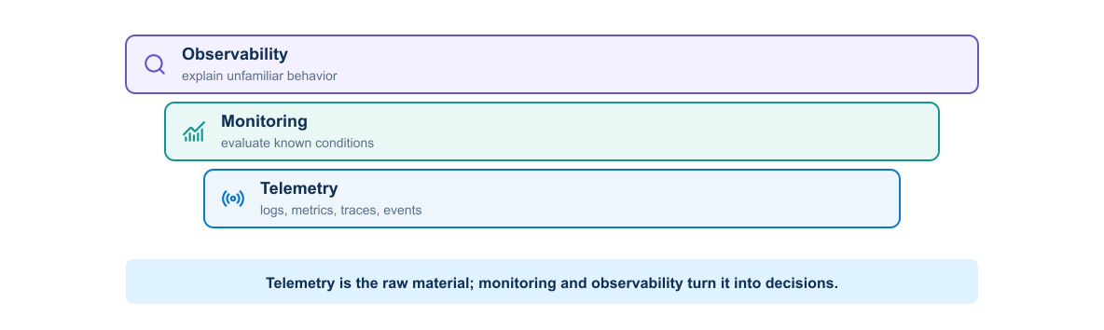
8
Module 5
Monitoring and observability
Telemetry provides raw signals. Monitoring evaluates known conditions. Observability supports investigation when the failure mode was not predicted.
Notes:
Purpose: Explain monitoring and observability through the diagram.
Reading order: Start with the main boundary or input, follow the connections, then identify the output or feedback path.
Key explanation: Telemetry provides raw signals. Monitoring evaluates known conditions. Observability supports investigation when the failure mode was not predicted.
Audience question: Where would a failure become visible, and which component should own the response?
Transition: Connect the diagram to the next engineering decision.

Slide 9
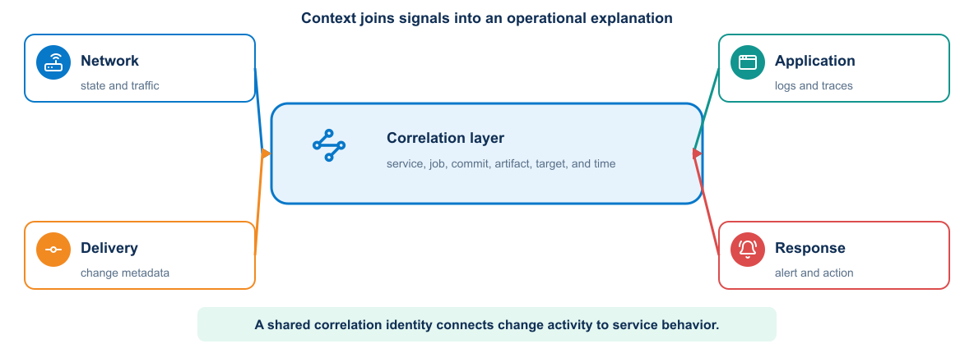
9
Module 5
Observability architecture
Applications, containers, Kubernetes, delivery jobs, and managed systems should send correlated events to a common analysis path.
Notes:
Purpose: Explain observability architecture through the diagram.
Reading order: Start with the main boundary or input, follow the connections, then identify the output or feedback path.
Key explanation: Applications, containers, Kubernetes, delivery jobs, and managed systems should send correlated events to a common analysis path.
Audience question: Where would a failure become visible, and which component should own the response?
Transition: Connect the diagram to the next engineering decision.

Slide 10
10
Module 5
Elastic data flow
Collection
Use
1
Application and pipeline logs
1
Normalize and enrich events
2
Container and Kubernetes events
2
Search by deployment identity
3
Host and workload metrics
3
Build service dashboards
4
Synthetic request measurements
4
Trigger actionable webhook alerts
Notes:
Purpose: Compare the two sides of elastic data flow.
Left side, Collection: Application and pipeline logs Container and Kubernetes events Host and workload metrics Synthetic request measurements
Right side, Use: Normalize and enrich events Search by deployment identity Build service dashboards Trigger actionable webhook alerts
Presenter cue: Explain the relationship between the columns rather than reading each line verbatim.
Audience question: Which responsibility is unclear or shared in your current environment?
Transition: Use the comparison to frame the next topic.

Slide 11
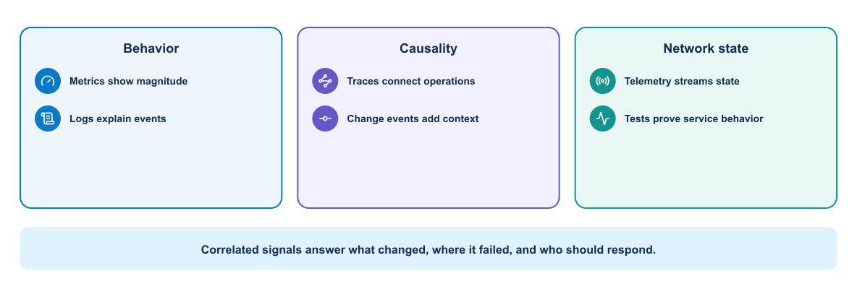
11
Module 5
Operational signals
Logs explain events, metrics show trends, traces follow requests, and state collection confirms the behavior of managed infrastructure.
Notes:
Purpose: Explain operational signals through the diagram.
Reading order: Start with the main boundary or input, follow the connections, then identify the output or feedback path.
Key explanation: Logs explain events, metrics show trends, traces follow requests, and state collection confirms the behavior of managed infrastructure.
Audience question: Where would a failure become visible, and which component should own the response?
Transition: Connect the diagram to the next engineering decision.

Slide 12
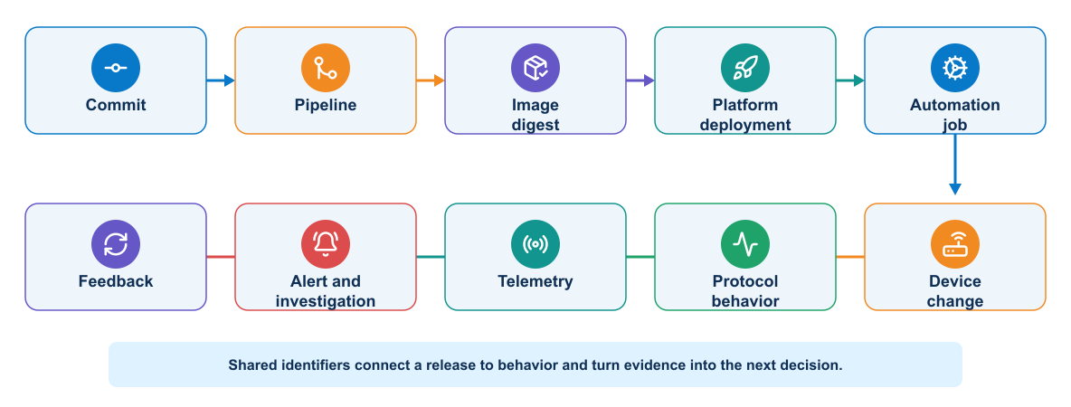
12
Module 5
Change-aware feedback
Deployment identity and timestamps connect pipeline events to changes in application, cluster, and network behavior.
Notes:
Purpose: Explain change-aware feedback through the diagram.
Reading order: Start with the main boundary or input, follow the connections, then identify the output or feedback path.
Key explanation: Deployment identity and timestamps connect pipeline events to changes in application, cluster, and network behavior.
Audience question: Where would a failure become visible, and which component should own the response?
Transition: Connect the diagram to the next engineering decision.

Slide 13
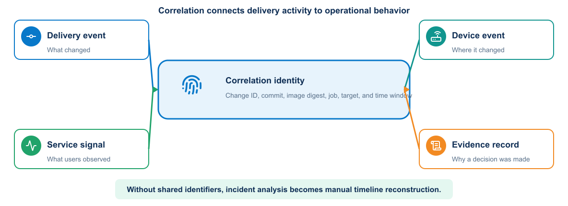
13
Module 5
Change correlation
Useful audit records link actor, source revision, pipeline, artifact, target, action, result, and observed service outcome.
Notes:
Purpose: Explain change correlation through the diagram.
Reading order: Start with the main boundary or input, follow the connections, then identify the output or feedback path.
Key explanation: Useful audit records link actor, source revision, pipeline, artifact, target, action, result, and observed service outcome.
Audience question: Where would a failure become visible, and which component should own the response?
Transition: Connect the diagram to the next engineering decision.

Slide 14
14
Module 5
Audit event content
Identity and intent
Execution and outcome
1
Timestamp and correlation identifier
1
Tool and dependency versions
2
Actor and workload identity
2
Command or API operation
3
Source revision and pipeline
3
Result and sanitized error detail
4
Target and requested action
4
Artifact, evidence, and cleanup status
Notes:
Purpose: Compare the two sides of audit event content.
Left side, Identity and intent: Timestamp and correlation identifier Actor and workload identity Source revision and pipeline Target and requested action
Right side, Execution and outcome: Tool and dependency versions Command or API operation Result and sanitized error detail Artifact, evidence, and cleanup status
Presenter cue: Explain the relationship between the columns rather than reading each line verbatim.
Audience question: Which responsibility is unclear or shared in your current environment?
Transition: Use the comparison to frame the next topic.

Slide 15
15
Module 5
Secrets management
Vault responsibilities
Pipeline responsibilities
1
Authenticate the workload
1
Request secrets only at runtime
2
Issue or return scoped secrets
2
Avoid printing or persisting values
3
Apply policy and lifetime
3
Limit the job and target scope
4
Record access for audit
4
Revoke access after use
Notes:
Purpose: Compare the two sides of secrets management.
Left side, Vault responsibilities: Authenticate the workload Issue or return scoped secrets Apply policy and lifetime Record access for audit
Right side, Pipeline responsibilities: Request secrets only at runtime Avoid printing or persisting values Limit the job and target scope Revoke access after use
Presenter cue: Explain the relationship between the columns rather than reading each line verbatim.
Audience question: Which responsibility is unclear or shared in your current environment?
Transition: Use the comparison to frame the next topic.

Slide 16
16
Module 5
Dashboards and alerts
Dashboards
Alerts
1
Cluster and workload health
1
Identify a condition that needs action
2
Application request success
2
Include service and deployment context
3
Response time and resource pressure
3
Use a tested notification path
4
Pipeline and change correlation
4
Reduce duplicate and non-actionable signals
Notes:
Purpose: Compare the two sides of dashboards and alerts.
Left side, Dashboards: Cluster and workload health Application request success Response time and resource pressure Pipeline and change correlation
Right side, Alerts: Identify a condition that needs action Include service and deployment context Use a tested notification path Reduce duplicate and non-actionable signals
Presenter cue: Explain the relationship between the columns rather than reading each line verbatim.
Audience question: Which responsibility is unclear or shared in your current environment?
Transition: Use the comparison to frame the next topic.

Slide 17
17
Module 5
Synthetic monitoring
Test request
Recorded evidence
1
Authenticate with a dedicated identity
1
HTTP result and timing
2
Access the published service endpoint
2
Application instance identity
3
Confirm device data appears
3
Target device and data timestamp
4
Measure total response time
4
Related pipeline and deployment version
Notes:
Purpose: Compare the two sides of synthetic monitoring.
Left side, Test request: Authenticate with a dedicated identity Access the published service endpoint Confirm device data appears Measure total response time
Right side, Recorded evidence: HTTP result and timing Application instance identity Target device and data timestamp Related pipeline and deployment version
Presenter cue: Explain the relationship between the columns rather than reading each line verbatim.
Audience question: Which responsibility is unclear or shared in your current environment?
Transition: Use the comparison to frame the next topic.

Slide 18
18
Module 5
Key takeaways
Security controls limit what delivery components can do. Observability shows what they did and whether the service remained healthy.
Use short-lived, scoped workload identity
Keep audit context across every pipeline stage
Correlate deployment and runtime signals
Design alerts around an operational response
Notes:
Purpose: Establish the scope of Key takeaways.
Explain: Security controls limit what delivery components can do. Observability shows what they did and whether the service remained healthy.
Discuss: Use short-lived, scoped workload identity Keep audit context across every pipeline stage Correlate deployment and runtime signals Design alerts around an operational response
Audience question: Which point is most familiar, and which point needs the most attention?
Transition: Introduce the first model or engineering boundary.

Slide 19
19
Module 5
Module 5 complete
✓
Module 5 complete
Course content complete
Review the key concepts before continuing.
Notes:
Purpose: Close Module 5.
Recap: Ask learners to state one concept they can apply and one question that remains.
Next: Course content complete
Presenter cue: Confirm the class is ready before moving to the next module.

