Slide 1
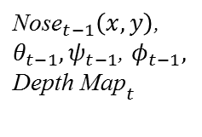

Nose Detection
${\text{Nose}}_{t−1}\left(x,y\right)$,
$θ_{t−1},ψ_{t−1}$, $φ_{t−1},$
$${\text{Depth} \text{Map}}_{t}$$
${\text{Nose}}_{t}\left(x,y\right)$,
Searching Window Setting
Point Cloud Generation
Inverse Rotation
z-min
Searching

