Slide 1
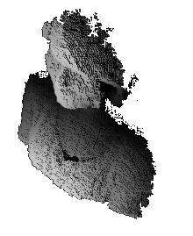
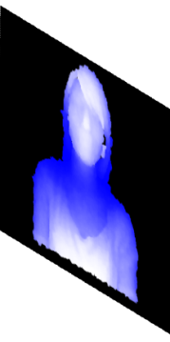
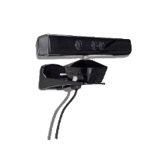
Scene
Focal Plane
Camera(0,0,0)
Focal Length f
3D Camera Coordinate p(x,y,z)
2D Image Coordinate P(X,Y)
Depth Value z

