Slide 1
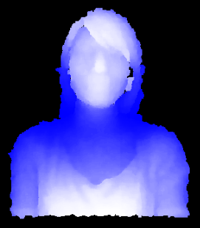
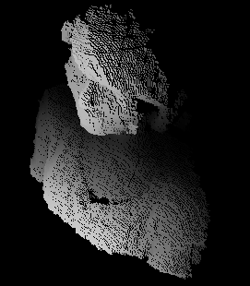
Point Cloud Generation
Depth Map
A set of 3D points

