Slide 1

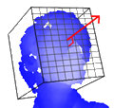
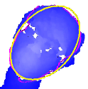
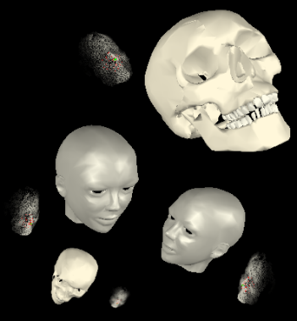
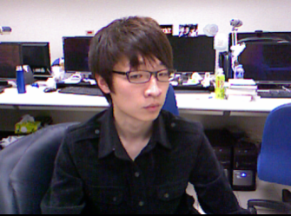
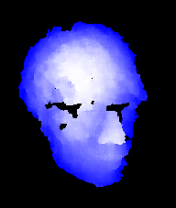
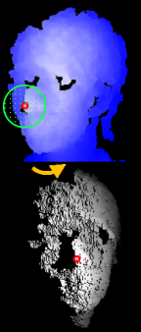

User Acting
Depth Data Acquisition
Real-time Head Pose Estimation
Avatar Control
Inverse Rotation
Nose Detection
Sampling
y
z
x
Least Square Error Method
Iterative Optimization Method

