Slide 1
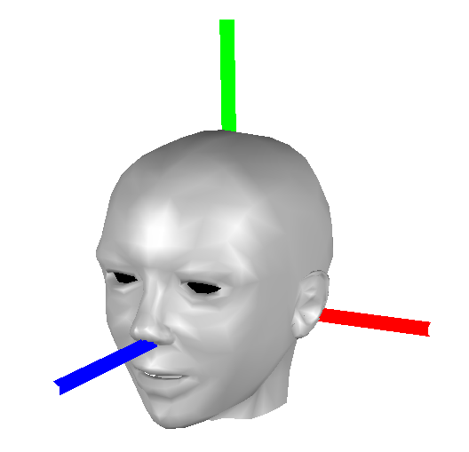
Yaw
Y-axis
X-axis
Z-axis
Pitch
Roll

