Slide 1



THE MAHARAJA SAYAJIRAO UNIVERSITY OF BARODA
ESTD. 1949 Accredited A+ Grade by NAAC
When Randomness Becomes a Model:
The Statistical Foundation of the Black-Scholes Model
-Tanya Chaurasia

Slide 2

A Question From 1900
“If something moves up and down for reasons nobody can predict, is there a mathematical rule for how it moves?”
The question Louis Bachelier asked in his 1900 thesis, Théorie de la Spéculation, modelling change as Normal with spread growing in time.
Rediscovered decades later, opening the field of continuous-time randomness. Today's path: probability, then a differential equation, then an exact formula — whose use in option pricing is the most famous application of the idea, not the idea itself.

Slide 3
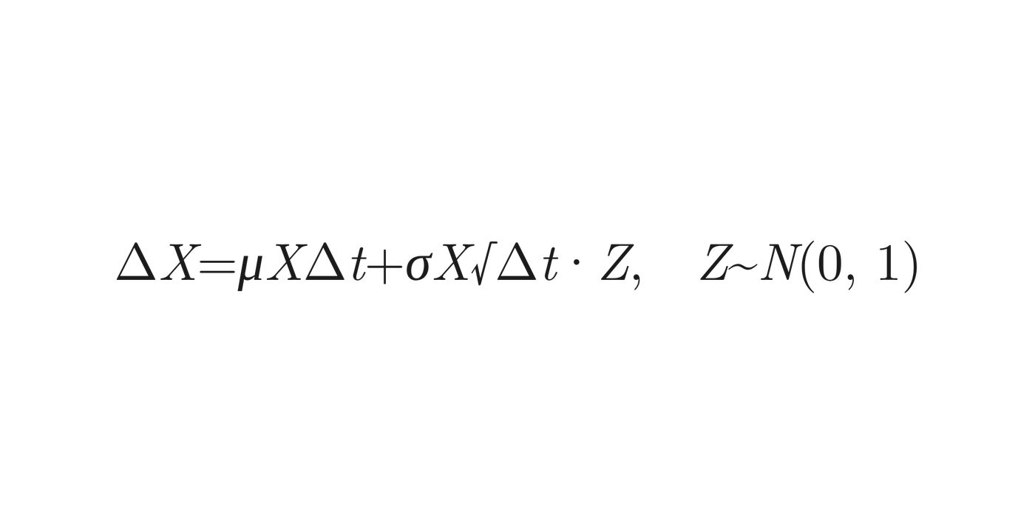


Writing Down How X Changes
Let X be a positive quantity that moves randomly over a small time step Δt:
where,
μ (drift) is the average growth rate
σ (volatility) sets the size of the random swings
NOTE: Using √Δt rather than Δt keeps variance growing in proportion to time.

Slide 4
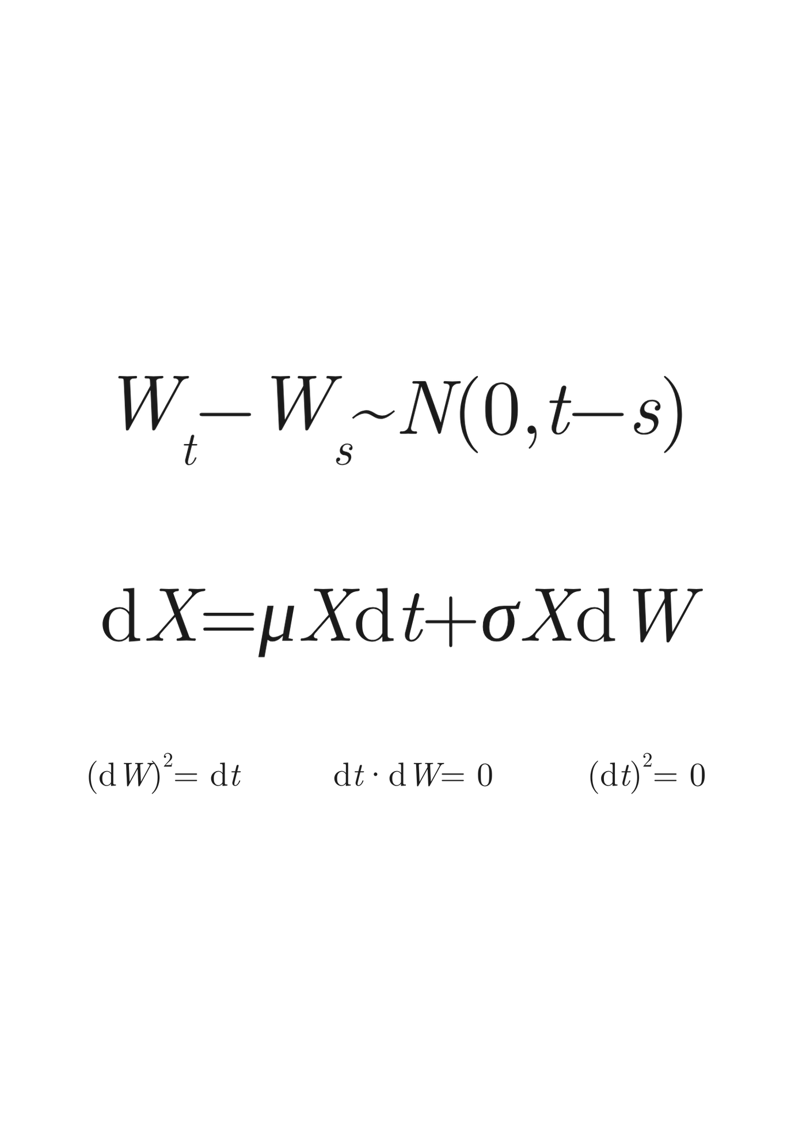
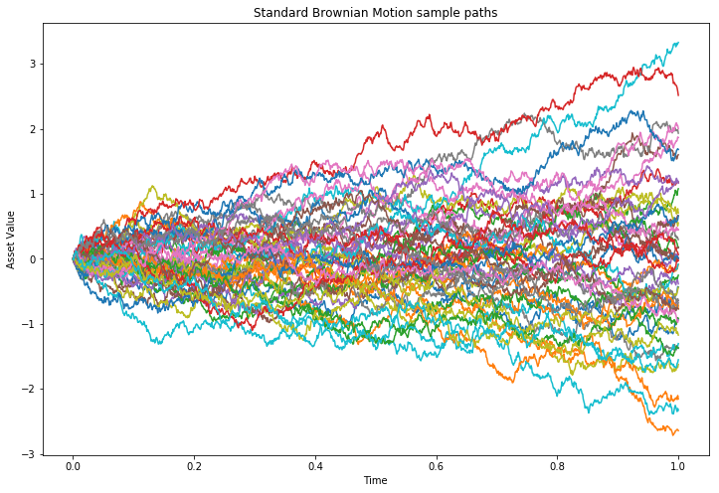
Brownian Motion, GBM & a New Rule
The mathematical object Bachelier needed: continuous, with independent Normal increments — made rigorous decades later by Norbert Wiener.
Properties:
Starts at zero: W(0)=0
Independent increments
Normally distributed increments: W(t)−W(s)∼N(0,t−s)
Continuous but nowhere differentiable paths
As Δt shrinks to zero, the step model becomes Geometric Brownian Motion, keeping X positive.
The rule (dW)² = dt is what makes stochastic calculus different.

Slide 5
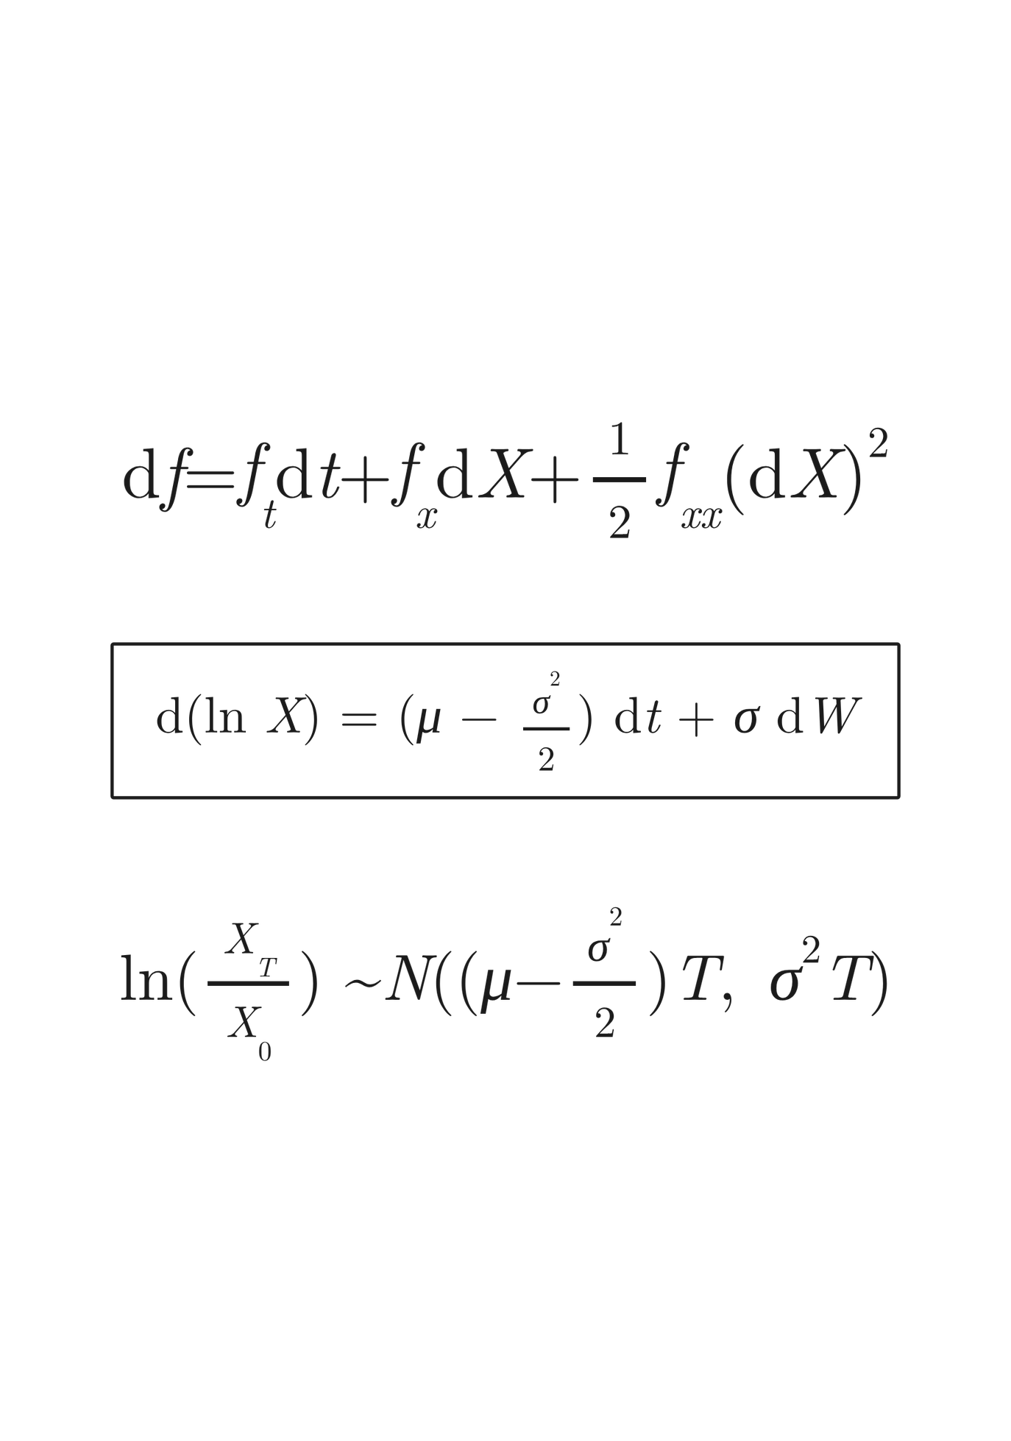
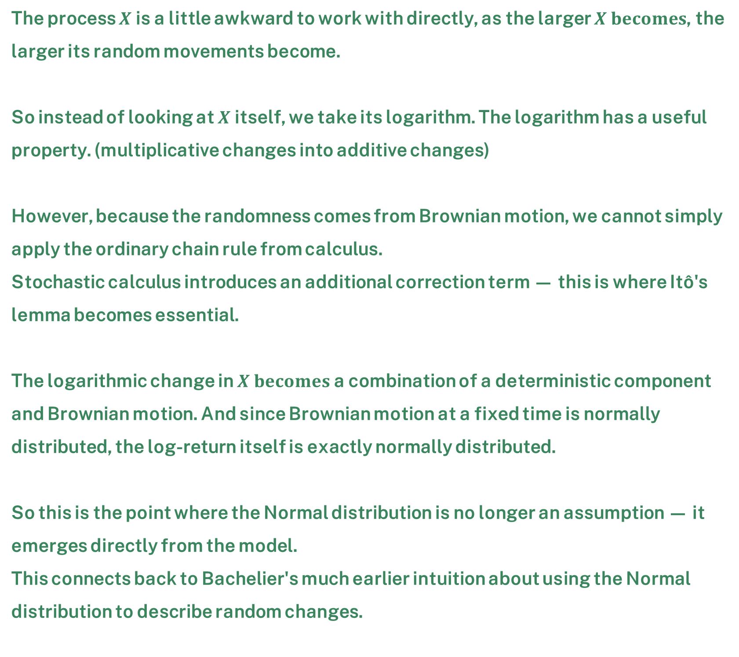
Itô's Lemma and the Log Transformation
The process $X$is a little awkward to work with directly, as the larger $X becomes$, the larger its random movements become.
So instead of looking at $X$itself, we take its logarithm. The logarithm has a useful property. (multiplicative changes into additive changes)
However, because the randomness comes from Brownian motion, we cannot simply apply the ordinary chain rule from calculus.
Stochastic calculus introduces an additional correction term — this is where Itô's lemma becomes essential.
The logarithmic change in $X becomes$ a combination of a deterministic component and Brownian motion. And since Brownian motion at a fixed time is normally distributed, the log-return itself is exactly normally distributed.
So this is the point where the Normal distribution is no longer an assumption — it emerges directly from the model.
This connects back to Bachelier's much earlier intuition about using the Normal distribution to describe random changes.

Slide 6
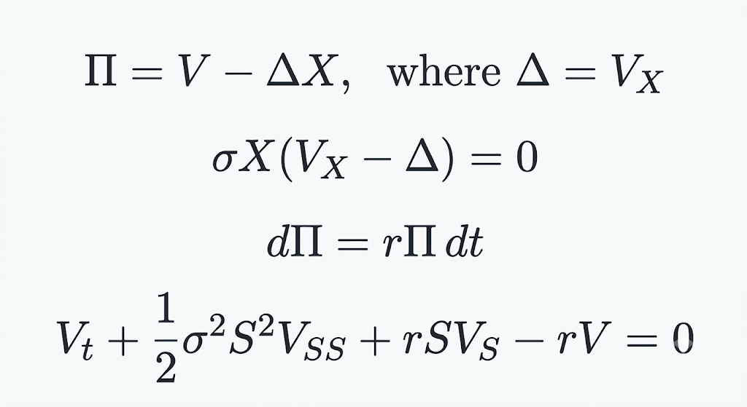


The Black-Scholes Equation
By choosing $Δ=V_{X}$, the random component cancels exactly, making the portfolio locally risk-free
01.
Build a combination Π of V and X, and pick the multiple of X that makes its random part vanish completely — three steps to the Black–Scholes equation.
Since the portfolio is risk-free, it must earn the risk-free rate. Otherwise, there would be an arbitrage opportunity.
02.
When we substitute the hedged portfolio into the risk-free condition, the drift term $μ$cancels out. What remains is the Black–Scholes equation.
03.

Slide 7
Every formula is a promise
Black–Scholes prices an option in one line — but that line only holds if reality behaves the way its assumptions say it does.
Returns are normally distributed
Prices move continuously
Volatility is constant
Historical, VIX, and implied figures all disagree with each other
Many real contracts pay dividends or allow early exercise
A constant, known risk-free rate
No transaction costs or arbitrage
Hedging
Real returns show jumps, clustering, and fatter tails than Normal
European exercise only

Slide 8
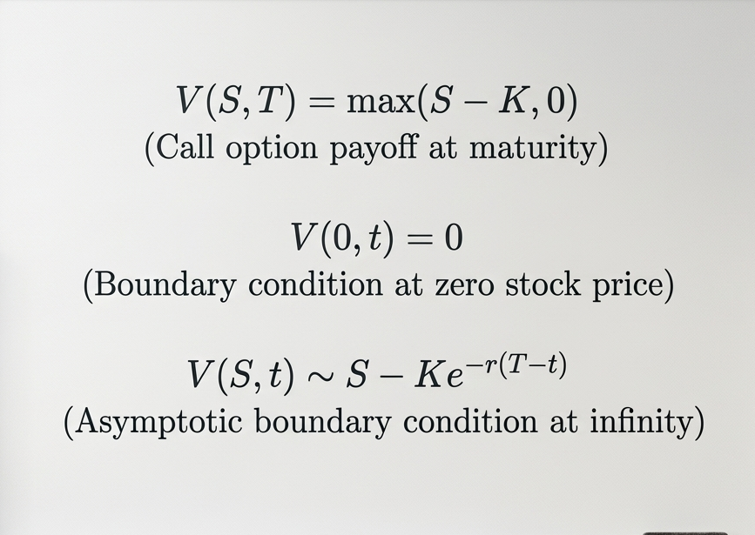
From Equation to Closed-Form Formula
European Call Option
Right: Gives the holder the right, but not the obligation, to buy the underlying asset.
Strike Price: The purchase is made at a predetermined strike price. (K)
Exercise: The option can be exercised only at maturity, not before.
Terminal condition:
Defines the option’s payoff at maturity.
01.
Boundary at zero:
Specifies the option value when the stock price reaches zero.
02.
Boundary at infinity:
Describes how the option value behaves when the stock price becomes very large
03.

Slide 9
From Black–Scholes PDE to European Call Formula
Using the Heat Equation and the Feynman–Kac Theorem
Heat Equation Approach
Feynman–Kac Approach
Start with the Black–Scholes PDE
The option price satisfies a partial differential equation with given conditions.
View the PDE probabilistically
Use the Feynman–Kac theorem to interpret the PDE solution as an expected value.
Change of variables
Transform the PDE into the standard heat equation using a suitable variable change.
Model the stock price
Under the risk-neutral measure, the stock price follows a stochastic process.
Solve the heat equation
Use the known solution method for the heat equation (e.g., Gaussian kernel).
Compute the expected payoff
Take the discounted expected value of the option's future payoff.
Transform back
Revert the variables to obtain the option price in terms of the original variables.
Express the price
This expectation gives the option value in terms of the underlying variables.
European Call Option Formula
The closed-form solution is obtained by combining both approaches.

Slide 10
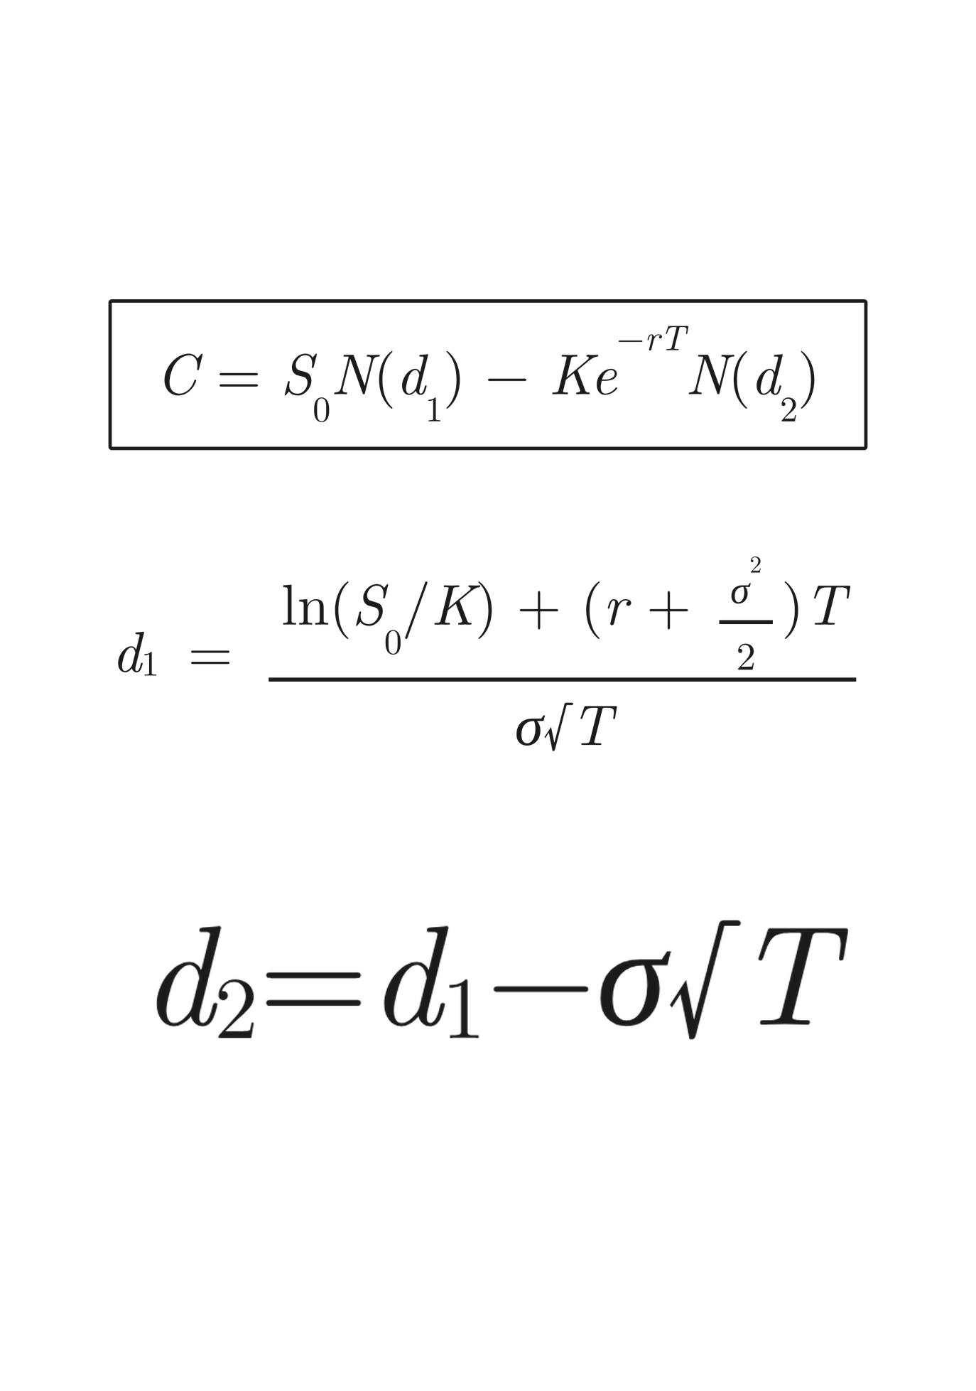
The European Call Option Formula
The formula can be read as follows:
It has two terms because the payoff (Sₜ − K)⁺ is itself the difference of two components: what the holder expects to receive and what the holder expects to pay.
N(d₂) is the probability, under the risk-neutral measure, that the option finishes in the money — that is, that Sₜ > K.
N(d₁) is a related but distinct weighting, reflecting that larger payouts occur alongside larger values of Sₜ ; it differs from N(d₂) by exactly σ√T, an echo of the Itô correction.
Discounting, e⁻ʳᵀ, applies only to K, because K is a fixed cash amount payable in the future and must be converted to a present value; S₀ is already expressed in present-value terms.

Slide 11
A Simple Worked Example First
Before the real NIFTY numbers, a small hypothetical case illustrates the idea:
a share at ₹100, strike ₹100, r=5%, σ=20%, T=1yr
C ≈ ₹10.45.
Step | Calculation | Result
d₁ | [ln(100/100) + (0.05 + 0.02)(1)] / 0.20 | 0.35
d₂ | 0.35 − 0.20 | 0.15
N(d₁) | standard normal table | 0.6368
N(d₂) | standard normal table | 0.5596
C | 100(0.6368) − 100e⁻⁰·⁰⁵(0.5596) | ≈ ₹10.45
A useful check: if σ were 0 — the share never moved — the option would be worth exactly ₹0,
since the payoff would always be zero.
The fact that C rises to ₹10.45 purely from σ=20% confirms the entire value is compensation for uncertainty.

Slide 12
Application in NIFTY 50
This is the final numerical part of the seminar: we take real NIFTY 50 data, walk through every step of the Black–Scholes calculation using it, and compare the model's price to the price at which an option actually traded.
NIFTY 50 daily price history — one row per trading day (date, open, high, low, close, volume), covering 10-Sep-2025 to 10-Sep-2026, 248 trading days in total.
A NIFTY 50 call option record — one row giving the strike price, market closing price, underlying NIFTY value, option date and expiry date for a specific option contract traded on 31-Aug-2026.
Item | Value
Underlying NIFTY spot price (S) | ₹24,080.40
Strike price (K) | ₹24,100.00
Observed market price of the call (C market) | ₹543.00
Option date | 31-Aug-2026
Expiry date | 27-Oct-2026

Slide 13
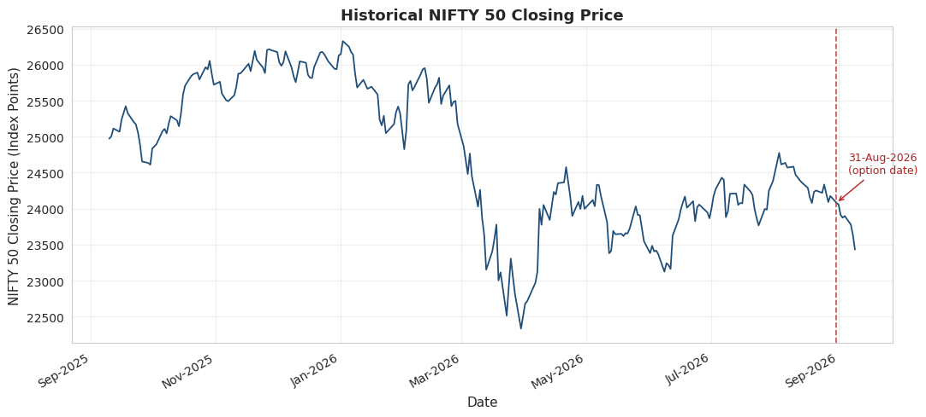
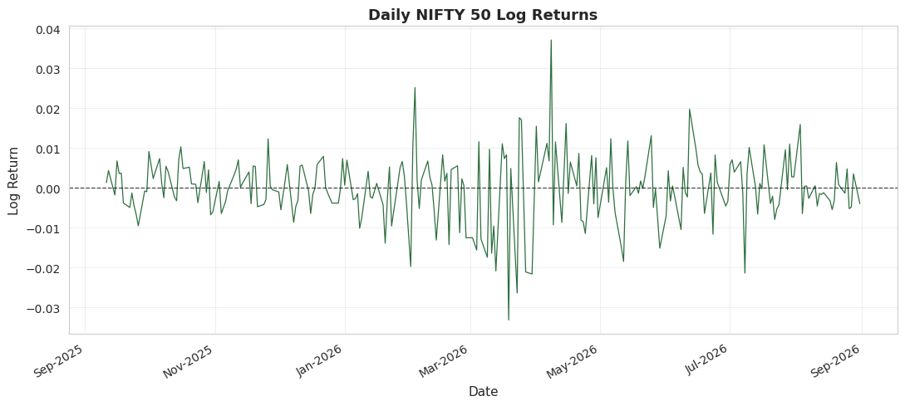

Empirical Analysis of Market Data
How the NIFTY 50 index has moved.
The graph plots the daily closing price for the full one-year period, with the option date marked.
How spread out these values are is exactly what we mean by "volatility”.
r(t) =$\ln\left(\frac{P_{t}}{P_{t−1}}\right)$
Variables:
r(t) = Logarithmic return at time t
$P_{t}$= Price today
$P_{t−1}$ = Price yesterday

Slide 14
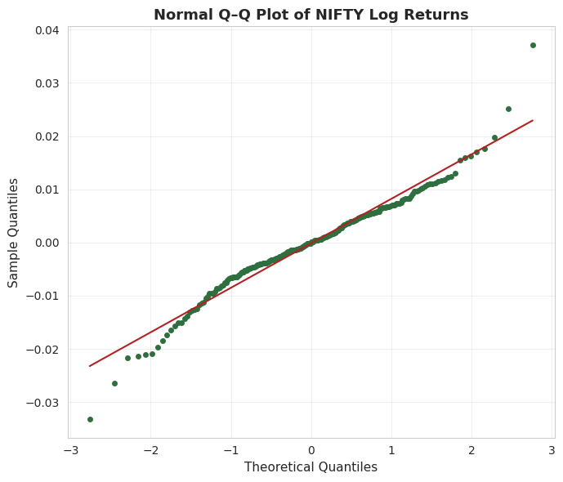
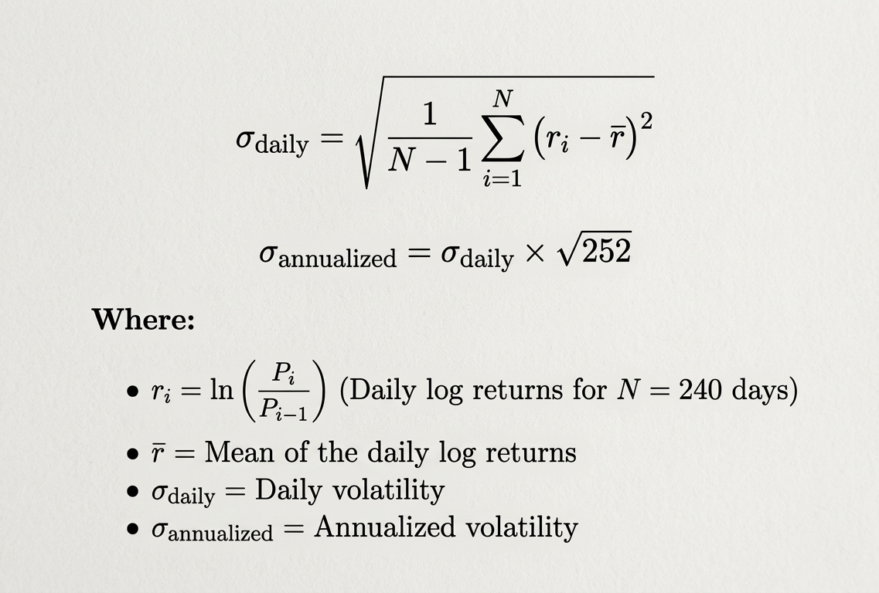
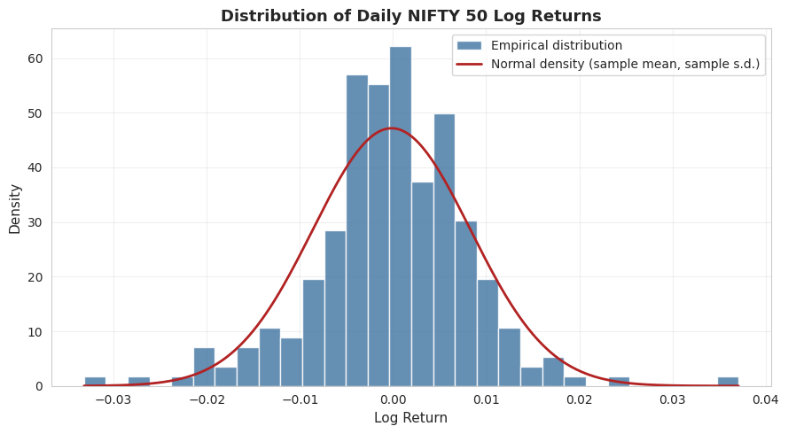
If the dots sit neatly on the straight line, the data looks normal; where the dots drift away from the line — usually at the two ends — the data departs from normality
Histogram of the returns and compare it to a normal curve with the same average and spread.
N is 240 as we are considering market values before the option closing.
Single annualised figure (13.43%) as our main input, exactly as the model requires.
Time to Expiry

Slide 15
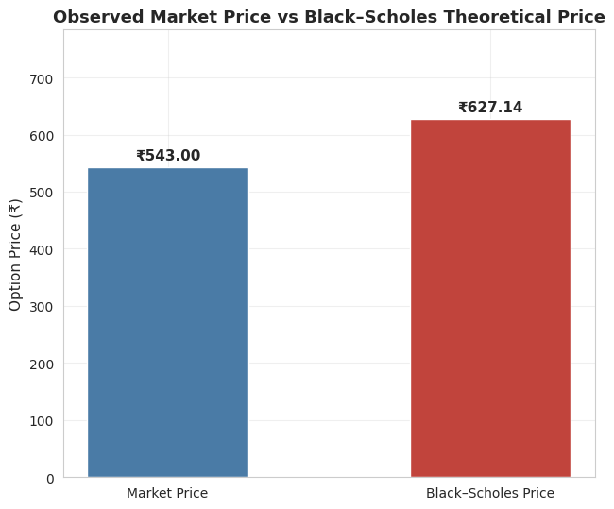
The Black–Scholes Formula
Input | Symbol | Value | Where it comes from
Spot price | S | ₹24,080.40 | Actual option data
Strike price | K | ₹24,100.00 | Actual option data
Volatility | σ | ≈13.43% | Estimated from NIFTY returns
Risk-free rate | r | 6.5% | Assumed — a reasonable illustrative rate; the data has no risk-free rate of its own
Dividend yield | q | 0% | Assumed, as a simplification
Time to expiry | T | 57 days ≈ 0.15616 years | Calculated from the option date and expiry date
Quantity | Value
d1 | 0.2025
d2 | 0.1494
N(d1) | 0.5802
N(d2) | 0.5594
The Black–Scholes estimate is approximately 15.49%
higher than the observed market price.
This difference does not necessarily imply that the model
or market is incorrect. It may reflect differences in
volatility assumptions, dividends, transaction costs,
liquidity, risk premiums and other real-market effects.
Step | Value
S × N(d1) | ₹13,972.06
Discount factor, e^(−rT) | 0.98990
K × e^(−rT) × N(d2) | ₹13,344.93
Black–Scholes price, C = first term − second term | ₹627.14

Slide 16

Thank You — Questions Welcome

