Slide 1
THREAT INTELLIGENCE LIFECYCLE
Dayananda sagar college of engineering
Department of computer science & engineering (cyber security)
Technical Seminar –I
2025-2026
Group Number: G-15
Presented By: Guided By:
Tanu Rajput Prof. Mangala L
1DS22CY056 Assistant Professor
CSCY, DSCE
Date: 25-04-2026

Slide 2
AGENDA
Abstract
Introduction
Literature Survey
Design and Working
Advantages and Disadvantages
Applications
Conclusion
Future Work
References

Slide 3
Abstract
.
Growing cyber threats make traditional security mechanisms insufficient
Threat Intelligence helps in proactive threat detection and mitigation
Threat Intelligence Lifecycle provides a structured intelligence process
Converts raw threat data into actionable intelligenceImproves decision‑making, response time, and cyber resilience
Used in SOCs, incident response, malware analysis, and risk management

Slide 4
INTRODUCTION
Modern digital systems increase attack surface.
Cyber‑attacks are targeted, persistent, and sophisticated.
Reactive security mechanisms are no longer effective.
Need for intelligence‑driven cybersecurity solutions.
Helps understand attacker behavior and intent.
Supports proactive defense and informed decision‑making.
Collection and analysis of threat data
Convert raw data into actionable intelligence
Understand attacker behaviour
Proactive defence and decision making

Slide 5
Literature Survey
Title | Author | Problem Statement | Methodology | Key Findings | Limitation
A Systematic Literature Review on Cyber Threat Intelligence | Saeed et al., 2023 | Lack of structured CTI for organizational resilience | Systematic review of CTI studies | CTI improves proactive defense and situational awareness | Depends on quality of reviewed studies
CTI Modeling Based on Heterogeneous GCNs | Zhao et al., 2021 | Isolated IoCs fail to capture complex threats | Graph Convolutional Networks | Better threat correlation and contextual analysis | High computational complexity
AI-Driven Threat Intelligence | Ovabor et al., 2024 | Slow detection of advanced threats | AI/ML-based intelligence frameworks | Faster zero-day and real-time threat detection | Data quality and ethical concerns
SANS 2022 Cyber Threat Intelligence Survey | Stirparo & Brown, 2022 | Low CTI maturity in organizations | Industry survey | Automation improves CTI effectiveness | Survey-based, not experimental
Dynamics of CTI | Kodituwakku et al., 2024 | Static CTI becomes outdated quickly | Temporal IoC analysis | Time-aware intelligence | Requires continuous data updates

Slide 6
DESIGN AND WORKING
Goal: Convert threat data into actionable intelligence
Integrates multiple data sources
Uses structured lifecycle approach
Supports real-time monitoring and response

Slide 7
Threat Intelligence Lifecycle Phase
Direction: Define intelligence goals
Collection: Gather data (logs, feeds, OSINT)
Processing: Normalize and filter data
Analysis: Identify patterns and threats
Dissemination: Share intelligence with teams
Feedback: Improve lifecycle continuously

Slide 8
Working Mechanism:
Collect threat data from internal and external sources
Process and correlate Indicators of Compromise (IoCs)
Analyze attacker behavior and attack patterns
Generate alerts and actionable insights
Support automated and manual response

Slide 9
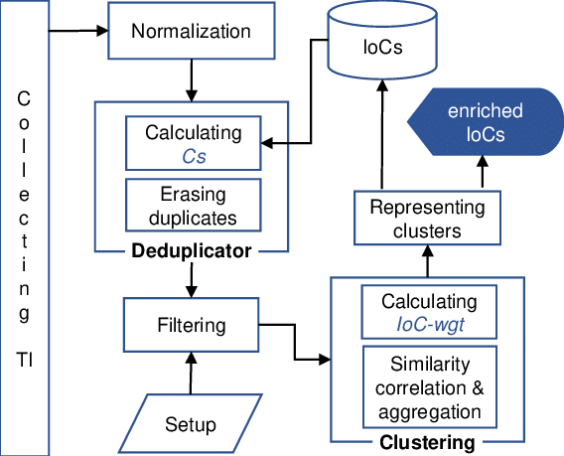

Slide 10
Step 1: Threat Intelligence Collection – Threat data is collected from multiple internal and external sources.
Step 2: Normalization – Collected threat data is converted into a common format for uniform processing.
Step 3: Deduplication – Correlation score (Cs) is calculated and duplicate IoCs are identified and removed.
Step 4: Filtering – Irrelevant and low‑quality IoCs are filtered based on predefined setup rules.
Step 5: Clustering & Correlation – IoC weights (IoC‑wgt) are calculated and similar IoCs are correlated and grouped into clusters.
Step 6: IoC Enrichment & Representation – Clusters are represented as enriched IoCs and stored for actionable threat intelligence.

Slide 11
Advantages and disadvantages
Advantages | Disadvantages
Enables proactive threat detection by identifying potential attacks before they occur | Dependency on data quality
Faster incident response | High data processing overhead
Provides better understanding of attacker behavior and attack patterns | Processing large volumes of data can increase system and resource overhead
Helps in prioritizing threats based on risk and impact | Requires skilled analysts to interpret and validate threat intelligence
Enhances overall security posture and situational awareness | Risk of false positives if data is noisy or poorly correlated

Slide 12
APPLICATIONS
Security Operations Centers (SOC) and threat hunting.
Helps in proactive identification and prevention of cyber threats
Improves incident response speed through actionable intelligence
Provides better understanding of attacker behavior and tactics
Enables effective risk prioritization and decision‑making
Enhances overall security posture and situational awareness

Slide 13
CONCLUSION
Threat Intelligence Lifecycle provides a structured approach to manage cyber threats effectively.
It transforms raw security data into meaningful and actionable intelligence.
The lifecycle enables proactive detection and faster response to cyber‑attacks.
It improves situational awareness and supports informed security decision‑making.
Overall, it strengthens organizational resilience against evolving cybersecurity threats.

Slide 14
FUTURE WORK
Integration with AI and Machine Learning
Automation of intelligence workflows
Time-aware and predictive threat models
Enhanced intelligence sharing platforms
Integration with Zero Trust and SOAR systems

Slide 15
References
[1] S. Saeed, S. A. Suayyid, M. S. Al-Ghamdi, and H. Al-Muhaisen, “A Systematic Literature Review on Cyber Threat Intelligence for Organizational Cybersecurity Resilience,” IEEE Sensors Journal, vol. 23, no. 16, pp. 7273–7301, Aug. 2023.
[2] J. Zhao, Q. Yan, X. Liu, B. Li, and G. Zuo, “Cyber Threat Intelligence Modeling Based on Heterogeneous Graph Convolutional Networks,” Proceedings of the IEEE International Conference on Cyber Security, pp. 1–10, 2021.
[3] K. Ovabor, I. O. Sule-Odu, T. Atkison, and J. O. Benedict, “AI-Driven Threat Intelligence for Real-Time Cybersecurity: Frameworks, Tools, and Future Directions,” Open Access Research Journal of Science and Technology, vol. 12, no. 2, pp. 040–048, 2024.
[4] J. Zhao, Q. Yan, X. Liu, B. Li, and G. Zuo, “Cyber Threat Intelligence Modeling Based on Heterogeneous Graph Convolutional Networks,” USENIX RAID Conference, pp. 1–12, 2020.
[5] S. Stirparo and R. Brown, “SANS 2022 Cyber Threat Intelligence Survey,” SANS Institute Whitepaper, 2022.

Slide 16
[6] A. Kodituwakku, C. Xu, D. Rogers, and D. K. Ahn, “Investigating the Temporal Dynamics of Cyber Threat Intelligence,” arXiv preprint arXiv:2412.19086, 2024.
[7] R. Kumar, S. Mishra, and P. Ashokan, “AI-Driven Threat Intelligence Platforms for Advanced Cybersecurity Monitoring,” IEEE Access, vol. 12, pp. 154321–154334, 2024.
[8] V. Kumar, P. Reddy, and M. Singh, “AI-Based Threat Intelligence and Adaptive Defense Mechanisms in Distributed Systems,” IEEE Access, vol. 10, pp. 98765–98776, 2022.
[9] Y. Jiang, Q. Meng, F. Shang, and B. Sikdar, “MITRE ATT&CK Applications in Cybersecurity and the Way Forward,” arXiv preprint arXiv:2502.10825, 2025.
[10] N. S. T. Erukude, V. C. Marella, and S. R. Veluru, “AI-Driven Cybersecurity Threats: A Survey of Emerging Risks and Defensive Strategies,” arXiv preprint arXiv:2601.03304, 2026.

Slide 17
THANK YOU

