Slide 1
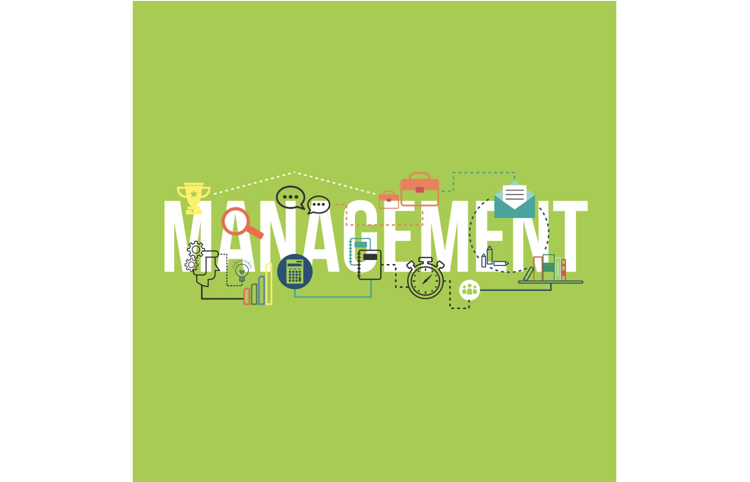
Funtions , Characteristics , Importance , Levels of management ,

Slide 2
What Is Management ?
Management = Manage + Men + Tactfully(To get the work done)
Traditional Authors : An art of getting things done.
Modern Authors : A process of accomplishing certain
certain objectives through the utilization of human and
other resources.

Slide 3
Management is the process of planning, organizing,
leading, and controlling resources—particularly human resources—to achieve organizational goals efficiently and effectively.
Effectively :Effectively is refers to completion of task on time.
Efficiently : Efficiency means to optimum utilization pf resources class
resources and getting maximum output.

Slide 4
Definitions :
“Management is the art of getting things done through and with people in formally organized groups “.
----Koontz
“Management is the art of getting things done through and with people”.
----Mary Parker
“Management is the art of knowing what you want to do and then seeing that it is
done in the best and cheapest way ”.
----F.W Taylor
“Management is the accomplishment of results through the efforts of other people”
----Lawrence
“Management is to manage is to forecast and plan , to organize , to command, to coordinate and control”.
----Henry Fayol

Slide 5
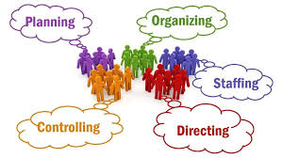
Functions of management

Slide 6

Nature and characteristics:
It is Goal Oriented.
It is a Continuous process.
It is Multi- dimensional.
It is an Intangible force.
It is a part of Group Effect.
It balances Effectiveness and Efficiency .
It is Dynamic Discipline.
It is a Science as well as an Art.

Slide 7
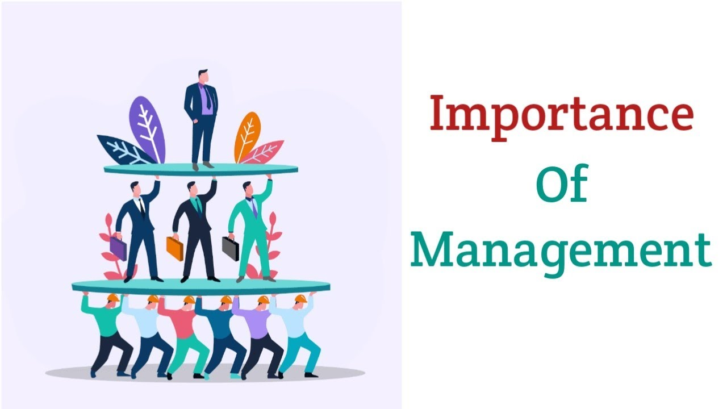
Importance of Management
It helps in Achieving Group Goals.
Effective Utilization of Resources.
Reduces Costs.
Establishes Sound Organization.
Helping the employees in achieving personal
objectives.
Development of Society and Nation.

Slide 8


Planning is the process of setting goals , defining actions to achieve those goals, and organizing the resources and efforts needed to carry out those actions. “Planning is deciding in advance What to do , How to do , when to do it , what to do it ,whose to do it”. Key points: Forecasting ,Budgeting , Formation policy and program , Thinking in advance.
Planning :

Slide 9
Organizing :
Organizing is arranging resources (human , financial , physical , informational) in a structured way to achieve planned objectives.
The purpose of organizing is to ensures that tasks are divided , resources are allocated and relationships are established.
Key Points :
Identify and grouping of activities.
Assign duties.
Development of authority and responsibility

Slide 10
Staffing :
Staffing is recruiting , selecting, training and developing employees to fill roles and ensure effective workforce performance.
The purpose of staffing is to have the right people in this right position.
Key Points:
HR planning
Recruitment and selection
Training and development.

Slide 11
Directing :
Directing is guiding and motivating employees to perform tasks effectively towards achieving organizational goals.
The purpose of directing is to ensure that the workforce is motivated and properly guided to execute plans.
Key points :
Leadership
Communication
Motivation
Supervision.

Slide 12
Controlling :
Controlling is monitoring performance, comparing actual result with planned result and goals and taking corrective actions if necessary.
The purpose of directing is to ensure that organizational activities are on track.
Key Points :
Measuring performance
Compare with standard.

Slide 13
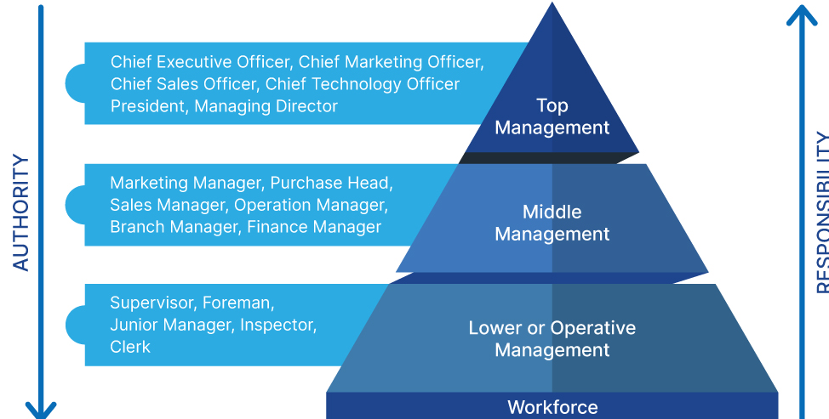
Levels of Management

Slide 14
Top Level Management

