Slide 1
Semi-parallel
linear and logistic regression
For
Genome-Wide Association Studies

Slide 2
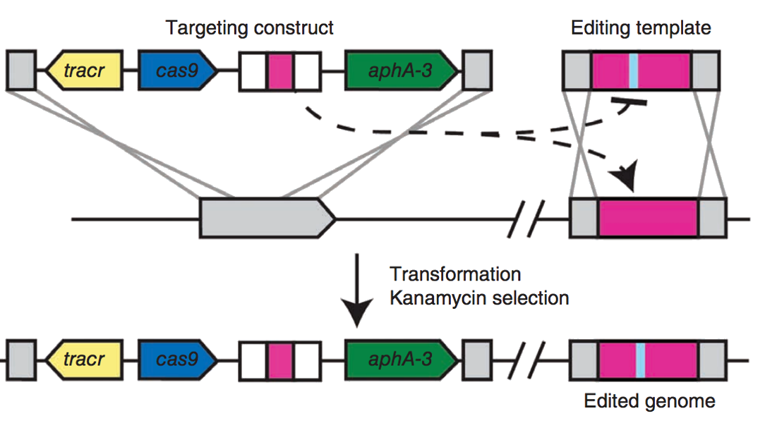
Why?
Introduction of CRISPR/cas9: cheap gene editing
Increase in computational power to analyse huge data
Completion of human genome project in 2003
Helps understand diseases better
Helps in pointing out correlation between diseases

Slide 3
About GWAS
Investigates influence of genes on humans/animal traits
Focuses on SNPs (Single Nucleotide Polymorphism) which in turn influences traits/chances of diseases
Statistical model used in GWAS-Univariate linear regression, Univariate logistic regression of phenotypes for each SNP (correcting for covariates like age, height and gender)
Problem: large data set’s storage and computation
Solution: “semi-parallel” simple rearrangements of linear model (using fast matrix operations)
Assumptions in the paper: not real data, simulated sample size of 10k individuals and 1k SNPs
Vision: Report computational time in standardized and reproducible way

Slide 4
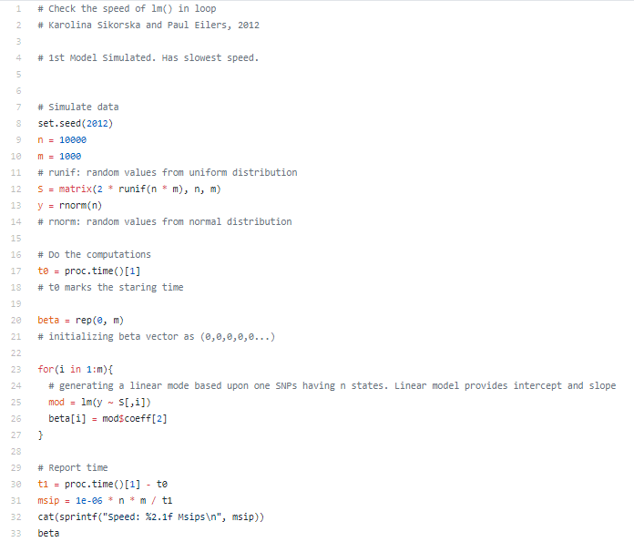

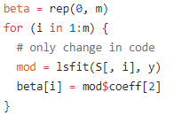
Linear Regression: Using lm and lsfit
Use of lm repeatedly to obtain 1000 regression lines
Using lsfit instead of lm gives faster results (a better function in R

Slide 5

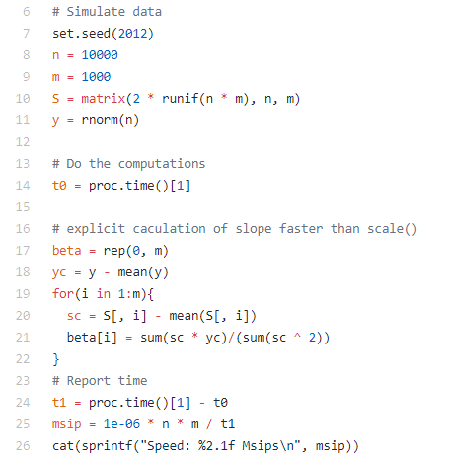
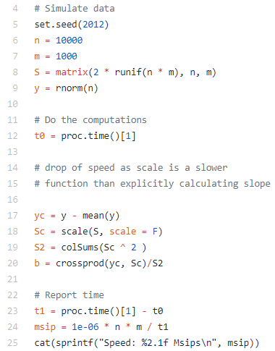
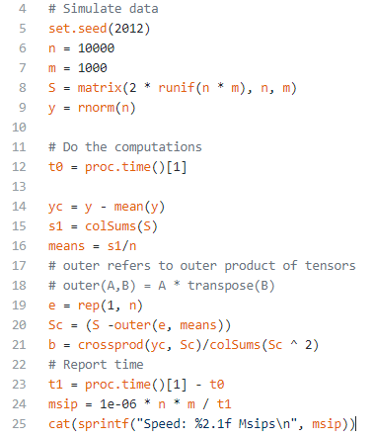
Linear Regression: using formula
Using formula directly in loop
Semi-parallel approach
Centering all columns at once
Explicit implementation

Slide 6
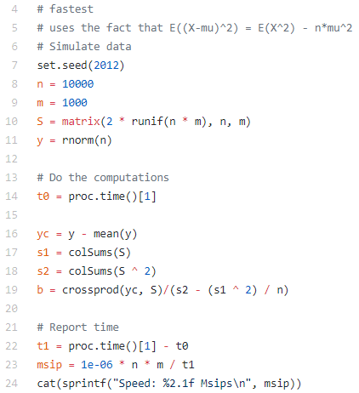


Linear Regression: without centering

Slide 7




Linear Regression with Covariates
where
R encounters memory problems while working with large nXn matrix. Hence s* and y* are calculated in parts

Slide 8
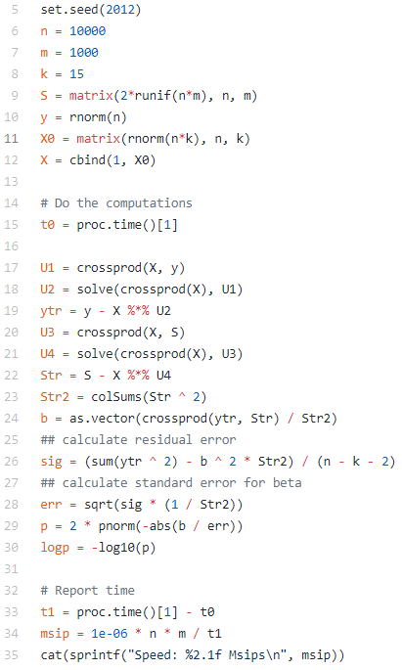
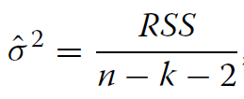
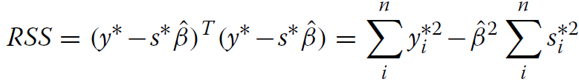

Linear Regression with Covariates

Slide 9
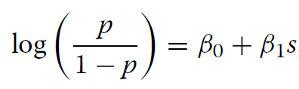
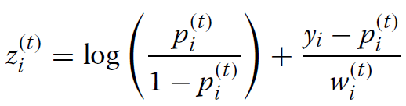

Logistic Regression
Likelihood function is maximized using iterative procedures like Newton-Raphson or Fisher Scoring.
A relation between maximum likelihood estimation using Fisher and weighted least squares estimation exists. (t+1)^{th} iteration of max. likelihood can be written as-
W^{(t)} is diagonal matrix with elements p_{i}^{(t)} (1 − p_{i}^{(t)} )
Every update of β involves solving a weighted least squares problem with updated weight matrix.
This process is called iteratively reweighted least squares.

Slide 10

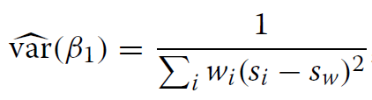
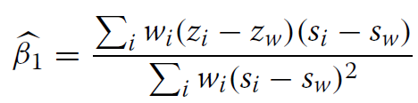

Logistic Regression without covariates
Can’t provide an exact solution, because in principle the weights are different for each SNP.
However, effects found in GWAS are usually of modest size, with a median odds ratio of 1.33 and only a few odds ratios exceeding 3.00
Meaning that probabilities predicted by a model without a SNP will not change much once SNP is included to the model.
Can do semi-parallel computations approximately using weights from the model without SNP (w˜ ) as starting values and updating the solution for β1 by one iteration.

Slide 11
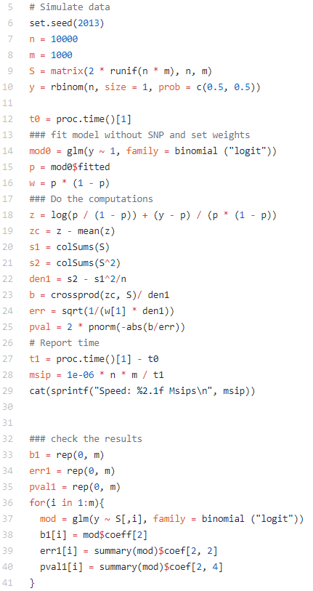

Slide 12


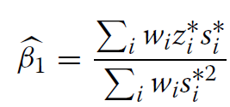
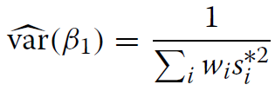
Logistic Regression with Covariates
where X is matrix of covariates including an intercept.
The weight matrix W is replaced with ˜W coming from the model without SNP.
After the transformation the solution for SNP effect and the standard error-

Slide 13
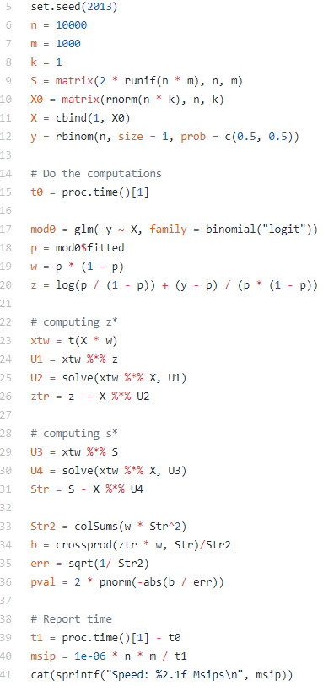
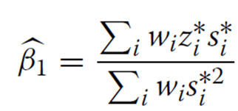

Slide 14
Analysis
Of iDash dataset

Slide 15
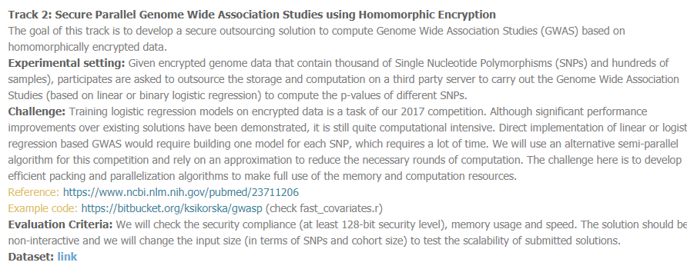
Data
Consist of VCF files of disease and control population
Covariates Comma Separated File (CSV)

Slide 16
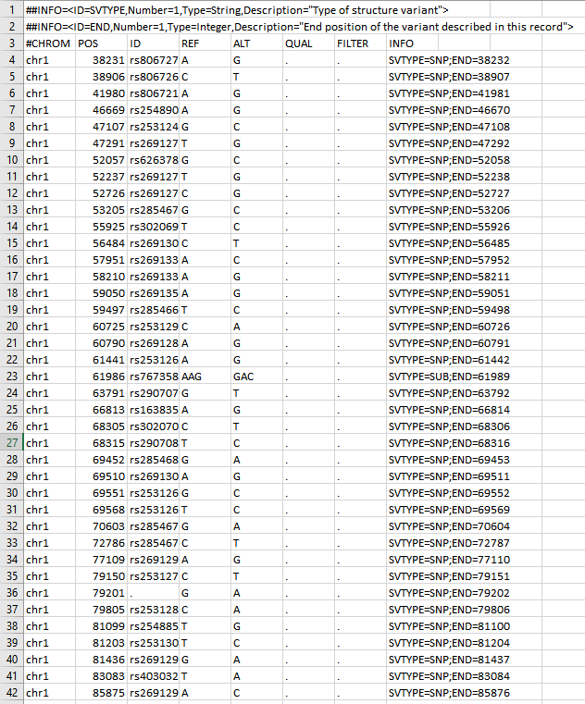
VCF File
Named in format huXXXXXX_variants.vcf where X is a hexadecimal character
Data for chromosome number 1 for all humans in the data set
Each row is SNP with original base and changed base at position defined

Slide 17
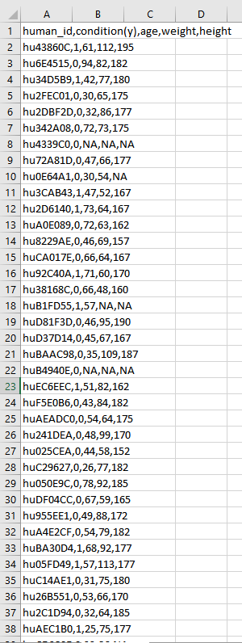
CSV File
Each human_id corresponds to name of huXXXXXX_variants.vcf
Condition specifies whether the person has disease /control condition
Covariates- age, weight and height
Missing values of covariates are imputed by their mean respectively

Slide 18
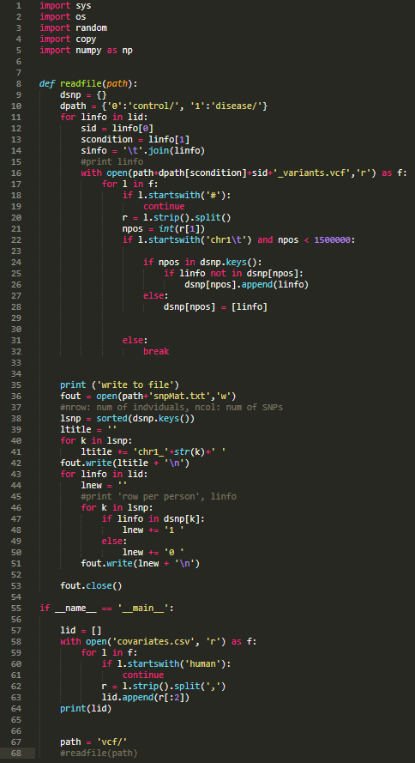
buildingFromVCF.py / buildMat.py
Reads data from all vcf files and maps it according to condition and snp variation to snpMat.txt
snpMat.txt consists of matrix of genotypes derived from vcf files (each SNP is label as chromosome position)
Each row presents an individual's genotype information: 1 means that the individual has the corresponding SNP, 0 otherwise. The order of individuals is the same as that in covariates.csv.
snpMat.txt consist of snp columns and 245 rows for each person

Slide 19
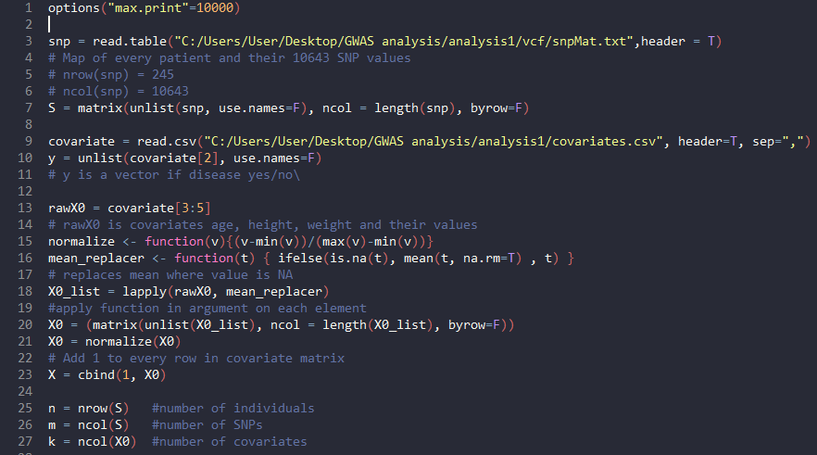
Regression.R file (1)
Normalizing the data and imputing the data with mean value of covariate wherever data is missing

Slide 20
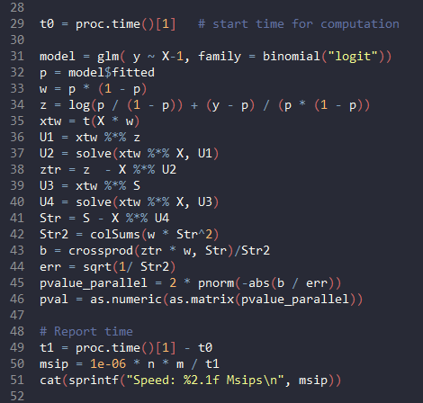
Regression.R file (2)
Calculating time needed for regression analysis
The code is exactly same as the code shown earlier for logistic regression with covariates

Slide 21
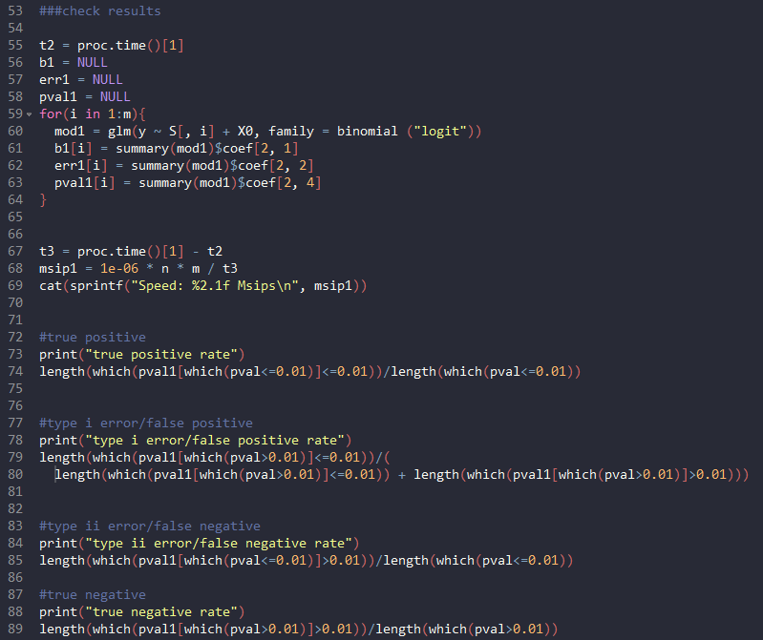
Regression.R file (3)
The result speed of faster logistic regression with covariates is checked against existing library “glm” for computational speed

Slide 22
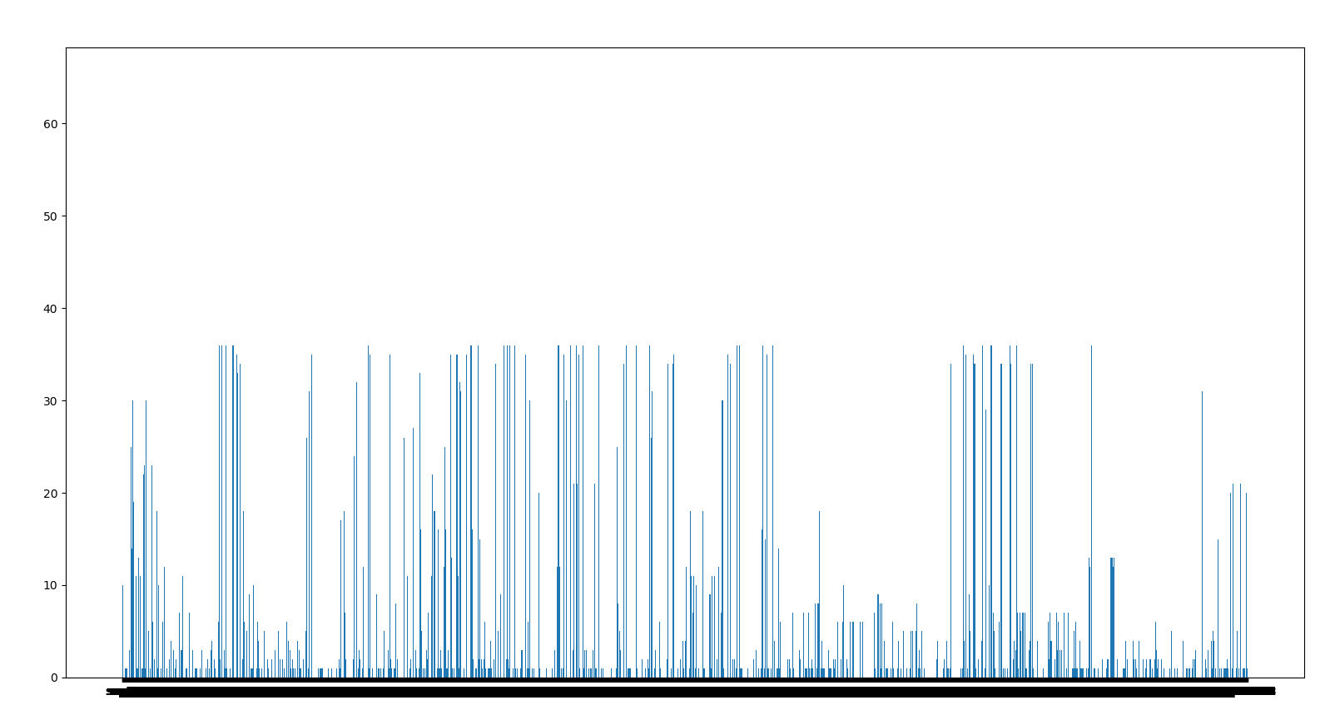
SNP count for disease detected population

Slide 23
