Slide 1

WEB DEVLOPMENT on information regarding fun activity
The slide begins

Slide 2
Basic Requirement of the project ?
My project requires two
Languages : HTML and CSS
HTML: Hypertext Markup Language
Used for layout of website.
CSS : Cascadding Style Sheet
.Used TO style the website.

Slide 3
THE TAGS USED IN BUILDING WEBSITE
<a href="..."> Statements... </a>
<a href="..."> Statements... </a>
Head tag: The head tag is used to contain all the head elements in the HTML file. It contains the title, style, meta, … etc tag.
Body tag: It is used to define the body of an HTML document. It contains images, tables, lists, … etc.
Title tag: It is used to define the title of an HTML document.
Heading tag: It is used to define the heading of an HTML document.
Paragraph tag: It is used to define paragraph content in an HTML document.
Bold tag: It is used to specify bold content in an HTML document.
Anchor tag: It is used to link one page to another page.
List tag: It is used to list the content.
Ordered List tag: It is used to list the content in a particular order.
Unordered List tag: It is used to list the content without order.
Image tag: It is used to add image elements in HTML documents. And so on few more.

Slide 4
THE ATTRIBUTES USED
The href Attribute
The src Attribute
The width and height Attributes
The alt Attribute
The style Attribute
The lang Attribute
The title Attribute
And some more.

Slide 5
Cascading Style Sheet
CSS stands for Cascading Style Sheet.
CSS is used to design HTML tags.
CSS is a widely used language on the web.
HTML, CSS and JavaScript are used for web designing. It helps the web designers to apply style on HTML tags.
. CSS Selector:
CSS Element Selector
CSS Id Selector
CSS Class Selector
CSS Universal Selector
CSS Group Selector

Slide 6
CSS PROPERTIES
CSS Properties
CSS background
CSS border
CSS font
CSS margin
CSS display
CSS overflow
CSS padding
CSS position
And so on.

Slide 7
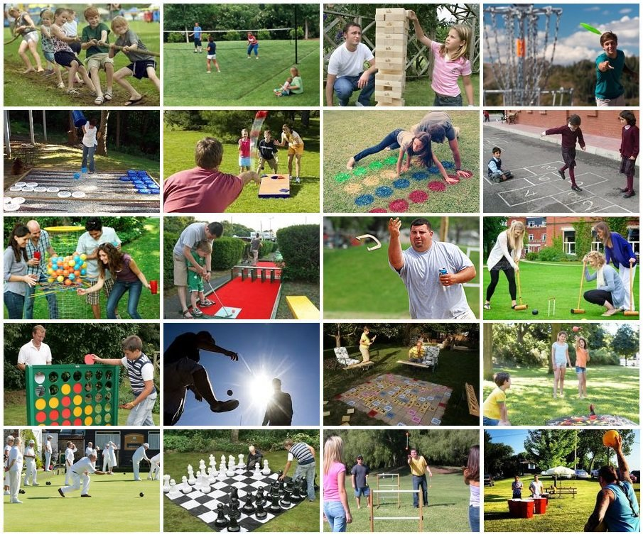
The Website contains about fun activities including Indoor and Outdoor games.
Linking has been done of each product for buying to have fun while your free time .
Fun activites are useful for building your personality that includes:::
never give up attitude,broadened your thinking skills, be more active and so on.
This can be the reason for being together sometimes with your family or friends that makes your connection more stronger.

Slide 8
THANK YOU

