Slide 1
ResQForce
Team Name : Hallucinators
Team Member 1 : Geethanjali Priyanka S
Team Member 2 : Prajwal Palaksha
Team Member 3 : Kavinkumar M
Team Member 4 : Tanu Jain
Team Member 5 : Kavya KK

Slide 2
Use Case: AI-Driven Human Trafficking Detection and Intervention Platform
Objective:
To proactively identify and prevent human trafficking by leveraging AI to unify and analyze cross-channel digital activity, detect hidden risk patterns, and trigger real-time, coordinated responses.
Why Human trafficking demands Innovation :
Global Impact: Human trafficking affects millions annually through forced labor, sexual exploitation, and coercion—posing a severe humanitarian and compliance risk.
Complex Detection Landscape: Traffickers exploit fragmented supply chains, online platforms, and anonymous networks, making detection difficult and inconsistent.
Data Disconnection: Early warning signs are often subtle and spread across disconnected systems, preventing a unified, actionable response.
Adaptive Threats: Traffickers continually evolve their tactics, outpacing legacy monitoring and rule-based systems.
Systemic Gaps: Most current detection efforts are reactive, siloed, and fail to provide early intervention or real-time insights.
Call to Action: There is a critical need for AI-powered, cross-platform solutions that unify data, detect hidden behavioral patterns, and enable proactive, intelligence-led intervention.
Business Value:
Enables early intervention and prevents harm.
Reduces investigation fatigue through intelligent analysis, reasoning and prioritization.
Strengthens compliance with regulatory obligations (e.g., travel, financial, etc.,).
Demonstrates proactive social responsibility.

Slide 3
Understanding Human Trafficking: The Core Framework
Act – What is Done
Means – How it is Done
Purpose – Why It is Done
Act can be through Recruitment, Transportation, Transfer, Harbouring.
Means – Threat or other forms of force, coercion, Fraud, Abuse of power.
Purpose – Exploitation in terms of Forced labour / services, slavery, Removal of organs, exploitation of the prostitution, child Kidnapping.

Slide 4
From Data to Action: Using Salesforce to Detect and Disrupt Trafficking Networks
Data Integration
Data Cloud serves as the foundation by ingesting data from multiple digital sources—social media platforms, job portals, booking engines, bank transactions, and mobile apps. This consolidated view is critical for detecting multi-faceted trafficking behavior across domains.
Early Detection
Einstein Studio Prediction model uses machine learning models trained on historical signals (e.g., suspicious transactions, risky communication patterns, abnormal travel behavior) to predict the likelihood of trafficking-related activity.
Scalability
Agentforce, combined with Data Cloud and Einstein Studio model builder, allows AI agents to continuously monitor massive data volumes across channels..
Proactive Intervention
When Einstein detects a high-risk scenario, Agentforce can automatically trigger analysis and reasoning, creation of a case, assigning it to the right investigative team, sending real-time alerts to law enforcement or NGOs, taking victim rehabilitation measures. This ensures that critical threats are acted on immediately, not days or weeks later.
Reducing False Positives
Using historical data and feedback loops, Einstein Studio Prediction model continuously refines its models, filtering out low-risk signals and prioritizing the highest-risk cases.
Adaptability
As traffickers change tactics, prediction models and agents can learn and evolve quickly to stay effective.

Slide 5
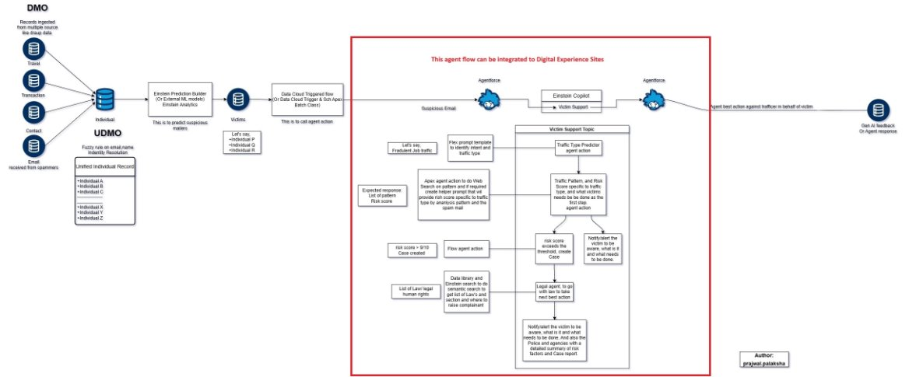
High Level Architecture

Slide 6
How the AI Agents Work Together in the Human Trafficking Detection Solution
This solution leverages three specialized agents that work in sequence to detect, respond to, and support cases of human trafficking. They can also be triggered from Slack to investigate, notify and take necessary upon request.
Investigation Agent – Detects and Analyzes Threats
When a suspicious activity is identified—based on a risk score (High, Medium, Low)—a message is immediately sent to a Slack channel to alert relevant stakeholders. If the score is High, the Investigation Agent is automatically triggered. It conducts deep reasoning to classify the risk type, patterns, and signals behind the detection. A formal case is then created to initiate tracking and follow-up.
Safety Notification Agent - Engages Law Enforcement
Once a case is created, the Safety Notification Agent is activated. It identifies the victim’s country or region and sends an immediate alert to the appropriate local or national law enforcement agencies, enabling quick intervention to protect the individual.
Victim Rehabilitation Agent - Supports Survivors Post Rescue
This agent acts as a digital caseworker to assist survivors in rebuilding their lives. It creates a personalized recovery plan, coordinating access to medical care, legal aid, housing, and other essential services—ensuring long-term rehabilitation and well-being.

Slide 7
Building a Legally Compliant and Secure Human Trafficking Detection System
When developing a human trafficking detection solution for government agencies, especially with cross-border data and personal information, it's essential to ensure that data handling is: Legally Compliant, Ethically Sound, Technically Secure
Why Detection Is Challenging in Traditional Systems
Data Fragmentation: Information is scattered across social media, job portals, financial systems, and messaging apps.
Jurisdictional Barriers: Cross-border privacy laws limit lawful data access across countries.
High Sensitivity: Victim identities and behavioral signals require robust data governance.
Lack of Consent or Legal Basis: Unifying personal data at scale is difficult without consent or legal agreements.
How Salesforce Overcomes These Challenges
Having right legal frameworks in place and Salesforce capabilities, secure and lawful detection becomes possible:
1. Legal Authorizations & Frameworks
Mutual Legal Assistance Treaties (MLATs): Enable lawful data sharing between countries.
Inter-Agency Agreements: Allow secure collaboration across departments.
2. Data Residency & Compliance
Salesforce Data Cloud supports localization for GDPR, CCPA, PDPA, and other regulations.
Enforces data sovereignty and regional storage policies.
3. Enterprise-Grade Data Protection
Shield Platform encryption, access control, and audit trails ensure secure data processing.

Slide 8
How We Bring Scattered Data Together for Detection
1. Data Collection
We collect data from different platforms like travel bookings, job applications, social media, and financial transactions.
Secure APIs are used to pull data from these sources (e.g., Booking.com for travel or LinkedIn for job listings).
2. Data Preprocessing
The collected data is stored in a cloud storage system (e.g., AWS S3 or Azure Data Lake).
We clean and standardize the data, fixing any errors and ensuring all information is in a consistent format.
3. Ingestion into Salesforce Data Cloud
Once the data is processed, it’s moved into Salesforce Data Cloud using APIs

Slide 9
Quantifying ROI
The Return on Investment (ROI) for developing a solution to detect human trafficking can be assessed across multiple dimensions—financial, social, operational.
Operational ROI - AI and automation reduce the manual effort needed to analyze large datasets.
Social ROI - Preventing exploitation, rescuing victims, and disrupting trafficking networks has a profound and immeasurable societal value.
Financial ROI - Reduces costs associated with investigations, healthcare, victim rehabilitation, and legal processes.

Slide 10
THANK YOU

