Slide 1

Multimodal Fusion & Alert System
Proposal : Basic integration of modules + rule-based alerting
WELCOME TO
BENNETT UNIVERSITY
Presented by : TANIYA DIXIT
Enrolment No : 35418011922 Supervisors : Dr. Upasna Joshi
Semester : 7

Slide 2
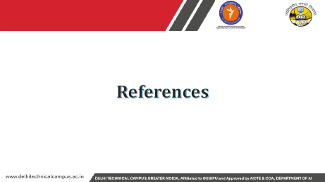
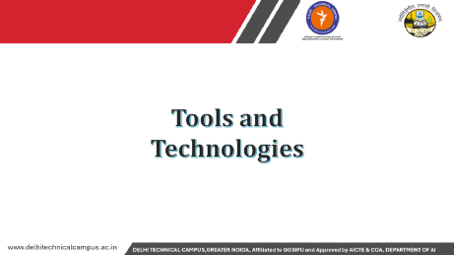

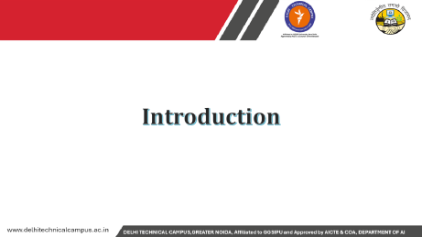

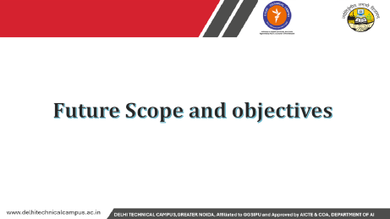
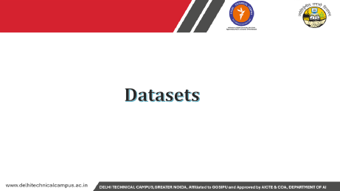
Contents

Slide 3
Introduction

Slide 4
INTRODUCTION
Modern vehicles and monitoring systems need real-time decision-making for safety.
Multimodal fusion integrates data from multiple sources:
  Vision (camera, object detection)
  Audio (sounds like horn, siren, yawning)
  Sensors (speed, GPS, OBD-II, environment)
Rule-based alerting applies simple IF–THEN logic to trigger safety alerts.
Goal: Provide early warnings to prevent accidents and ensure driver awareness.

Slide 5
PROBLEM STATEMENT
Basic integration of modules + rule-based alerting
Rising number of road accidents due to:
  Driver distraction and drowsiness
  Ignoring traffic signals/signs
  Environmental factors (rain, speed, obstacles)
Current systems often rely on a single modality → limited accuracy.
Need for a fused multimodal system that generates reliable alerts.

Slide 6
OBJECTIVES
Integrate vision, audio, and sensor modules into one system.
Perform multimodal fusion to combine module outputs.
Apply rule-based logic for detecting risky situations.
Provide real-time alerts (audio, visual, haptic) to the driver.
Maintain event logs for analysis and improvement.
Collect Data (Vision, Audio, Sensors) → Fuse Data → Apply Rules → Generate Alerts → Improve Driver Safety.

Slide 7
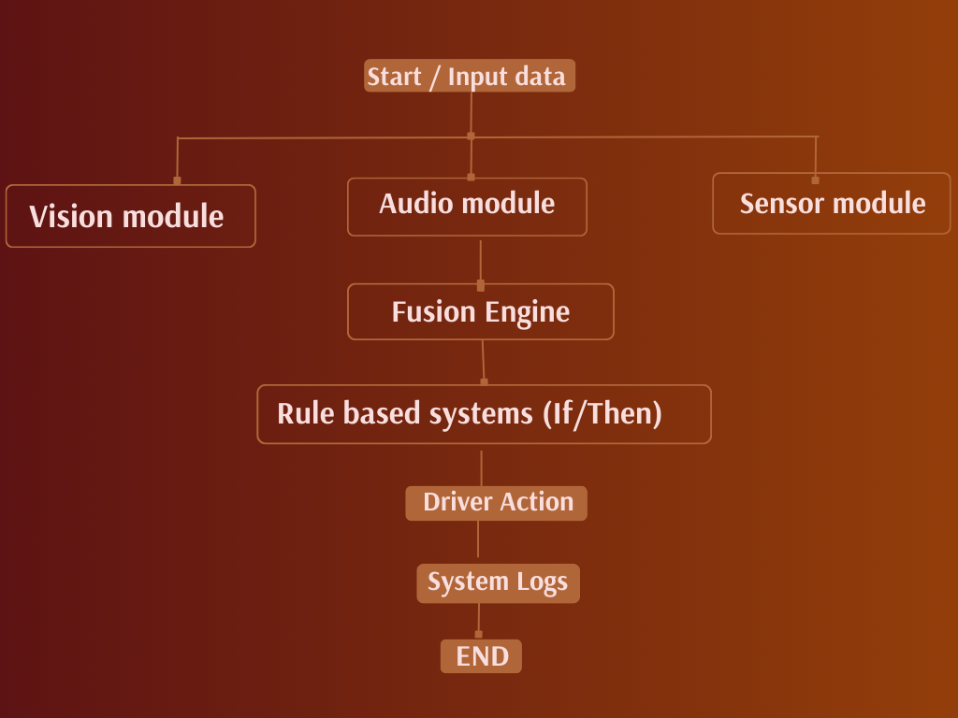
Flowchart

Slide 8
Tools and Technologies

Slide 9


TOOLS AND TECHNOLOGIES
Programming: Python
Libraries: OpenCV, YOLO (Ultralytics), Librosa/PyAudio, Scikit-learn, PyTorch
Hardware: Camera, Microphone, OBD-II / Sensors (Speed, Rain, GPS)
Development Tools: Jupyter, VS Code, Git
Alert System: Speakers, Dashboard display,

Slide 10
Datasets

Slide 11
SOURCES AND TYPES
1. Vision (Camera Data)
Public datasets: COCO, KITTI, Cityscapes (vehicles, pedestrians, traffic signal signs)
Custom dataset: Driver attention (eyes closed, phone usage)
2. Audio (Microphone Data)
UrbanSound8K (horns, sirens, environment sounds)
Custom recordings: Yawning, in-vehicle audio

Slide 12
CONT
3. Sensor Data
Vehicle OBD-II logs (speed, acceleration, RPM)
Simulated environment data (rain, GPS, steering grip)
4. Annotation Tools
CVAT for image annotations
Audacity + manual labeling for audio clips

Slide 13
Methodology

Slide 14
METHODOLOGY
Approach:
Collect data from Vision, Audio, and Sensor modules.
Perform Pre-processing (noise removal, feature extraction).
Apply Multimodal Fusion (combine all inputs).
Use Rule-Based System (IF–THEN conditions).
Trigger Alerts (audio, visual, haptic).
Store results in System Log for analysis.
Data Collection → Fusion → Rule Checking → Alert → Driver Action → Logging.
Notes:
Basal cell carcinoma – Occurs in the basal cells in the lower part of the epidermis (outside layer).
Squamous CC – Occurs in the squamous cells in the outside layer of the skin.
Melanoma – Occurs in cells called melanocytes, which causes pigmentation of skin. Most deadly.
Merkel CC – Occurs in merkel cells in epidermis layer, it is aggressive form of carcinoma.
Sebaceous C – Occurs in skin’s oil producing glands called, sebaceous glands, commonly found in hairy skin area.

Slide 15
METHODOLOGY STEPS
1. Data Acquisition
Vision → Camera + YOLO (object detection, driver monitoring).
Audio → Microphone + Audio classifier (horn, siren, yawning).
Sensors → OBD-II / GPS / environment sensors (speed, rain, grip).
2. Pre-processing
Vision → Resize, normalize frames.
Audio → Convert to spectrogram, filter noise.
Sensor → Normalize values, handle missing data.
3. Multimodal Fusion
Combine all outputs into a unified structured format.
Example: {pedestrian=True, speed=65, driver_drowsy=True}

Slide 16
CONT
4. Rule-Based Alerting
IF pedestrian detected + speed high → Collision Alert
IF eyes closed > 2s → Drowsiness Alert
IF red light + moving → Traffic Violation Alert
5. Alert Generation
Audio: Voice / Beep
Visual: Dashboard / HUD icons
Haptic: Steering vibration
6. Logging & Feedback
Store event data for performance analysis and improvements.

Slide 17
Future Scope and objectives

Slide 18
Future Scope
Integration with Advanced Driver Assistance Systems (ADAS)
Use of deep learning + multimodal transformers instead of rule-based logic
Cloud-based data storage for fleet monitoring & analytics
Real-time integration with IoT and 5G for faster alerts
Expansion to autonomous vehicle systems

Slide 19
APPLICATIONS
Driver Safety Systems → Drowsiness, distraction, and collision alerts
Traffic Management → Monitoring violations (signal jumping, overspeeding)
Smart Vehicles → Enhanced in-car assistant with multimodal awareness
Insurance Industry → Accident data logging for claim verification
Public Transport & Logistics → Fleet safety monitoring and route optimization

Slide 20
Gantt chart and Work plan

Slide 21
GANTT CHART
phase | Week 1-2 | Week 3-4 | Week 5-6 | Week 7-8 | Week 9-10
Requirement analysis
Dataset collection
Pre processing
Model development (yolo
Rule based system design
Integration and fusion
Testing and evaluation

Slide 22
WORK PLAN
Task | Duration | Description / Module
Requirement Analysis | Week 1-2 | Define system scope, objectives
Dataset Collection | Week 1-4 | Collect vision, audio, sensor data
Pre-processing | Week 3-6 | Clean data, feature extraction
YOLO Model Development | Week 5-8 | Train object detection model
Rule-Based System Design | Week 7-8 | Define alert rules and thresholds
Integration & Fusion | Week 7-10 | Combine all modules into unified system
Testing & Evaluation | Week 9-10 | Test alerts, accuracy, and reliability
Documentation & Report | Week 9-10 | Prepare final report and presentation

Slide 23
References

Slide 24
References
Bochkovskiy, A., Wang, C., & Liao, H. (2020). YOLOv4: Optimal Speed and Accuracy of Object Detection. arXiv preprint arXiv:2004.10934.
Ultralytics. (2023). YOLOv8 Documentation. Available at: https://docs.ultralytics.com
Salamon, J., & Bello, J. P. (2014). UrbanSound8K: A Dataset of Urban Sounds. Proceedings of the 22nd ACM International Conference on Multimedia.
Geiger, A., Lenz, P., & Urtasun, R. (2012). Are We Ready for Autonomous Driving? The KITTI Vision Benchmark Suite. CVPR 2012.
Redmon, J., & Farhadi, A. (2018). YOLOv3: An Incremental Improvement. arXiv preprint arXiv:1804.02767.
OpenCV Team. (2023). OpenCV Documentation. Available at: https://opencv.org

Slide 25


