Slide 1




MOVIE RECOMMENDATION SYSTEM
Khushal 0011800823
Taniya 35418011922

Slide 2

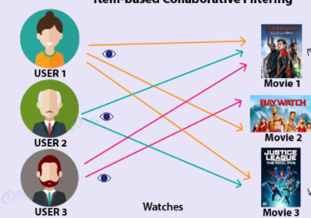
PROBLEM STATEMENT
To implement a movie recommendation system
Incorporate ML algorithm and Data mining
Platform: Pyspark

Slide 3
Dataset Description
1,000,209 anonymous ratings
3,900 movies
6,040 MovieLens users

Slide 4
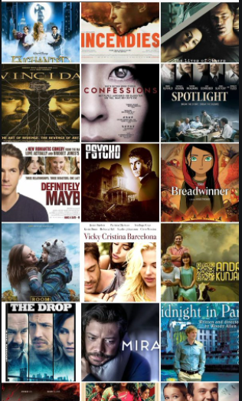
DATASET FILES
UserID::MovieID::Rating::Timestamp
UserID::Gender::Age::Occupation::Zip-code
MovieID::Title::Genres

Slide 5
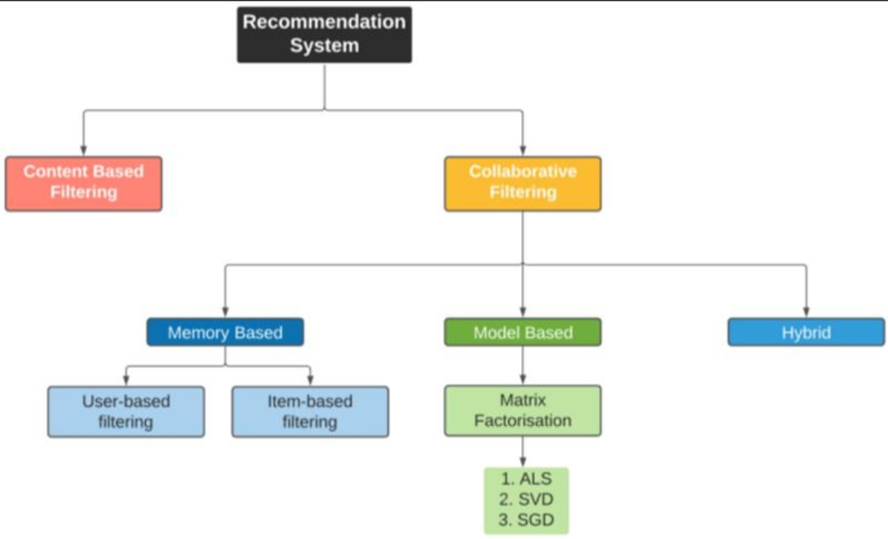
IMPLEMENTATION SYSTEM

Slide 6
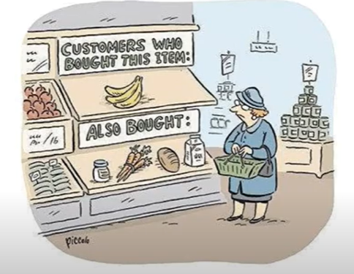
Market basket analysis
Market basket analysis is a data mining technique used by retailers to increase sales by better understanding customer purchasing patterns. It involves analyzing large data sets, such as purchase history, to reveal product groupings, as well as products that are likely to be purchased together.

Slide 7
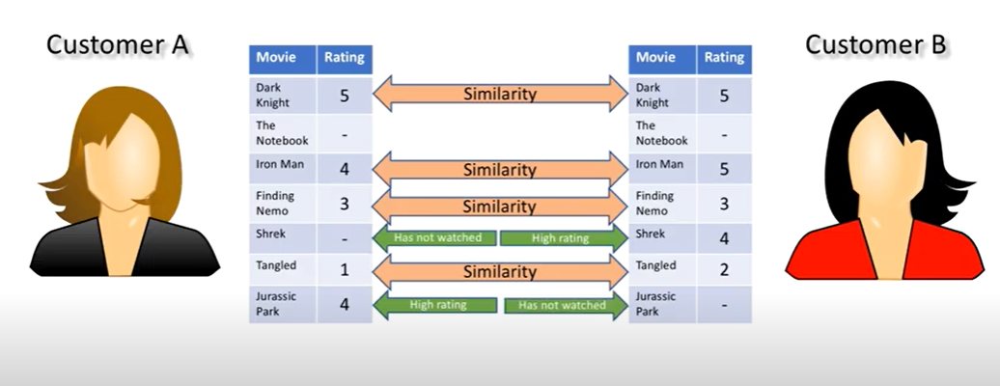

Slide 8
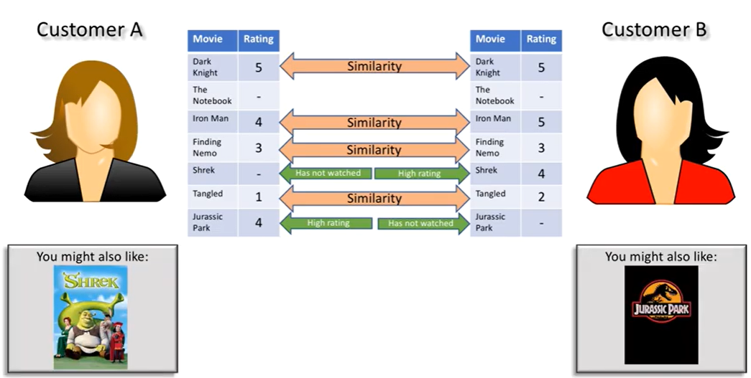

Slide 9

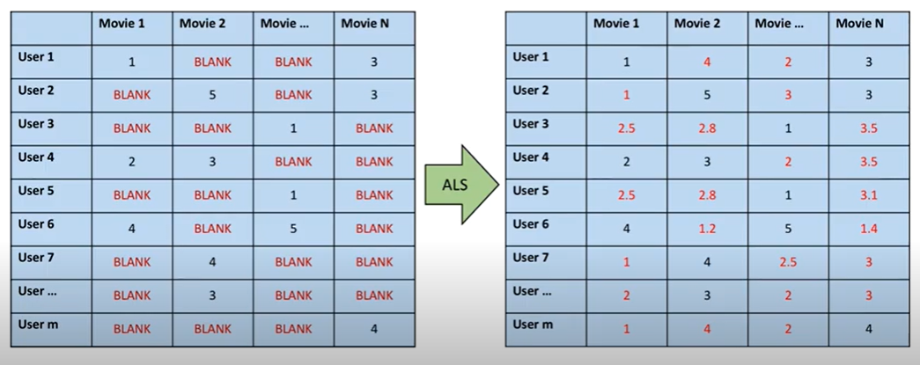

Slide 10
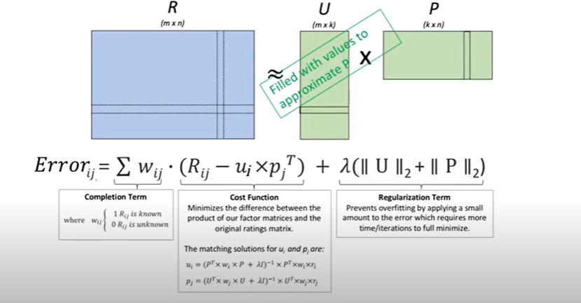

Slide 11
THANK YOU

