Slide 1
Influence Maximisation on Signed Networks
Our optimised Artificial Bee Colony (ABC) vs the ABCVNS paper algorithm — on the majority-rule model
Bitcoin Alpha · Bitcoin OTC · Slashdot | k = 10…50 | 30 restarts | numpy + torch/CUDA | 8/11/2026

Slide 2
FOUNDATIONS
The Majority Rule Model (signed)
Activation rule — node v activates once its NET support strictly exceeds its threshold:
Σ w(+ edges from active neighbours) − Σ w(− edges from active neighbours) > θ_v · deg(v)
Each node draws a random threshold per run: θ_v ~ U[0.5 − δ, 0.5 + δ], δ = 0.15 → 0.35…0.65
deg(v) = total incident |weight|; activation is progressive (once active, always active)
Unsigned case = plain majority rule. The signed version adds ENEMY edges that push support down — realistic for trust networks (Bitcoin ratings −10…+10, Slashdot friend/foe)
Non-monotone: adding an enemy seed can REDUCE spread — on the hub-blocker toy graph σ({1,2,3,4}) = 6 but σ({1,2,3,4,5}) = 5
Consequence: influence is a property of COALITIONS, not of individual nodes — the foundation for why we need set-level metaheuristics

Slide 3
MOTIVATION
Why an Artificial Bee Colony over the current methods
Greedy / CELF build the set one node at a time from singleton marginal gains. Under majority rule those gains are ≈ 0 until a threshold tips — greedy is choosing among ties and is effectively blind.
CELF's lazy bounds assume submodularity — false here. We run it as a heuristic and AUDIT every bound (violations recorded in the results CSVs).
SA and GRASP are decent baselines, but SA spends most of its budget on random-walk temperature schedules; neither exploits coalition structure.
ABC searches WHOLE k-sets with a population of food sources: employed + onlooker + scout bees can assemble complementary coalitions greedy can never even represent.
A CELF warm start guarantees the ABC never returns worse than CELF — the two designs are complementary: CELF supplies the gradient, ABC supplies the global set-level search.
Measured on real networks (majority rule): ABC within 1% of Greedy at 0.44–1.16× the time · beats CELF by up to +7.3% (Slashdot k=20) · beats Degree by +13…28% on the signed Bitcoin graphs

Slide 4
OUR ABC DESIGN
ABC weaknesses → our optimisations (1 of 3)
W1 · Weak exploitation
W2 · Roulette wheel collapse
W3 · Blind scout restarts
Canonical ABC's random partner walk converges slowly late in the run.
Fix: gbest-guided neighbours — with probability gbest_prob = 0.6 the perturbation partner is the global-best set, turning the random walk into a directional pull (Zhu & Kwong 2010).
Fitness-proportional onlooker selection degenerates when fitnesses are near-equal (exactly what happens on zero-gain plateaus).
Fix: tournament selection (size 4) for onlookers — roulette kept only as an option.
Abandoned food sources were rebuilt by pure uniform resampling — wasted evaluations.
Fix: directed scouts — rebuild near the incumbent with a strong perturbation (Kiran & Findik 2015); random reset only w.p. 0.3.

Slide 5
OUR ABC DESIGN
ABC weaknesses → our optimisations (2 of 3)
W4 · Rigid perturbation
W5 · Duplicate food sources
W6 · Refinement budget blow-out
One fixed-strength swap per move made the colony insensitive to problem scale.
Fix: modification-rate control — n_mod partner-guided swaps per candidate plus a mutation_rate = 0.2 chance of an extra random swap (Akay & Karaboga 2012).
The colony collapses onto identical sets, wasting population slots.
Fix: dedupe — every duplicate source is replaced by a fresh biased set; replacements counted and reported.
Local refinement can silently consume the whole evaluation budget.
Fix: reserve_fraction = 0.15 of the budget for refinement, every call capped at remaining(); stagnation_limit early-stop when no gain for many cycles.

Slide 6
OUR ABC DESIGN
ABC weaknesses → our optimisations (3 of 3)
W7 · Zero-gain plateaus
W8 · Stale refinement
W9 · Broken coalitions
σ is flat on plateaus: bees cannot see which way is uphill and get stuck.
Fix: plateau gradient — fitness = σ + λ·Φ, where Φ = Σ min(1, net/need) at convergence is computed in the SAME cascade pass (free); accept_equal lets bees slide across exact ties; explore_prob = 0.15 injects fresh random sets.
Refinement keeps consuming budget after the 1-opt neighbourhood is exhausted.
Fix: adaptive gating — after two consecutive zero-swap refinement passes, refinement switches off and its budget returns to the colony.
1-opt cannot repair a set that needs two simultaneous swaps — the main reason CELF + 1-opt gains so little.
Fix: cascade-aware swap-in candidates (neighbours of seeds and of near-threshold nodes) + a 2-swap shaking phase when 1-opt stalls.

Slide 7
THE BASELINE
ABCVNS — the paper's algorithm (Tang et al., SWEVO 105 (2026) 102404)
Fitness: LIE (Local Influence Estimation) — a closed-form 2-hop surrogate of Independent Cascade; NO Monte-Carlo inside the search loop
Population init: half = top-k degree nodes (each node replaced w.p. 0.5), half = uniform random k-sets
Employed / onlooker bees: EGCNC — elite-global cooperative neighbourhood construction (union of better neighbours' sets, resampled); onlookers chosen by tournament (ts = 3)
Scouts: bifurcated — w.p. 0.5 keep S ∩ Gbest + random fill, else a fully random set
VNS on Gbest every generation: N1 = Score-driven 1-swap · N2 = betweenness-oriented 2-hop swap · N3 = community-aware swap (retain top r = 0.2 by BC) + Eq. 19 local search over the top-cn = 10 Score-ranked neighbours
Population management: after τ_max = 5 stagnant generations keep the top r·NP, re-seed the rest by Score-guided sampling, then cyclic VNS on P_best
Parameters: gmax = 150 · NP = 50 · ts = 3 · r = 0.2 · cn = 10 · L = 5 · τ_max = 5 · m_max = 3 · α = 0.5 · p = 0.05 (0.01 Slashdot) · 30 restarts

Slide 8
COMPARISON
ABC vs ABCVNS — where they actually differ
Aspect | ABC (ours) | ABCVNS (paper)
Fitness | σ + λ·Φ — Monte-Carlo estimate of the ACTUAL model + plateau gradient | LIE — fixed 2-hop formula built for Independent Cascade
Budget model | k × 200 cascade evaluations per restart, spent adaptively | No MC budget — fixed ~15–25k structural (LIE) evaluations
Initialisation | CELF warm start (never worse than CELF) + sign-aware biased sets | Top-degree with 0.5 mutation + uniform random
Bee operators | gbest-guided partners · tournament onlookers · directed scouts · dedupe | EGCNC union-of-elites sampling · tournament ts = 3 · bifurcated scouts
Local improvement | Budget-aware lazy 1-opt (audited bounds) + 2-swap shaking | 3-tier VNS (Score / BC / community) + Eq. 19 neighbour search
Guarantee | ≥ CELF always (elitism) | None — optimises a surrogate, not the model
Generality | Any diffusion model (majority, signed, IC) | IC only — LIE has no notion of majority thresholds or edge signs
Restarts | 5 or 30 (matched to the paper here) | 30 (the paper's training setting)

Slide 9
FIXING THE PAPER ALGORITHM
The fix: giving ABCVNS a fitness that actually spreads
Problem (measured): on the signed majority model, LIE's seeds activate only themselves — OTC spread = k exactly at every k; Alpha k=10: 10.1 vs ABC's 549.9
Mechanism: LIE rewards 2-hop DENSITY, so it selects a tight cluster whose neighbours have mean degree 88.9 (median 50). At δ = 0.35 a single active seed can flip 0 of 100 such neighbours — majority cascades need LOW-degree neighbours, LIE rewards the opposite.
Fix (a documented deviation, search machinery untouched): replace only the scalar fitness by a 2-hop expected-activation surrogate of the majority rule:
Score(S) = |S| + Σ P_v(net from S) + Σ P_v(net from S ∪ N1) P_v(c) = clamp( (c/deg_v − (0.5−δ)) / 2δ , 0, 1 )
Same EGCNC, VNS tiers, scouts, population management, all 30 restarts — only the fitness changed.
After the fix: Alpha k=10 10.2 → 595.2 (= Greedy) · OTC k=50 50.4 → 1,856 (beats ABC's 1,649, +12.5%) · Slashdot matches the degree solution at every k

Slide 10
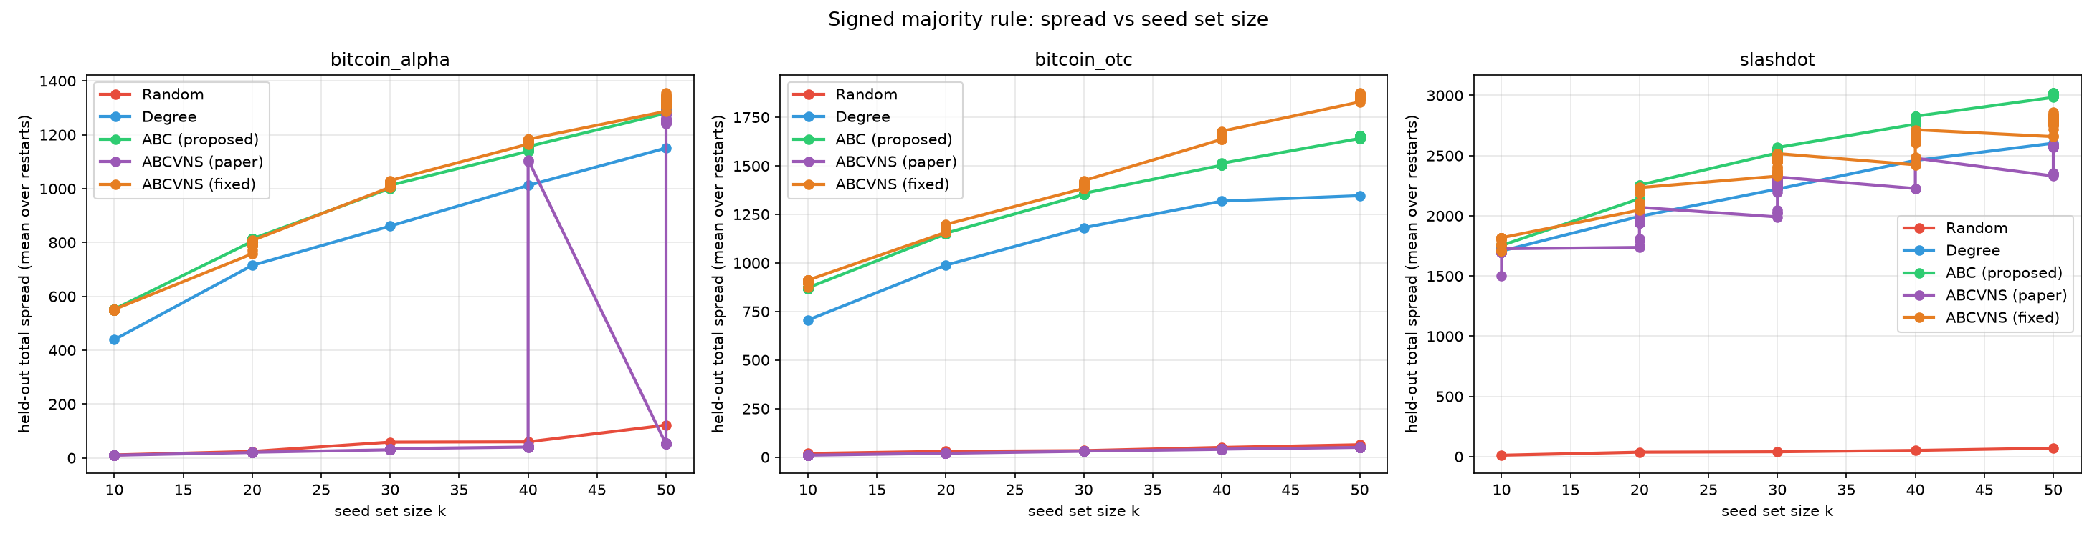
MEASURED RESULTS
Signed benchmark — held-out spread vs seed-set size
Total spread (positive + negative), all three graphs
Means over restarts (ABC & ABCVNS ×30, baselines ×1). ABCVNS-paper's unchanged LIE fitness collapses to ≈ k on the Bitcoin graphs; the fixed surrogate matches ABC.

Slide 11
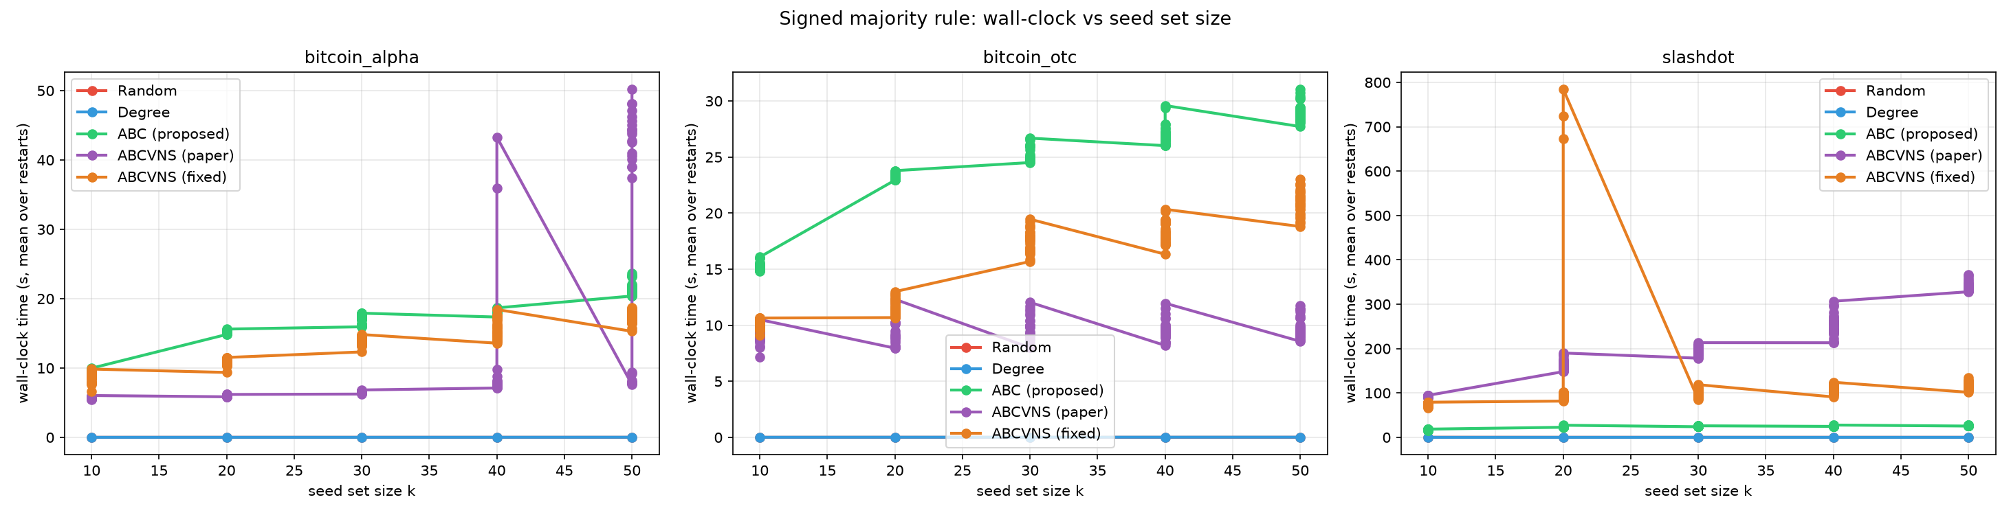
MEASURED RESULTS
Signed benchmark — wall-clock vs seed-set size
Seconds per restart, all three graphs
CPU/GPU hybrid: the search is Python-loop bound; k = 40/50 ABCVNS restarts grow because the VNS local search scales with k.

Slide 12
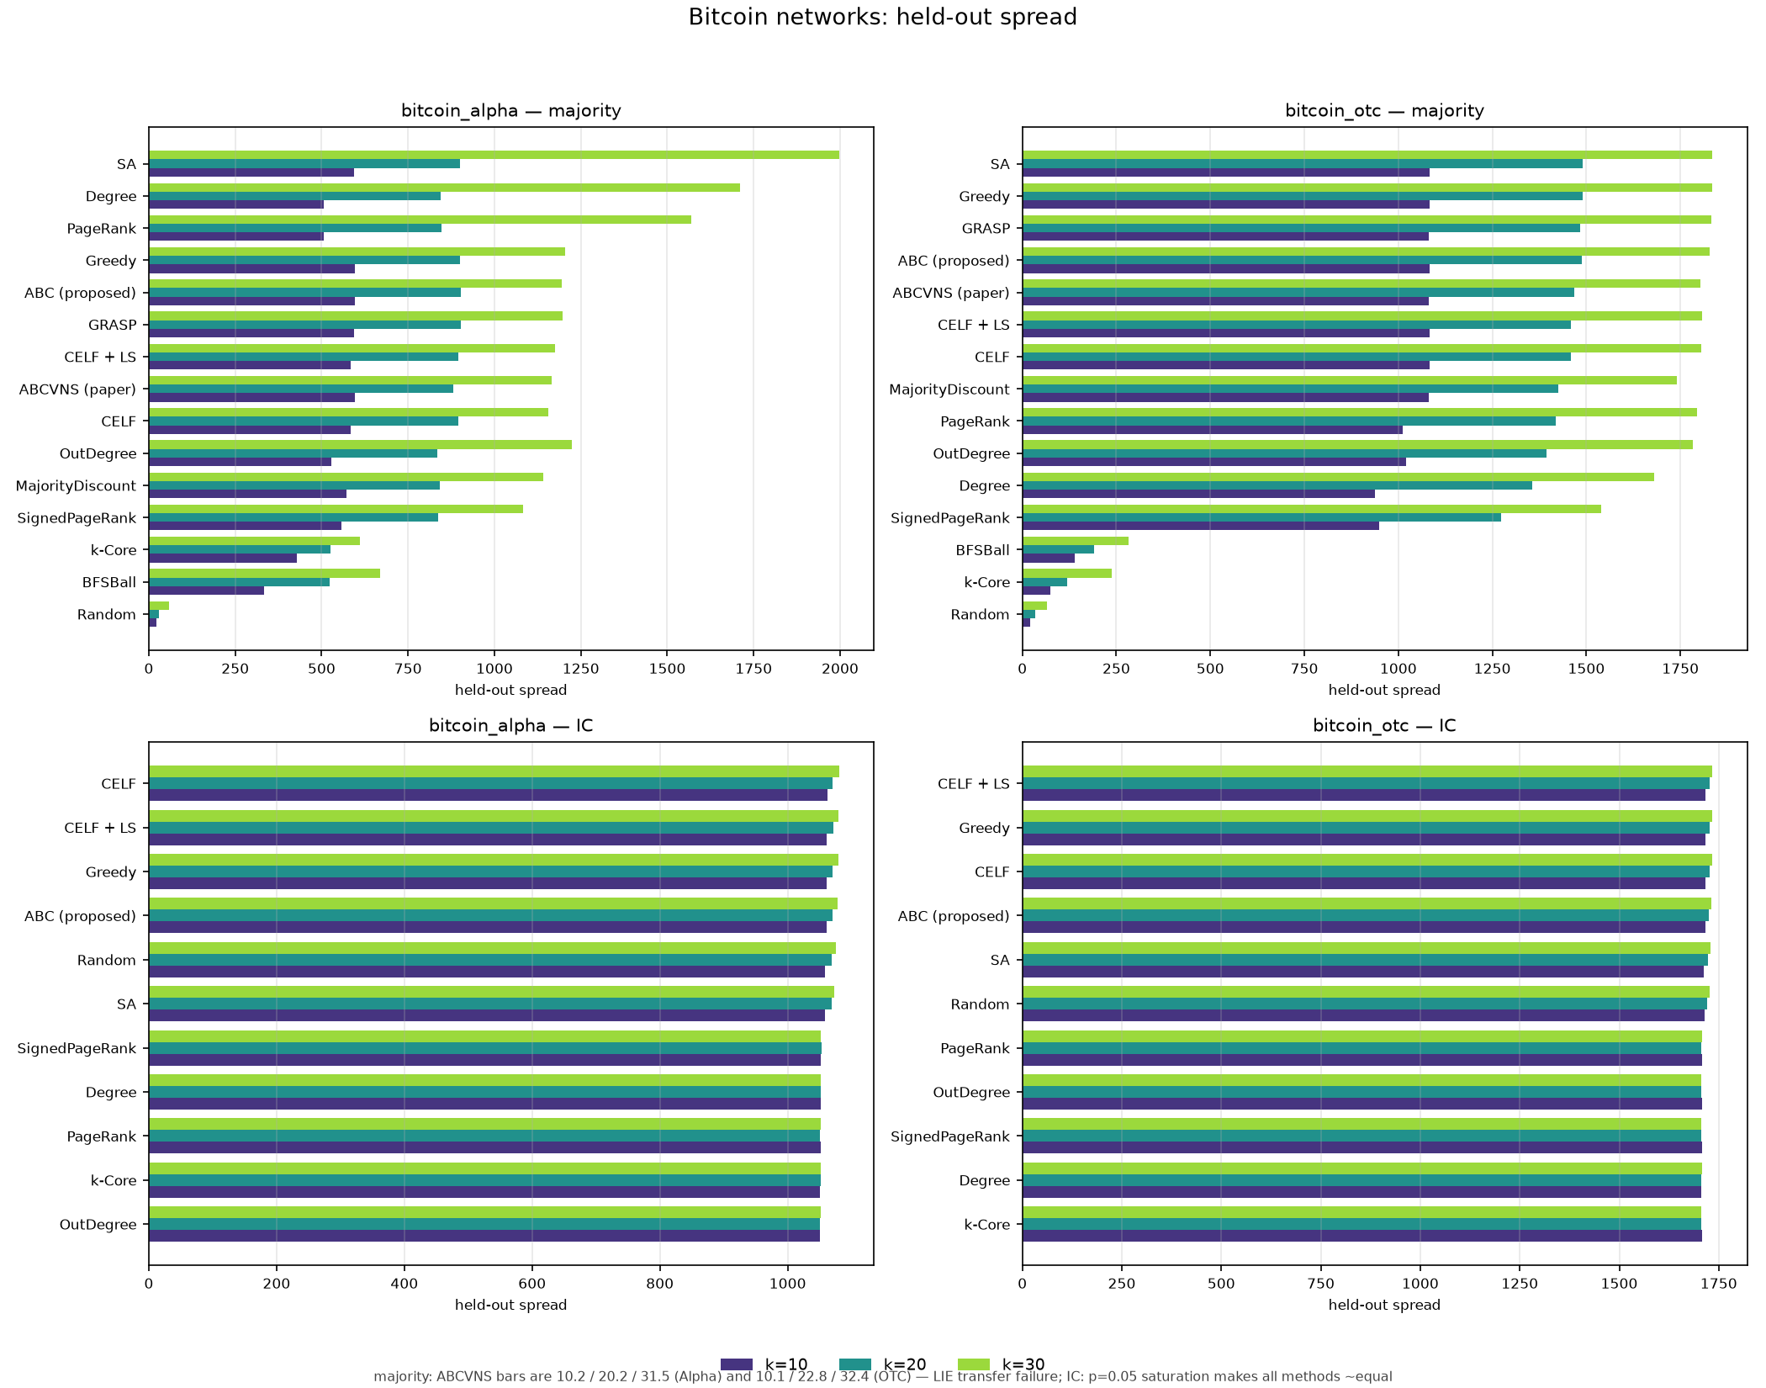
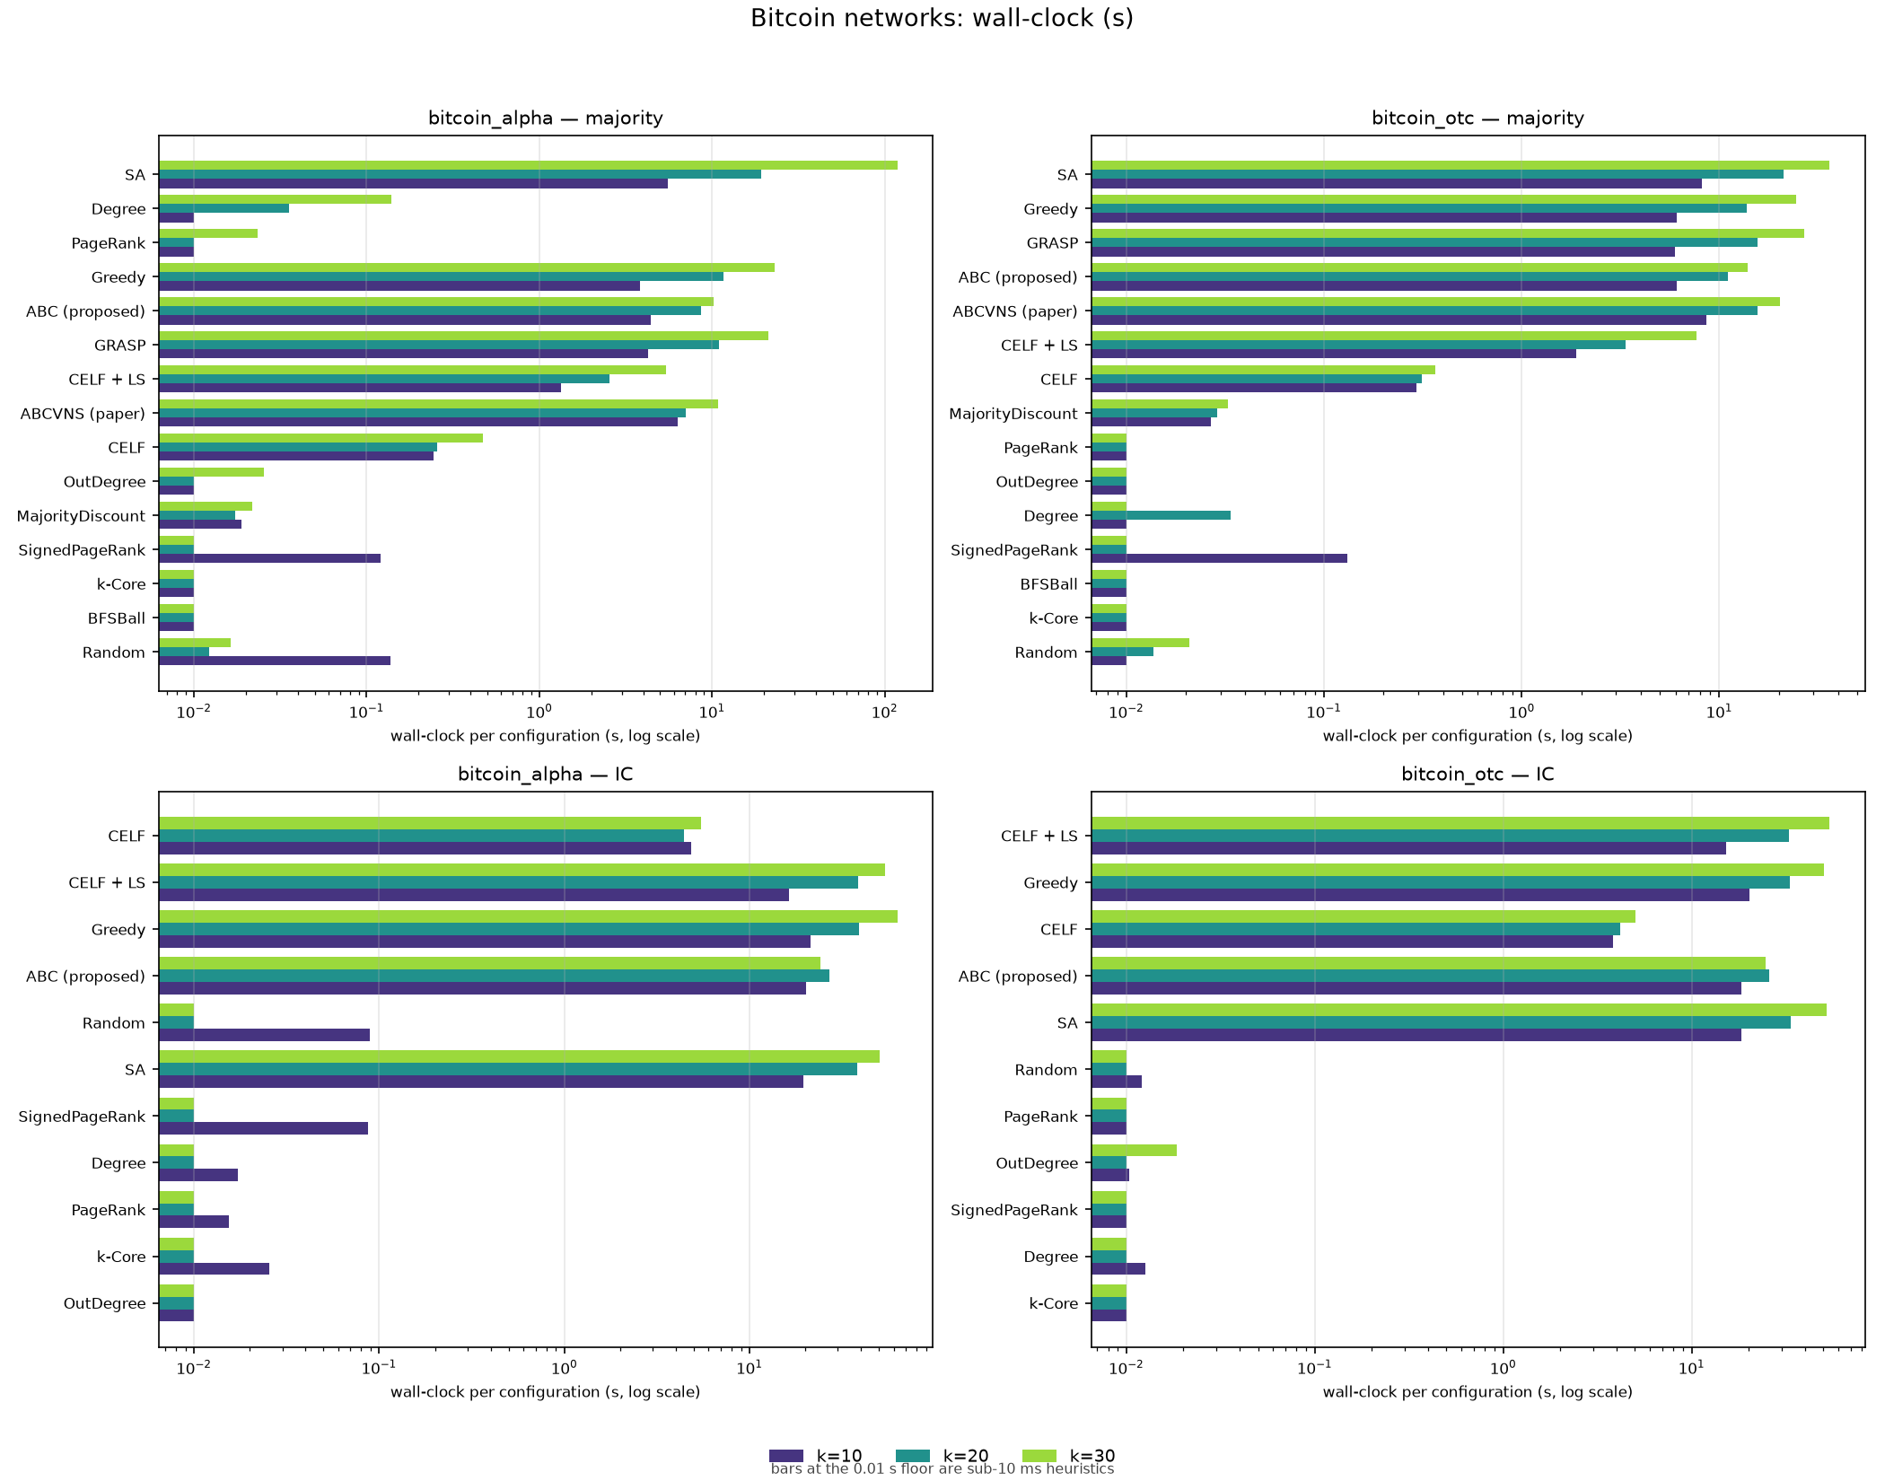
MEASURED RESULTS
Real networks — Bitcoin Alpha & OTC
Held-out spread
Wall-clock (log scale)
Unsigned majority rule (top) and Independent Cascade (bottom). ABCVNS-paper's LIE fails on majority; IC at p = 0.05 saturates, so all methods tie.

Slide 13
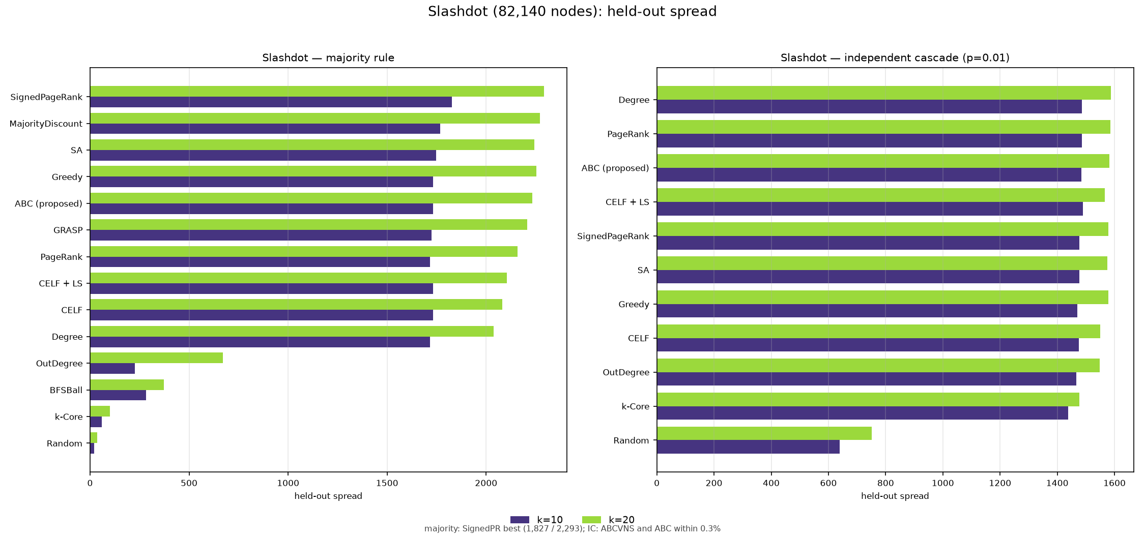
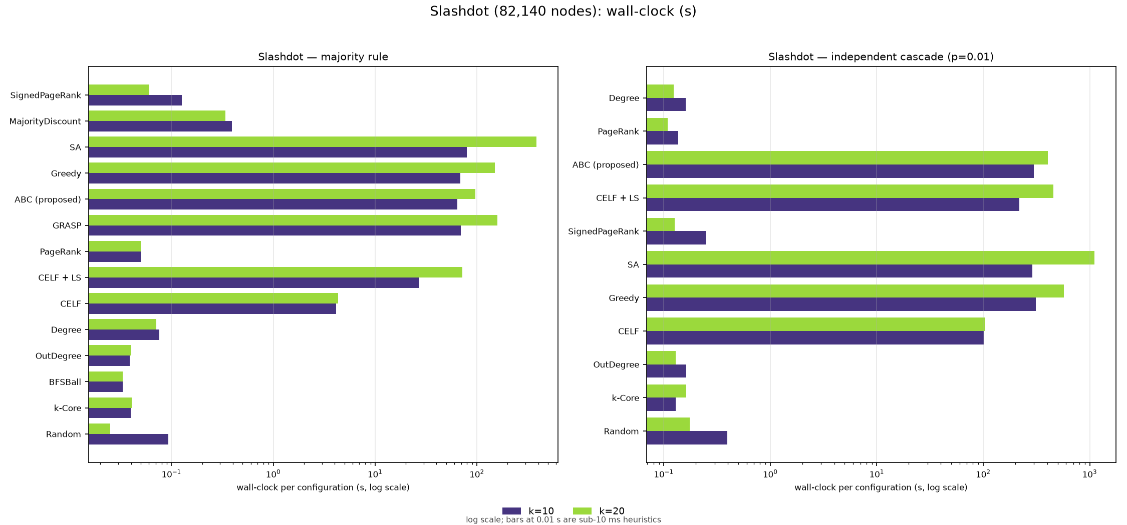
MEASURED RESULTS
Real networks — Slashdot (82,140 nodes)
Held-out spread
Wall-clock (log scale)
Majority rule and IC side by side. On Slashdot the cheap Signed-PageRank baseline beats ABC on majority; under IC, ABCVNS and ABC are within 0.3%.

Slide 14
NEXT STEPS
Future scope & optimisations
Fuse the two designs: drop ABCVNS's VNS tiers into ABC as its refinement operator — surrogate-free search with ABC's σ + λ·Φ fitness
Learned surrogates: fit a model-specific LIE-style estimator from MC traces (cheap per-eval fitness that tracks the actual model, per graph)
Sign-aware multi-objective fitness: maximise positive spread while explicitly penalising negative-spread activation
Theory: submodular envelopes / sandwich bounds for the signed majority model to give ABCVNS-style searches actual guarantees
Performance: batch the VNS candidate evaluations into single GPU kernels (removes the per-eval launch overhead), parallel restarts, adaptive restart allocation
Scale: exact betweenness + k = 100 on Slashdot-class graphs, temporal/dynamic signed edges, other dynamics (Linear Threshold, SIR)
Auto-configuration: per-graph tuning of colony size, gbest_prob, λ, and refine cadence (small meta-optimisation)

