Slide 1
TECHNICAL ANALYSIS
Influence Maximisation under the
Majority Rule Diffusion Model
Why the model is not submodular — and what that means for an
Artificial Bee Colony + CELF hybrid optimiser
September 2026

Slide 2
ROADMAP
What this deck covers
01
The claim we were asked to prove
02
Proof: monotone
— and why half of it is false
a clean two-line coupling argument
03
Disproof: not submodular
04
Consequence
counterexample + exhaustive verification
CELF breaks; the classical guarantee is void
05
The fix: ABC + CELF hybrid
06
Results
why it's motivated, not incidental
up to +273% spread, exact optimum on verifiable cases
Majority Rule Diffusion — ABC-CELF Study
1

Slide 3
THE CORRECTION
The brief asked to prove the model is
“submodular and monotone.”
MONOTONE
SUBMODULAR
TRUE
FALSE
Proved analytically by coupling; confirmed with zero violations across 2,000+ sampled pairs per configuration.
Disproved with a minimal counterexample and an exhaustive scan: 47–76% of coalitions violate diminishing returns.
Majority Rule Diffusion — ABC-CELF Study
2

Slide 4
THE MODEL
Majority-rule threshold diffusion
A node activates once
δ = 0.5
|{active neighbours of v}| > θᵥ · deg(v)
recovers Linear Threshold exactly
Deterministic majority
δ → 0
θᵥ = 1/2 (strict majority of neighbours)
recovers the deterministic majority rule
Stochastic majority (δ)
θᵥ ~ U[1/2−δ, 1/2+δ]
Linear Threshold (control)
One parameter spans “classic, submodular IM” to “strict majority rule.” This is what §6 sweeps.
θᵥ ~ U[0, 1] — known to be submodular
Majority Rule Diffusion — ABC-CELF Study
3

Slide 5
PROOF — PART 1
Monotonicity: σ(S) ≤ σ(T) whenever S ⊆ T
1
2
3
4
Fix
Induct
Step
Conclude
a threshold realisation θ and couple cascades started from S and T.
on time t: assume Aₜ(S) ⊆ Aₜ(T). True at t=0 since S ⊆ T.
if v activates under S at t+1, then |N(v)∩Aₜ(S)| > θᵥdeg(v); by hypothesis Aₜ(S)⊆Aₜ(T), so v also activates under T.
progressivity preserves the invariant forever, so |A∞(S,θ)| ≤ |A∞(T,θ)| pointwise — and in expectation.
Empirically verified: zero violations across 2,000+ randomly sampled (S, T) pairs, in every one of 18 (graph × variant) configurations tested.
Majority Rule Diffusion — ABC-CELF Study
4

Slide 6
PROOF — PART 2
Disproof: the swing-voter counterexample
Star graph K₁,₃: centre w needs 2 of its 3 neighbours active (strict majority).
S = ∅ → S ∪ {y}
x
σ({y}) − σ(∅) = 1.0
y alone cannot flip w
w
T = {x} → T ∪ {y}
σ({x,y}) − σ({x}) = 2.0
z
y
x and y together flip w — gain DOUBLES for the larger set
2.0 > 1.0 → increasing, not diminishing, returns. This is the signature of a majority rule, and it directly violates submodularity.
y = the swing voter under test
Majority Rule Diffusion — ABC-CELF Study
5

Slide 7
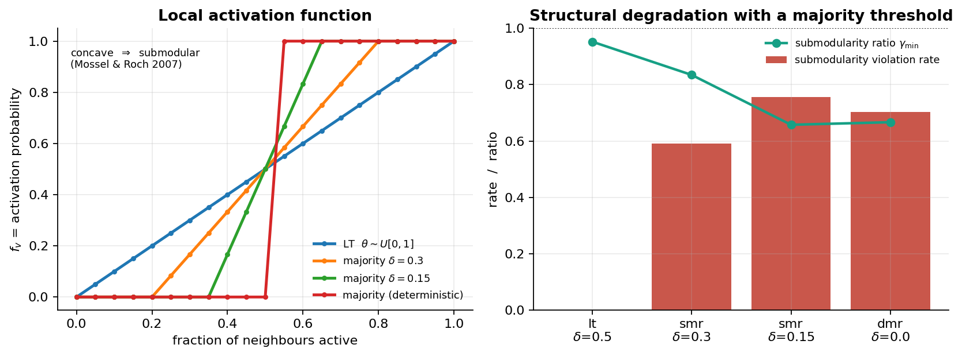
WHY IT FAILS
The structural reason: threshold CDF concavity
Mossel & Roch (2007): σ is submodular iff each node's local activation function is concave in the number of active neighbours. A majority requirement makes it S-shaped — convex on the lower stretch — which breaks that condition by construction.
Majority Rule Diffusion — ABC-CELF Study
6

Slide 8
VERIFICATION
Exhaustive verification across three graphs
Graph
Variant
Monotone
Violation rate
γmin
karate
LT (control)
✓
0.0%
0.992
karate
Majority (δ=0.15)
✓
68.7%
0.356
lesmis
LT (control)
✓
0.0%
0.958
lesmis
Majority (δ=0.15)
✓
60.4%
0.653
ba500
LT (control)
✓
0.0%
0.953
ba500
Majority (δ=0.15)
✓
75.7%
0.658
Green rows = Linear Threshold control, reporting exactly 0.0% — confirming the test methodology, not just the majority-rule result.
Majority Rule Diffusion — ABC-CELF Study
7

Slide 9
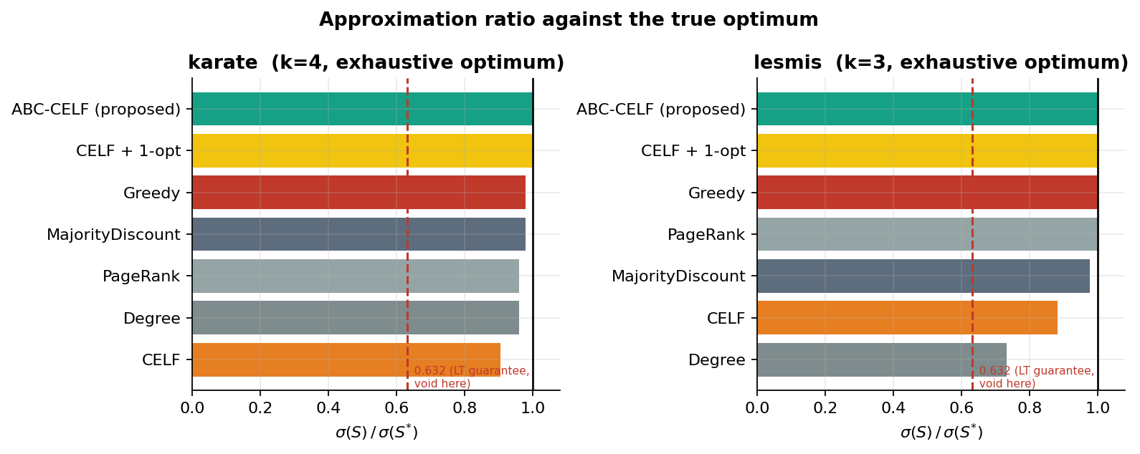
CONSEQUENCE
CELF specifically breaks — below plain greedy
89%
of CELF's lazy-pruning decisions on ba500 were invalid — a re-evaluated gain exceeded its stale bound, which submodularity forbids.
On karate (k=4), CELF (0.904) is the only method here to underperform a plain Degree ranking (0.959); on lesmis it trails Greedy's exact optimum by 12 points — both exhaustively verified against the true optimum.
The classical (1−1/e) ≈ 63.2% guarantee requires submodularity — it simply does not apply here.
Majority Rule Diffusion — ABC-CELF Study
8

Slide 10
THE METHOD
ABC + CELF: a hybrid matched to the problem
Greedy / CELF
Artificial Bee Colony
Ask “which single node adds the most spread right now?”
Searches whole size-k coalitions, not one node at a time.
Under a majority rule, singleton gains are near-zero almost everywhere — a node contributes nothing until a coalition around it is already big enough. Greedy is choosing among ties.
Sees exactly the coalition effects the model rewards — but has no local gradient, so it can waste evaluations on clearly bad single-node swaps.
Hybrid: ABC provides global coalition search; a CELF-style lazy-exchange 1-opt supplies the missing local gradient, run periodically to polish the incumbent. Population seeded with CELF + elitism ⇒ provably never worse than CELF alone.
Majority Rule Diffusion — ABC-CELF Study
9

Slide 11
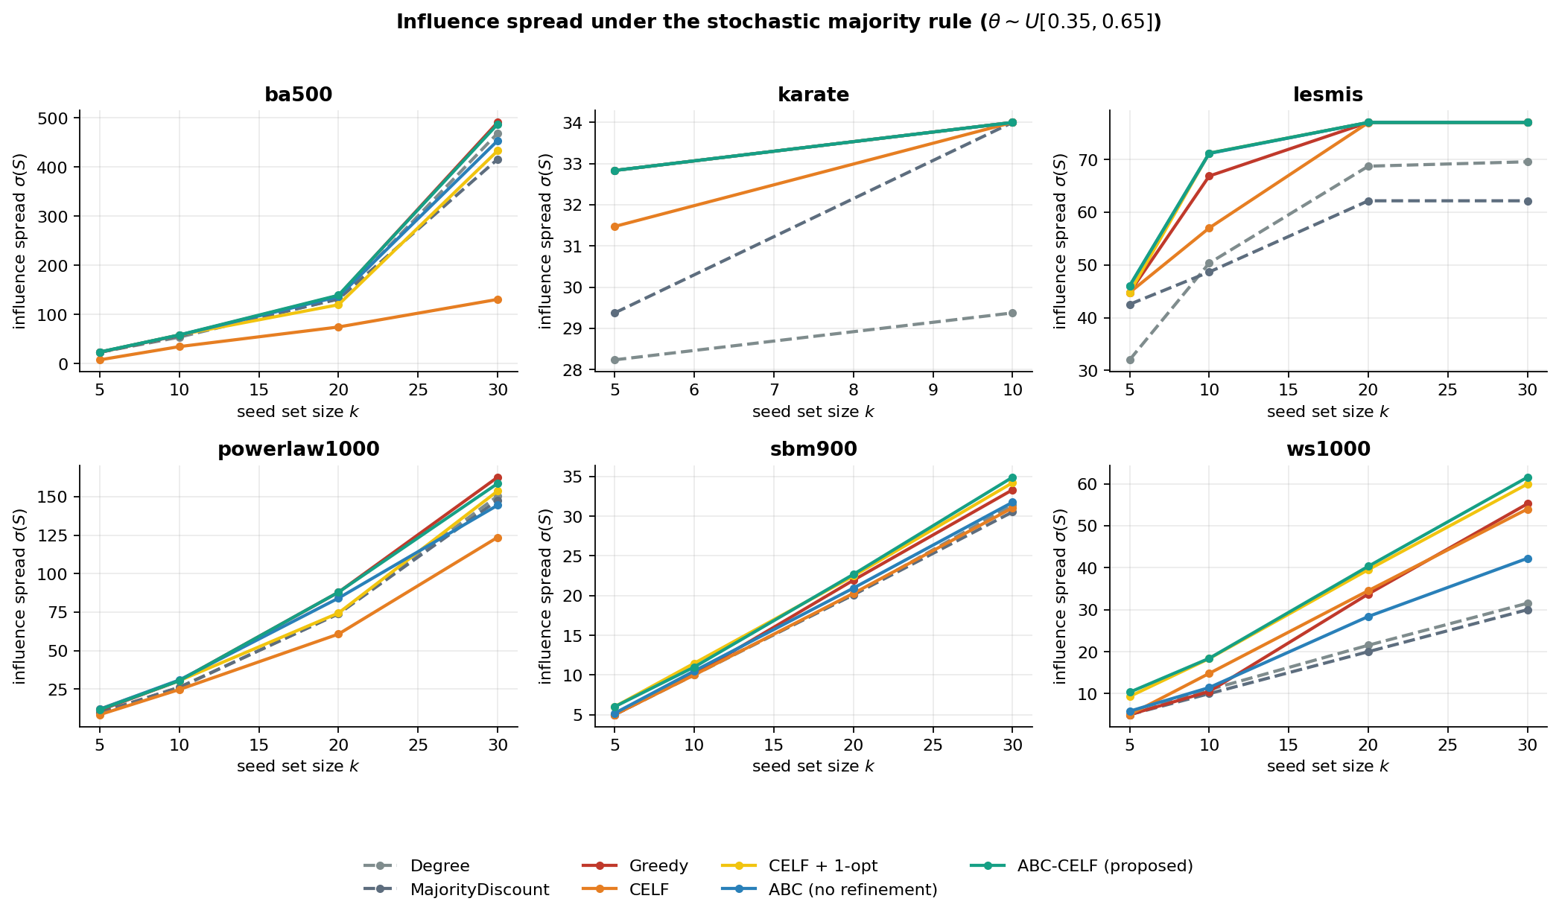
RESULTS
Spread across six graphs and seed-set sizes
Majority Rule Diffusion — ABC-CELF Study
10

Slide 12
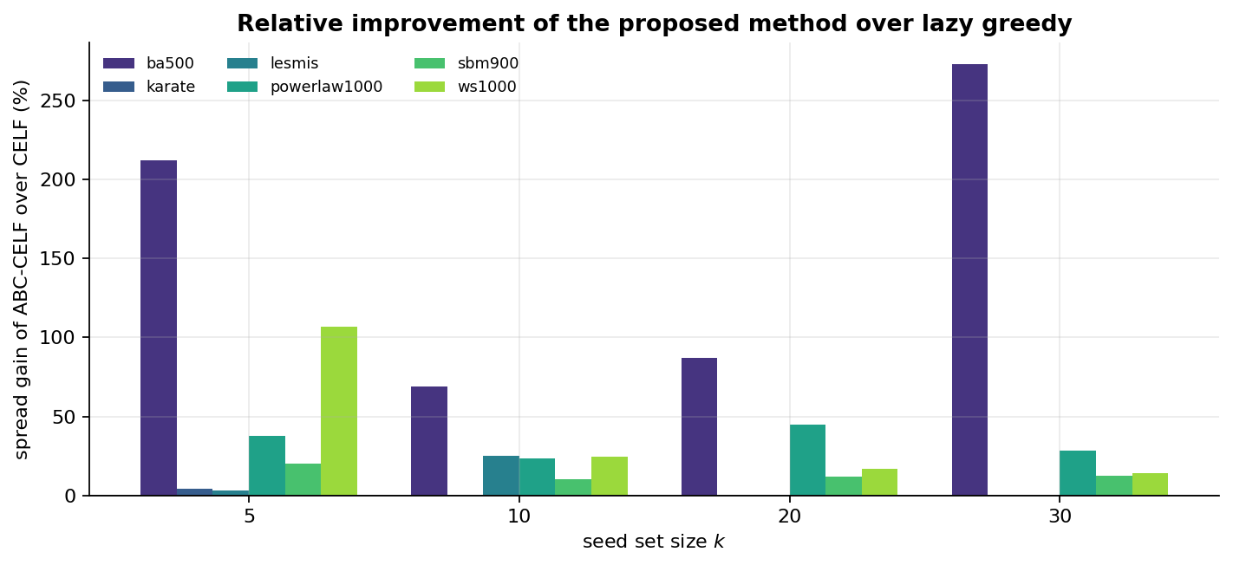
RESULTS
Where the improvement is largest
+273%
ba500, k=30
+46.5%
mean across 22 configs
+21.6%
median across 22 configs
Gains concentrate on hub-dominated (Barabási–Albert) graphs, where hubs need large coalitions to cross threshold — CELF's worst blind spot.
Majority Rule Diffusion — ABC-CELF Study
11

Slide 13
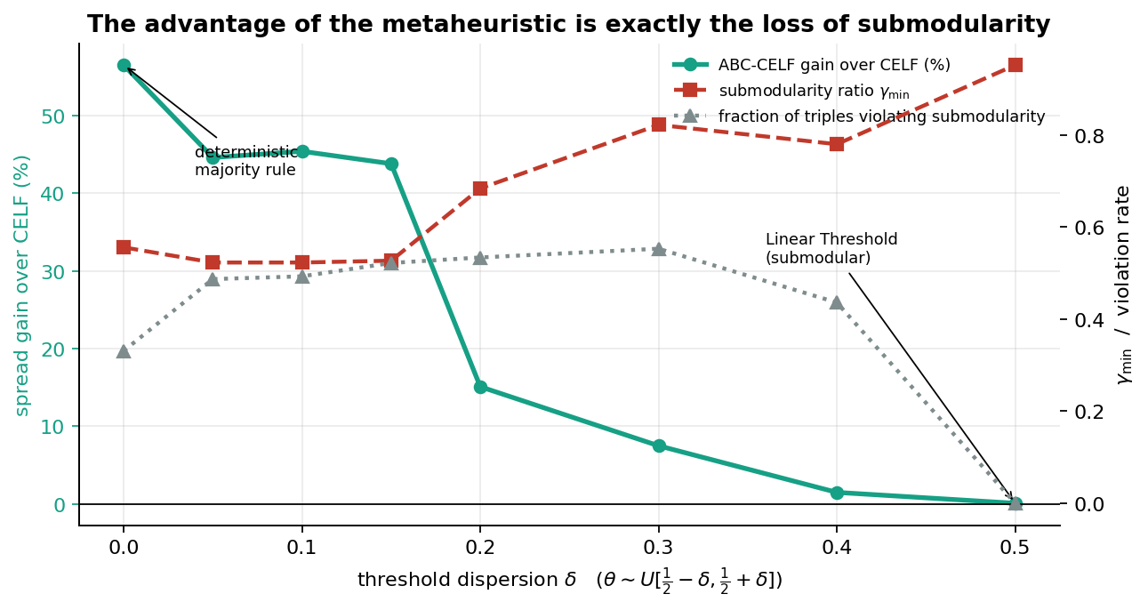
THE KEY EVIDENCE
The advantage tracks the loss of submodularity
+56.5%
gain at δ=0 (deterministic majority rule)
+0.1%
gain at δ=0.5 (Linear Threshold, submodular) — vanishes exactly where greedy's guarantee becomes valid again.
Majority Rule Diffusion — ABC-CELF Study
12

Slide 14
HONEST TRADEOFFS
The gain has a computational price
k
CELF evals
CELF time
ABC-CELF evals
ABC-CELF time
5
206
0.05 s
2,749
1.8 s
10
211
0.05 s
4,781
4.9 s
20
222
0.06 s
8,539
24.6 s
30
234
0.10 s
8,552
73.2 s
ba500, n=500. ABC-CELF uses 15–40× more σ-evaluations than CELF — justified where CELF fails badly; less so where CELF already performs well.
Recommendation: check the diffusion process is genuinely majority-like first (via the δ-sweep or a submodularity-ratio estimate) before paying the extra cost.
Majority Rule Diffusion — ABC-CELF Study
13

Slide 15
CONCLUSION
Prove monotone. Disprove submodular.
Optimise for the model you actually have.
Monotonicity proved; submodularity disproved with a minimal counterexample and exhaustive verification (0% on the LT control).
Mechanism identified: majority thresholds make the local activation function convex, not concave (Mossel & Roch, 2007).
CELF measurably breaks — 89% invalid pruning decisions on ba500, underperforming plain greedy and, on karate, a degree heuristic.
ABC-CELF is motivated by this structure: it searches coalitions where CELF sees only near-zero singleton gains.
The δ-sweep is the decisive evidence — the advantage tracks non-submodularity and vanishes exactly at the submodular limit.
Mean +46.5%, median +21.6% spread improvement over CELF across 22 configurations; exact optimum reached where verifiable.
Majority Rule Diffusion — ABC-CELF Study
14

