Slide 1
TECHNICAL ANALYSIS
Influence Maximisation under the
Majority Rule Diffusion Model
The model is monotone, not submodular — and that is why set-level search beats greedy
An Artificial Bee Colony optimiser with equal-budget, held-out evaluation
September 2026

Slide 2
THE CORRECTION
The brief asked to prove the model is
"submodular and monotone."
MONOTONE
SUBMODULAR
TRUE
FALSE
Proved by coupling; verified with zero violations across 5,800 sampled pairs in every (graph × variant) configuration.
Disproved by a K1,3 counterexample and exhaustive scans: 23–76% of non-degenerate triples violate diminishing returns.
Majority-Rule Diffusion — ABC Study
1

Slide 3
THE MODEL
Majority-rule threshold diffusion
A node activates once the count of active neighbours exceeds a threshold fraction of its degree:
Key property
|{active neighbours of v}| > θv · deg(v)
A neighbour is either worthless or decisive. Until a coalition reaches the majority threshold, singleton marginal gains are near zero — so greedy methods that look one node at a time are blind to the winning coalition.
Deterministic majority (dmr)
θv = 1/2
Stochastic majority (smr)
θv ~ U[1/2−δ, 1/2+δ]
Linear Threshold (control)
θv ~ U[0,1] — submodular
Majority-Rule Diffusion — ABC Study
2

Slide 4
PROOF — PART 1
Monotonicity: σ(S) ≤ σ(T) for S ⊆ T
1
2
3
4
Fix
Induct
Step
Conclude
a threshold realisation θ and couple cascades started from S and T.
on time t: assume At(S) ⊆ At(T). True at t = 0 since S ⊆ T.
if v activates under S at t+1, |N(v)∩At(S)| > θv deg(v); because At(S) ⊆ At(T), v also activates under T.
progressivity preserves the invariant forever; expectation keeps σ(S) ≤ σ(T).
Empirically verified: 0 violations across 5,800 sampled (S ⊆ T) pairs in 12 (graph × variant) configurations.
Majority-Rule Diffusion — ABC Study
3

Slide 5
PROOF — PART 2
Disproof: the swing-voter counterexample
Star graph K1,3: centre w needs 2 of its 3 neighbours active.
S = ∅ → S ∪ {y}
x
σ({y}) − σ(∅) = 1.0
y alone cannot flip w
w
T = {x} → T ∪ {y}
z
y
σ({x,y}) − σ({x}) = 3.0
x and y together flip w — gain triples for the larger set
y = the swing voter under test
Majority-Rule Diffusion — ABC Study
4

Slide 6
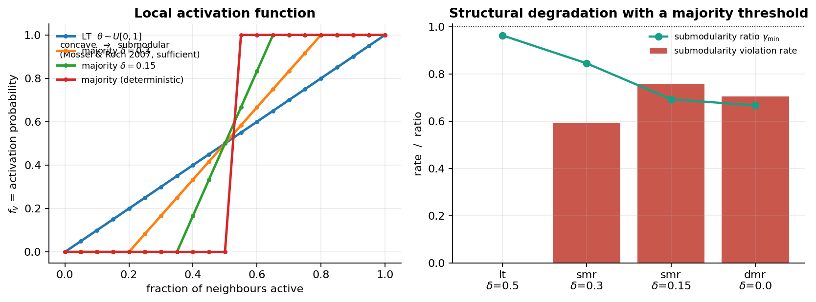
WHY IT FAILS
Threshold CDF concavity breaks submodularity
Mossel & Roch (2007): σ is submodular only if every local activation function is concave in the active-neighbour count. A majority requirement makes it S-shaped — convex on the lower stretch — breaking that condition by construction.
Majority-Rule Diffusion — ABC Study
5

Slide 7
VERIFICATION
Exhaustive verification across graphs
Graph | Variant | Monotone | Non-deg. violations | γmin
karate | LT (control) | ✓ | 0.0% | 0.992
karate | Majority (δ=0.15) | ✓ | 68.7% | 0.345
lesmis | LT (control) | ✓ | 0.0% | 0.967
lesmis | Majority (δ=0.15) | ✓ | 60.4% | 0.653
ba500 | LT (control) | ✓ | 0.0% | 0.963
ba500 | Majority (δ=0.15) | ✓ | 75.7% | 0.693
Green rows = Linear Threshold control. Its clean 0.0% violation rate calibrates the test, confirming that majority-rule violations are real, not noise.
Majority-Rule Diffusion — ABC Study
6

Slide 8
CONSEQUENCE
CELF's lazy bound is wrong half the time
50.2%
16 / 17
13 / 17
lazy-bound violations over all CELF runs
418 of 832 re-checks
configs where CELF differs from exact Greedy
configs where CELF is strictly worse
The collapse on hub graphs (ba500, k = 30, held-out)
CELF loses to a trivial degree ranking. The +273% gap is CELF's collapse, not ABC's miracle — gains against CELF should be read this way.
Majority-Rule Diffusion — ABC Study
7

Slide 9
THE METHOD
ABC: upgrades chosen by a leave-one-out ablation
Weak exploitation | gbest-guided partner (p = 0.6) | only operator that matters
Roulette convergence | tournament selection (size 4) | kept
Blind scouts | directed scouts near incumbent | kept
Fixed perturbation | n_mod swaps + mutation | kept
Duplicate sources | deduplication | kept
Plateau rigidity | Φ tie-break + accept-equal + random moves | neutral
Refinement budget | removed — it hurt (LOO) | REMOVED
1-opt can't repair coalitions | 2-swap + cascade-aware candidates | in CELF+LS
Leave-one-out ablation (Δ held-out)
Final method = CELF-seeded, gbest-guided population search with no refinement phase. Elitism guarantees it is never worse than CELF.
Majority-Rule Diffusion — ABC Study
8

Slide 10
METHODOLOGY
Equal budgets, held-out scoring, graph = unit
01
Equal budget
02
Held-out scoring
03
Graph = unit
Every budgeted solver is capped at Greedy's cost: k × |pool| fresh cascade evaluations. Audit: 0 budget violations across 532 runs.
Final seed sets are re-scored on 1,000 independent threshold draws. ABC in-sample − held-out gap: +0.13 (worst +4.4) — not an overfitting artefact.
Spreads are averaged over k within each graph before testing. Wilcoxon signed-rank + cluster-bootstrap CIs treat the graph, not the (graph,k) row, as the statistical unit.
04
Pre-specified primary
05
Baselines isolate the claim
One declared primary comparison: ABC vs Greedy on 16 WS graphs. Nine family tests → Bonferroni threshold 0.0056.
Zero-MC: Degree, PageRank, k-Core. Marginal: Greedy, CELF, CELF+LS. Set-level: ABC, SA, GRASP.
Majority-Rule Diffusion — ABC Study
9

Slide 11
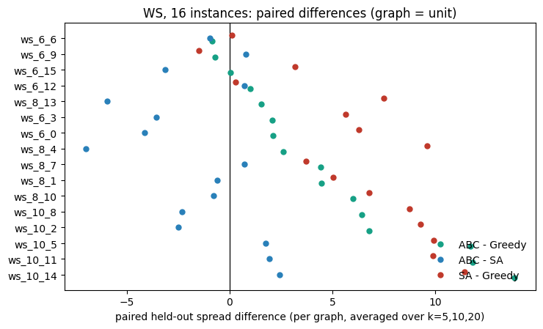
PRIMARY RESULT
ABC beats Greedy on 16 independent WS instances
Comparison | Mean diff | Wins | p
ABC − Greedy (primary) | +4.57 | 14/16 | 3.1e-4
SA − Greedy | +5.99 | 15/16 | 1.5e-4
ABC − SA | −1.41 | 6/16 | 0.093
ABC − CELF | +2.69 | 16/16 | 3.1e-5
mean ABC − Greedy 95% CI: [+2.46, +6.91]; p = 3.1×10⁻⁴ passes Bonferroni.
SA ≥ ABC is stated plainly, not buried. ABC's contribution is budget efficiency and a ≥CELF guarantee, not superiority over every set-level searcher.
Majority-Rule Diffusion — ABC Study
10

Slide 12
OTHER FAMILIES & REGIME
Where the advantage lives
Family means on WS
ABC − Greedy gain vs (k − k*)
+64.6%
+23.0%
≈ 0
mean relative gain below k*
at and above k*
on BA: Greedy already cascades at k = 5
Majority-Rule Diffusion — ABC Study
11

Slide 13
BUDGET & COST
ABC reaches its ceiling at 1× budget; SA needs 4×
Wall-clock per config
Majority-Rule Diffusion — ABC Study
12

Slide 14
THE Δ-SWEEP — AND ITS CONFOUND
Advantage vs threshold dispersion: real, then a caution
ws1000: large for δ ≤ 0.2, gone beyond
ba500: only vs CELF tracks δ; vs Greedy is a wash
Confound, controlled: partial correlation removing δ kills every association (p ≥ 0.31). The structural claims rest on the proof, scans and CELF audit — not on this sweep.
Majority-Rule Diffusion — ABC Study
13

Slide 15
SIGNED GRAPHS
A real extension — and a control for the plateau
Non-monotonicity witness
Sign-ablation control
σ({1,2,3,4}) = 6 > σ({1,2,3,4,5}) = 5
Seeding an enemy leaf blocks the hub: a larger seed set can have smaller influence.
17.6
17.7
15.4
14.6
ABC mean
SA mean
Greedy
CELF
The ABC-vs-Greedy advantage persists — and grows — when signs are removed. The plateau effect, not the signs, drives the gain.
Majority-Rule Diffusion — ABC Study
14

Slide 16
IMPLEMENTATION STORY
From the first implementation to the final submission
Original implementation
Shortcomings found
Fixes / optimisations
Where we failed
Final submission
Standard Greedy + CELF pipeline, Linear Threshold assumptions, graph as (n,k) row, budgets not audited, no held-out scoring.
CELF lazy-bound failed 50% of re-checks; submodularity false; small-graph wins vanished under equal budgets and fresh thresholds.
Equal-budget protocol, held-out scoring, graph = statistical unit. Canonical ABC → gbest-guided, tournament, directed scouts, dedupe, Φ tie-break, CELF-seeded population. Refinement removed; ABC-CELF kept only as ablation.
Φ as global fitness hurt; Greedy+Φ trailed Greedy; Metropolis variant stayed below SA; δ-sweep correlation confounded; "signed gives ABC a distinct advantage" rejected by sign-ablation control.
Monotone proof + non-submodular witness + CELF audit + LOO-selected ABC + honest equal-budget evaluation (WS/BA/SBM) + signed extension. ABC is a budget-efficient, guarantee-carrying set-level searcher — not the best possible one.
Majority-Rule Diffusion — ABC Study
15

Slide 17
CONCLUSION
Five claims that survive scrutiny — and three that don't
What the evidence supports
1. The model is monotone (proved) and not submodular (witnessed, scanned, explained via Mossel–Roch).
2. CELF breaks: 50.2% lazy violations; differs from Greedy in 16/17 configs, strictly worse in 13/17.
3. On sparse clustered graphs below the contagion threshold, set-level search beats Greedy: +4.6 held-out on 16 WS; ties on BA; beats CELF everywhere.
4. ABC is a valid set-level searcher — budget-efficient (ceiling at 1× vs SA's 4×), ≥CELF guarantee, CV 1.7%.
5. The signed extension adds the model and a non-monotonicity witness — no distinct search advantage.
What not to claim
✗ “ABC is the best set-level searcher” — SA ≥ ABC on WS and BA.
✗ “The advantage tracks submodularity” — the δ-sweep correlation is confounded.
Majority-Rule Diffusion — ABC Study
16
✗ “Signed graphs need ABC specifically” — sign-ablation control shows it is the plateau effect.

Slide 18
FUTURE SCOPE
Limitations and what comes next
Current limitations
Next steps
Final framing
Absolute effects are small (<1% of n among top methods). BA/SBM evidence is exploratory (n=8). Ceiling certification rests on budget-insensitivity; sandwich bound is vacuous at this scale. Candidate pool capped at 200 nodes on large graphs.
Real-network signed tests (Epinions, Slashdot, Bitcoin-Alpha, ego-Facebook, email-Eu-core). Tighter ceiling certification. Budget-aware k selection relative to contagion threshold k*. Extend the audit to other non-submodular diffusion families.
The submission shows that for majority-rule diffusion on sparse, clustered graphs, coalitions carry the influence and a carefully audited set-level searcher is a sound, defensible choice.
Majority-Rule Diffusion — ABC Study
17

