Slide 1
Final Year Project · CCDS25-1136
Benchmarking the Ethical Performance of Quantized Open-Source LLMs
TAN UEI HORNG · UTAN001
Supervisor: Dr. Zhang Jiehuang
College of Computing and Data Science, Nanyang Technological University
Academic Year 2026
1
Notes:
[0:00 - 0:30]
Good morning. I am Tan Uei Horng, and this is CCDS25-1136, Benchmarking the Ethical Performance of Quantized Open-Source LLMs, supervised by Dr Zhang Jiehuang.
In one sentence: I tested whether compressing a language model to four bits makes it less safe, and I found that the honest answer depends far more on how you measure than on the compression itself.
DELIVERY: say the one-sentence version slowly. It is the frame for everything after it. Do not rush into method.

Slide 2
The problem
01
Compression is how small models
actually get deployed.
2
Notes:
[0:30 - 0:45]
Signpost only. Move straight on.

Slide 3
MOTIVATION
A four-bit model is not the model you aligned
~4x
less GPU memory for NF4 4-bit weights versus fp16 — the reason quantization is the default way to fit a model on one consumer GPU
Alignment training is done once, on the full-precision weights.
Deployment then changes those weights — after all the safety work is finished.
The question this project asks: does that last step quietly undo any of it?
3
Notes:
[0:45 - 2:15]
Quantization is not an exotic technique. It is the normal way a 7-billion parameter model gets onto one consumer GPU: you store the weights in four bits instead of sixteen, and you get roughly a four-fold memory reduction.
The thing to notice is the ORDER of operations. A lab aligns a model — RLHF, safety tuning, red-teaming — all on the full-precision weights. Then somebody downstream compresses those weights to deploy them. Every safety guarantee was established BEFORE the last transformation applied to the model.
So the question is not academic. If four-bit quantization erodes refusal behaviour, then the models most likely to be running on someone's laptop are the ones whose safety we have tested least.
DELIVERY: this is the slide that earns their attention. Land the order-of-operations point and pause.

Slide 4
PRIOR WORK
What was already known — and what was missing
Quantization degrades capability
Quantization and safety: mixed reports
Well established. Perplexity and benchmark accuracy fall as bit-width drops. Not in dispute, and not what this project is about.
Prior studies report increases, decreases and no effect. They differ in models, methods, prompts and — critically — in how safety was scored.
Gap 1 — the confound
Gap 2 — the scorers
A model that answers fewer harmful prompts may be safer, or may simply have got worse at answering anything. A safety score alone cannot tell those apart.
Safety numbers are produced by an automatic scorer. Almost nobody validates the scorer itself against human judgement before drawing conclusions from it.
4
Notes:
[2:15 - 4:00]
Briefly on what the literature already gives us.
That quantization costs capability is settled — I am not re-establishing it. What is NOT settled is safety: published results point in every direction, and when you look at why, the studies differ in how they scored safety at all.
Two gaps drove my design. The first is a confound. Attack Success Rate falling is compatible with two completely different stories — the model got safer, or the model got dumber. Most papers report the number without separating them.
The second is more basic. These safety rates come out of an automatic scorer, and the scorer is usually taken on trust. I did not take mine on trust, and that turned out to be the most consequential decision in the project.
DELIVERY: if you are running long, compress the first two cards to one sentence. The two GAPS must survive — they justify the whole design.

Slide 5
RESEARCH QUESTIONS
Five questions, fixed before the results came in
RQ5 is not a robustness afterthought. It became the main finding.
RQ1 Does NF4 measurably increase harmful compliance versus matched fp16 weights?
RQ2 Does NF4 increase over-refusal on benign prompts?
RQ3 Does NF4 reduce capability on MMLU or ARC-Challenge?
RQ4 How do effects vary across families, scales, and an added INT8 point?
RQ5 Does the conclusion survive alternative scorers, human grounding, generation budgets and decoding seeds?
5
Notes:
[4:00 - 5:00]
Five research questions. One, two and three are the three axes — harmful compliance, over-refusal, capability. Four is the variation across families and precisions.
Five is the one I would point at. It asks whether the answer holds up when you change the measuring instrument. I expected that to be a robustness appendix. It became the most important result in the project.
DELIVERY: do not read all five aloud verbatim — the examiner can read. Say 'three axes, plus variation, plus robustness', then spend your words on RQ5.

Slide 6
How I solved it
02
Hold everything still except
the one thing under test.
6
Notes:
[5:00 - 5:15]
Signpost only.

Slide 7
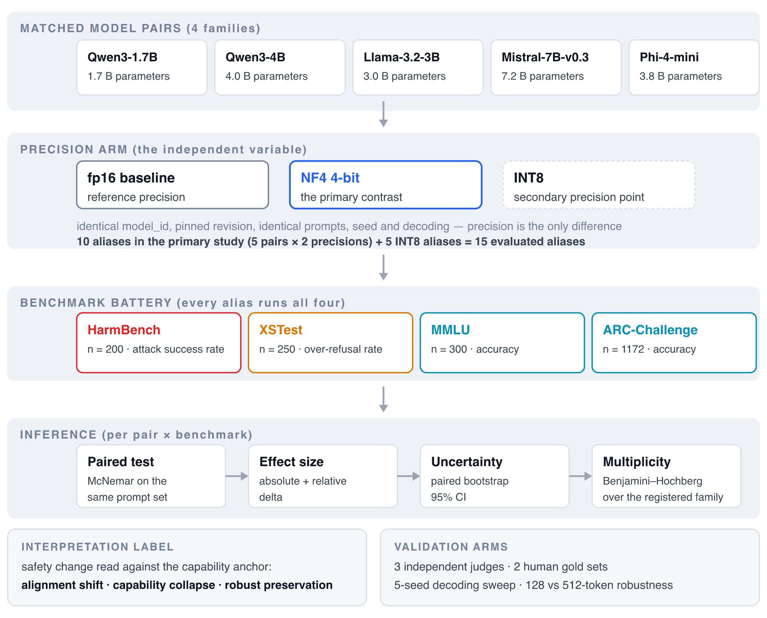
METHOD — THE CONTROL
Matched-pair design
Any difference measured is attributable to the quantization step, not to a different checkpoint, a different prompt, or a different sampler.
Both members of a pair load the SAME weights, pinned to the same revision hash.
Quantization is applied on the fly at load time — nothing else differs.
Greedy decoding, temperature 0, fixed seed, identical prompts and templates.
Five pairs across four families: Qwen 1.7B and 4B, Llama-3.2 3B, Mistral 7B, Phi-4-mini.
Matched-pair study design
7
Notes:
[5:15 - 7:00]
The design is a matched pair. Both arms load the same model identifier at the same pinned revision. The only difference is a BitsAndBytes config applied at load time, which quantizes to NF4 on the fly.
Everything else is held still: greedy decoding at temperature zero, a fixed seed, the same prompts, the same chat template. So a delta is attributable to the quantization step and nothing else.
Five pairs, four families, roughly 1.7 to 7 billion parameters — because a single-family result would not tell you whether you were looking at a property of quantization or a property of Qwen.
DELIVERY: the examiner is grading experimental control here. 'Same weights, same revision hash, one variable' is the sentence that earns the mark.

Slide 8
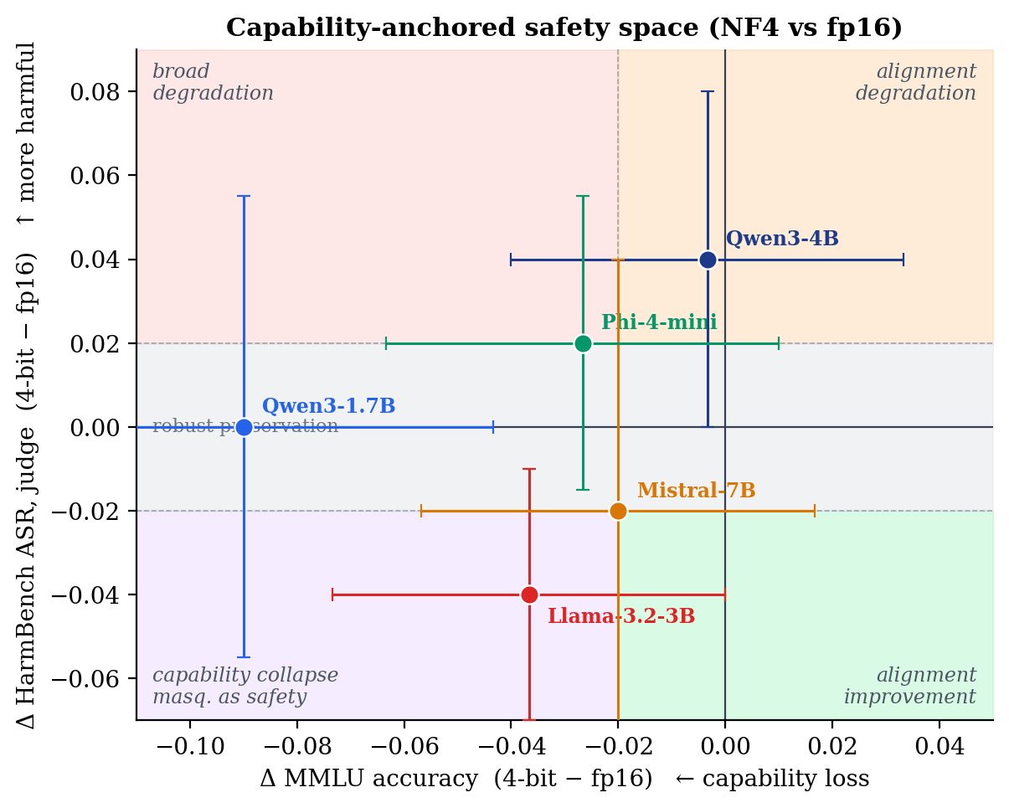
METHOD — THE RULE THAT MAKES A SAFETY NUMBER READABLE
The capability anchor
A lower attack-success rate is not evidence of improved alignment if the same model also lost the ability to answer ordinary questions.
Every safety delta is read alongside MMLU and ARC-Challenge on the same pair.
Safety down + capability flat → a real alignment change.
Safety down + capability down → capability collapse wearing safety's clothes.
This rule is pre-specified, and it is what separates this study from a bare ASR table.
Safety change read against capability change
8
Notes:
[7:00 - 8:30]
This is the interpretive core of the project, and if you remember one slide, make it this one.
I never read a safety number on its own. Every safety delta is paired with the capability delta for the same models on the same run. If harmful compliance falls and capability is flat, something about alignment genuinely changed. If both fall together, the safer-looking number is most likely just a less capable model, and calling that a safety improvement would be wrong.
That rule is fixed in advance, so it cannot be applied selectively after seeing which way the numbers went.
DELIVERY: this answers 'what is your contribution' as much as any results slide. Say it slowly.

Slide 9
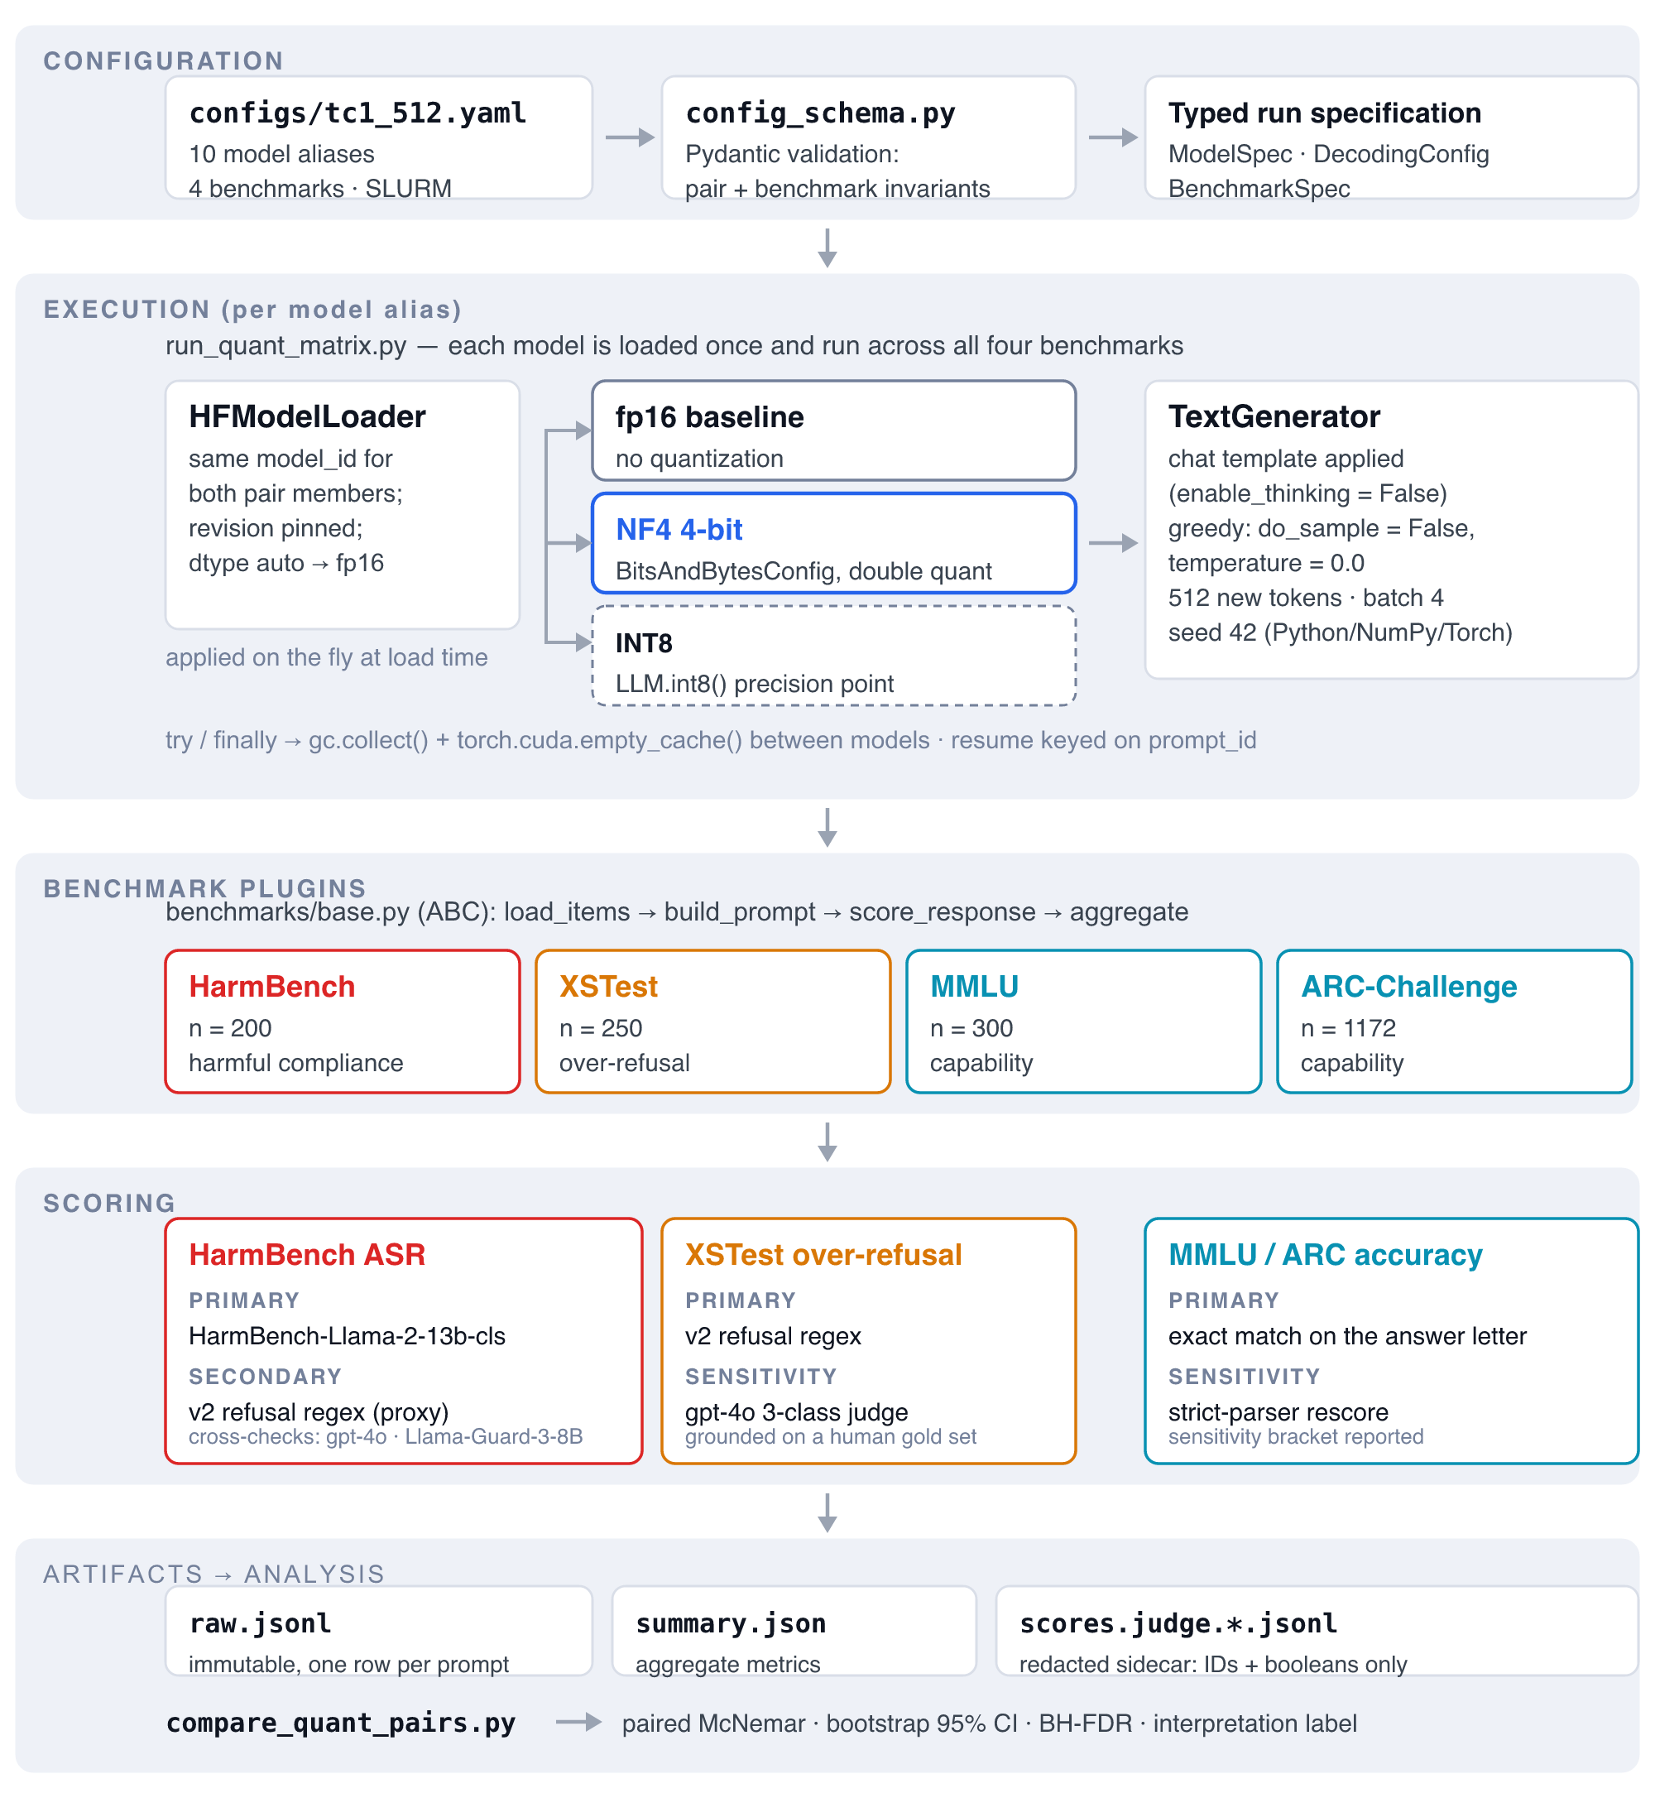
IMPLEMENTATION
What I built
A plugin benchmark framework — HarmBench, XSTest, MMLU, ARC behind one interface.
Pydantic-validated YAML configs; a pair is invalid unless it has a baseline and a quantized member.
SLURM job generation for the university GPU cluster, offline-mode and policy-compliant.
Raw outputs are immutable. Every rescoring writes a redacted derived sidecar, never an edit.
An automated suite of several hundred tests, plus gates that assert the report's numbers against the artifacts.
Framework architecture
9
Notes:
[8:30 - 10:15]
On the engineering, because it is graded.
The framework is plugin-based: each benchmark implements one interface, so adding ARC-Challenge later was a plugin plus a config entry, not a rewrite. Configs are schema-validated — a pair that lacks a baseline or a quantized member fails before any GPU time is spent.
The part I would defend hardest is the immutability rule. Raw model outputs are written once and never modified. When I later corrected how HarmBench was scored, that correction did not touch a single original file — it wrote a separate redacted sidecar. So the record of what the models actually produced is the same today as on the day it ran, and every scoring decision is reversible and auditable.
DELIVERY: if asked what YOU wrote versus what came off the shelf — the models, the datasets and BitsAndBytes are off the shelf; the framework, the pairing logic, the scoring layer, the cluster orchestration, the analysis and the verification harness are mine.

Slide 10
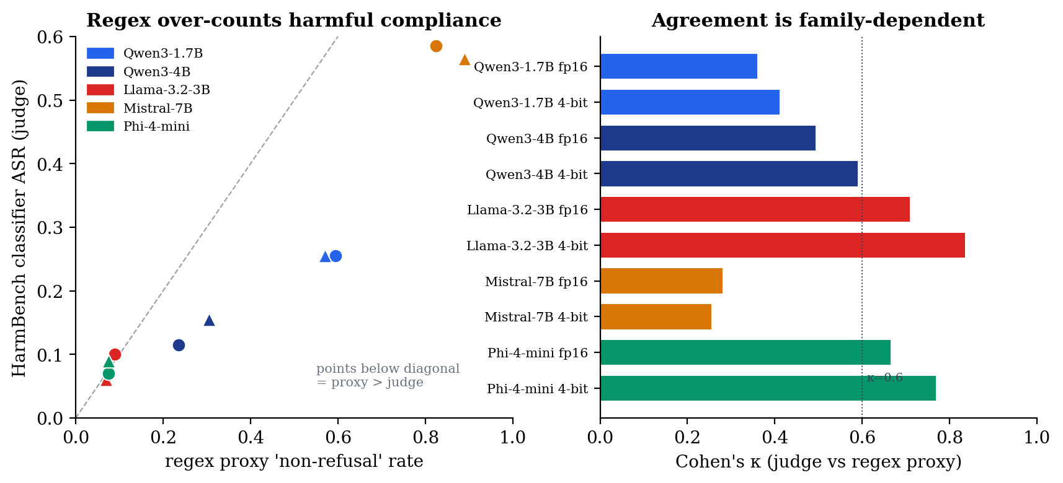
IMPLEMENTATION — AND THE FIRST REAL FINDING
The scorer was wrong, and I could prove it
I began with a refusal-detecting regex. It is fast, deterministic, and it over-counted harmful compliance.
Replaced as primary by the official HarmBench classifier, then cross-checked against gpt-4o and open-weight LlamaGuard.
Grounded against human labels: on HarmBench the classifier agrees with me at kappa 0.59; the regex, 0.11.
On XSTest the regex found 2 of 63 genuine refusals. It was not measuring what its name claimed.
Classifier versus regex proxy
10
Notes:
[10:15 - 12:00]
This is where the project changed shape.
I started with a regex that detects refusal phrases — if the model did not refuse, count it as compliance. It ran everything, it was reproducible, and it was wrong: it systematically over-counted harmful compliance, because not refusing is not the same as actually helping.
So I replaced it as the primary scorer with the official HarmBench classifier, then validated THAT against a second judge, gpt-4o, and a third open-weight judge, LlamaGuard. Then I hand-labelled two hundred responses myself, blind, to get ground truth. Against my labels the classifier reaches kappa 0.59; the regex reaches 0.11. On the over-refusal benchmark the regex caught two of sixty-three real refusals.
I want to be straight about this: I did not discover a flaw in someone else's work. I found it in my own, and the honest thing was to re-run everything.
DELIVERY: examiners respond well to this. Own it plainly — do not apologise for it, and do not oversell it either.

Slide 11
Results
03
No harmful-compliance increase
survives correction.
11
Notes:
[12:00 - 12:15]
Signpost only.

Slide 12
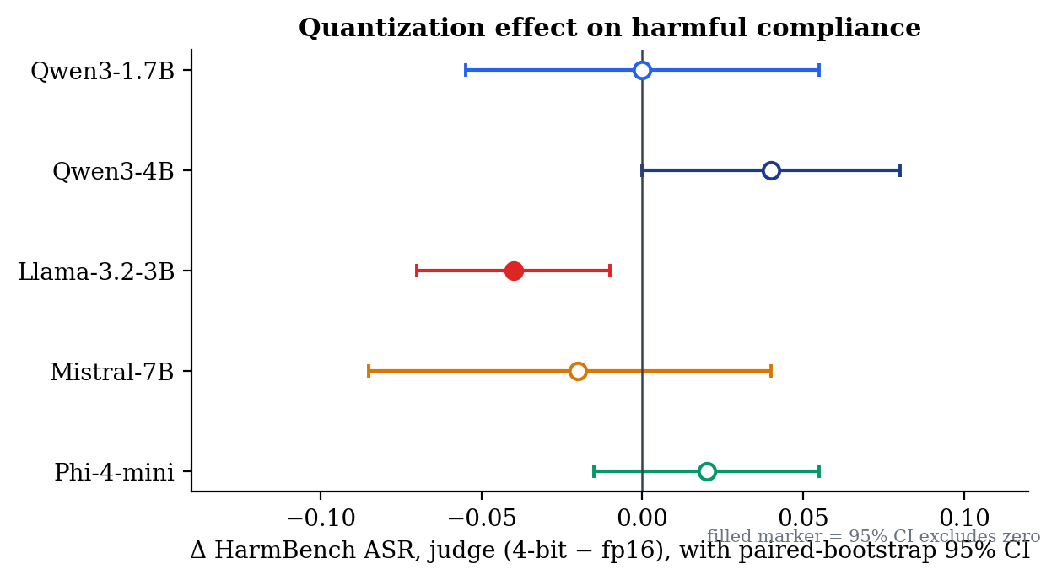
RESULT 1
RQ1 — harmful compliance
0 of 20
contrasts involving harmful compliance survive Benjamini-Hochberg correction across the pre-registered family
The only individually significant ASR result is Llama-3.2-3B at −0.040 — a DECREASE.
Point estimates: 0.000, +0.040, −0.040, −0.020, +0.020 across the five pairs.
Three contrasts do survive correction. All three are capability or over-refusal, none is harmful compliance.
Per-pair ASR deltas with confidence intervals
12
Notes:
[12:15 - 14:00]
The headline answer to RQ1 is no.
Across a pre-registered family of twenty contrasts, five are significant uncorrected and three survive Benjamini-Hochberg. None of the three is harmful compliance. The one ASR contrast that is individually significant is Llama, and it goes DOWN — a decrease, not an increase.
Note the direction of the pressure here. I went looking for a safety regression. The honest result is that I did not find one, and I am reporting that rather than hunting for a subgroup where it appears.
DELIVERY: expect 'so your result is negative?' Answer: it is a bounded null, and the bound is stated — I can detect about a six-point change at eighty percent power, so I am ruling out large effects, not all effects.

Slide 13
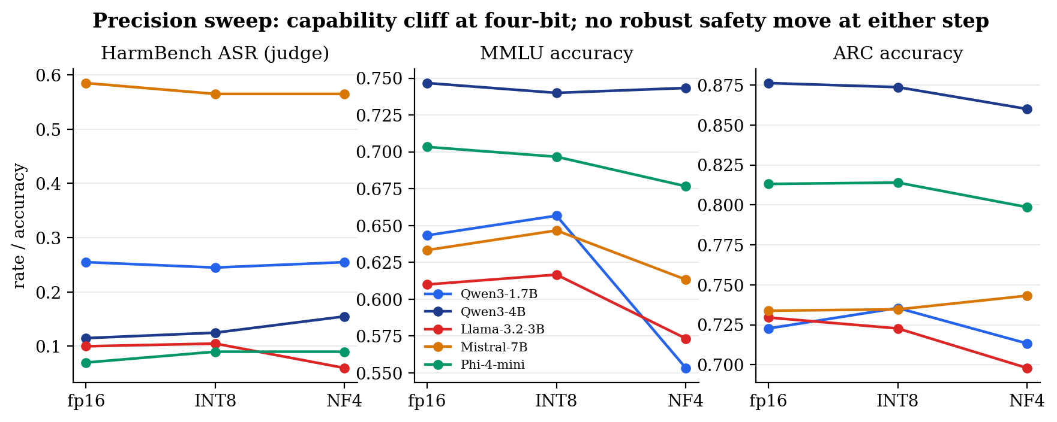
RESULT 2
RQ3 — where the loss actually is
So the trade-off is real, but it sits on the capability axis, not the safety axis. That is a different engineering decision from the one the literature implies.
Qwen3-1.7B loses 9.0 points of MMLU accuracy (q = 0.008).
Llama-3.2-3B loses 3.2 points of ARC-Challenge (q = 0.008).
Phi-4-mini's over-refusal falls 4.8 points (q = 0.012) — a decrease, and scorer-dependent.
Capability loss is a cliff at four bits, not a smooth slope: the INT8 point barely moves.
fp16 → INT8 → NF4
13
Notes:
[14:00 - 15:30]
The three survivors are all capability or over-refusal.
The smallest model, Qwen 1.7B, loses nine points of MMLU. Llama loses three points of ARC. And Phi's over-refusal falls — note falls, meaning it became less conservative on benign prompts, not more.
The precision sweep adds something the two-point comparison would have missed. Capability loss is not graded by bit-width. INT8 sits almost on top of fp16, then four-bit drops. It behaves like a cliff, and that matters if you are choosing a deployment precision.
DELIVERY: this is the slide that answers 'so what should a practitioner do'. The answer: budget for capability loss at four bits, and do not assume the safety axis is where your risk is.

Slide 14
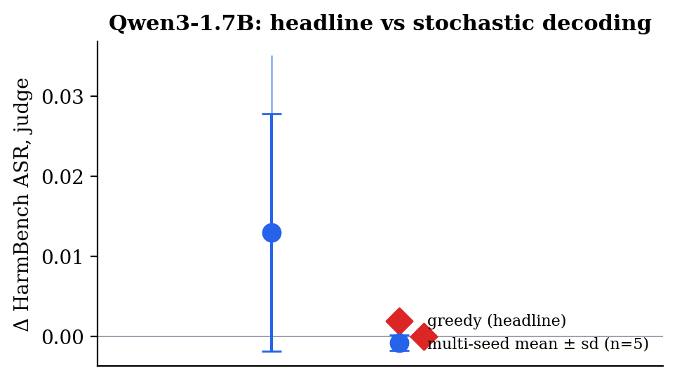
RESULT 3 — RQ5, AND THE METHODOLOGICAL CONTRIBUTION
The result I nearly published was an artefact
Both judges agree it disappears. This is the finding I would most want another group to check, because it implies some published effects in this area are measurement artefacts.
At a 128-token generation budget, Qwen3-1.7B showed +0.055 ASR — a clean, publishable-looking safety regression.
At 512 tokens, HarmBench's own reference budget, the same contrast is +0.000.
62% of responses run past the 128-token ceiling; median length goes from 567 to 1675 characters.
The 'regression' was truncation: cut a model off mid-sentence and a refusal it never finished reads as compliance.
Stability across decoding seeds
14
Notes:
[15:30 - 17:15]
This is the result I am proudest of, and it started as an embarrassment.
At a 128-token generation budget I had a clean safety regression: Qwen 1.7B, plus five and a half points of harmful compliance. It was significant. It was exactly the finding the project was set up to detect.
Then I re-ran everything at 512 tokens, which is HarmBench's own reference budget. The same contrast is zero. Sixty-two percent of responses had been running past the old ceiling — the median response more than doubles in length. What I had measured was truncation. If you cut a model off mid-sentence, a refusal it had not finished writing gets scored as compliance.
So my headline number was an artefact of a decoding parameter, and both judges agree it vanishes. The uncomfortable implication is that this is a cheap mistake for anyone in this area to make.
DELIVERY: this plus the scorer slide is your answer to 'what is the contribution'. Two measurement-validity findings, both discovered by checking my own work.

Slide 15
LIMITATIONS, STATED UP FRONT
What this study does not establish
Direct requests only
A bounded null, not a proof of no effect
HarmBench ran in its standard DirectRequest configuration. No jailbreaks, no adversarial suffixes. Preservation here is not evidence of robustness under attack.
Representative MDE is about 0.059 at 80% power. I can rule out large effects. I cannot rule out small ones, and I say so.
Two quantization methods
The cost axis is not measured
NF4 and INT8, both BitsAndBytes. GPTQ, AWQ and GGUF are untested and may differ.
I did not measure VRAM, latency or throughput, so I quantify the safety and capability side of the trade-off, not the engineering benefit side.
Every one of these is disclosed in the report; none was found by a reviewer after the fact.
15
Notes:
[17:15 - 18:45]
I want to state the limits myself rather than have them extracted from me.
Everything here is scoped to direct requests — I ran no jailbreaks, so I have shown nothing about robustness under attack. The null is bounded: I can detect roughly a six-point change, so I am excluding large effects, not all effects. Two quantization methods, both from one library. And the fourth one is a fair hit — my title says trade-off, and I measured the cost in capability but never in memory or latency, so half of that trade-off is unquantified.
DELIVERY: saying these before the examiner does converts four attacks into four marks for judgement. Do not rush it, and do not sound defensive.

Slide 16
CONCLUSION
Conclusion and future work
The answer to RQ1
Where the cost is
In these five matched pairs, four-bit NF4 quantization produced no statistically significant increase in harmful compliance under direct requests.
Capability, and as a cliff at four bits rather than a gradient — with the smallest model paying most.
The transferable lesson
Next
Two of my strongest early findings were measurement artefacts. Validate the scorer and the generation budget before believing a safety delta.
An attack-augmented arm, a second annotator on the gold sets, other quantization families, and the cost axis this study left unmeasured.
16
Notes:
[18:45 - 20:00]
To close.
On the evidence I have, four-bit quantization did not make these five model pairs measurably more willing to comply with harmful direct requests. The cost is real but it is on the capability axis, it behaves like a cliff at four bits, and the smallest model pays most.
The part I would carry into any future work is the methodological one. Twice, the most exciting result I had turned out to be an artefact — once of the scorer, once of the generation budget. Both were found by checking my own instrument rather than by anyone reviewing me.
Future work: an attack-augmented arm, a second annotator, other quantization families, and measuring the cost axis properly.
Thank you — I am happy to take questions.
DELIVERY: land on the methodological lesson, not on the null. It is the more interesting sentence and it invites a better class of question.

Slide 17
Thank you
Questions
TAN UEI HORNG · UTAN001 · CCDS25-1136
17
Notes:
[Q&A — 10:00]
Q&A is ten minutes. Study docs/viva/VIVA_QA_BANK.md.
Three rules under pressure:
1. Answer the question asked, in one sentence, THEN give evidence.
2. If you do not know, say so and say what you would do to find out. That scores better than a confident guess, and the panel can tell the difference.
3. Point at an artifact whenever you can — a figure, a table, a committed file. Every number you cite exists in results_512/analysis.

