Slide 1
Emotion Detection project
Submitted By - Tanu Goyal

Slide 2
WORKFLOW / APPROACH
Data Preprocessing
Emotion Dataset
[Link]
Data Cleaning
Remove duplicates
Data balancing
Text Cleaning
Punctuation, emoji removal using NeatText.
Stop word removal Lemmatization using NLTK
Train Test splitting
Vectorization
TFIDF Vectorizer
Evaluation
Accuracy 2.Precision
Recall 4. F1 Score
5. Confusion Matrix
Model Development
SVC
C=0.1,C=1.0
Multinomial Naïve Bayes
Model saving
Streamlit app

Slide 3
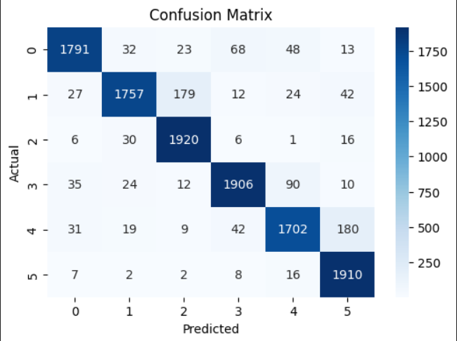
Results For the best Model (SVC Classifier with C=0.1 Regularized model) :
Testing Accuracy : 91.5%
Training Accuracy: 93.7 % (NO OVERFITTING)
Precision: 91.7%
Recall: 91.5%
F1 Score: 91.5%
Confusion Matrix :

