Slide 1
ECMAScript
(European Computer Manufacturers Association Script)

Slide 2
What is ECMAScript?
ECMAScript (or ES) is a scripting-language specification standardized by Ecma International
It was created to standardize JavaScript, so as to foster multiple independent implementations.
JavaScript is a language based on ECMAScript.
Other implementation of ECMAScript include SpiderMonkey, V8, Jscript, QtScript, InScript and ActionScript

Slide 3
ECMAScript Editions
Official Name | Description
ECMAScript 1 (1997) | First Edition.
ECMAScript 2 (1998) | Editorial changes only.
ECMAScript 3 (1999) | Added Regular Expressions, try/catch.
ECMAScript 4 | Never released.
ECMAScript 5 (2009) | Added "strict mode“, JSON support, String.trim(), Array.isArray(), Array Iteration Methods.
ECMAScript 2015 (ES 6) | Added let and const, default parameter values, Array.find(), Array.findIndex().
ECMAScript 2016 | Added exponential operator (**), Array.prototype.includes.
ECMAScript 2017 | Added string padding, new Object properties, Async functions, Shared Memory.
ECMAScript 2018 | Added rest / spread properties, Asynchronous iteration, Promise.finally(), Additions to RegExp.

Slide 4
ES6 browser compatibility
ES6 features supported by different web browsers:
Chrome 72 – 98%
Firefox 60 – 98%
Safari 12 – 98%
IE Edge – 96%
IE 11 – 11%
Compatibility tables
http://kangax.github.io/compat-table/es6/

Slide 5
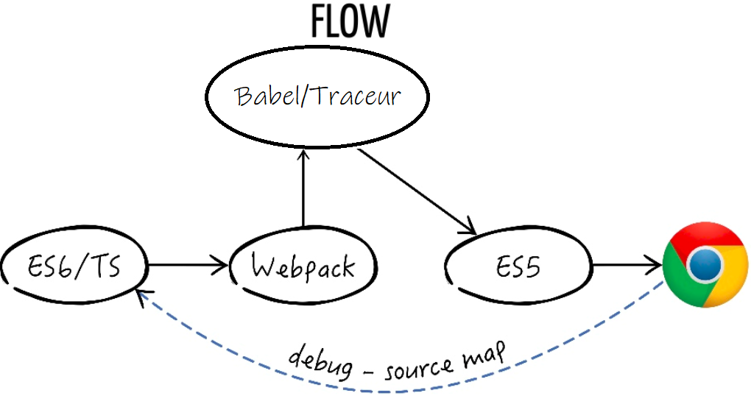
ES6 to ES5 Transpilers
Babel
http://babeljs.io
Traceur
https://github.com/google/traceur-compiler
TypeScript
(Superset of JavaScript that aims to align with ECMAScript 6)
http://www.typescriptlang.org

Slide 6
Features that has given edge to ES6 (Key features overview)
let
const
Block Scope
Arrow function
Extended Parameter Handling
Template Literals
Enhanced Object Properties
Modules
Classes
Destructuring Assignment
Promises
Async and Await

Slide 7
let Cannot be re-declared
var i = 5; … var i = 10; // Here i is 10
let i = 5; … let i = 10; // Identifier i has already been declared

Slide 8
const Cannot be reassigned or re-declared.
const PI;
//Return an error: Uncaught SyntaxError: Missing initializer in const declaration
const PI = 3.14159;
//Correct
PI = 3.14; // This will give an error PI = PI + 10; // This will also give an error
Constant Objects can be changed, but cannot be re-assigned.

Slide 9
Block Scope
var x = 10; // Here x is 10 { var x = 2; // Here x is 2 } // Here x is 2
let x = 10; // Here x is 10 { let x = 2; // Here x is 2 } // Here x is 10

Slide 10
Arrow function / Fat Arrow
var greetings = function () {
console.log( "Hello, how are you?" );
}
var numbers = [ 1, 2, 3, 4 ];
var squares = numbers.map( function( num ) {
return num * num;
} );
var greetings = () => {
console.log( "Hello, how are you?" );
}
var numbers = [ 1, 2, 3, 4 ];
var squares = numbers.map( num => num * num );

Slide 11
Extended Parameter Handling
Three new features:
Default Parameters
Rest Operator
Spread Operator

Slide 12
Template Literals
String Interpolation
Multi-Line
Tags
Raw

Slide 13
Enhanced Object Properties
Property Shorthand
Computed Property Names
Method Properties

Slide 14
Modules
index.js
add.js
import { add, subtract } from './add';
console.log( add ( 1, 2 ) );
console.log( subtract ( 1, 2 ) );
export function add ( x, y ) {
return x + y;
}
export function subtract ( x, y ) {
return x - y;
}
ECMAScript module loader
Ref: https://github.com/standard-things/esm

Slide 15
Classes
Definitions
Extends
Super
Static members
Getters and Setters

Slide 16
Destructuring Assignment
Array Matching
Object Matching
Deep Object Matching
Default Values

Slide 17
Promises
An Alternative to callbacks
Chaining
All & Race
Catch

Slide 18
Async & Await An Alternative to Promises
function getAge () {
return Promise.resolve(16);
}
function getName () {
return Promise.resolve('Ram');
}
async function getData () {
try {
const [name, age] = await Promise.all([getName(), getAge()]);
console.log( name + “ “ + age );
} catch ( error ) {
console.log(error);
}
}

Slide 19
Other References
https://developer.mozilla.org/en-US/docs/Web/JavaScript/New_in_JavaScript/ECMAScript_2015_support_in_Mozilla
https://www.w3schools.com/js/js_versions.asp
http://es6-features.org
Enroll to free video course
https://www.udemy.com/leveling-up-to-es6

Slide 20
Conclusion
ES6 is a feature set provided on top of the JavaScript library to provide developers with a collection of awesome new features. ES6 will make your code clean and concise, and it will make your life easier as a developer. It also has additional functions and features that were not even possible in prior versions of JavaScript. A majority of the latest browsers now support most, but not all, of the ES6 features. Since most web applications are compiled using Babel.js to provide support for all browsers and older version of browsers. A majority of the latest libraries and frameworks are now being written in ES6, so we don't want to get left behind.

Slide 21
Questions?

