Slide 1
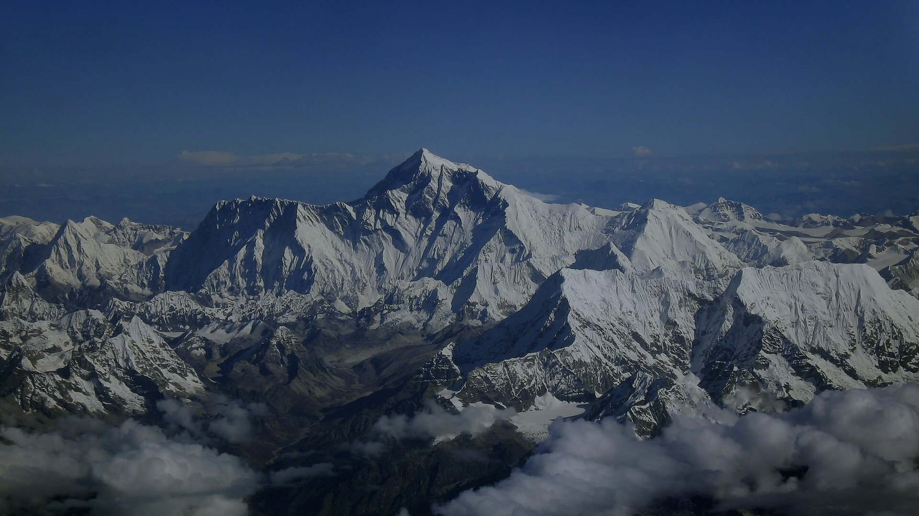
EARTH SCIENCE & GEOGRAPHY
The Roof of the World
Geology, Ecology, and the Planetary Majesty of the Himalayas
SERIES: PPTmaker Earth Science APEX SUMMIT: 8,848.86 m (Everest) IMPACT: 1.9 Billion People Sustained
Notes:
Welcome everyone. Today we examine the greatest geological monument on Earth: the Himalayas. Stretching in a monumental arc across Asia, this mountain system is not simply a static crown of rock and ice, but the dynamic hydrological engine that sustains nearly a quarter of humanity. Let us begin by measuring its extraordinary scale.

Slide 2
SCALE & ELEVATION
A Geological Crown Measured in Kilometers and Billions
8,848.86 m
PLANETARY IMPORTANCE
The Stratospheric Barrier and Engine of Asia
Summit of Mount Everest
▪ Stratospheric Altitude: Mount Everest reaches 8,848.86 meters above sea level, where atmospheric pressure drops to one-third of sea level.
▪ Continental Hydrology: Ten major Asian river systems originate in the high snows, irrigating the world's most productive agricultural valleys.
▪ Active Orogeny: The range is not an ancient fossil, but the planet's youngest and most rapidly evolving mountain chain.
The highest point on planet Earth, pushing directly into the lower stratosphere
1.9B+
People Dependent Downstream
Nearly a quarter of humanity relying on Himalayan glacial meltwater for life
The Roof of the World: Geology, Ecology, and the Planetary Majesty of the Himalayas
02 / 11
Notes:
To grasp the significance of the Himalayas, we must understand two contrasting numbers: eight thousand eight hundred and forty-eight meters of vertical elevation at the peak of Everest, and one point nine billion human lives sustained down in the river valleys below. This range is both a boundary of the stratosphere and the planetary cradle of Asian civilization. Let us now trace how fifty million years of continental collision created this colossal barrier.

Slide 3
TECTONIC GENESIS
Fifty Million Years of Continental Collision and Uplift
100–70M BCE
50–45M BCE
20–10M BCE
2M BCE–Present
1
2
3
4
The Tethys Ocean
Continental Impact
Main Central Thrust
Glacial Carving & Rise
The Indian plate breaks from Gondwana and drifts rapidly north at 15 cm/yr across the ancient sea.
India collides head-on with Eurasia, crumpling marine sediment and initiating crustal buckling.
Gigantic crystalline nappes of granite and gneiss are thrust upward, forming the Great spine.
Quaternary glaciers chisel sharp horns while active tectonic push continues to raise peaks by 5 mm/yr.
Living Tectonics
The Indian plate continues driving north at 5 cm/year, generating active seismic uplift
The Roof of the World: Geology, Ecology, and the Planetary Majesty of the Himalayas
03 / 11
Notes:
The birth of the Himalayas is the most dramatic collision in Earth's geological history. Fifty million years ago, the drifting Indian continent slammed into the underbelly of Eurasia. The ancient Tethys seafloor was crumpled and lifted into the sky—which is why marine fossils are found today on the summit rocks of Everest. This tectonic engine has never stopped; it continues to lift the mountains by five millimeters each year. Next, let us examine the three distinct parallel ranges that make up this mountain architecture.

Slide 4
MORPHOTECTONIC BELTS
Three Parallel Longitudinal Ranges That Define the System
SUB-HIMALAYA
MIDDLE HIMALAYA
HIGHER HIMALAYA
Outer Himalaya (Siwaliks)
Lesser Himalaya (Himachal)
Great Himalaya (Himadri)
600–1,200 m Foothills
1,500–4,500 m Ridges
6,000–8,848 m Apex
The youngest, southernmost belt formed of folded sandstone and river conglomerates, acting as the transition zone from the Indo-Gangetic plains.
Deeply dissected temperate valleys and metamorphic ridges hosting historic settlements, pine forests, and high-altitude agricultural terraces.
The crystalline central axis of perennial snow, massive valley glaciers, and all fourteen of Earth's Eight-Thousander peaks.
The Roof of the World: Geology, Ecology, and the Planetary Majesty of the Himalayas
04 / 11
Notes:
Geographers divide the Himalayan system into three distinct parallel zones running west to east. At the base lie the Siwalik foothills, formed from ancient river sediments. Above them rises the Lesser Himalaya, characterized by pine-forested ridges and terraced human communities. Finally, soaring into the sky is the Great Himalaya or Himadri—the crystalline core of perennial ice and sheer granite that contains all fourteen of the world's highest peaks. Let us now look at how this frozen spine acts as the freshwater engine of Asia.

Slide 5

HYDROLOGICAL ENGINE
The Water Towers of Asia Feeding a Fifth of Humanity
▪ Ten Transboundary Rivers: The Himalayas are the primary headwaters for the Indus, Ganges, Brahmaputra, Yangtze, Yellow, Mekong, and Salween rivers.
▪ Spring Meltwater Buffer: Before the monsoon rains arrive, high-altitude snow and glacial melt contribute up to 60% of streamflow in arid upper basins.
▪ Agricultural Lifeblood: Over 20% of global food production—including the vast wheat and rice basins of India and China—depends on Himalayan river runoff.
▪ Hydropower Potential: Glacial valleys supply thousands of megawatts of clean renewable energy for mountainous developing economies.
10 River Basins
HYDROLOGICAL BASINS OF ASIA
Sustaining agriculture, drinking water, and industry across 18 Asian nations
Indus & Ganges High-Altitude Headwaters
The Roof of the World: Geology, Ecology, and the Planetary Majesty of the Himalayas
05 / 11
Notes:
The Himalayas are rightfully known as the Water Towers of Asia. Ten of the continent's mightiest rivers originate in these glaciers. During the dry spring months before monsoon rains arrive, meltwater from these high snows is the only thing keeping downstream rivers flowing. This water irrigates the vast agricultural belts of South and East Asia that produce a fifth of the world's food supply. Let us look at the astonishing physical numbers that quantify this colossal system.

Slide 6
MOUNTAIN METRICS
The Extremes of Altitude: The Himalayan System in Numbers
14
2,400 km
Eight-Thousander Summits
Continuous East-West Arc
All fourteen of Earth's peaks exceeding 8,000 meters are located in this mountain system
Stretching from Nanga Parbat in Pakistan to Namcha Barwa in Tibet across five countries
46,000 sq km
5 mm / yr
Glacial Ice Cover
Active Tectonic Uplift
The world's largest store of freshwater ice outside the Arctic and Antarctic polar ice sheets
Continuous crustal compression pushing the high summits higher against natural erosion
The Roof of the World: Geology, Ecology, and the Planetary Majesty of the Himalayas
06 / 11
Notes:
These four numbers illustrate why the Himalayas stand alone in earth science. They contain all fourteen of the world's eight-thousand-meter peaks. Their arc spans two thousand four hundred kilometers across five sovereign nations. They hold forty-six thousand square kilometers of glacial ice—the largest ice reserve outside the poles. And because the Indian plate continues its northward push, the range is actively growing by five millimeters every year. Behind these sheer physical extremes lies a profound history of human exploration, highlighted next.

Slide 7

SUMMIT PHILOSOPHY
A Historic First Ascent and the Humility of the Heights
“
"It is not the mountain we conquer, but ourselves."
Sir Edmund Hillary
First verified ascent of Mount Everest (with Tenzing Norgay) — May 29, 1953
When Edmund Hillary and Tenzing Norgay stood atop Everest on May 29, 1953, their triumph redefined human endurance. Yet their legacy established that high-altitude exploration is not about conquering nature, but about confronting human limits with reverence, teamwork, and supreme humility.
SIR EDMUND HILLARY
First Ascent, May 29, 1953
The Roof of the World: Geology, Ecology, and the Planetary Majesty of the Himalayas
07 / 11
Notes:
On May 29, 1953, Edmund Hillary and Tenzing Norgay achieved what many believed was physiologically impossible: reaching the summit of Mount Everest. Yet Hillary's reflection afterward remains the definitive truth of mountaineering: it is not the mountain we conquer, but ourselves. In the thin air above eight thousand meters, ego disappears and survival depends on respect for natural forces. Let us now examine how Earth's highest individual giants compare.

Slide 8
EIGHT-THOUSANDERS
Crown of the Earth: The Six Supreme Summits Compared
PEAK NAME | ELEVATION | RANGE & LOCATION | FIRST ASCENT & GEOLOGICAL CHARACTER
Mount Everest | 8,848.86 m | Mahalangur / Nepal-China | 1953 (Hillary & Norgay) — Earth's supreme pinnacle with ancient marine limestone summit
K2 (Godwin-Austen) | 8,611 m | Karakoram / Pak-China | 1954 (Compagnoni & Lacedelli) — The 'Savage Mountain' known for severe technical steepness
Kangchenjunga | 8,586 m | Kangchenjunga / India-Nepal | 1955 (Band & Brown) — Five sacred treasures of snow; eastern sentinel of the range
Lhotse | 8,516 m | Mahalangur / Nepal-China | 1956 (Luchsinger & Reiss) — Connected to Everest via South Col with massive 3.2 km South Face
Makalu | 8,485 m | Mahalangur / Nepal-China | 1955 (Couzy & Terray) — Distinctive four-sided granite pyramid with knife-edge ridgelines
Annapurna I | 8,091 m | Annapurna / Nepal | 1950 (Herzog & Lachenal) — First 8,000 m peak summited; prone to massive avalanches
The Roof of the World: Geology, Ecology, and the Planetary Majesty of the Himalayas
08 / 11
Notes:
This comparative matrix outlines six of Earth's supreme peaks. While Everest claims the absolute altitude record at 8,848 meters, mountains like K2 present far steeper technical climbing difficulties, and Annapurna is notorious for deadly avalanches. Each summit possesses a distinct geological architecture, from Everest's marine limestone bands to Makalu's sheer granite pyramid. But today, these timeless glaciers face an existential threat from global warming.

Slide 9
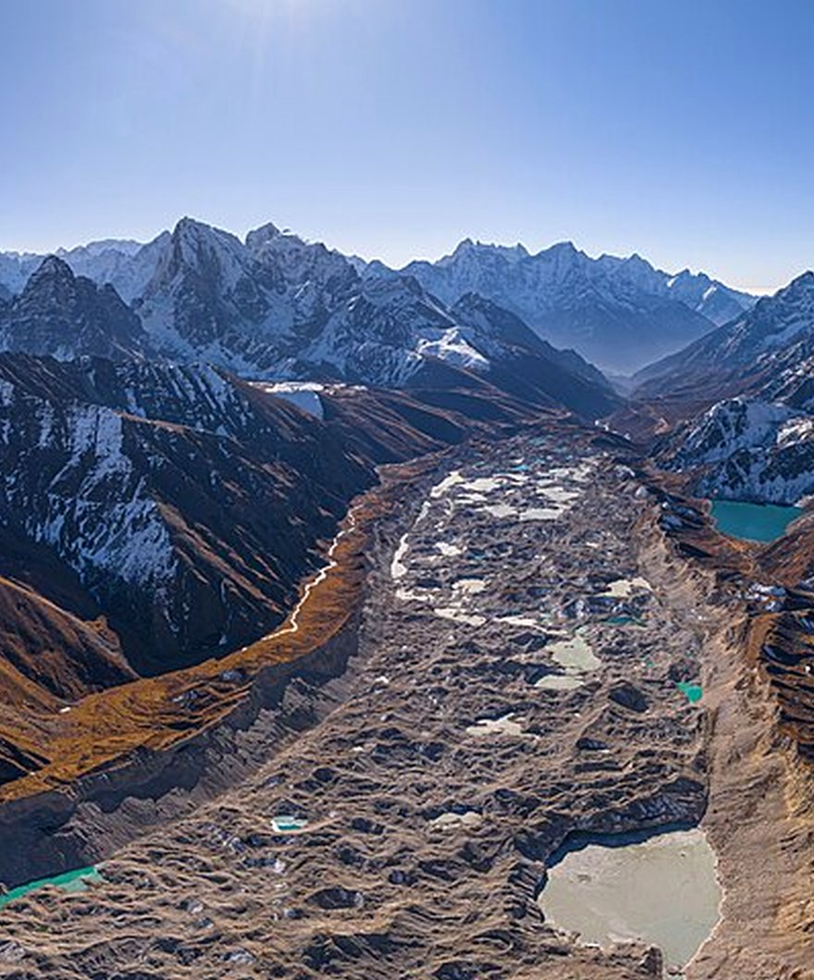
CLIMATE FRONTLINE
The Third Pole in Crisis: Glacial Retreat and Rising Risks
▪ Accelerated Ice Volume Loss: ICIMOD scientific models warn that up to 75% to 80% of Himalayan glacier ice could melt by 2100 under current warming trajectories.
▪ Glacial Lake Outbursts (GLOFs): Rapidly melting glaciers form thousands of unstable moraine-dammed lakes, creating catastrophic flood hazards for downstream valleys.
▪ Shifting Seasonal Water Cycles: Initial decades of increased flooding will be followed by severe long-term dry-season droughts across South Asian river basins.
▪ Global Albedo Feedback: Diminishing high-altitude snowpack reduces solar reflection, accelerating localized warming across the Tibetan Plateau.
Up to 80% Loss
GLACIOLOGY & RETREAT
Khumbu Glacier & Supraglacial Lakes
Projected glacier volume loss by 2100 without aggressive global climate action
The Roof of the World: Geology, Ecology, and the Planetary Majesty of the Himalayas
09 / 11
Notes:
The Himalayas are warming at up to double the global average rate, earning them the title of climate ground zero. As glaciers retreat at unprecedented speeds, unstable meltwater lakes form behind fragile gravel dams, threatening mountain villages with catastrophic outburst floods. In the short term, this increases flooding; in the long term, once the glaciers shrink, river flows will plummet during dry seasons. Preserving this frozen reservoir is an international emergency. Let us now examine the resilient biodiversity and human cultures that inhabit these extremes.

Slide 10
ECOLOGY & ADAPTATION
Extreme Ecology and the Resilience of High-Altitude Life
ECOLOGICAL JEWEL
GENETIC WONDER
Alpine Biodiversity Hotspot
Human Genetic Adaptation
Spanning five distinct bioclimatic zones, the range shelters endangered apex predators including the elusive Snow Leopard, Red Panda, and over 10,000 endemic alpine plant species.
Centuries of high-altitude life have selected the unique EPAS1 gene variant in Sherpa and Tibetan populations, enabling optimal cellular oxygenation without dangerous blood thickening.
PLANETARY DUTY
Planetary Guardianship
A Global Ecological Imperative
Protecting the Himalayan ecosystem requires cross-border scientific cooperation, sustainable tourism governance, and aggressive global carbon reduction to safeguard water for nearly two billion people.
The Roof of the World: Geology, Ecology, and the Planetary Majesty of the Himalayas
10 / 11
Notes:
Despite freezing temperatures and thin air, the Himalayas host an extraordinary web of life. Endangered snow leopards stalk blue sheep along rocky cliffs, while alpine meadows host thousands of endemic medicinal plants. Human communities, particularly Sherpas and Tibetans, have developed extraordinary physiological adaptations to high altitude at a genetic level. But local resilience is not enough; safeguarding this global commons requires transboundary conservation and worldwide climate action. Let us conclude with our final synthesis.

Slide 11
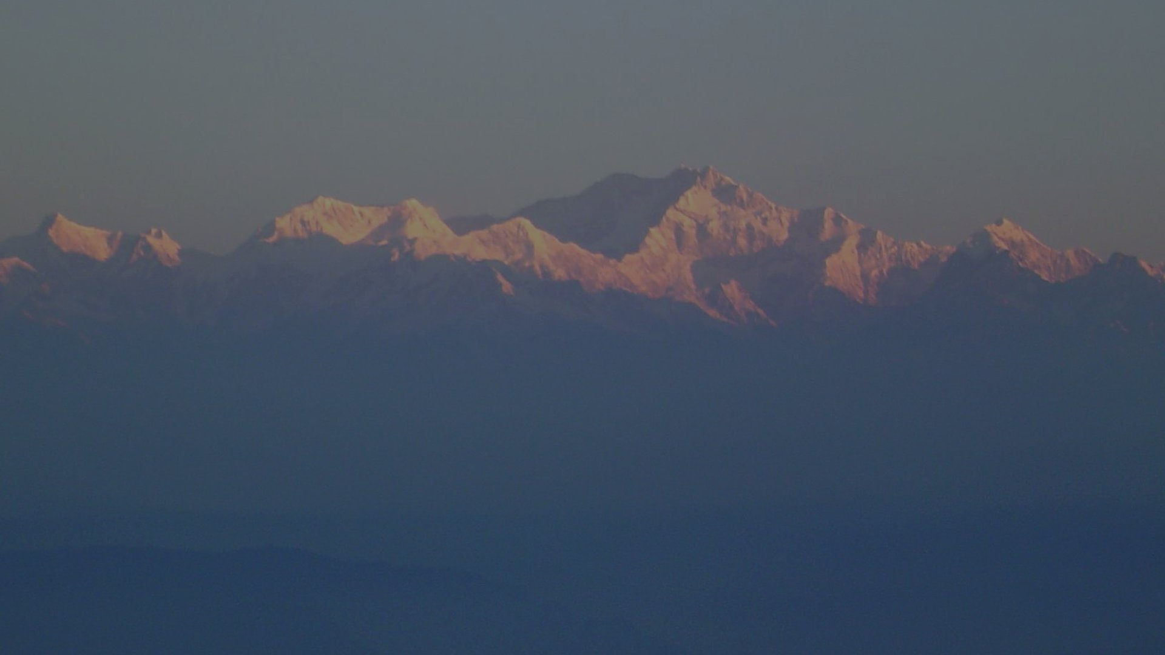
THE TIMELESS SENTINEL
The Eternal Spine of Asia
A Monument of Earth's Past, the Lifeline of Its Present, and the Crucible of Its Future
The Living Giant
Standing 8,848 meters above the sea, the Himalayas remind humanity of the geological forces that shaped our world and the fragile climate that sustains it
Notes:
In conclusion, the Himalayas are far more than a mountaineer's dream or a scenic horizon. They are the living pulse of continental tectonics, the frozen water tower sustaining a fifth of humankind, and the definitive barometer of our planet's climate health. Protecting this eternal sentinel is not merely a regional priority—it is an imperative for all humanity. Thank you.

