Slide 1
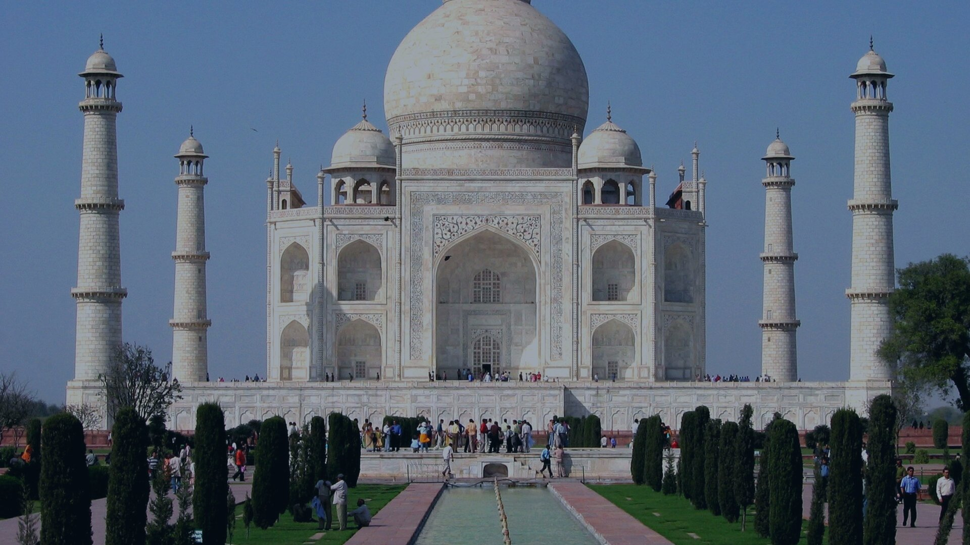
CULTURAL MASTERCLASS
The Living Civilization
Five Millennia of Indian Culture, Philosophy, and Global Resonance
AUTHOR & CURATION: PPTmaker Cultural Series ARCHETYPE: Heroic Legacy Arc TIMELINE: 5,000 BCE — Present
Notes:
Welcome everyone. Today we step inside the story of the world's longest unbroken continuous civilization. For over five thousand years, Indian culture has not merely survived; it has continuously assimilated, renewed, and enriched human thought. Let us begin our exploration with its foundational scale.

Slide 2
SCALE & ANTIQUITY
A Civilization Measured in Millennia and Millions
5,000+
CIVILIZATIONAL CONTINUITY
A Living Heritage Unmatched in Human History
Years of Living Continuity
▪ Millennial Depth: Archaeological and literary records confirm continuous philosophical and ritual traditions from 2500 BCE to today.
▪ Living Synthesis: Unlike ancient Greece or Egypt, India's classical scripts, sacred geometries, and mantras remain daily lived realities.
▪ Composite Identity: A civilization forged through centuries of reciprocal assimilation across hundreds of distinct regional communities.
Originating in Harappan urbanism and continuing unbroken into the 21st century
1.4B+
Living Heritage Custodians
The world's most populous cultural democracy carrying forward ancient lineages
The Living Civilization: Five Millennia of Indian Culture, Philosophy, and Heritage
02 / 11
Notes:
When we examine world history, most bronze age civilizations survive only as museum relics. In India, however, ancient mantras composed three thousand years ago are chanted at sunrise today. With over 1.4 billion people actively living these traditions, Indian culture is a living ecosystem of human memory. Let us trace how this epic chronology unfolded across key epochs.

Slide 3
CIVILIZATIONAL EPOCHS
From Harappan Urbanism to Devotional Renaissance
2500–1700 BCE
1500–500 BCE
300 BCE–500 CE
800–1700 CE
1
2
3
4
Harappan Urbanism
Vedic & Upanishadic Era
Classical Golden Age
Bhakti Renaissance
Planned brick grid cities, dockyards, drainage systems, and seals across the Indus basin.
Composition of the Vedas and foundational metaphysical dialogues on Atman, Brahman, and Dharma.
Ashokan edicts of non-violence, Natya Shastra treatises, and the zenith of Gupta mathematics.
Monumental stone temple construction, egalitarian Bhakti-Sufi poetry, and syncretic arts.
5,000-Year Arc
An unbroken lineage of architectural, philosophical, and literary innovation
The Living Civilization: Five Millennia of Indian Culture, Philosophy, and Heritage
03 / 11
Notes:
This timeline illustrates how Indian thought developed over five thousand years. It began with the egalitarian urban engineering of the Indus Valley, progressed into the profound psychological inquiries of the Upanishads, flowered into classical science during the Gupta golden age, and culminated in the passionate, egalitarian poetry of the Bhakti movement. Next, let us examine the timeless philosophical pillars that tie this vast chronology together.

Slide 4
PHILOSOPHICAL BEDROCK
Three Universal Pillars That Anchor Indian Thought
COSMIC LAW
MORAL CORE
UNIVERSAL VISION
Dharma & Karma
Satya & Ahimsa
Vasudhaiva Kutumbakam
Cosmic Order & Moral Cause
Truth & Active Non-Injury
The World is One Family
Dharma defines the ethical duty that sustains the cosmos, while Karma establishes that every action leaves an indelible moral imprint shaping destiny.
Foundational to Vedic, Jain, and Buddhist traditions, non-violence is affirmed as the highest spiritual discipline and ultimate moral strength.
Originating in the Maha Upanishad, this dictum transcends parochial borders to declare all humanity and living creation as a single household.
The Living Civilization: Five Millennia of Indian Culture, Philosophy, and Heritage
04 / 11
Notes:
At the heart of Indian civilization lies a triadic philosophy that governs ethical life. Dharma is the universal balance of moral duty; Karma is the law of cause and effect; and Satya and Ahimsa represent the twin virtues of truth and active compassion. Overarching them all is the Upanishadic declaration Vasudhaiva Kutumbakam—the truth that the entire planet is a single interconnected household. Now let us see how these metaphysical truths took physical form in stone.

Slide 5
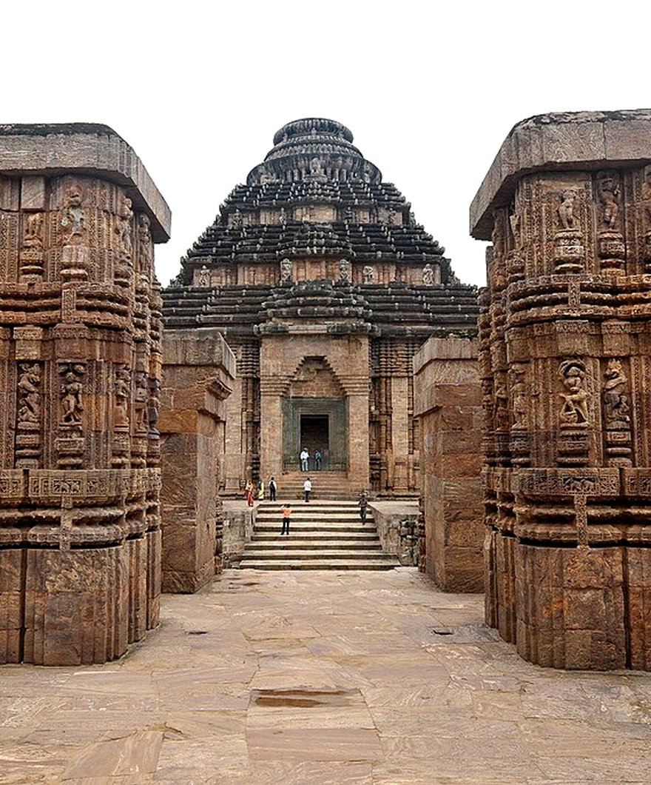
SACRED ARCHITECTURE
Stone Carved into Cosmic Geometry and Devotion
▪ Monolithic Marvels: The 8th-century Kailasa Temple at Ellora was carved vertically downward from a single cliff, quarrying 200,000 tonnes of basalt.
▪ Three Sacred Styles: Temple architecture codified into Nagara (northern curvilinear spires), Dravida (pyramidal towers), and Vesara hybrid forms.
▪ Vastu Mandala Precision: Sanctums are geometrically aligned to cardinal directions as sacred cosmic models, balancing astronomy and sacred geometry.
▪ Living Sacred Masterpieces: From the rock-cut frescoes of Ajanta to the granite majesty of Thanjavur, stone monuments act as open-air scriptures.
42 UNESCO Sites
SACRED GEOMETRY IN STONE
34 cultural world heritage monuments protected across the Indian subcontinent
Sun Temple Konark & Kailasa Monolith
The Living Civilization: Five Millennia of Indian Culture, Philosophy, and Heritage
05 / 11
Notes:
Indian sacred architecture is not mere engineering; it is cosmic geometry frozen in stone. Consider the Kailasa temple at Ellora, where artisans started at the top of a mountain and carved downward through solid volcanic rock to create a multi-story cathedral of stone. Whether in the towering Dravidian gopurams of Tamil Nadu or the sandstone Nagara spires of the north, every temple acts as a microcosm of the universe. Let us now look at the astonishing demographic and linguistic diversity that fills these spaces.

Slide 6
DEMOGRAPHIC MOSAIC
The World's Most Pluralistic Society by the Numbers
22
42
Constitutional Languages
UNESCO World Heritage Sites
Recognized under the Eighth Schedule across four major linguistic families
34 cultural monuments celebrating millennia of artistic and engineering mastery
240M+
121
Pilgrims at Kumbh Mela
Languages with 10k+ Speakers
The largest peaceful gathering in human history, honored by UNESCO as intangible heritage
Part of a living mosaic containing over 19,500 distinct regional mother tongues
The Living Civilization: Five Millennia of Indian Culture, Philosophy, and Heritage
06 / 11
Notes:
These four numbers capture the extraordinary scale of Indian pluralism. India does not have a single national language; instead, its Constitution recognizes twenty-two major languages. Over forty-two UNESCO World Heritage sites dot its landscape, while the Kumbh Mela brings together more than two hundred million pilgrims in an unparalleled display of collective faith. Behind this immense diversity lies a deep philosophical commitment to harmony, as captured so memorably on our next slide.

Slide 7
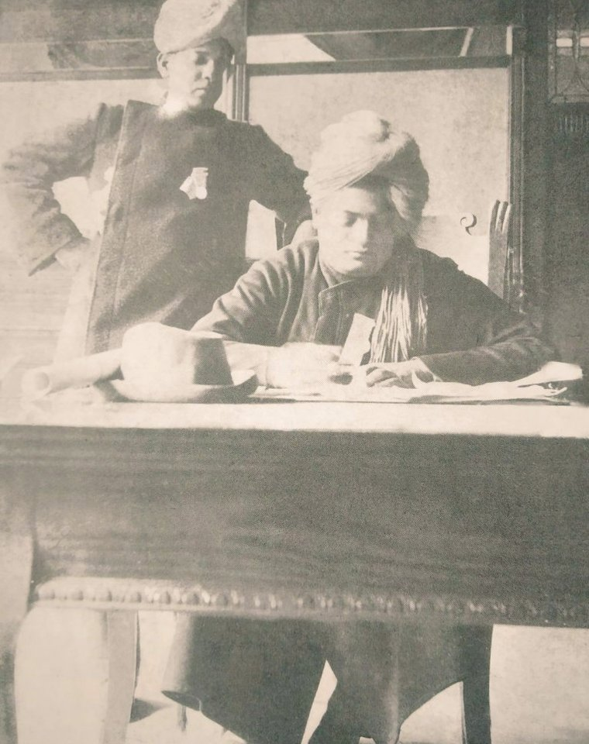
CIVILIZATIONAL HARMONY
A Universal Message of Tolerance and Acceptance
“
"I am proud to belong to a religion which has taught the world both tolerance and universal acceptance. We believe not only in universal toleration, but we accept all religions as true."
Swami Vivekananda
World Parliament of Religions, Chicago — September 11, 1893
Vivekananda's historic address articulated the core ethos of Indian thought: the conviction that diverse spiritual paths converge upon a single reality, establishing universal tolerance not as passive concession, but as active reverence for all human seekers.
SWAMI VIVEKANANDA
Chicago, 1893
The Living Civilization: Five Millennia of Indian Culture, Philosophy, and Heritage
07 / 11
Notes:
When Swami Vivekananda addressed the World Parliament of Religions in Chicago in 1893, he didn't just represent Hinduism; he articulated the civilizational soul of India. His message that tolerance is not merely passive endurance, but active acceptance of all spiritual traditions, remains India's greatest intellectual gift to world peace. Next, let us turn to the sublime physical expression of this spiritual impulse through classical performing arts.

Slide 8
PERFORMING ARTS
The Six Great Dimensions of Classical Indian Dance
DANCE FORM | ORIGIN & REGION | FOUNDATIONAL TREATISE | SIGNATURE AESTHETICS & EXPRESSION
Bharatanatyam | Tamil Nadu | Natya Shastra / Sadir | Geometric lines, crisp footwork, and intricate expressive Abhinaya
Kathak | Uttar Pradesh | Natya Shastra / Gharanas | Rhythmic Tatkar footwork, rapid Chakkars (spins), and poetic storytelling
Kathakali | Kerala | Hastha Lakshana Deepika | Elaborate Aharya makeup, grand headdresses, and vivid theatrical mime
Odissi | Odisha | Abhinaya Darpana | Sensuous Tribhangi (three-bend) posture mirroring temple stone sculptures
Manipuri | Manipur | Govinda Sangit Leela | Gentle circular lyrical swaying portraying Raslila devotional ecstasy
Kuchipudi | Andhra Pradesh | Natya Shastra / Yakshagana | Vibrant dance-drama, swift storytelling, and rhythmic brass plate footwork
The Living Civilization: Five Millennia of Indian Culture, Philosophy, and Heritage
08 / 11
Notes:
India's classical dance forms are among the world's most sophisticated theatrical systems, codified two millennia ago in Bharata Muni's Natya Shastra. As this comparative matrix shows, each regional form translates the same universal emotional archetypes—the nine Rasas—through distinct physical idioms: from the sharp geometric lines of Bharatanatyam to the sculpted tribhanga poses of Odissi and the explosive theatrical makeup of Kathakali. Beyond high classical art, Indian life is synchronized by the vibrant cycle of festivals.

Slide 9
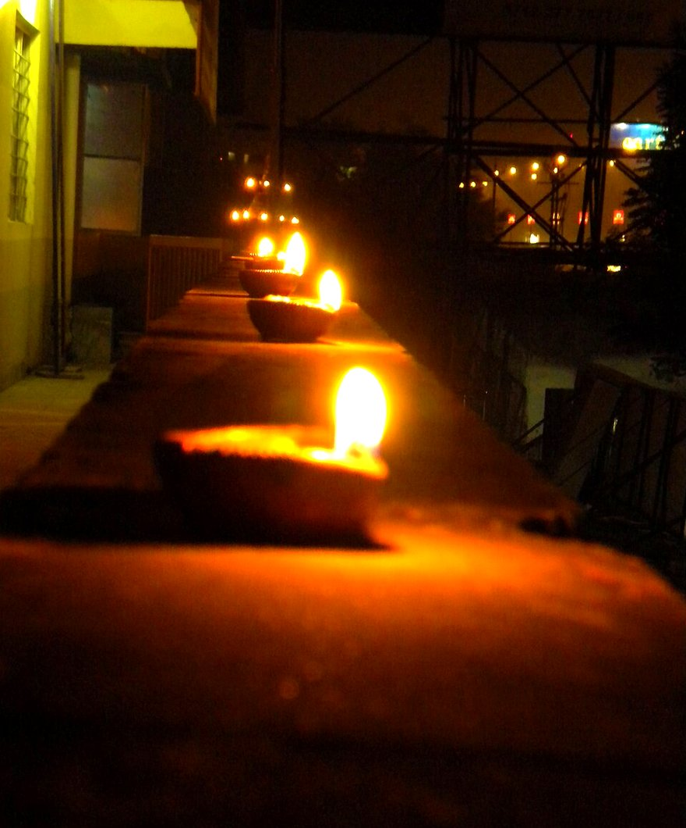
LIVING CELEBRATIONS
A Calendar Governed by Seasons, Moons, and Sacred Light
▪ Diwali & Sacred Light: Celebrated nationwide as the triumph of light over darkness, marked by millions of glowing earthen diyas and rangoli art.
▪ Holi & Seasonal Renewal: The spring festival of colors that dissolves social barriers in joyous communal dancing, music, and seasonal rebirth.
▪ Durga Puja & Public Art: A ten-day festival in Bengal honored by UNESCO for its monumental temporary temple pavilions and craft installations.
▪ Harvest Celebrations across States: Celebrated synchronously as Pongal in the South, Makar Sankranti in the North, Bihu in Assam, and Onam in Kerala.
UNESCO Intangible
FESTIVAL OF LIGHTS & RENEWAL
Diwali Diyas & Sacred Traditions
Kumbh Mela, Durga Puja, and Vedic chanting inscribed on world heritage lists
The Living Civilization: Five Millennia of Indian Culture, Philosophy, and Heritage
09 / 11
Notes:
In India, time is marked not by bureaucratic calendars, but by the cosmic rhythms of nature and harvest. Festivals like Diwali, Holi, and Durga Puja are not private ceremonies; they transform entire cities into vibrant public art galleries. Whether it is lighting a clay lamp or celebrating the winter harvest across twenty different regional names, Indian festivals serve as a social glue uniting diverse communities in celebration. Let us now examine how these ancient traditions resonate across the modern globe.

Slide 10
GLOBAL IMPACT
Ancient Wisdom Reimagined as 21st-Century Soft Power
UNIVERSAL HEALTH
TRANSNATIONAL BRIDGE
Holistic Wellness & Yoga
The Global Indian Diaspora
Celebrated across 190+ nations on International Yoga Day and backed by the WHO Global Centre for Traditional Medicine, Yoga and Ayurveda offer holistic wellness solutions for contemporary life.
From pioneering global technology leadership to popularizing classical music, cuisine, and literature, 32 million overseas Indians actively share civilizational values of pluralism and enterprise.
ETERNAL SYNTHESIS
Continuity in Modernity
Symbiosis of Heritage & Technological Advance
India's emergence as an economic, space, and technological powerhouse is deeply anchored in its civilizational ethos, proving that millennia-old wisdom and cutting-edge innovation flourish together.
The Living Civilization: Five Millennia of Indian Culture, Philosophy, and Heritage
10 / 11
Notes:
As we look at the contemporary world, Indian culture is exerting unprecedented global influence. Yoga is practiced in over one hundred and ninety countries as a universal discipline of mind and body. Ayurveda is being validated through modern scientific research. And the thirty-two-million-strong diaspora carries these ethos of pluralism, enterprise, and hospitality into every corner of the world. India proves that a nation can lead the technological future while keeping its ancient spiritual roots firmly intact.

Slide 11
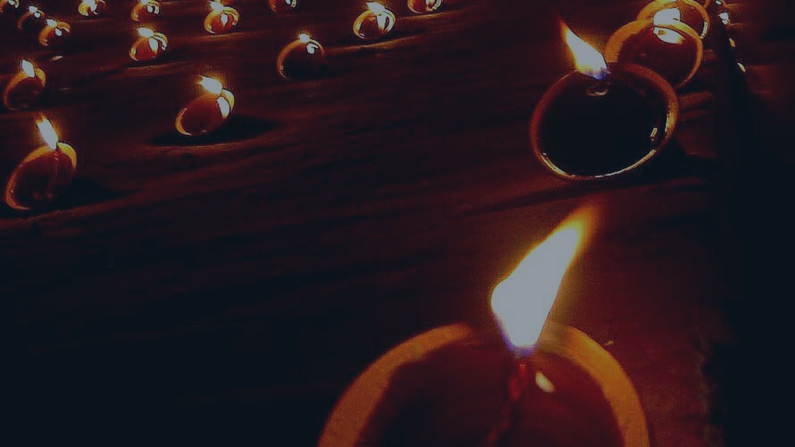
THE TIMELESS LEGACY
Continuity in Transformation
The Eternal Flow of Bharat — Rooted in Five Millennia, Inspiring the Global Future
5,000 Years of Living Thought
From ancient Vedic hymns to modern space exploration, the spirit of India continues to illuminate human consciousness
Notes:
To conclude: Indian culture is not an antique frozen in time. It is a flowing river—what the ancients called Sanatana, that which is eternal yet constantly renewed. It taught the world that unity does not require uniformity, that truth has infinite facets, and that all humanity belongs to one single family. Thank you.

