Slide 1

GameGuard AI
Adaptive Preventive Wellness Companion for Gamers
AI-Based Tactical Wellness System
Presented By
Tanuja Jadhav | PRN: 202501110023
Khushi Bode | PRN: 20250110032
Sharyu Surkute | PRN: 202501110028
Shrutika Kasbe | PRN: 202501110074

Slide 2
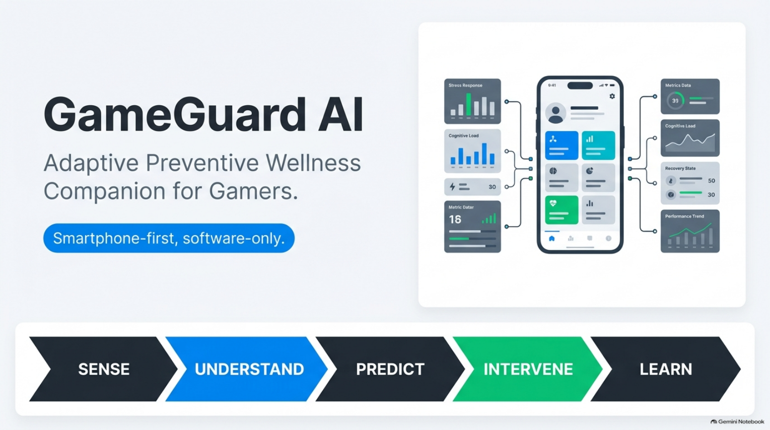

Slide 3
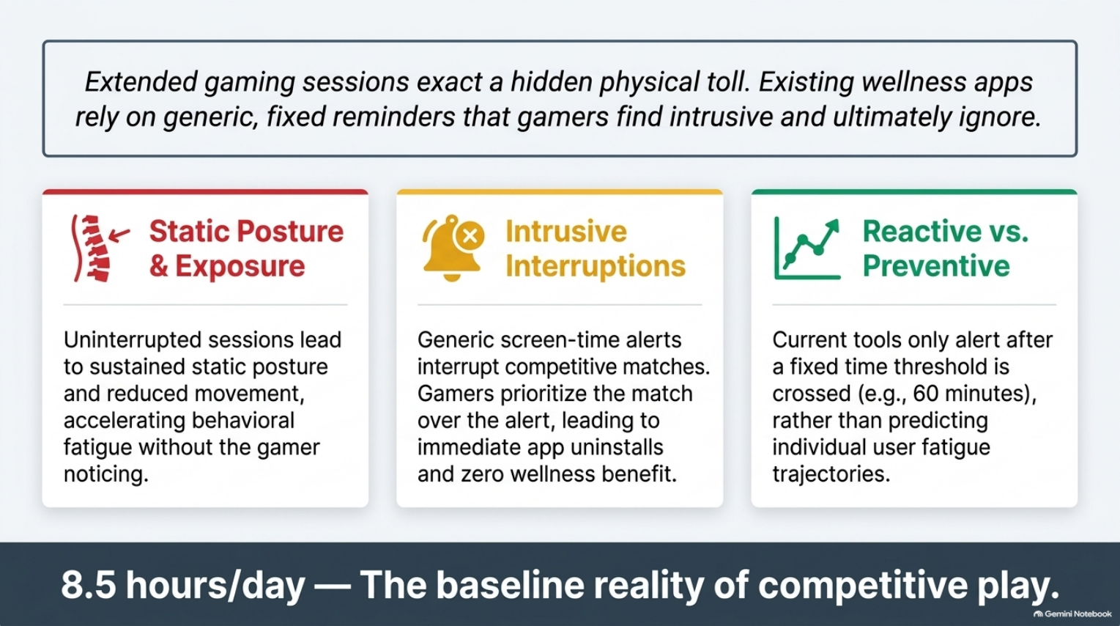

Slide 4
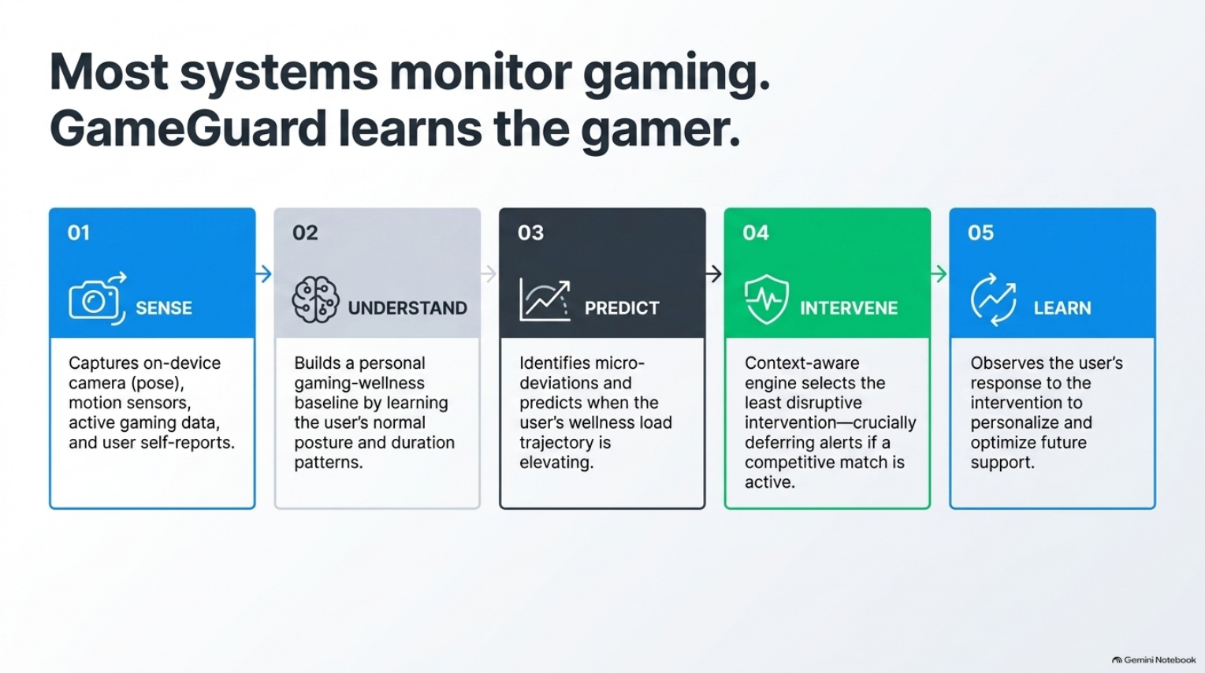

Slide 5
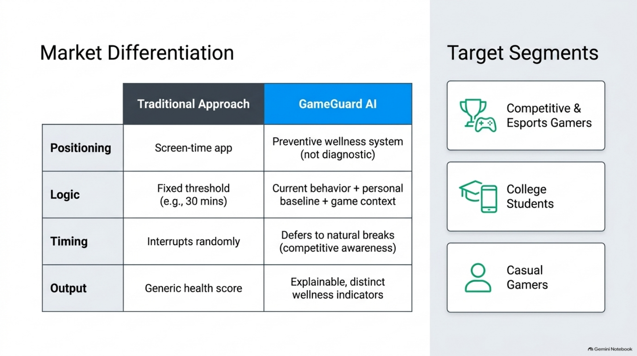

Slide 6
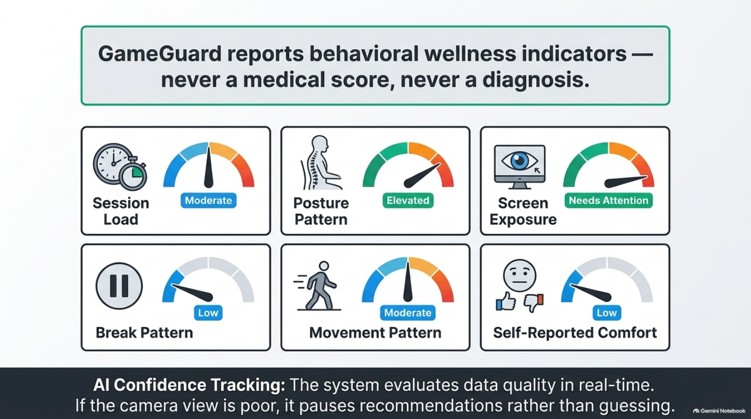

Slide 7
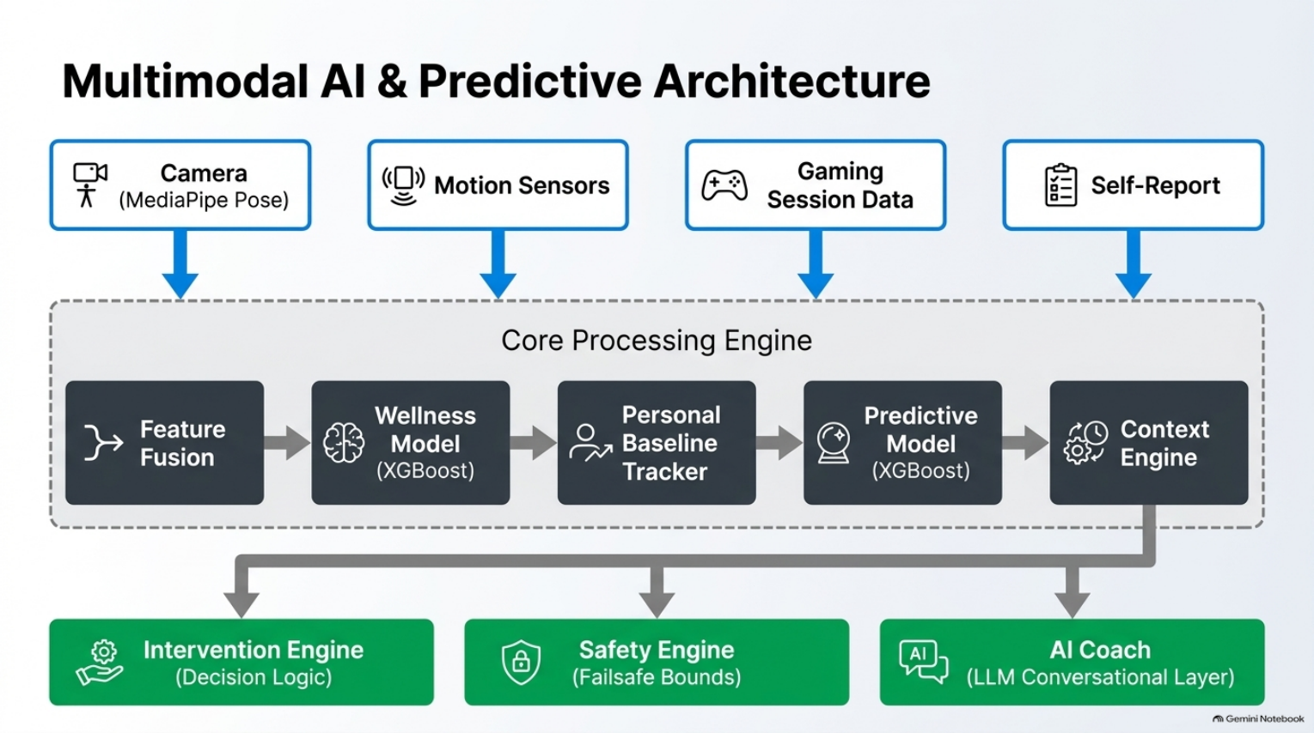

Slide 8
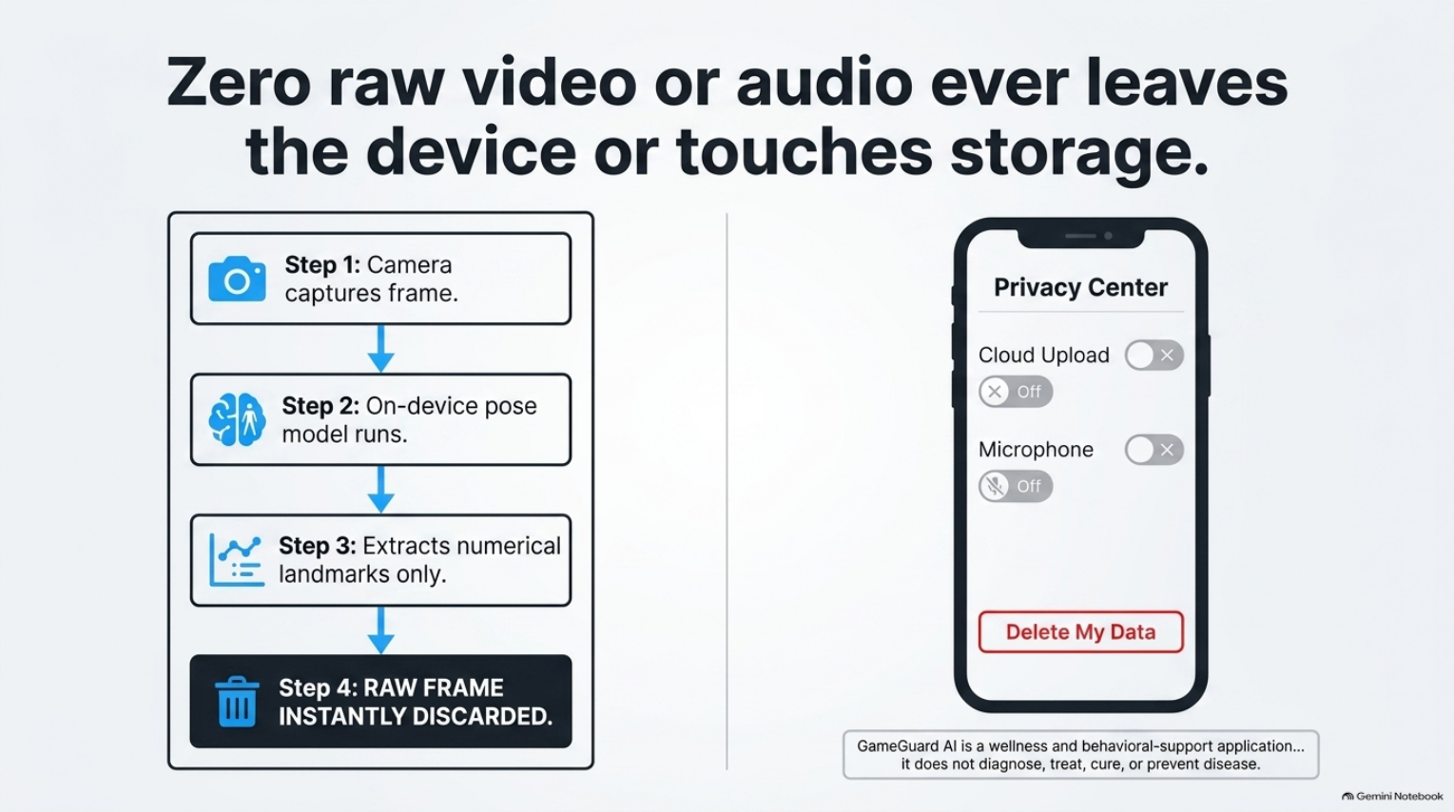

Slide 9
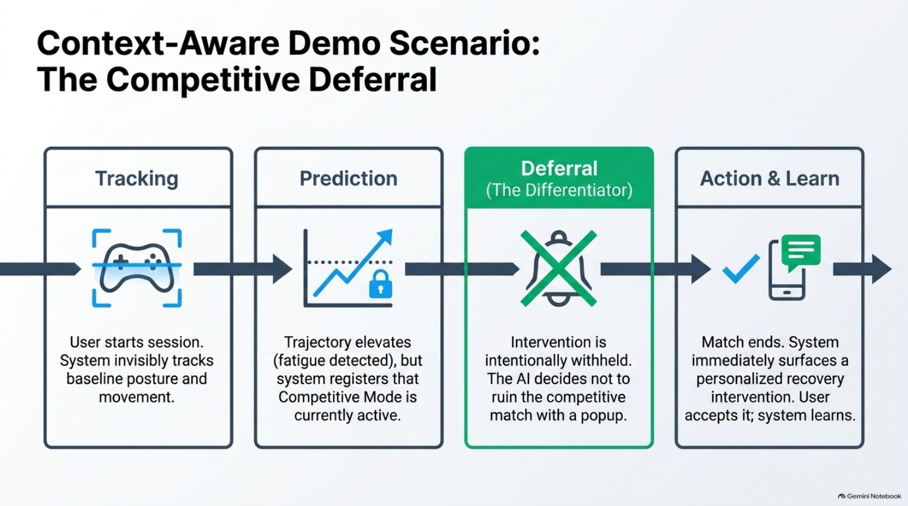

Slide 10
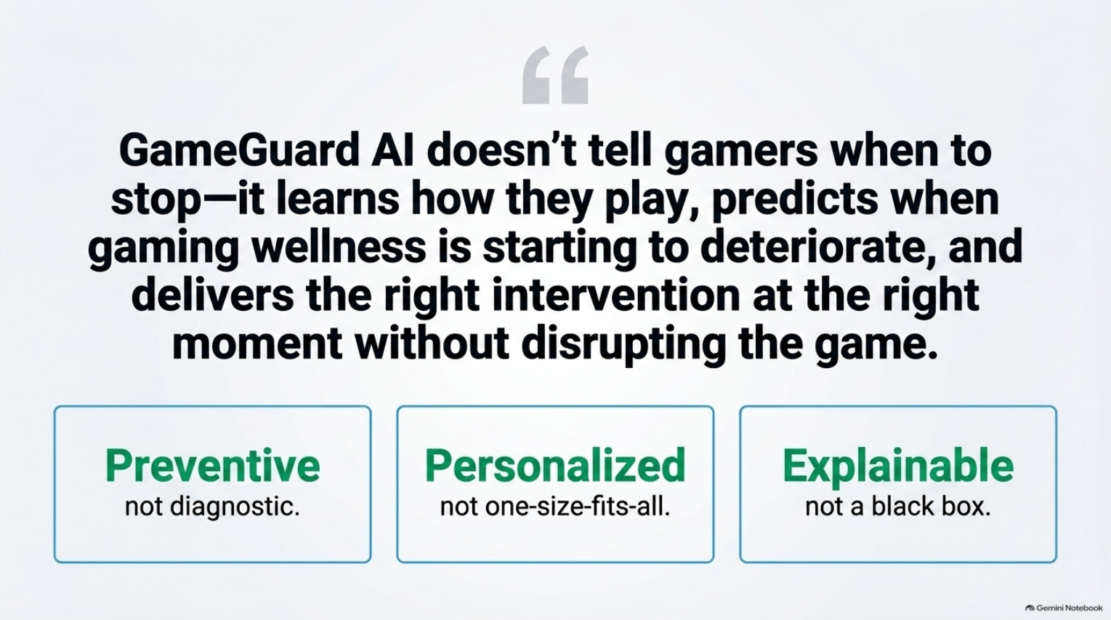

Slide 11
THANK YOU!!!!

