Slide 1

EDGE-AI ENABLED IOT ARCHITECTURE FOR EARLY FIRE DETECTION IN SMART AGRICULTURE
SIR C R REDDY COLLEGE OF ENGINEERING
DEPARTMENT OF ELECTRONICS AND COMMUNICATION ENGINEERING
Under the Guidance of
Mr. H.Sudhakar M.Tech,(Ph.D)
Assistant Professor
Dept of ECE
Presented by
G.Tanuja Sai Swathi (22B81A0452)
B.Sri Rajendra (22B81A0422)
Ch.Raj Kumar (22B81A0426)
D.Ajay (22B81A0441)
B.Ramesh (22B81A0420)

Slide 2
CONTENTS
_________
Introduction
Problem Statement
Objectives
Literature Survey
Existing Methodology
Designed Methodology
Block Diagram
Materials
Working
Prototype
Implementation Details
Key Observations
Key Differences
Results and Discussion
Limitations of Existing Methodology
Key Advantages of Proposed System
Python Code
Conclusion
References

Slide 3
ABSTRACT
_________
Agricultural fields face high fire risk due to heat, drought, dry vegetation, lightning, equipment faults, and human activity. Rapid fire spread demands early detection to reduce crop loss. This project presents an Edge-AI IoT fire detection system for smart agriculture. It integrates DHT11 temperature and humidity sensing, flame sensors, and a camera for multi-layer monitoring. A YOLO-based model on Raspberry Pi 4 performs real-time fire detection with bounding boxes and alerts. Edge computing ensures low latency and no internet dependency. A Flask dashboard displays live video, sensor data, and alerts. Testing shows reliable, fast detection with a cost-effective, scalable design.
Keywords:
IoT, Smart Agriculture, Early Fire Detection, Sensor Fusion, Raspberry Pi, Edge-Ai, Python, Cloud, Mobile Alerts, Sustainability, YOLO.

Slide 4
1.Introduction
_________
Smart Agriculture: The integration of IoT technologies is crucial for optimizing crop management and monitoring.
Global Challenges: Climate change is increasing pressure on natural resources and heightening food safety requirements.
The Problem of Fire: Fire risk management is a major challenge in the agricultural sector, potentially causing significant resource loss and impacting food safety.
Need for Innovation: Traditional fire detection methods can be inadequate in speed and accuracy, making it essential to develop advanced systems for real-time monitoring and effective risk management.

Slide 5
______________
2. Problem Statement
Agricultural fields are increasingly vulnerable to fire hazards due to climate change, rising temperatures, and resource stress conditions. Existing fire detection methods are often slow, reactive, and lack accuracy, making them ineffective in preventing rapid fire spread. Most current systems do not leverage the combined capabilities of IoT & Edge AI for real-time, local detection. Additionally, the absence of immediate data processing and automated alert mechanisms leads to delayed response and increased damage. Therefore, there is a critical need for an intelligent, real-time fire detection system that enables fast, accurate, and autonomous monitoring in agricultural environments.

Slide 6
3.Objectives
________
To design and develop an Edge-AI based fire detection system for agricultural fields by integrating sensors and computer vision for real-time monitoring.
To implement a YOLO-based deep learning model on Raspberry Pi for accurate and low-latency fire detection using local (edge) processing.
To develop a web-based monitoring and alert system that provides real-time data visualization and immediate fire notifications to users.

Slide 7
4. Literature survey
Author | Year | Methodology | Advantages | Limitations
Ramadan et al. | 2024 | UAV-based early wildfire detection using thermal + RGB cameras, onboard SBCs, and lightweight CNNs at the edge | Fast detection over large areas; edge AI reduces latency; scalable coverage | Limited drone flight time and energy; less ground-level sensor fusion
Morchid et al. | 2024 | IoT-enabled fire detection in sustainable agriculture using , multi-sensors, ThingSpeak/cloud, classical ML & embedded DL | Real-time detection; dashboards for farmers; sustainable design | Prototype scale; needs stronger mesh resilience and sensor fusion
Titu et al. | 2024 | Real-time fire detection using drones with edge computing and pruned CNN/YOLO models | Edge inference reduces latency and backhaul; good accuracy | Focuses on visual detection only; lacks smoke/gas sensor fusion
Özel et al. | 2024 | Survey of modern forest-fire detection (vision + DL + sensors) comparing edge vs cloud | Identifies DL + edge computing as future direction; maps trends | No implementation; review only
Aliyu et al. | 2023 | Blockchain-based trusted logging of IoT sensor data over LoRa/Cellular gateways | Tamper-proof audit trail; improved trustworthiness | Scalability & transaction cost issues for constrained nodes

Slide 8
5.Existing Methodology
_ ____ ___
Manual Monitoring: Fire detection relies on human observation, which is slow, inconsistent, and prone to delay.
Sensor-Based Detection: Uses smoke, heat, or flame sensors with fixed thresholds, often leading to false alarms in outdoor environments.
Cloud-Based Processing: Data from sensors or cameras is sent to cloud servers for analysis, causing latency and dependency on internet connectivity.
Limited Automation: Existing systems lack intelligent analysis and real-time alert mechanisms, resulting in delayed response to fire incidents.

Slide 9
6.Designed Methodology
_ ____ ___
System Architecture Design: A three-layer IoT architecture (sensing, edge processing, application) is designed to ensure modularity and efficient data flow.
Hardware Integration: Sensors (DHT11, flame sensor) and camera are interfaced with Raspberry Pi for real-time data acquisition.
Algorithm Development: A YOLO-based deep learning model is implemented for accurate fire detection from video frames.
Edge Implementation & Integration: The system processes all data locally on Raspberry Pi and integrates detection results with a Flask-based web dashboard for monitoring and alerts.

Slide 10
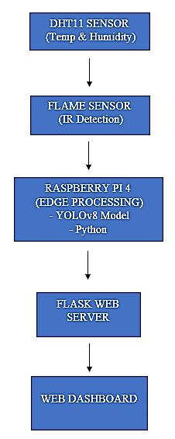
7.Block Diagram
____

Slide 11
8.Materials
_______
Raspberry Pi 4 Model B
Operating voltage: 5V / 3A
DHT11 Temperature & Humidity Sensor
Temperature range: 0°C to 50°C
Humidity range: 20% to 80% RH
Flame Sensor (IR-based)
Detection range: up to ~1 meter
Detection wavelength: 760nm to 1100nm
Camera Module (USB / Pi Camera)
Operational resolution: ~640×480 (for real-time processing)
Frame rate: ~15–30 FPS
Power Supply Unit
Input requirement: 5V / 3A
Supports battery / solar-based operation

Slide 12
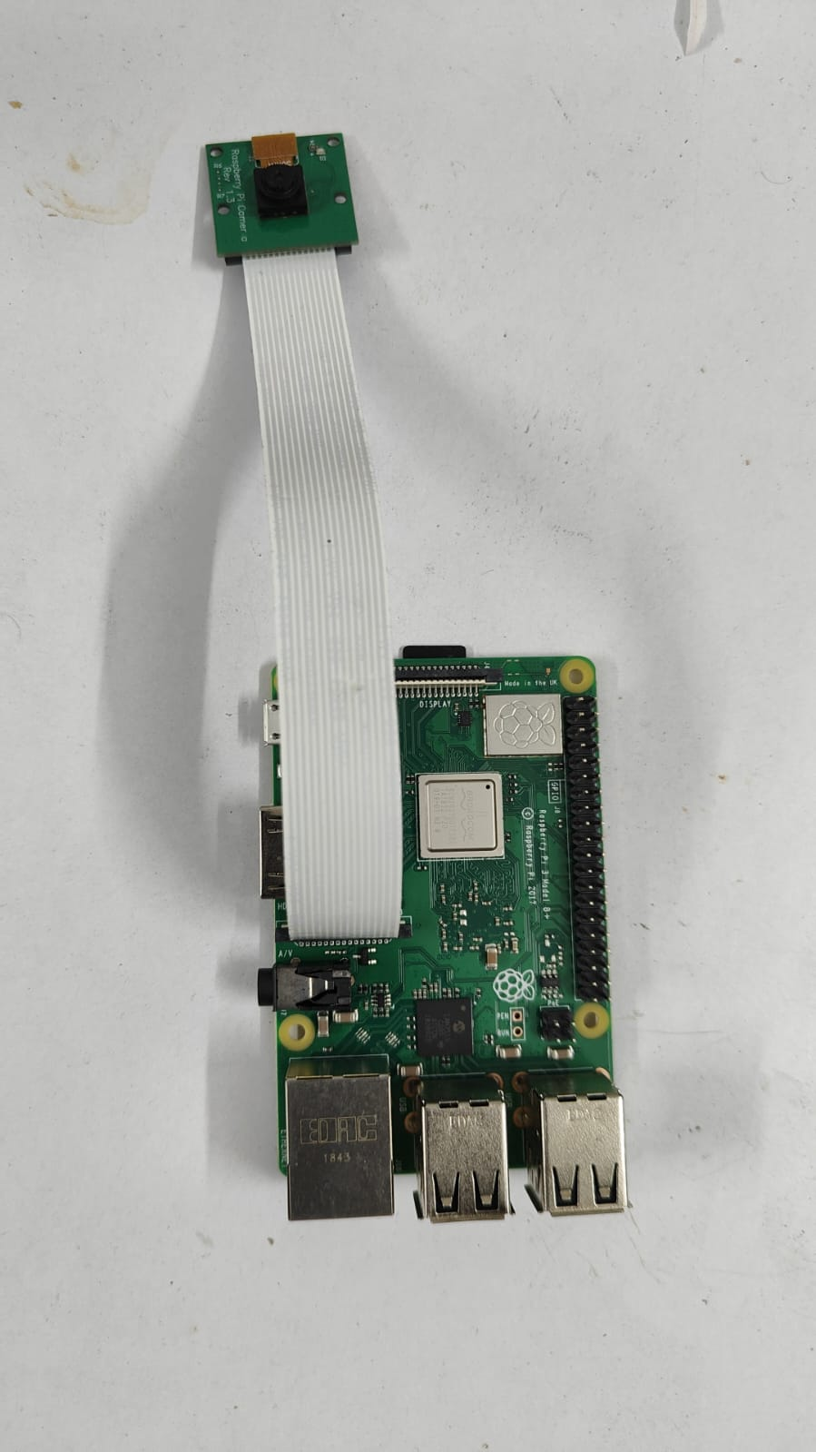
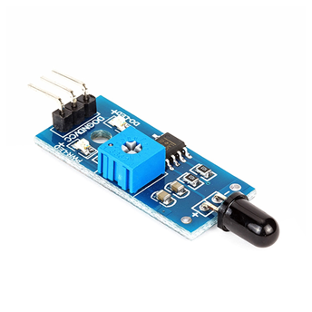
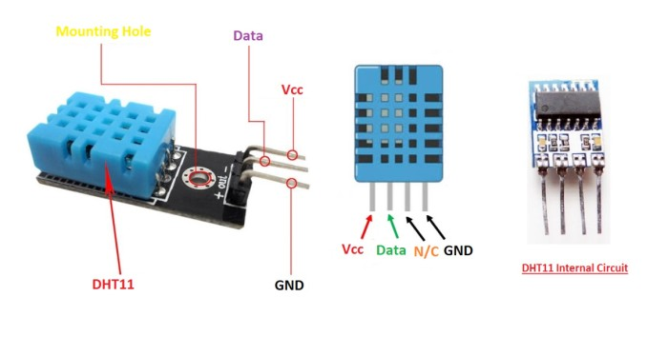
Raspberry pi with camera
DHT11 & Humidity sensor
Flame sensor

Slide 13
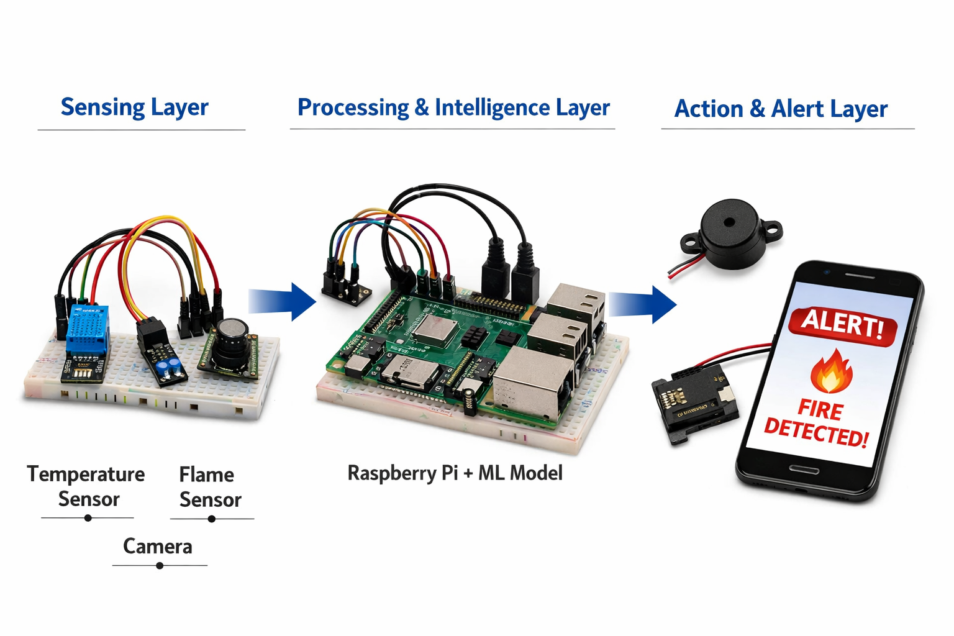
9.Working
Flow diagram
Sensing Layer: Collects real-time environmental and visual data using DHT11, flame sensor, and camera.
Edge Processing Layer: Processes sensor and video data on Raspberry Pi using YOLO to detect fire in real time.
Application Layer: Displays data and generates alerts through a Flask-based web dashboard.

Slide 14
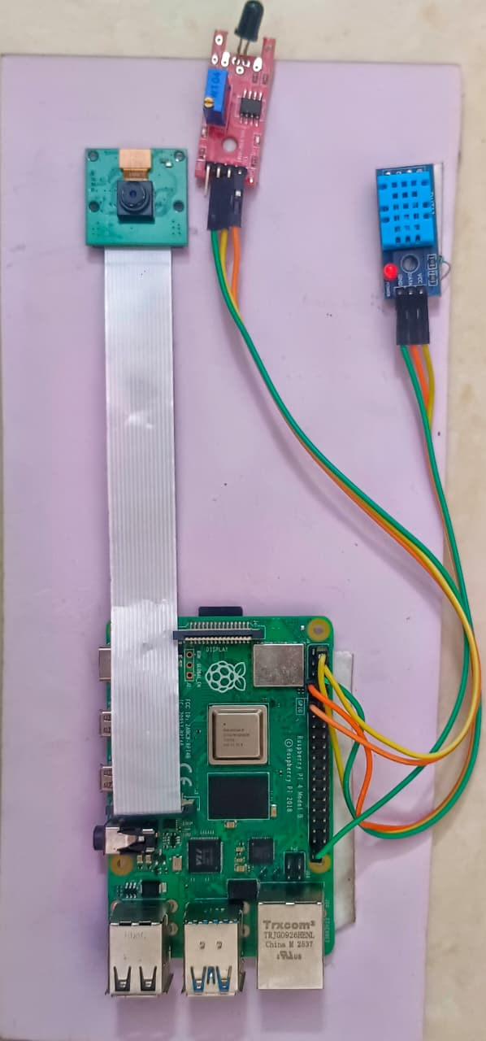
10. Prototype
_______

Slide 15
11. Implementation Details
__________________
Hardware Setup: The Raspberry Pi 4 is interfaced with DHT11 and flame sensors through GPIO pins, while a USB/Pi camera is connected for continuous video capture.
Sensor Integration: Temperature, humidity, and flame data are periodically read using Python libraries and stored for real-time processing.
Fire Detection Algorithm: A YOLOv8 model is deployed on the Raspberry Pi to analyze video frames and detect fire regions with bounding boxes and confidence scores.
Multithreaded Processing: Separate threads are used for sensor data collection, video processing, and web server execution to ensure smooth real-time performance.
Web Dashboard & Alerts: A Flask-based application displays live video, sensor data, and generates alerts when fire is detected.

Slide 16
12. Key Observations
______________
Fire detection is faster and more reliable when sensor data and vision (YOLO) are combined rather than used individually
Detection performance is highest within short to medium range (up to ~2 meters) and decreases with distance
Temperature rise and humidity drop act as early indicators before visible fire is detected
Edge processing on Raspberry Pi ensures low latency and continuous operation without internet dependency.

Slide 17
13.Key Differences
__________
Edge-based local processing vs cloud-based processing (lower latency, no internet dependency)
Multi-modal detection (YOLO + sensors) vs sensor-only detection
Real-time alerts vs delayed cloud-based response
Intelligent AI-based analysis vs threshold-based detection
Faster response and higher accuracy vs limited responsiveness and reliability

Slide 18
14. Results and Discussion
________________
Results
Detected flame quickly and accurately.
Edge AI (Raspberry Pi) gave faster response than cloud-only.
Sensors setup reduced false alarms.
Data and alerts shown on mobile.
Sensors fusion made the system robust against false triggers like dust or temporary smoke.

Slide 19
Discussion
System is accurate, fast, and reliable.
Works in remote farms with solar power.
System is cost effective and suitable for small to medium-scale deployment
Supports safe and sustainable smart agriculture
Uses the sensors and device’s quantity based on Land scalability and space.

Slide 20
15.Limitations of Existing Layer
______________________
Rely on single sensors (only smoke or flame) → more false alarms.
Work on simple thresholds → cannot adapt to complex conditions.
No Edge AI → all processing is cloud-based, causing delays.
Limitations of Existing Methods before using Raspberry Pi with Edge AI + Cloud)

Slide 21
16.Key Advantages of Proposed System
_______________________
Low Latency Detection
Internet Independence
Improved Accuracy
Cost-Effective Solution
Real-Time Monitoring and Alerts

Slide 22
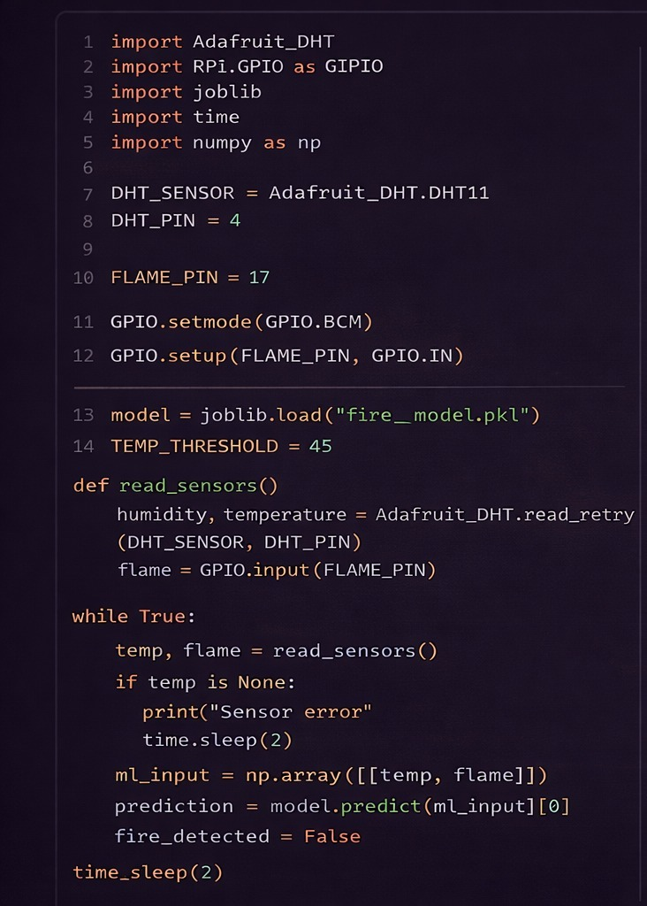
17.Python Code
________

Slide 23
18.Conclusion
_______
Developed an Edge-AI based fire detection system for smart agriculture
Integrated sensors and YOLO model for real-time fire detection
Achieved low latency using edge computing without internet dependency
Provided live monitoring and alerts through a web dashboard
Demonstrated reliable performance with good accuracy and low false alarms
Proposed a cost-effective and scalable solution for agricultural fire safety

Slide 24
References
M
Morchid, A., Oughannou, Z., El Alami, R., & Qjidaa, H. (2024). IoT-enabled fire detection for sustainable agriculture: real-time fire detection system tailored for smart agriculture. Sustainable Computing: Informatics and Systems, Elsevier.
Lee, S.-J., Yun, H.-S., Sim, Y.-B., & Lee, S.-H. (2025). Design and Validation of an Edge-AI Fire Safety System with SmartThings Integration for Accelerated Detection and Targeted Suppression. Applied Sciences, MDPI.
Titu, M. F. S., Pavel, M. A., Michael, G. K. O., Babar, H., Aman, U., & Khan, R. (2024). Real-Time Fire Detection: Integrating Lightweight Deep Learning Models on Drones with Edge Computing. Drones, MDPI.

Slide 25
References
Rachman, A. S., et al. (2021). Fire early detection IoT-based using NodeMCU ESP8266 and ThingerIO web server. ResearchGate.
Sharma, N., & Yadav, V. (2024). NodeMCU-based Forest Fire Detection System. International Journal of Novel Research and Development (IJNRD).
Rahman, A., & Paul, B. (2025). Efficient Edge Deployment of Quantized YOLOv4-Tiny for Aerial Emergency Object Detection on Raspberry Pi 5. arXiv preprint.
Yin, H., et al. (2023). A real-time detection model for smoke in grain bins with compressed ML techniques. Sensors (MDPI).

