Slide 1
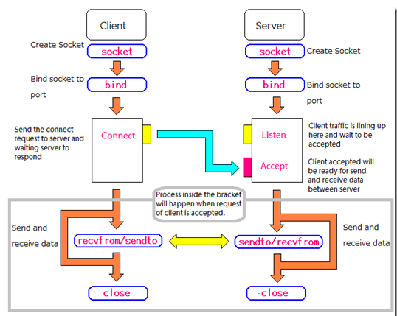
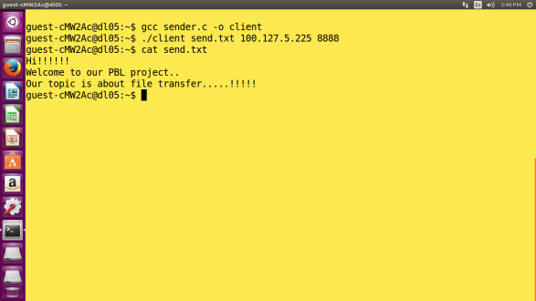
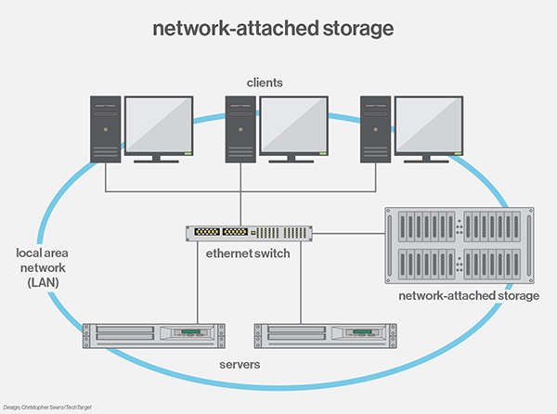
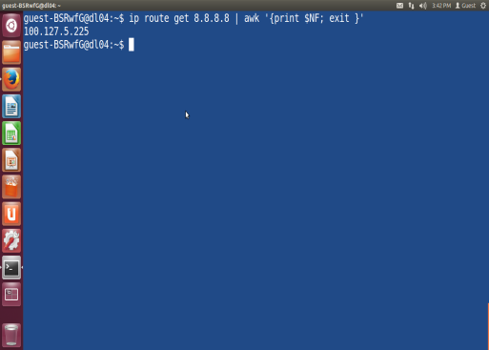
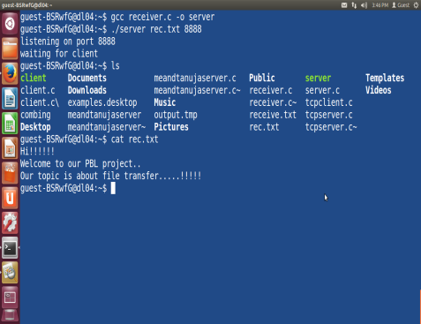
BMS INSTITUTE OF TECHNOLOGY & MANAGEMENT
Department of CSE
Mr. Ravi Kumar B N, Assistant Professor
FILE TRANSFER IN LINUX
Swathi B R , Swathi N S,Tanuja S,Tanushree S
Introduction:-
File sharing is the public or private sharing of computer data or space in a network with various levels of access privilege. While files can easily be shared outside a network (for example, simply by handing or mailing someone your file on a diskette), the term file sharing almost always means sharing files in a network, even if in a small local area network.
System Architecture:-
Fig:
Fig: Displaying contents of transferred file in client terminal.
Snapshots:-
Fig: To get the IP address of server
Objectives:-
To use 2 computer systems having Linux environment as an Operating Systems and having LAN connection.
Always the system in which the client program runs is the sender of the file.
Always server is the recipient of the file sent by the client.
Here we assume that, only one client is transferring the file at a time.
Here we are transferring only text files.
There is no limit for the size of the file to be transferred from Client to Server.
Conclusion And Future Enhancements:-
Timeout functions can be added for the receiver part such that how long it can wait to receive the massage from the client.
Here we are using one client and one server. Future scope can be implemented with more number of clients , transferring files to the server or among the clients itself.
Group chat can also be implemented.
Further, transferring of audio and video files can be done using 2 way communication.
Here we are implementing sharing files in same platform .For future scope we can implement for cross environment.
Fig: Displaying contents of transferred file in server terminal.

