Slide 1
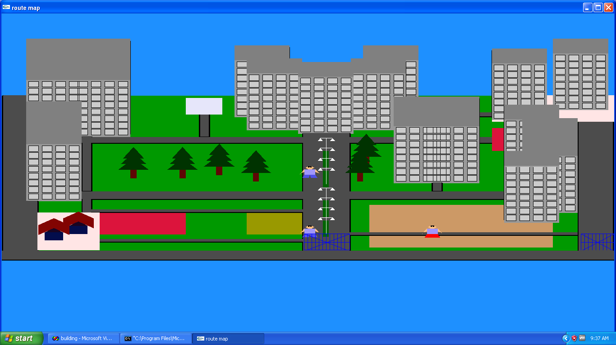
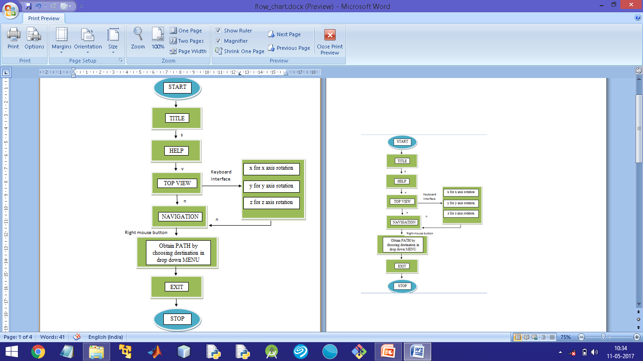
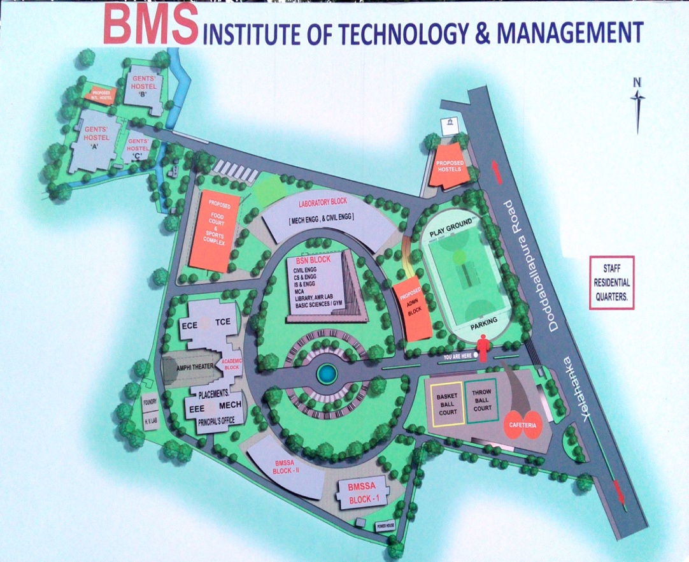
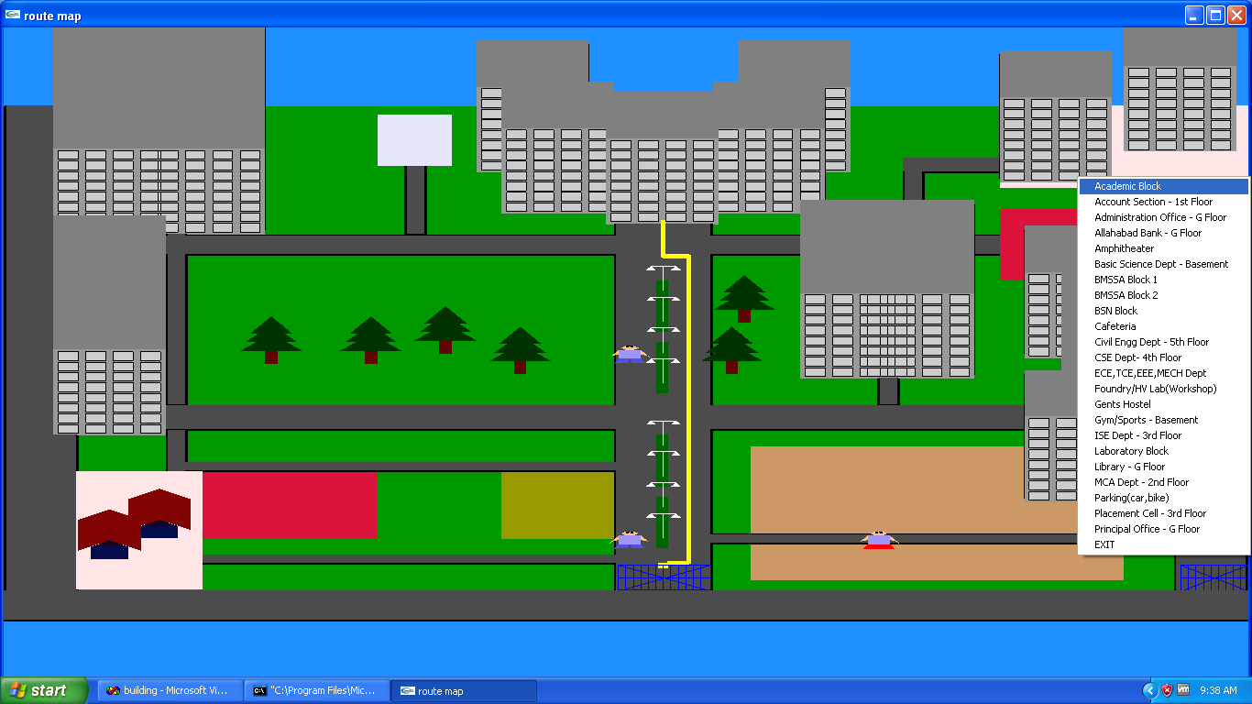
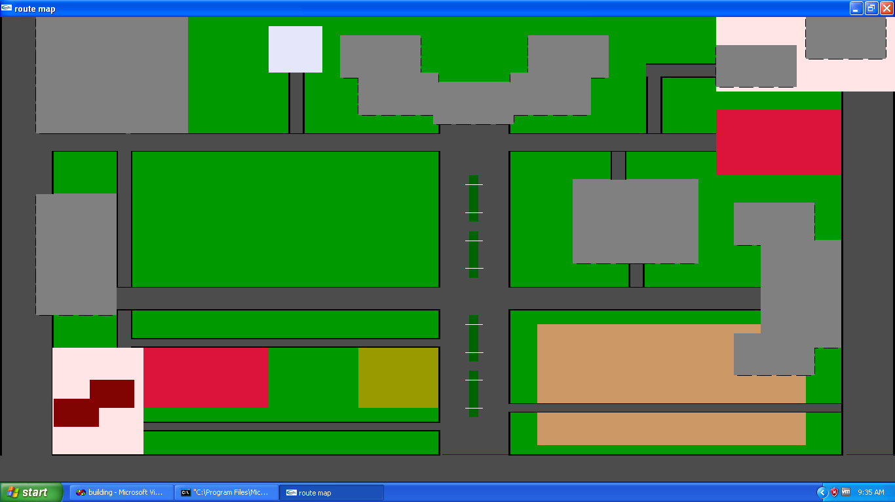
GRAPHICAL IMPLEMENTATION OF 3D ROUTE MAP OF BMSIT&M
Dr Anil G N(Associate Professor),Mr Anand R(Assistant Professor),
Mrs Ambika G N(Assistant Professor), Dept. of CSE
Tanuja S,Tanushree S
Introduction:-
Before GPS, before radar, and even before sonar, a traveler’s best chance at finding the way around the big land was charts and maps. One of the mostly used maps are Road maps or Route maps. A road map or route map is a map that primarily displays roads and transport links rather than natural geographical information. This route maps can be implemented using openGL API .
Flow Chart :-
Fig. Front View
Snapshots:-
Fig. Route map of BMSIT & M College.
Fig. Obtaining the path
Objectives:-
To show the navigation path through BMSIT&M using openGL.
Effective usage of c++ language.
To provide a variety of route options like menus, commands etc.
To provide multiple interfaces by either using keyboard or mouse.
To make user friendly application supporting with all information required.
To show navigation in top, front and 3d views.
Future Enhancement:-
Detailed graphical implementation can be done .
Collision detection algorithm can be added.
Perspective views can be added and camera viewing options can be given.
More than one path can be shown .
Conclusion:-
If you are a visitor to BMSIT&M you can use this 3D ROUTE MAP to navigate the entire campus without any hurdles in your way.
Fig.Top View

