Slide 1

BMS INSTITUTE OF TECHNOLOGY AND MANAGEMENT
Department of Computer Science and Engineering
Project Presentation Phase - I
Multimodal Biometrics for User Security and Identification Management.
Batch No:CSE-B7
Under the Guidance of:
Mrs.Bharathi R.
Associate Professor
Dept of CSE
BMSIT&M,Bengaluru.
Submitted By:
Sumaiya Rahman (1BY14CS076)
Tanuja S. (1BY14CS081)
Tanushree S. (1BY14CS082)
Vaishnavi V. (1BY14CS087)

Slide 2
CONTENTS
Introduction
Problem Statement
Literature Survey
Objectives
Proposed System
Methodology
References

Slide 3
INTRODUCTION
Multimodal biometric technology uses more than one biometric identifier to compare the identity of the person.
Benefits and Advantages of Multimodality:
􀁺 Accuracy– False Non Match Rate(FNMR), False Match Rate(FMR).
􀁺Enrollment– Full Time Equivalent , Universal registration requirements.
􀁺Anti-Spoofing.

Slide 4
PROBLEM STATEMENT
The systems using passwords, pin codes, etc for authorization purposes have a disadvantage that other persons may know their secret numbers or even they can guess that easily.
To avoid theft through hacking or other techniques, biometrics which involves measuring and analysing a person’s unique characteristics can be implemented.
Hence the system can be ultra secure.
To provide more-than-average accuracy we carry out multi-modal biometrics.

Slide 5
LITERATURE SURVEY
Papers | Authors | Description | Publication
[1] A Robust Multimodal Biometric System Integrating Iris, Face and Fingerprint using Multiple SVMs . | Sheetal Chaudhary, Rajender Nath ,Kurukshetra University | This paper presents a robust multimodal biometric recognition system integrating iris, face and fingerprint based on match score level fusion using multiple support vector machines (SVMs). | Volume 7, No. 2, March-April 2016 ,IJARCS.
[2] Multimodal Biometric Authentication Using Fingerprint and Iris Recognition in Identity Management | Kamer Vishi, S¸ ule Yildirim Yayilgan Gjøvik University College | This paper presents a novel multimodal biometric authentication approach fusing iris and fingerprint traits at score-level. | 2013 Ninth International Conference on Intelligent Information Hiding and Multimedia Signal Processing, IEEE.

Slide 6
OBJECTIVES
To improve the authentication accuracy using more than one biometric.
To enhance the quality of feature extraction of fingerprint and iris.
Develop and implement score level fusion for above modalities.

Slide 7
PROPOSED SYSTEM
AMOLD FRAMEWORK
Acquisition

Slide 8
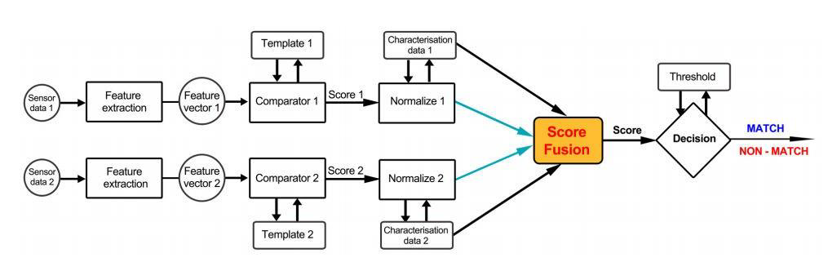
METHODOLOGIES

Slide 9
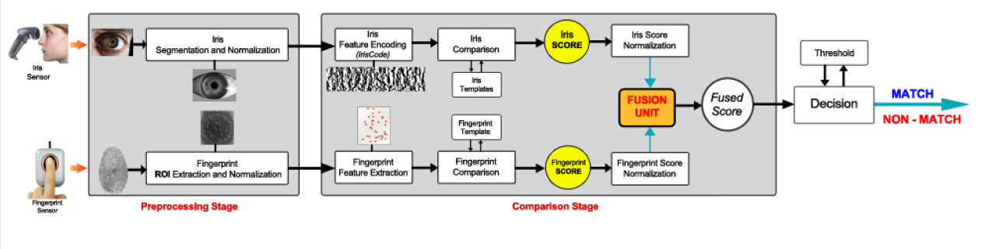

Slide 10
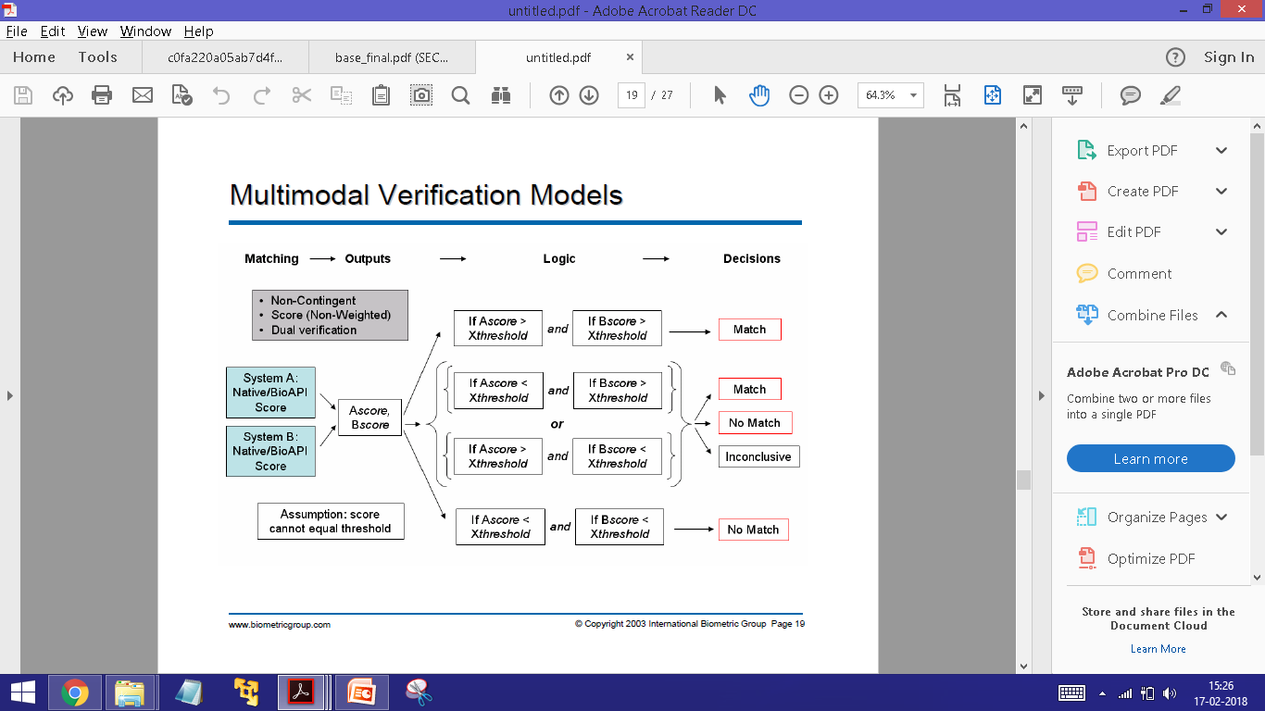

Slide 11
REFERENCES
[1] Safaa S. Omran , Maryam A. Salih “Design and Implementation of Multi-Model Biometric Identification System”,International Journal of Computer Applications (0975 – 8887) Volume 99 – No.15, August 2014 .
[2] Kamer Vishi, S¸ule Yildirim Yayilgan, “Multimodal Biometric Authentication using Fingerprint and Iris Recognition in Identity Management”, IEEE Ninth International Conference on Intelligent Information Hiding and Multimedia Signal Processing 2013.
[3] B.Sabarigiri a and D.Suganyadevi b, “An Efficient Multimodal Biometric Authentication based on IRIS and Electroencephalogram (EEG)”, Proc. of Int. Conf. on Control, Communication and Power Engineering, CCPE, Elsevier, 2014,pg 606-618.

Slide 12
THANK YOU……!!!!

