Slide 1

BMS INSTITUTE OF TECHNOLOGY AND MANAGEMENT
Department of Computer Science and Engineering
Project Presentation Phase - II
Multimodal Biometrics for User Security and Identification Management.
Batch No:CSE-B7
Under the Guidance of:
Mrs.Bharathi R.
Associate Professor
Dept of CSE
BMSIT&M,Bengaluru.
Submitted By:
Sumaiya Rahman (1BY14CS076)
Tanuja S. (1BY14CS081)
Tanushree S. (1BY14CS082)
Vaishnavi V. (1BY14CS087)

Slide 2
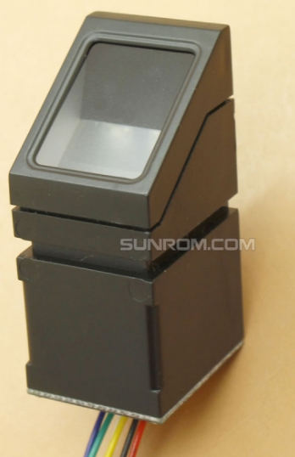
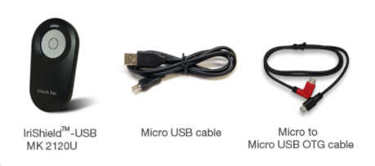
Component Specification
HARDWARE SPECIFICATION
Fingerprint module:
R307.
Iris module:
IriShield MK2120UL.
Interface:
Arduino Board.
SOFTWARE SPECIFICATION
Visual Basic 2017

Slide 3
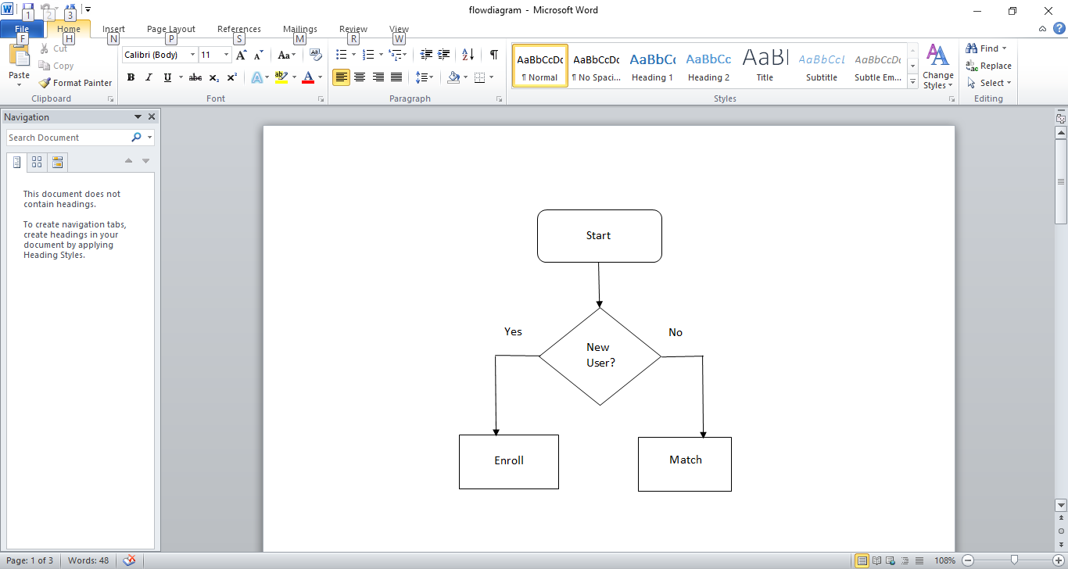
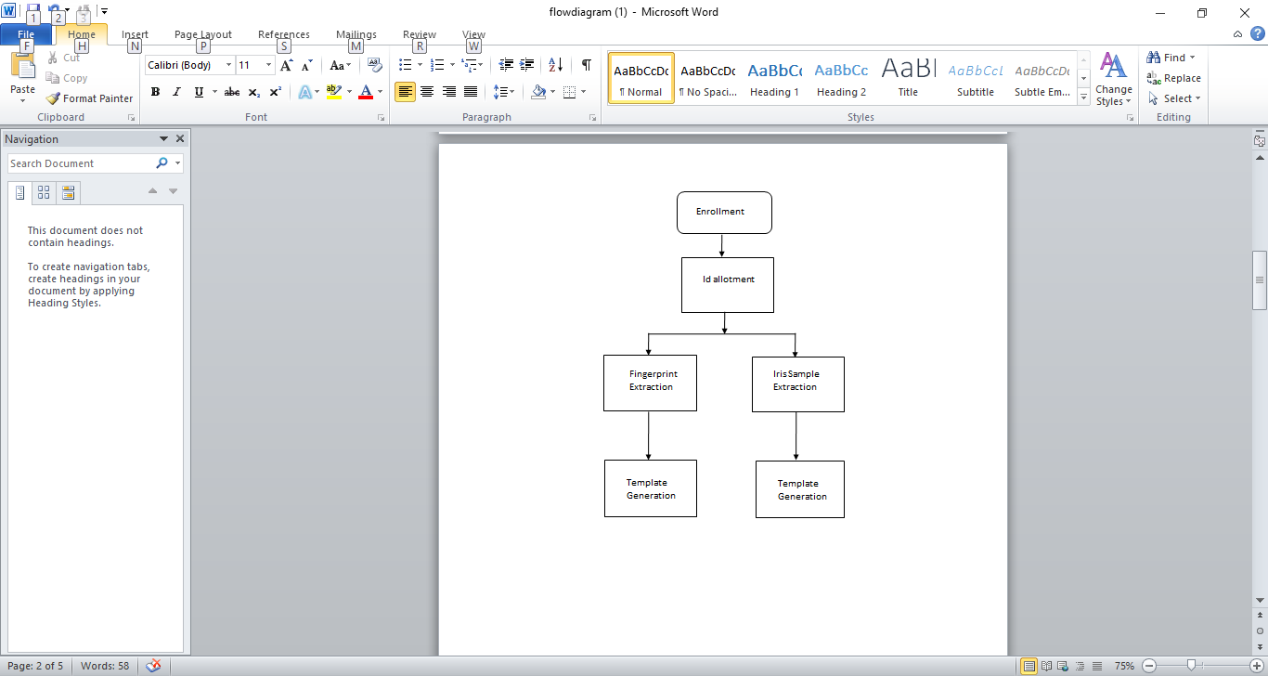
Flow Diagram
(register)

Slide 4
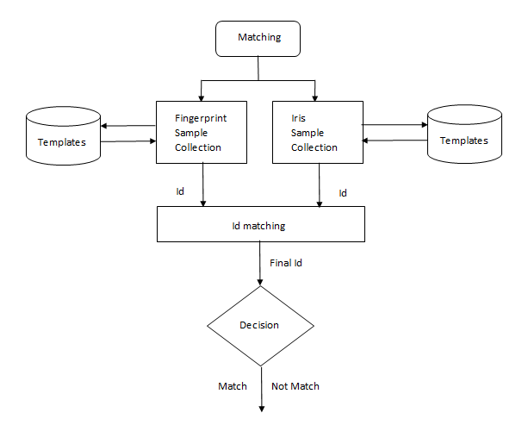

Slide 5

Use Case
USER
DEVICE

Slide 6
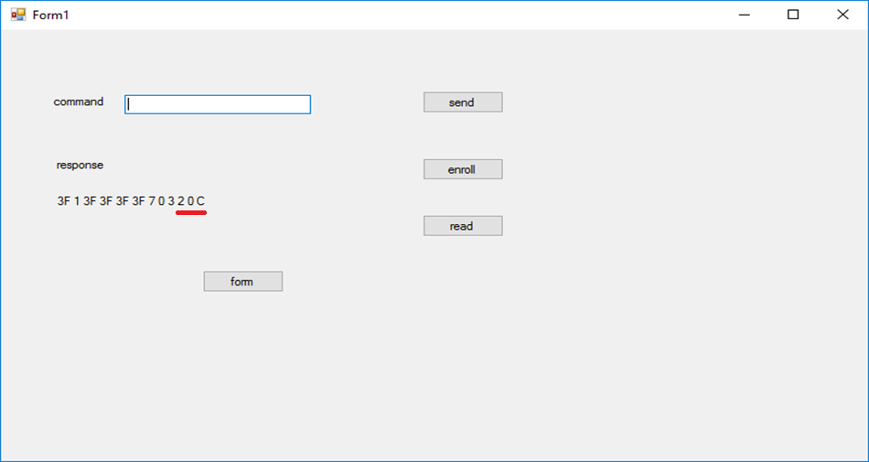
Work in Progress

Slide 7


Slide 8
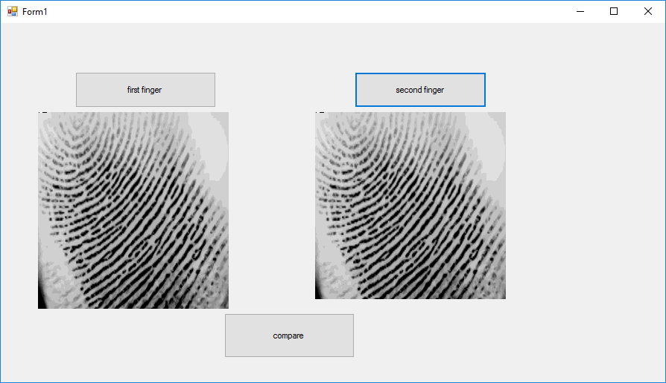

Slide 9
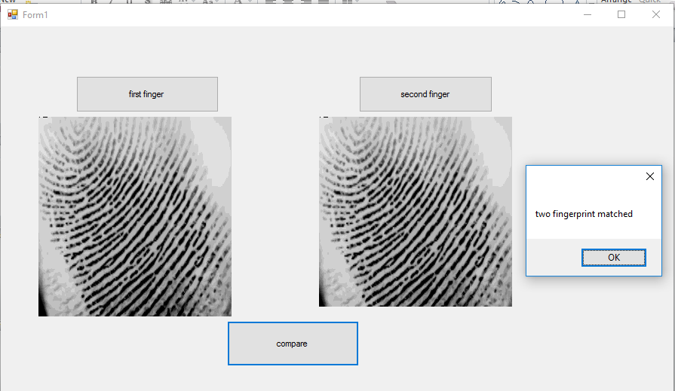

Slide 10
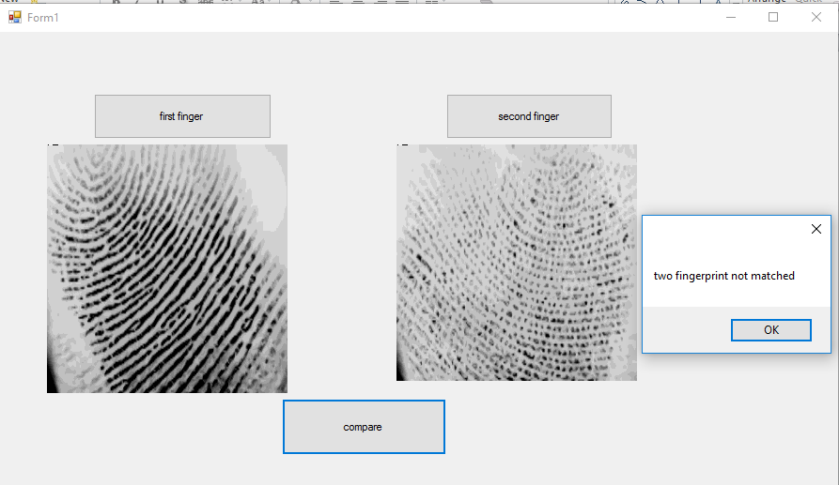

Slide 11
Thank You

Slide 12
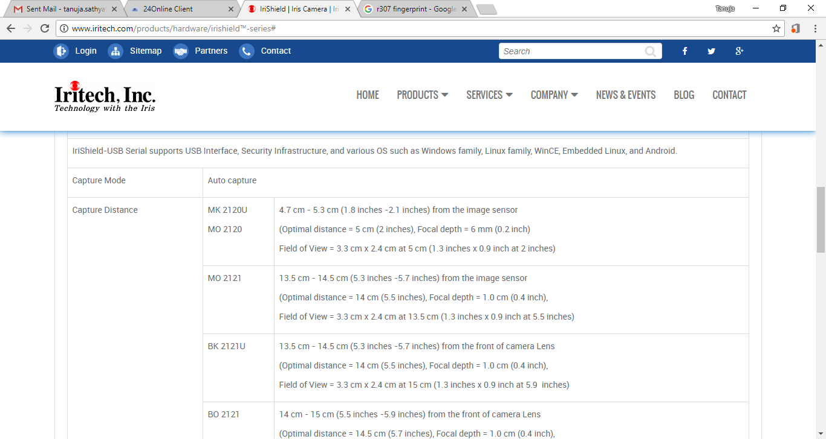

Slide 13


Slide 14
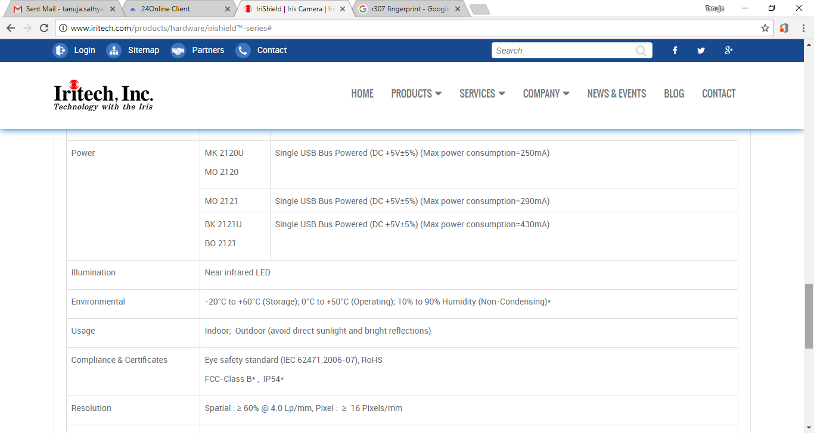

Slide 15
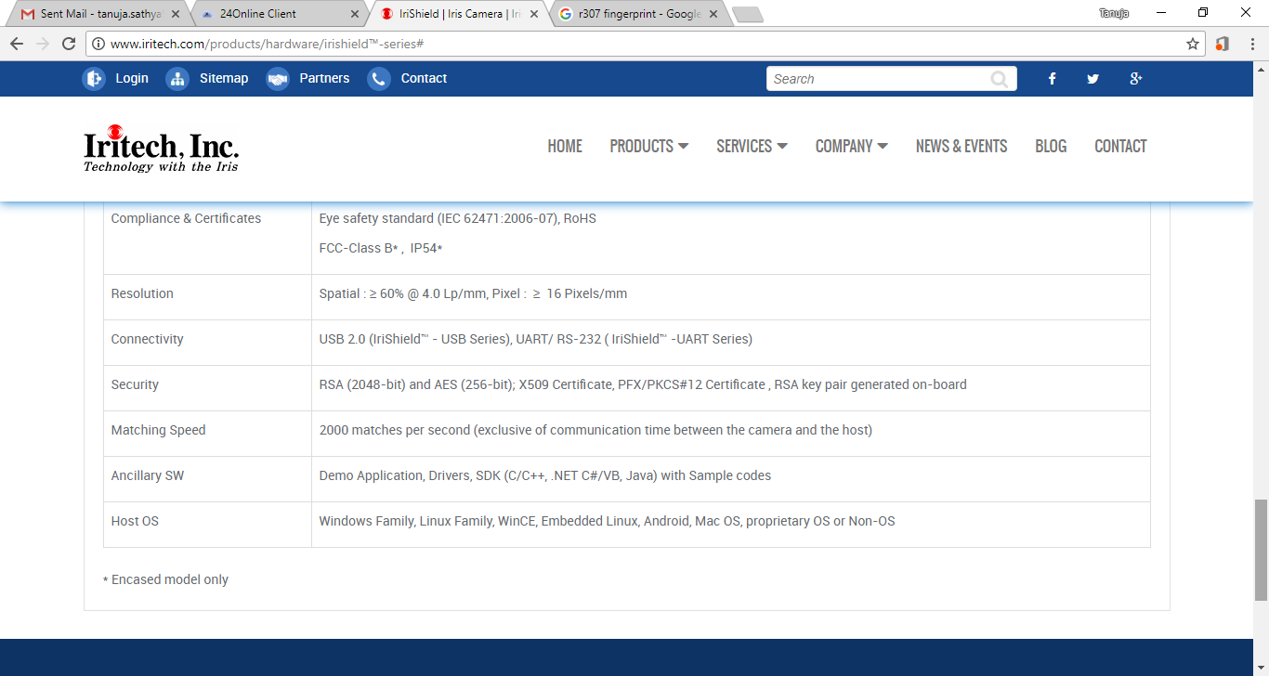

Slide 16
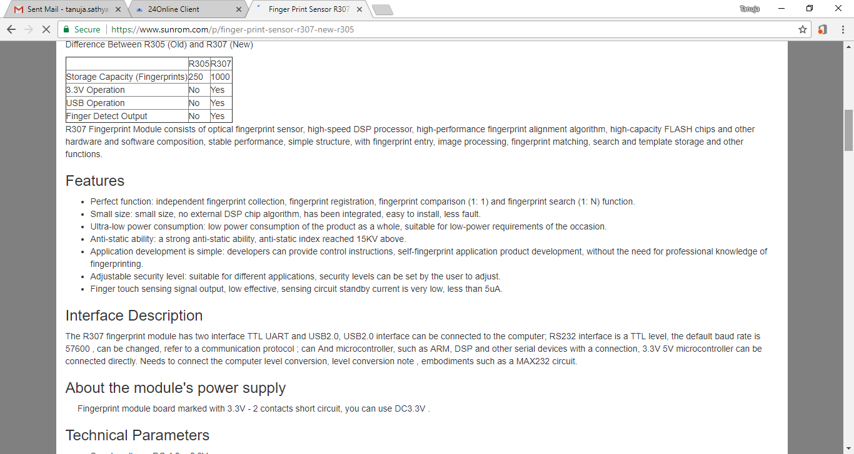

Slide 17
