Slide 1

BMS INSTITUTE OF TECHNOLOGY AND MANAGEMENT
Department of Computer Science and Engineering
Project Presentation Phase - III
Multimodal Biometrics for User Security and Identification Management.
Batch No:CSE-B7
Under the Guidance of:
Mrs.Bharathi R.
Associate Professor
Dept of CSE
BMSIT&M,Bengaluru.
Submitted By:
Sumaiya Rahman (1BY14CS076)
Tanuja S. (1BY14CS081)
Tanushree S. (1BY14CS082)
Vaishnavi V. (1BY14CS087)

Slide 2
CONTENTS
Implementation of the system
Test and Validate of the system
Results
Conclusion
Future Enhancement.

Slide 3
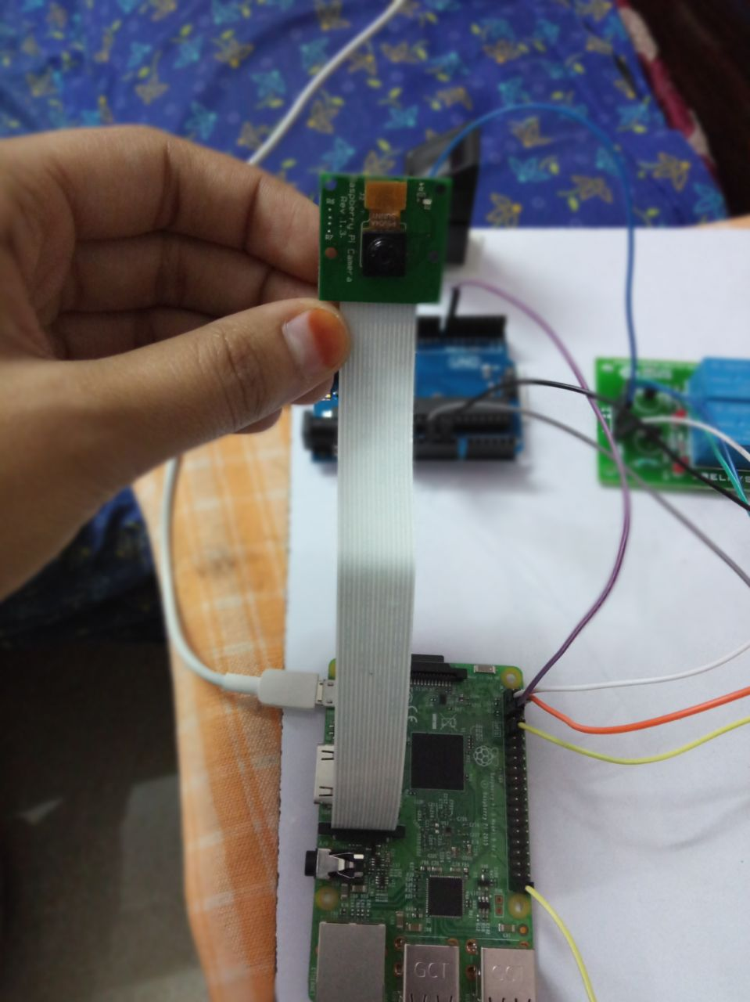
IMPLEMENTATION OF THE SYSYTEM

Slide 4
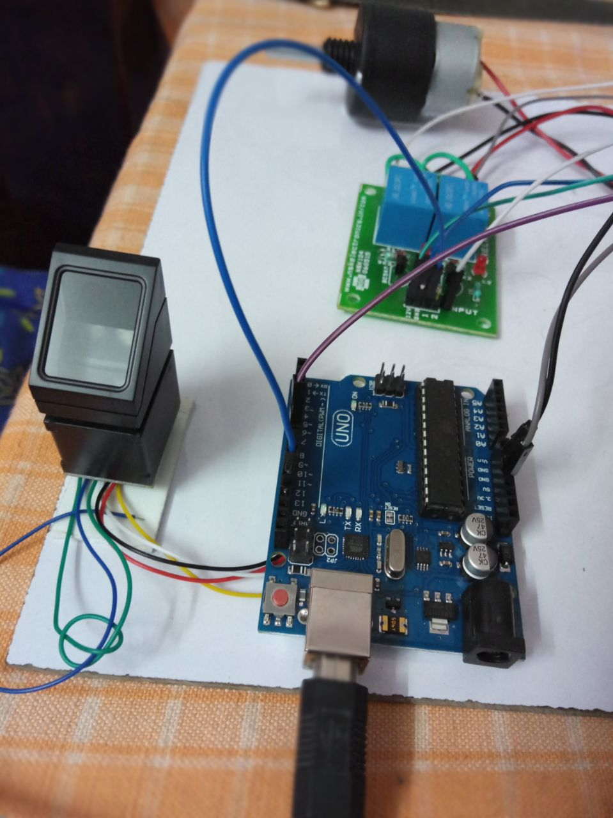

Slide 5
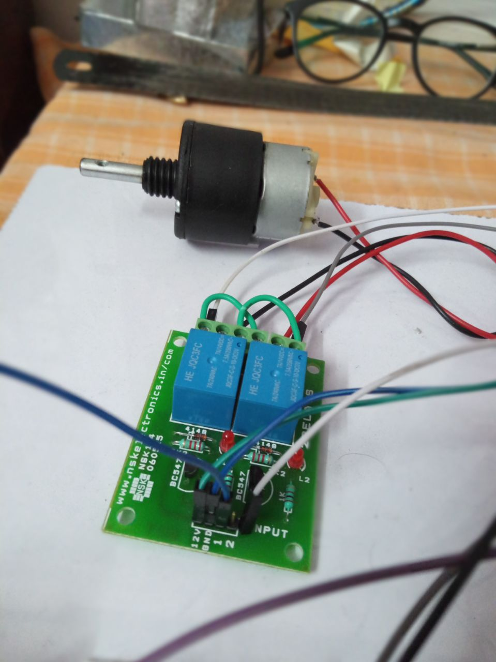

Slide 6
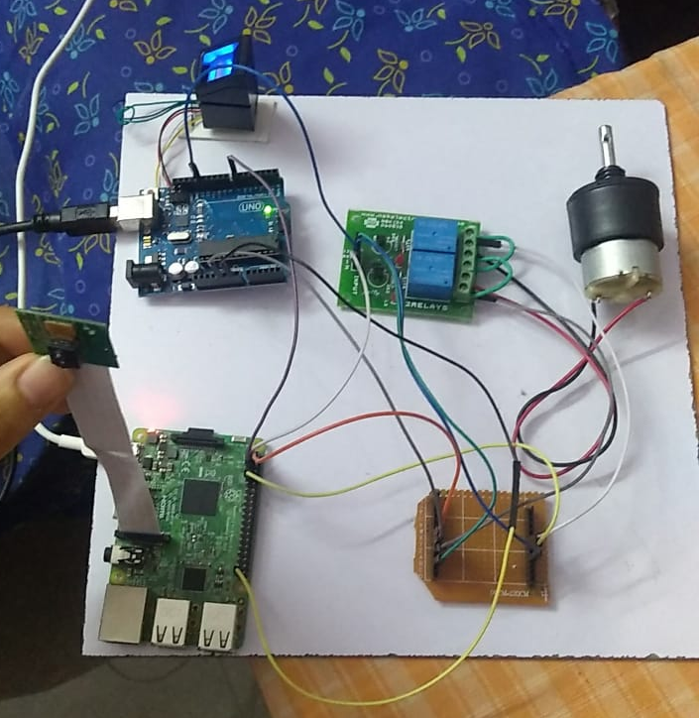

Slide 7
TEST AND VALIDATE OF THE SYSTEM
Test Case 1:
Iris Matched
Fingerprint Matched
Motor On
Test Case 2:
Iris Matched
Fingerprint not Matched
Motor off
Test Case 3:
Iris not Matched
No further Process

Slide 8
RESULTS

Slide 9
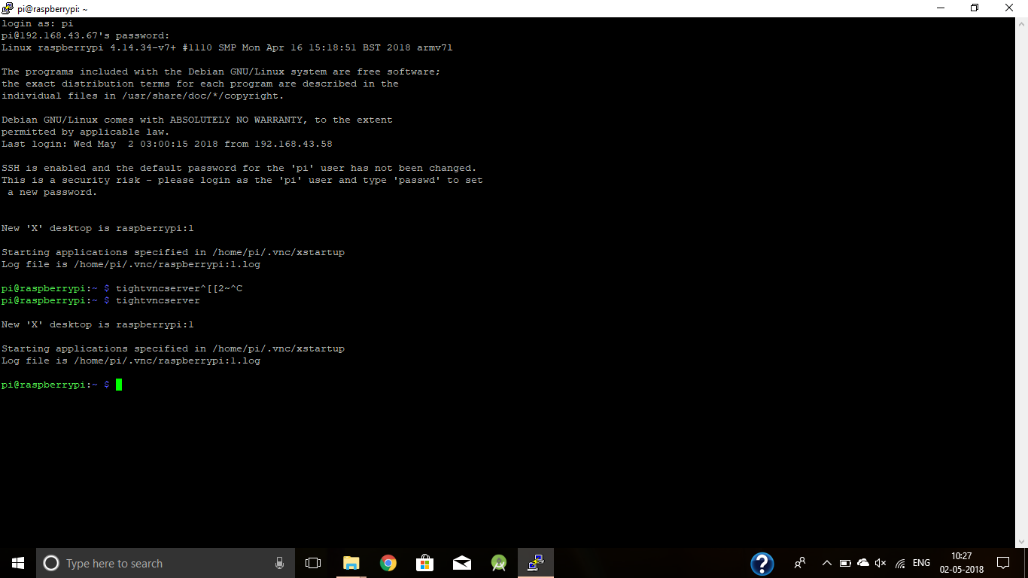

Slide 11
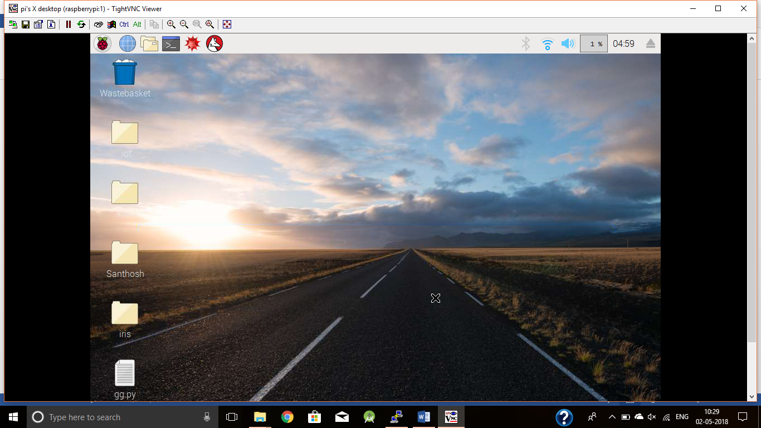

Slide 12
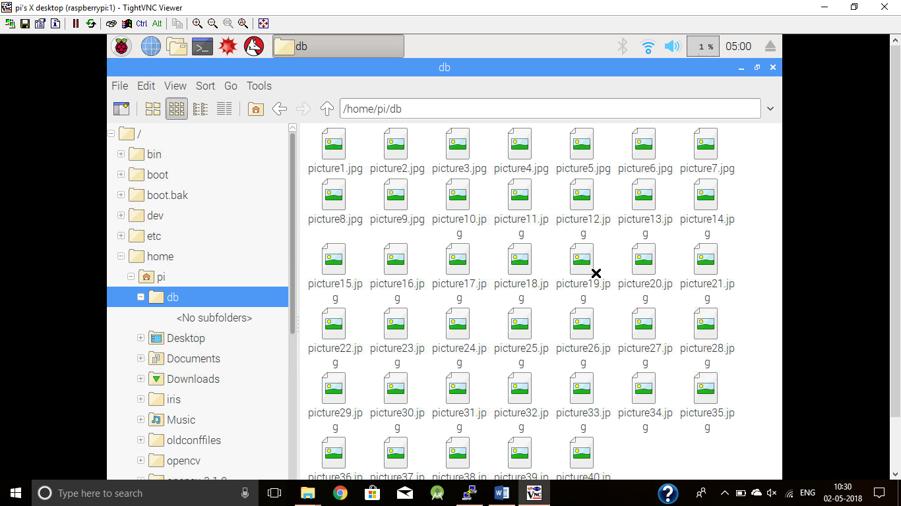

Slide 13
THANK YOU

