Slide 1
Virtual Shopping
A VR and AR application which virtualize and enhance shopping experience

Slide 2
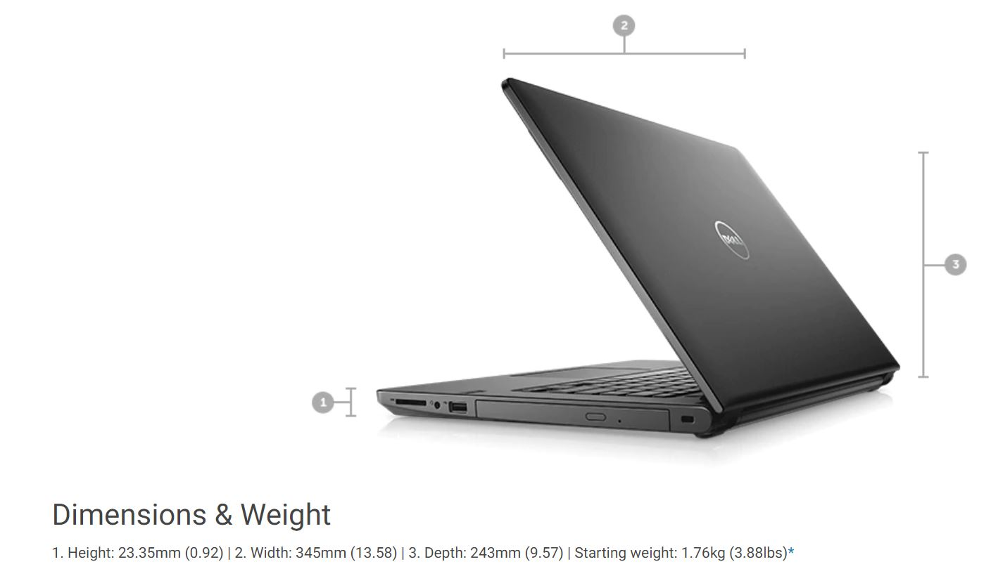
Current Scenario
The specifications of a laptop like screen size, thickness etc are given in the 2d form or 360 degree view.
Unable to get the measure of the laptop.
Unable to feel the laptop weight.
Unable to test the performance.

Slide 3
Proposed Idea
To design a walk-in shopping application.
VR application - campaign and stalls
AR application – customers (Buy or Sell)

Slide 4
Business benefits
Objective of this project is to build a virtual shopping application which makes customers interact with the Dell products.
AR is used for scanning the 2D images and getting the 3D model of the products. Through this method, it flaunts the appearance of product in a 360 angle.
So the customer can select the products based on categories, like gamming, student, work laptops
Using VR technology the physical appearance of the product can be felt. So they can make judgment based on look and feel of object through VR than just scrolling through and reading the content in the shopping websites.
VR application can be used in stalls or campaigns.
AR application can be used similar to shopping application of Dell products.

Slide 5
Features AR
An Augmented reality application where list of all laptops are present.
Based on the selection of product from the list , 3D image of the object is rendered.
Performance Categorization.
Users will be able to distinguish the correct physical appearance of 2D images available in websites and look at the configurations.
Voice enabled application.

Slide 6
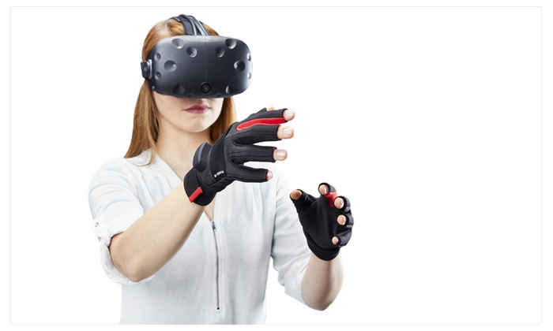
Features VR
A virtual reality application which virtualizes the product like laptop and produces a physical world experience like size experience, weight experience etc.
The user will be able to measure the size of the laptop like width, length etc by the experience of holding it in hand.
The user will be able to distinguish between the weight of the laptop by picking it up in VR.

Slide 7
Proposed AR Workflow
Phase 1
Phase 2
Phase 3(future scope)
Developing an application with inventory of Dell products.
Rendering the 3D object and specifications for each product.(zoom In and Zoom out).
Filtering the inventory based on the performance categorization.
Directing the purchase button to dell.com website
AR camera object for scanning posters/ banners of the product and 3D view configured to it.
Integrating AR module to the application in previous phase.
AR camera object- scan the actual product and get details of it (image recognition).
Voice recognition (input the product name through voice and get the product details).
Integrate the application with VR module if possible.

Slide 8
Proposed VR Workflow
Phase 1
Phase 2
Phase 3
The development of VR module in which user will be able to see the laptop and touch it . The user will get the size feel by touching the edges.
Development of the VR Gloves with electronic circuit consisting of actuators, capacitors etc. The user will be able to experience the weight of the laptop.
Integration of the modules for virtualizing the whole experience.

Slide 9
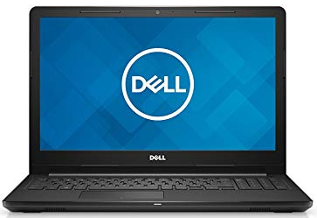
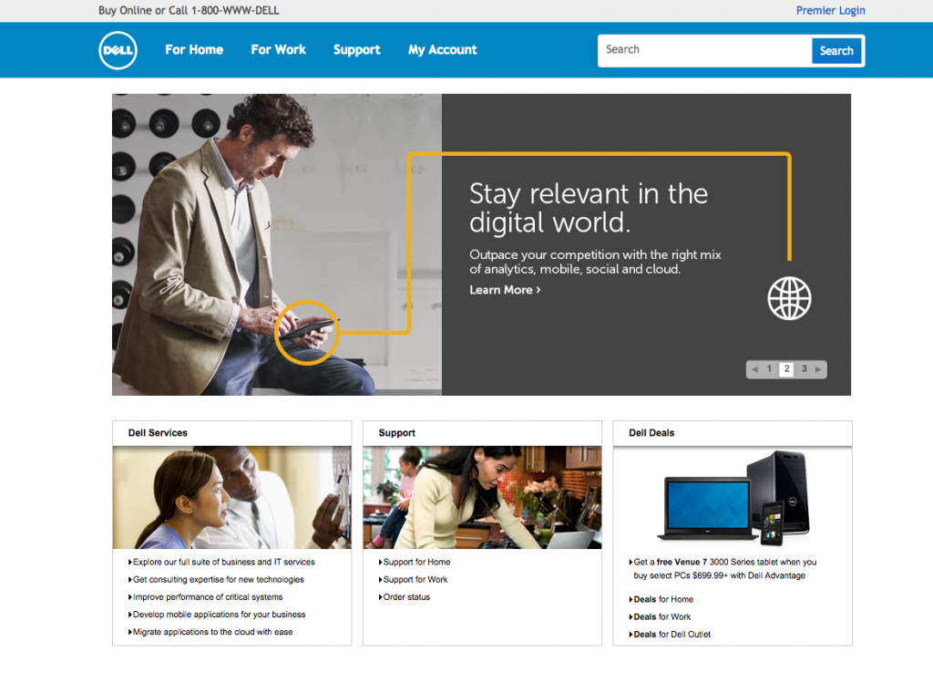
Design Implementation
Back button
3D object view
Category
Virtual View
Scan poster
Buy now
360 laptop view
View configuration
Description and configuration of the product
Inventory system containing list of all laptops
Each product has 2 buttons
Buy now
Dell.com website
Back button
Back button

Slide 10
Required Material
AR glasses
Smartphone
Google Oculus Rift/HTC Vive or any windows VR Headset
Leap Motion Controller for Mac or PC

