Slide 1
Credit Card Default Prediction
Submitted By: Tanuja S.Dhope (Ineuron)
29/06/2023

Slide 2
Objective and Benefits
Objective :
The goal is to predict the probability of credit default based on the credit card owner's characteristics and payment history.
Benefits:
Banking/Financial Institutions: Key Players in Financial Services
Ensuring Integrity: Prudent Investments to Prevent Financial Loss
Assessing Customer Potential: Prior to Extending Credit
Credit Scoring: Evaluating Loan Characteristics and Default Risk

Slide 3
Architecture
Start
Data Ingestion
Data Transformation
Prediction
Selecting Best Model
Model Building/Training
Save Model
Save Model
Deploy in local Host Application
Saving Output
Defaulter Prediction
Data from User
End

Slide 4
Architecture
Data Description:The dataset was taken from Kaggle (URL: https://www.kaggle.com/uciml/default- of-credit-card-clients-dataset), This dataset contains information on default payments, demographic factors, credit data, history of payment, and bill statements of credit card clients in Taiwan from April 2005 to September 2005.
Data Ingestion:This included importing of important libraries such as seaborn, matplotlib, pandas ,scikit-learn etc. We imported the same dataset mentioned above from Kaggle.
Data Pre-processing and Transformation:
Performing EDA to get insight of data like identifying distribution ,outliers,collinearity etc.
checking and handling the null values, changes in the column names has been done.
Encode categorical values with numeriacal values
Performing standard scalers to scle down values
Train/Test Split of 75-25%, where 75% of the data was used to train the model and the latter 25% was used to predict the same.

Slide 5
Architecture
Model Building :We tried and tested multiple models such as XGBoost, Random Forest,Decision Tree, ADABoost for the model and came up with the model with the best performance, i.e the Random Forest Classifier.
Selecting Best Model:The Random Forest Classifier(RFC) with hyper tuning of parameters has been done to select the best RFC model.
Prediction:The selected best model of RFC provides accuracy 81.7% and the F1 score was 47.3%.
Save Model:Model was saved using the pickle library which saves the file in a binary mode.
Deploy in Local Host:We created a HTML template and deployed the model through Flask and Prediction has been done.

Slide 6
INCREASING THE PREDICTIVE POWER
There is the n_estimators hyperparameter, which is just the number of trees the algorithm builds before taking the maximum voting or taking the averages of predictions. In general, a higher number of trees increases the performance and makes the predictions more stable, but it also slows down the computation.
max_features, which is the maximum number of features random forest considers to split a node. Sklearn provides several options, all described in the documentation.
The last important hyperparameter is min_sample_leaf. This determines the minimum number of leafs required to split an internal node
RANDOM FOREST MODEL

Slide 7
INCREASING THE MODEL’S SPEED
INCREASING THE PREDICTIVE POWER
The n_jobs hyperparameter tells the engine how many processors it is allowed to use. If it has a value of one, it can only use one processor. A value of “-1” means that there is no limit.
The random_state hyperparameter makes the model’s output replicable. The model will always produce the same results when it has a definite value of random_state and if it has been given the same hyperparameters and the same training data.
here is the oob_score (also called oob sampling), which is a random forest cross-validation method. In this sampling, about one-third of the data is not used to train the model and can be used to evaluate its performance. These samples are called the out-of-bag samples. It's very similar to the leave-one-out-cross-validation method, but almost no additional computational burden goes along with it.

Slide 8
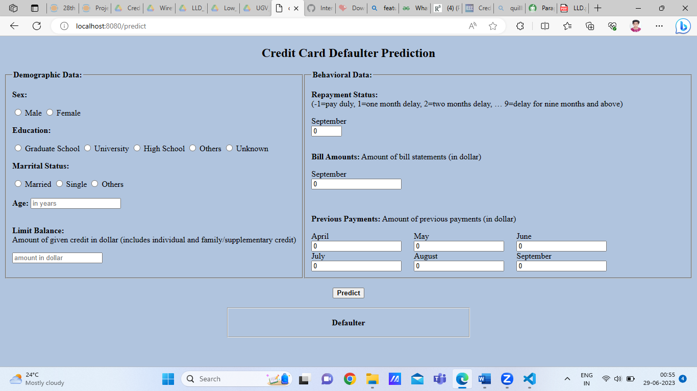
Application Form

Slide 9
Thank You

