Slide 1

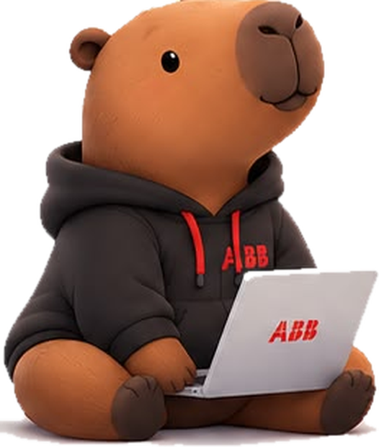
ABB Help Me
HELP ME
Hi, I'm Capy!
CONCEPT PITCH · OCTOBER 2026
Real people. Real conversations.
A safe, verified space where every ABB employee can ask, share and feel supported.
Working prototype · Expo / React Native · iOS, Android and web
Notes:
Open with the one-line idea: a safe, verified place for every ABB employee to ask, share and get support. Introduce Capy, our mascot, who guides people through it. This is a working prototype, not a mock-up.

Slide 2



Employees need help, but rarely know where to ask
Three needs come up again and again, whether you are an intern, an engineer or a manager:
“I need an answer.”
12 bn
Leave, VPN, a policy: fast and correct, from a source I can trust.
working days are lost every year to depression and anxiety, about US$1 trillion in productivity
“I need to say something safely.”
Stress, a difficult manager, a doubt. I'll only speak if it can't be traced back to me.
21%
“I want to be seen.”
of employees worldwide are engaged at work
Recognition for helping others and for wins, especially as an intern or new joiner.
Sources: WHO & ILO (2022), mental health at work; Gallup, State of the Global Workplace 2025.
Notes:
Three needs: an answer, a safe voice, and recognition. The cost of getting this wrong is large: WHO and ILO estimate 12 billion working days lost each year to depression and anxiety, and Gallup finds only 21% of employees engaged. Today these needs are spread across tickets, intranet pages and private chats.

Slide 3
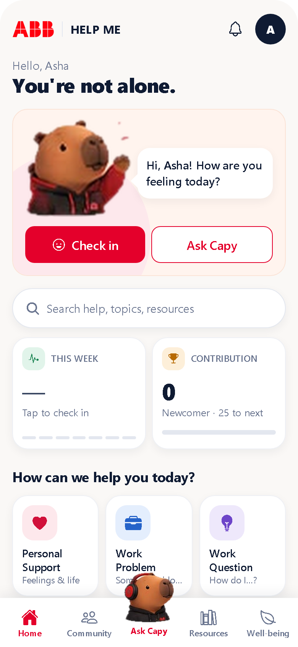
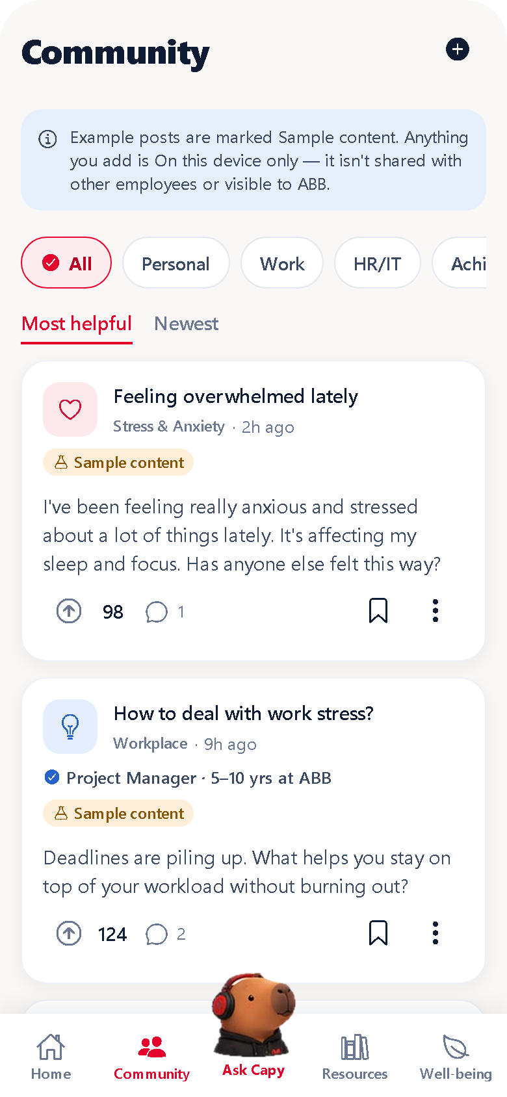
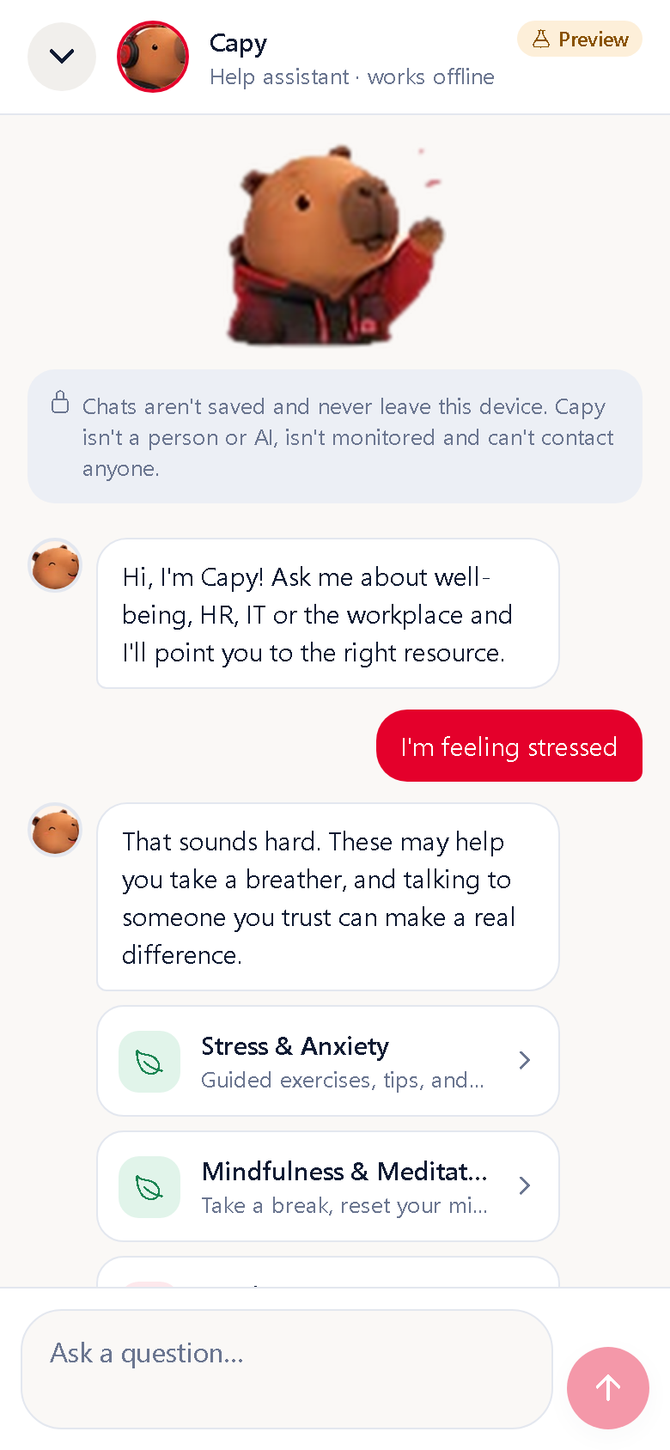





One app to ask, share and get support
Capy guides employees to the right place, and every screen below is from the working prototype.
Ask Capy
Points you to the right resource
Community Q&A
Verified, anonymous answers
Well-being
1-tap check-in, private trends
Resources
HR, IT, EAP and policies together
Recognition
Achievements and a helpfulness score
Home: Capy greets you
Community: most helpful first
Ask Capy: guided answers
Notes:
Five pillars in one app. Walk through the screenshots: Capy greets you on Home and reacts to your check-in; Community shows the most helpful answers first with verified role tags; Ask Capy points to the right resource. All of this runs in the prototype today.

Slide 4






Built around what employees told us they need
Status reflects the prototype today; Phase 2 adds the shared backend.
BUILT
BUILT
PARTLY BUILT
Mood and weekly stats
Contribution score
Verified, anonymous voice
One-tap check-in with tags; week and month trends, private to the device.
Rewards helpful answers, capped daily, never used in performance reviews.
No names. Optional role and experience band, e.g. “Intern · <1 yr at ABB”.
PARTLY BUILT
PARTLY BUILT
PARTLY BUILT
Moderation
Answers you can trust
Capy assistant
On-device check stops attacks and leaks; AI and human review next.
Upvotes, downvotes with a reason, accepted answers; HR and IT mark Official.
Points to the right resource offline today; AI on approved HR/IT content next.
Notes:
These six features came straight from our discussion of what an employee expects. Be honest about status: mood stats and the contribution score are built; verification is simulated, moderation layer 1 is built, and official answers and the AI assistant arrive with the Phase 2 backend.

Slide 5

Why not just Reddit, Teams or the intranet?
Reddit's format, made safe, accurate and specific to ABB.
What matters | Reddit | Teams / intranet | ABB Help Me
Only verified colleagues can join | No | Yes | Yes
Anonymous, with role context | Partly | No | Yes
Official answers from HR and IT | No | Partly | Yes
Rewards helpfulness, not popularity | No | No | Yes
Well-being and support built in | No | No | Yes
Private: not visible to managers | Partly | No | Yes
Verified, not public
Helpful, not viral
Supportive, not monitored
Notes:
The obvious question: why not Reddit or Teams? Reddit has the format but no verification, no official answers and rewards popularity. Teams and the intranet are verified but named, so people stay silent on sensitive topics. ABB Help Me combines verified membership, anonymity with role context, official answers and built-in well-being.

Slide 6








Capy makes asking for help feel safe
Same Capy, different moments, built on well-studied behavioural psychology.
WHY IT WORKS
PROVEN ELSEWHERE
Cuteness invites care
Duolingo
Round, soft “baby-schema” features trigger warmth and lower defences.
Duo the owl’s reminders and celebrations turned daily practice into a habit.
A listener that never judges
Finch
People disclose more to a virtual agent they see as non-judging (Lucas et al., 2014).
People look after a virtual bird by completing real self-care tasks.
Mirroring builds trust
Headspace
Capy reacts to your mood, so you feel heard, not processed.
Friendly characters make meditation feel approachable, not clinical.
Celebration builds habits
Clippy (the lesson)
Dresses for your role, reacts to your mood
Cheers and progress bars use positive reinforcement and the goal-gradient effect.
A mascot that interrupts gets resented. Capy never interrupts or guilt-trips.
Notes:
Capy is not decoration. Cute, round characters trigger warmth (the baby-schema effect). Research by Lucas and colleagues (2014) found people disclose more to a virtual agent they believe is not judging them, which matters for a support app. Capy mirrors your mood and celebrates progress. Duolingo, Finch and Headspace show mascots drive habits; Clippy shows the failure mode, so Capy never interrupts or guilt-trips.

Slide 7







Architecture: local-first today, backend-ready by design
Screens talk only to interfaces, so Phase 2 services plug in without rewriting the UI.
PHASE 1 · BUILT
PHASE 2 · PLUG-IN SERVICES
Mobile app
Company SSO
Shared community
Expo / React Native · iOS, Android, web
Verify employment, store no identity
Votes, answers, official replies
Repository interface
The only way screens read or write data
AI moderation
AI assistant
Same interfaces
Plus human review and appeals
On approved HR and IT content
Encrypted on-device database
SQLCipher · key kept in the OS keystore
Aggregate insights for HR
Capy assistant (offline)
Moderation layer 1
Demo verifier
Only for groups of 10+ people, after works-council approval
20+
43
1 codebase
0 bytes
screens built
automated tests passing
iOS, Android and web
leave the device in Phase 1
Notes:
Feasibility is proven: the prototype has 20+ screens and 43 automated tests, runs on iOS, Android and web from one codebase, and stores everything encrypted on the device. Screens only use interfaces (repository, assistant, moderation, verifier), so Phase 2 swaps in a backend, company SSO, AI moderation and an AI assistant without rewriting the UI.

Slide 8








Impact for employees and for ABB
What we expect to change, and how a pilot will measure it.
For employees
For ABB
Answers in minutes, not ticket queues
Fewer repetitive HR and IT tickets
A safe outlet that stays anonymous
Know-how shared across sites and roles
Recognition for helping colleagues
Anonymous, aggregate signals of hotspots
A gentle route to support on hard days
Stronger engagement and retention
PILOT SUCCESS METRICS
Time to first answer
Questions resolved
Tickets avoided
Weekly active users
Median, per question
Share with an accepted or official answer
Repeat HR/IT tickets vs. baseline
And check-in participation
Notes:
Impact works on two levels. For people: faster answers, a safe voice, recognition and a gentle route to support. For ABB: fewer repetitive tickets, shared know-how and early, anonymous signals. We will not promise numbers before a pilot; these four metrics are how we will prove it.

Slide 9






Risks and how we mitigate them
Designed in from day one, not added afterwards.
Fear of surveillance
Re-identification
Harmful content
Local-first. Managers and HR never see mood or identity; only aggregates of 10+ people, after legal and works-council review.
No names. Broad role and experience bands, shown only when the author opts in for that post.
On-device check stops attacks and leaks before posting; AI screening, human moderators and appeals in Phase 2.
Wrong or outdated answers
Someone in crisis
Gamification pressure
Downvotes need a reason; accepted answers rise to the top; HR and IT can mark answers Official.
Never blocked or punished: Capy shows support and emergency routes, with a clear “not monitored” notice.
Points capped daily and never used in reviews; no streak guilt. Capy never interrupts (the Clippy lesson).
Notes:
Every risk has a design answer already in the prototype or the Phase 2 plan. Privacy and anonymity come first, because without trust no one will post. Crisis content is never blocked; it is routed to support. Gamification is capped and never tied to performance reviews.

Slide 10





Roadmap and what we need
A working prototype today; a one-site pilot is the next step.
PHASE 1
Done
PHASE 2
Next
PHASE 3
Later
Prototype
Pilot
Scale
Local-first app with Capy
Community, well-being, resources
43 automated tests
One site, about 12 weeks
SSO, shared community, AI moderation
Official HR and IT answers
More sites and languages
Aggregate insights for leaders
Link to HR/IT service tools
What we need to start the pilot
Executive sponsor
One pilot site
HR and IT content owners
Privacy, legal and
works-council review
Notes:
Close with the ask. The prototype is done. To run a one-site pilot of about 12 weeks we need an executive sponsor, a pilot site, HR and IT owners for official answers, and privacy, legal and works-council review. Capy is ready when you are.

