Slide 1
CS5610
CAREER COMPASS
Using Supervised Machine Learning
Advanced R for Data Science
Team Members
Lahari Potharaju
Tanuja Neelapu
Nikhil Sairam Adari

Slide 2



OUTLINE
PRESENTATION OUTLINE
A quick roadmap of the project from problem setup to final results and demo.
1
2
3
4
Introduction
Objectives
Tools & Libraries
Data Description
5
6
7
8
Design & Methods
Machine Learning Models
Shiny App Structure
Model Accuracy
9
10
11
Project Challenges
Live Demo
Conclusion

Slide 3





INTRODUCTION
INTRODUCTION
A clear path from data preparation to insight-driven career guidance.
Data Collection
Problem Definition
Gather and clean historical career data to build the foundation for the project.
Study patterns and trends to uncover the factors that influence career growth.
Solution Approach
Develop an R Shiny web application to deliver personalized career insights and recommendations.

Slide 4





OBJECTIVES
OBJECTIVES
The project focuses on building a practical, data-driven career guidance solution.
Data Analysis
Model Development
Prediction Accuracy
Identify key factors driving career advancement
Develop predictive models using Random Forest
Provide actionable career guidance
User Interface
Create an easy-to-use web application

Slide 5





TOOLS & LIBRARIES
TOOLS & LIBRARIES
A streamlined stack for building, modeling, visualizing, and evaluating the career guidance solution.
R + Shiny
Data Manipulation
Machine Learning
Interactive web app
dplyr, readr
randomForest, glm, svm (e1071)
Visualization
Statistical Testing
ggplot2, plotly, corrplot
MLmetrics (F1 Score, Accuracy)

Slide 6

















DATA OVERVIEW
DATA DESCRIPTION
Captures detailed information on professional career paths and skill sets
Data Source
Dataset Name
Kaggle - LinkedIn Profiles
linkedin.csv
Observations
Attributes
1,251
11
Key Variables Used
Career Category
Years of Experience
Job Position
Primary profession group or domain
Total professional experience
Current role or title
Skills
Salary
Education Level
Core technical and soft skills
Reported compensation level
Highest degree or qualification
Location
Company Size
Industry
Geographic work location
Organization scale or headcount
Business sector or field
Job Satisfaction
Career Advancement
Reported satisfaction with current role
Indicators of progression and growth
Key Variables Used
category
experience
position
clean_skills

Slide 7






EXPLORATORY DATA ANALYSIS
Dataset Overview
Career Category Distribution
Feature Relationships
The dataset consists of 1,251 LinkedIn employee profiles with 11 features, including career category, years of experience, job position, and skills. These features form the basis for predicting employee career advancement.
The distribution of career categories was analyzed to understand the representation of different professional fields and identify potential class imbalance.
Correlation analysis was performed to understand relationships among numerical features and support feature engineering.
Feature Selection
Experience Distribution
Exploratory analysis highlighted influential features such as experience, position, career category, and skills, which were used for machine learning model development.
Data Quality
Years of experience were analyzed to understand the distribution of professionals across different career stages.
The dataset was inspected for missing values, duplicate records, and inconsistent formatting before model training to ensure high-quality input data.

Slide 8
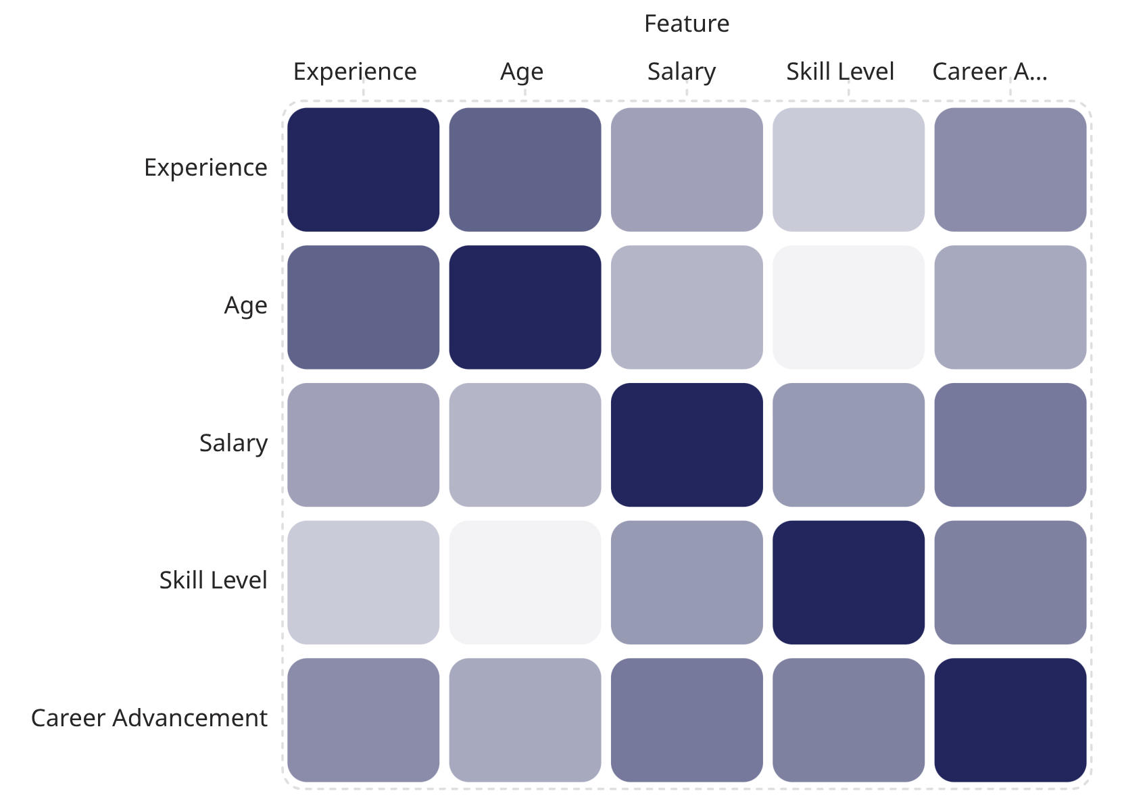
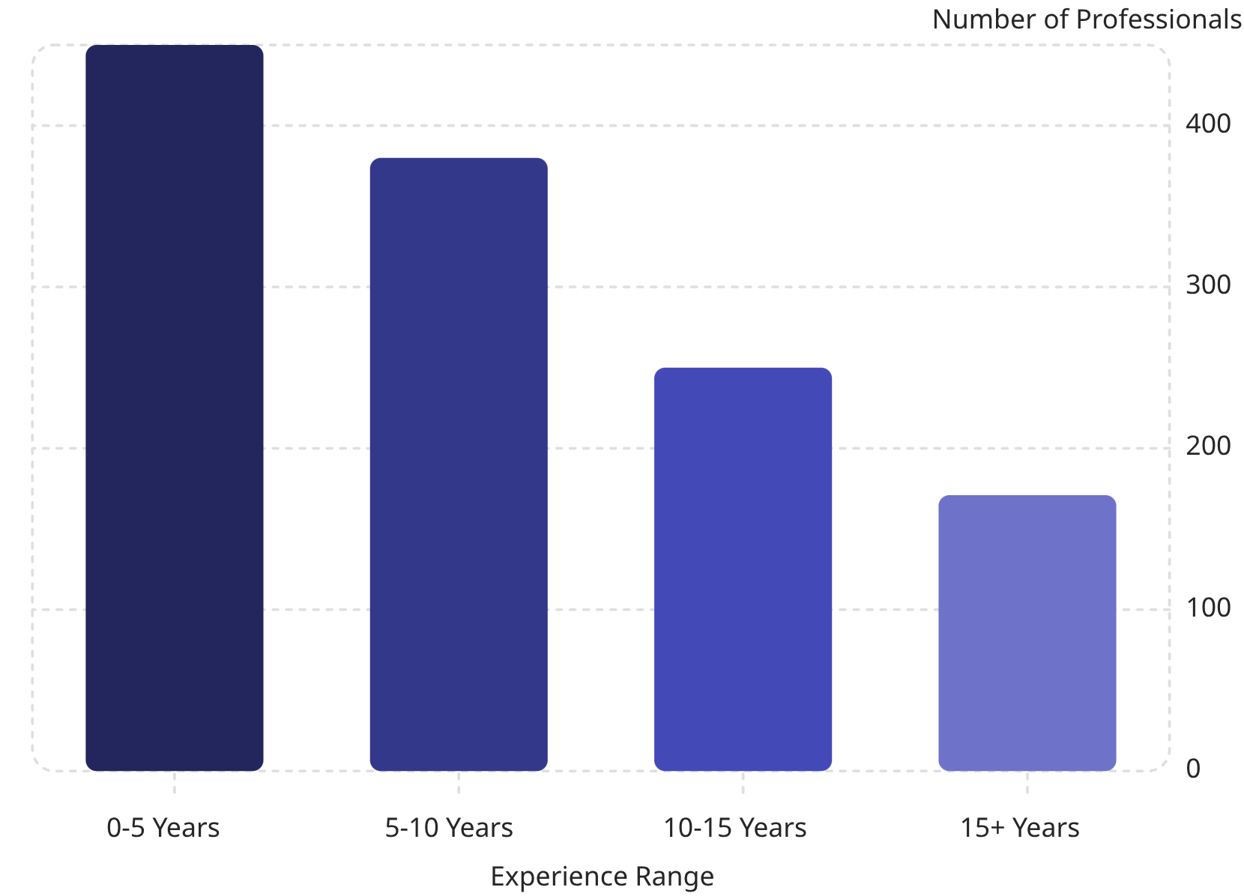
EDA VISUALIZATIONS
Correlation Heatmap
Experience Distribution
Correlation analysis was performed to understand relationships among numerical features and identify variables that may influence career advancement.
Distribution of employee experience across different career stages, providing insights into the composition of the dataset.

Slide 9





METHODOLOGY PIPELINE
A complete end-to-end workflow from raw data to personalized career prediction
Data Preprocessing
Feature Engineering
Remove inconsistencies and prepare data
Derive new variables and rank features
Model Training
Model Evaluation
Logistic Regression, Random Forest, SVM
Evaluate using Accuracy, Precision, Recall and F1 Score
Deployment
Build interactive interface and enable career prediction

Slide 10






MACHINE LEARNING MODELS
Three approaches used to classify outcomes and compare career prediction performance
Random Forest
Logistic Regression
SVM
Many Trees: Random Forest uses many decision trees to make better predictions.
Random Choices: It picks random data and features to build each tree, making the model stronger.
Better Results: It gives accurate results and works well even if some data is missing.
Predicts Yes or No: Logistic Regression estimates the chance of an outcome in two categories.
Uses Probabilities: It outputs probabilities to help classify results more confidently.
Draws a Curve: It uses a sigmoid curve to separate outcomes smoothly.
Draws a Line: SVM finds the best boundary that separates classes.
Focuses on Borders: It pays special attention to the closest points near the margin.
Works Well with Complex Data: It can handle difficult patterns using powerful boundaries.

Slide 11




SHINY APP
SHINY APP STRUCTURE & FEATURES
Three core tabs that guide users from input to prediction insights
Home Tab
Predict Tab
Insights Tab
Users can enter basic details such as name, age, education level, and preferred industry.
Allows users to input experience and skillset; displays visual outputs based on career prediction results.
Explains the purpose of the application and includes a feedback form for user suggestions.

Slide 12





SHINY APP
MODEL PERFORMANCE & SELECTION
A visual comparison of the three candidate machine learning models and the reason Logistic Regression was selected for deployment.
Random Forest
Logistic Regression
SVM (Linear)
Accuracy: 73.6%
F1 Score: 0.735
Accuracy: 80%
F1 Score: 0.80
Accuracy: 80%
F1 Score: 0.80
Chosen model
Chosen Model
Logistic Regression was selected because its simplicity, interpretability, and reliable predictive accuracy make it ideal for deployment in the Shiny web application.
Simplicity makes the model easy to implement and maintain
Interpretability helps explain predictions clearly
Reliable accuracy supports practical deployment

Slide 13



PROJECT OVERVIEW
PROJECT CHALLENGES & SOLUTIONS
Key obstacles encountered during the project and the practical solutions used to address them.
Lack of Structured Data
Synthetic Dataset Creation
Model Selection Challenge
User-Friendly Design
Manually analyzed public LinkedIn profiles to identify real-world career trends.
Used insights from LinkedIn analysis to build a realistic synthetic dataset.
Evaluated Random Forest, Logistic Regression, and SVM; selected Logistic Regression.
Built an interactive Shiny app with sliders and dropdowns for non-technical users.

Slide 14





LIVE DEMO
LIVE DEMONSTRATION
Interactive Shiny Application
This section will showcase the live application experience, walking through how users interact with the interface, generate predictions, and explore the results in real time.
Watch the demo to see how input changes instantly update predictions and visual insights.
User Input Interface
Real-time Predictions
Visual Analytics
Explore sliders, dropdowns, and other controls used to configure inputs.
See the model respond instantly as input values are adjusted.
Review charts and insights that make the results easy to interpret.
Ready to explore the app live? Use the demo to test inputs, compare outputs, and see the model in action.

Slide 15




CONCLUSION
Final Takeaway
CONCLUSION
Career Compass successfully demonstrates how machine learning can guide professional growth by combining data analysis with user-friendly web interfaces.
Data-driven insight
Better decisions
Ongoing growth
Offers professionals a data-driven glimpse into their career future
Promotes informed decision-making about career progression
Encourages skill development and professional growth
Key takeaways
Machine learning can translate complex data into practical career guidance
Simple, user-friendly interfaces make insights more accessible
Interactive tools support clearer and more confident career planning

Slide 16
THANK YOU
THANK YOU
Lahari Potharaju • Tanuja Neelapu • Nikhil Sairam Adari
CS5610 - Advanced R for Data Science

