Slide 1
COVID DATA ANALYSIS

Slide 2
OBJECTIVE
To perform data analysis and visualization on Covid_19 data using ETL tools.
To perform data analysis on Covid_19 data and extract the meaningful information from the dataset which will help in taking quick and informed decision.

Slide 3
TECHNOLOGIES USED
AWS Glue
SparkSQL
Redshift
AWS S3
SparkSQL
Crawler
AWS Lambda
PySpark

Slide 4
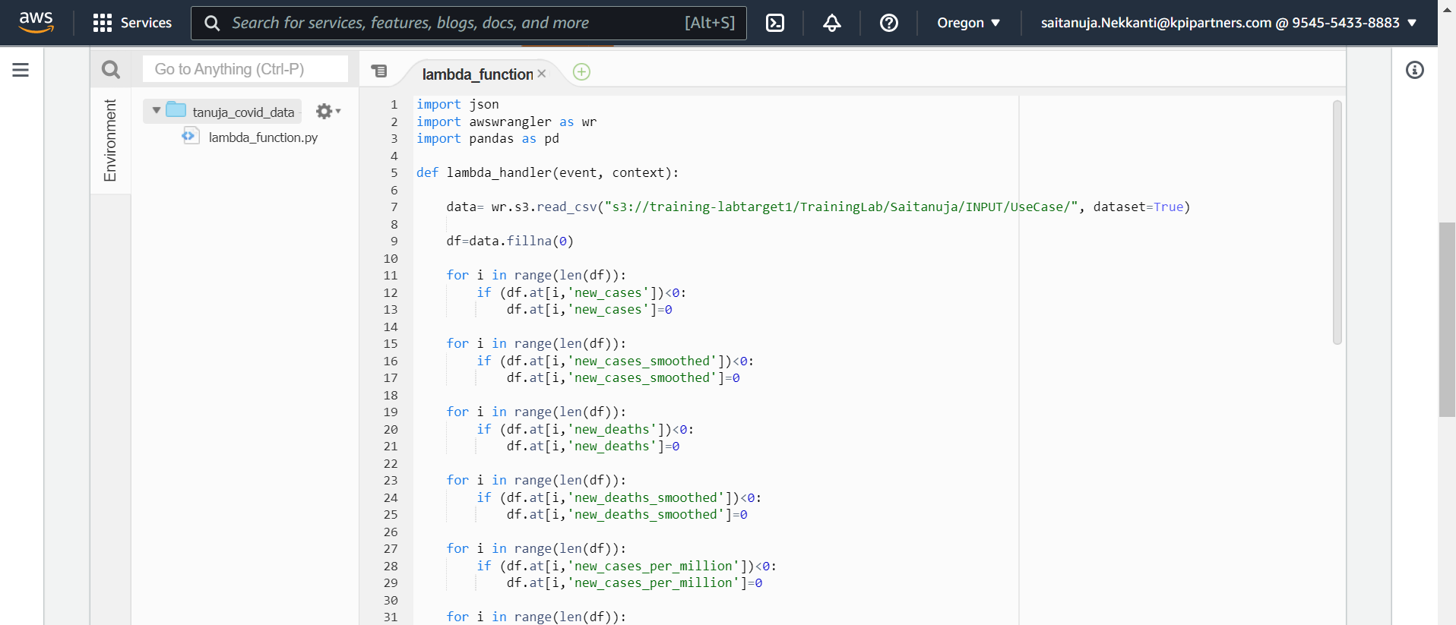
Problem Statements 1.Clean and transform data for processing job name: Tanuja_covid_data

Slide 5
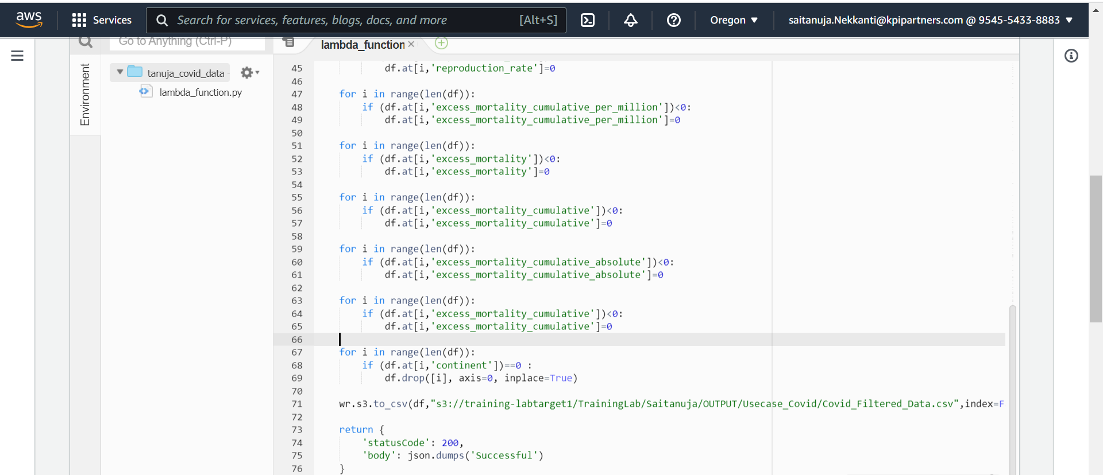
1.Clean and transform data for processing Cont…

Slide 6
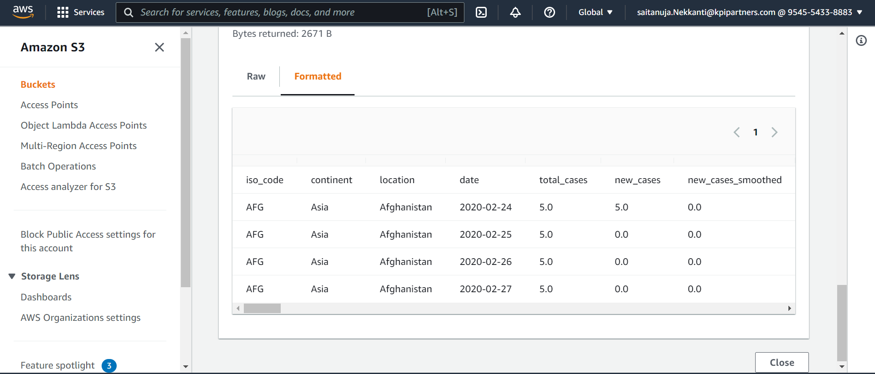
1.Output

Slide 7
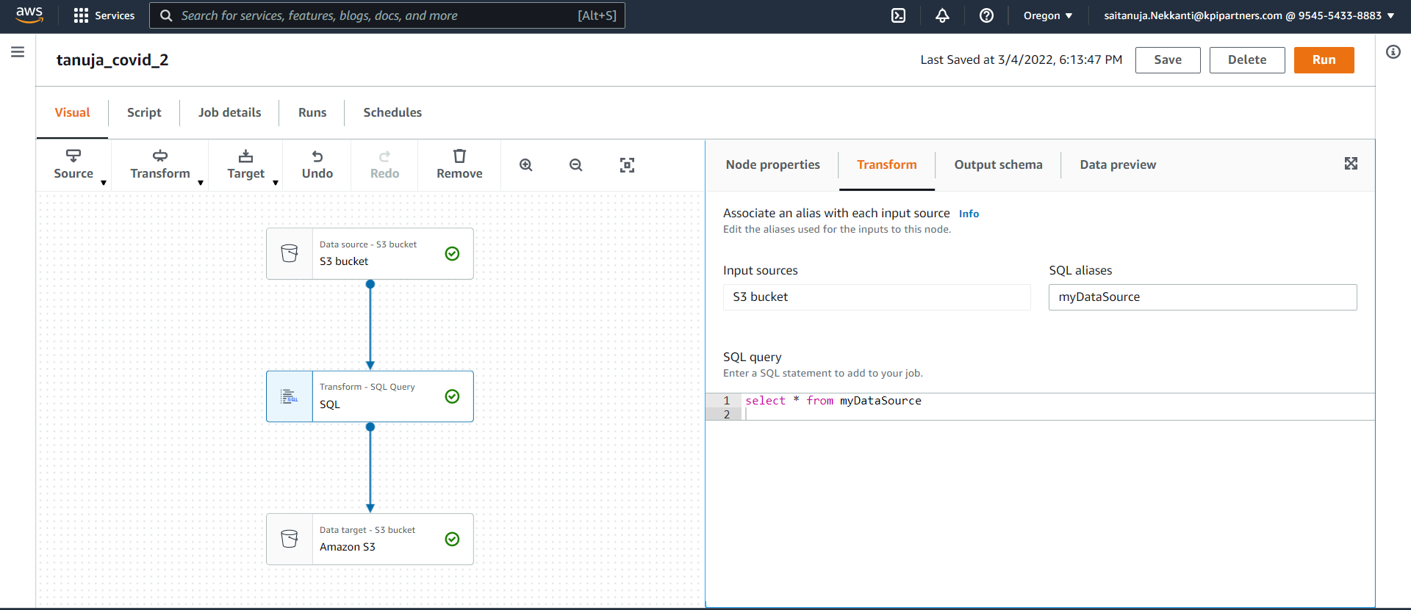
2. ETL operations on dataset Job name: tanuja_covid_2

Slide 8
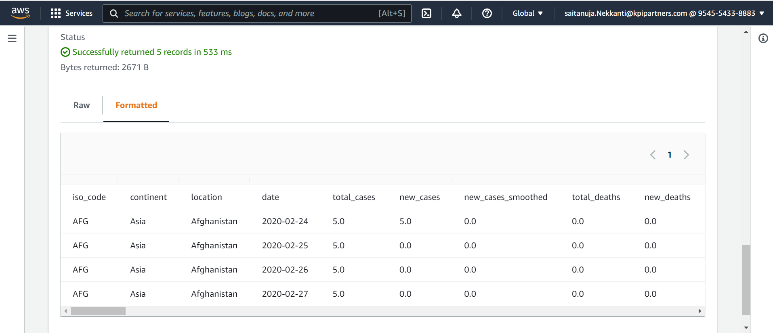
2.Output

Slide 9
3. Storing the modified data in AWS

Slide 10
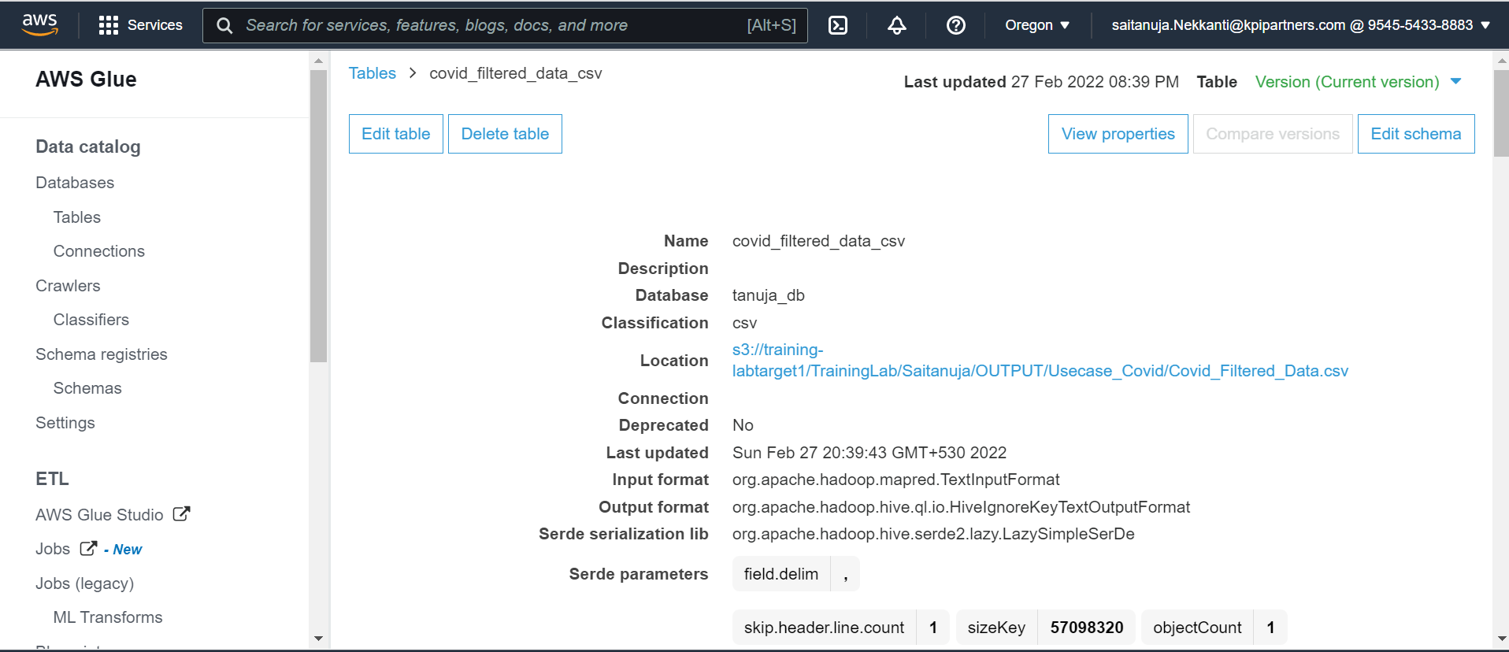
4.Display total cases ,new cases , recovered cases and deaths. CREATING CRAWLER

Slide 11
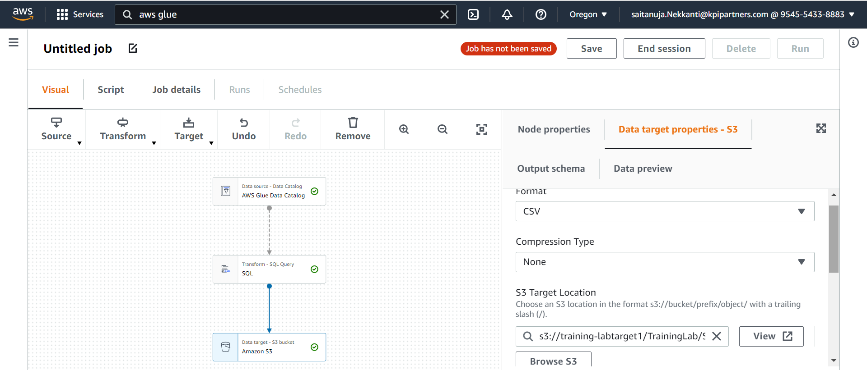
4. Display total cases ,new cases ,recovered cases and deaths. Job name: tanuja_q4

Slide 12
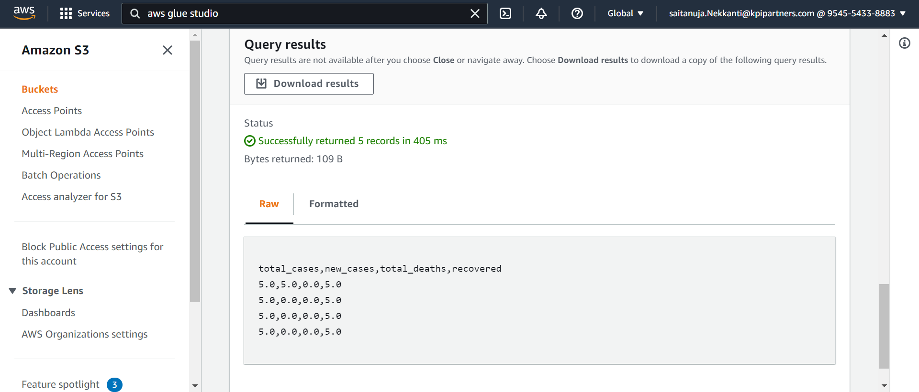
4.OUTPUT

Slide 13
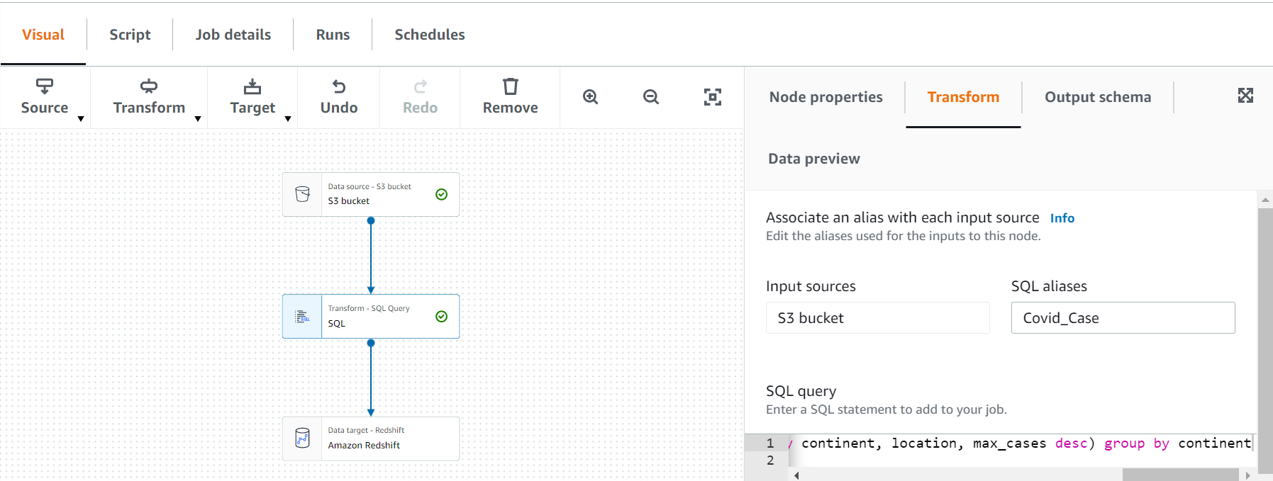
5.Which country in Distinct WHO region highest cases in till date. JOB NAME :tanuja_covid_5

Slide 14
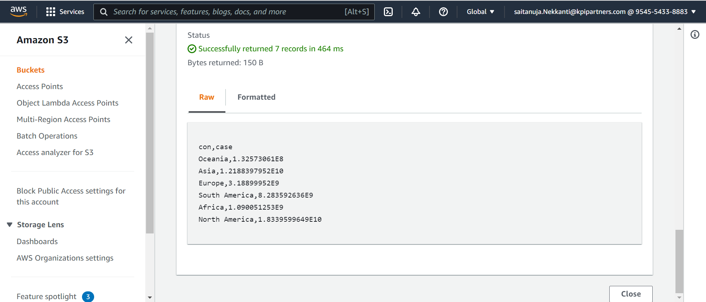
5.OUTPUT

Slide 15
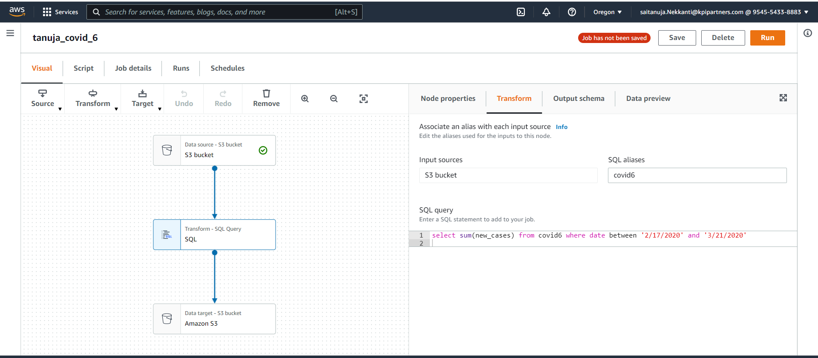
6. Total no of confirmed cases over between a certain date. JOB NAME :tanuja_covid_6

Slide 16
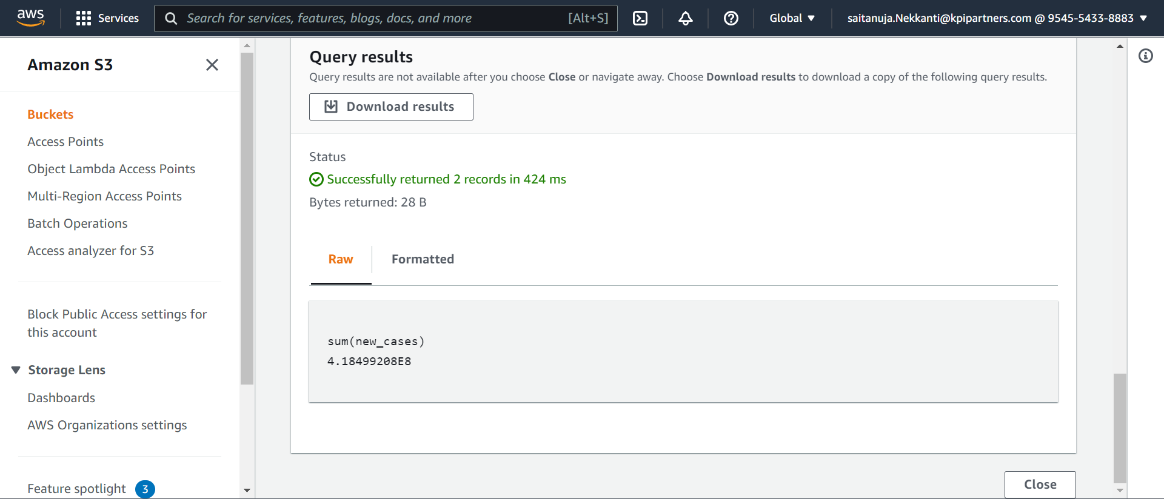
6.OUTPUT

Slide 17
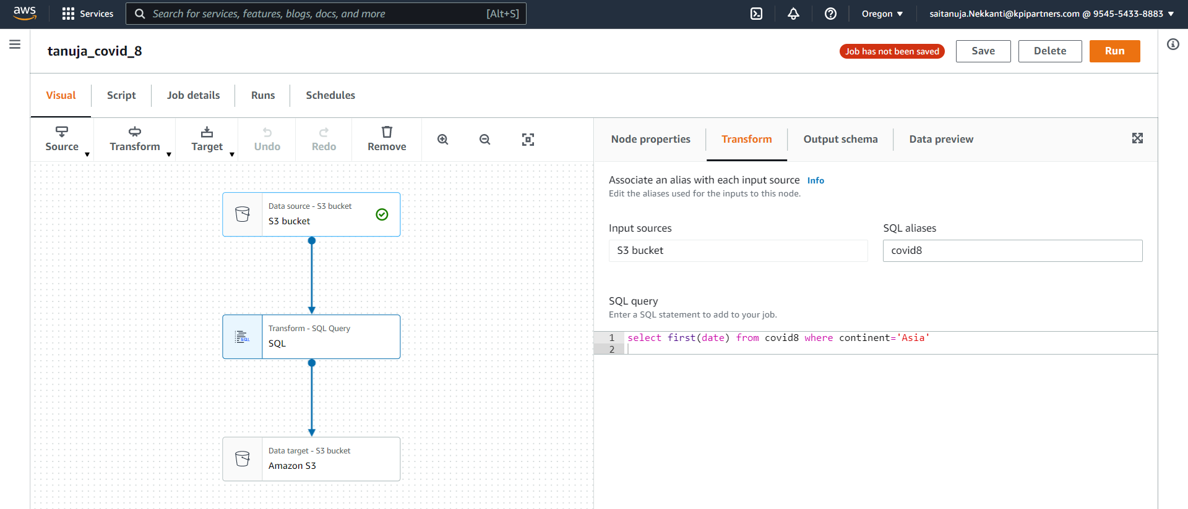
8.Date of first confirmed case in a particular region. JOB NAME :tanuja_covid_8

Slide 18
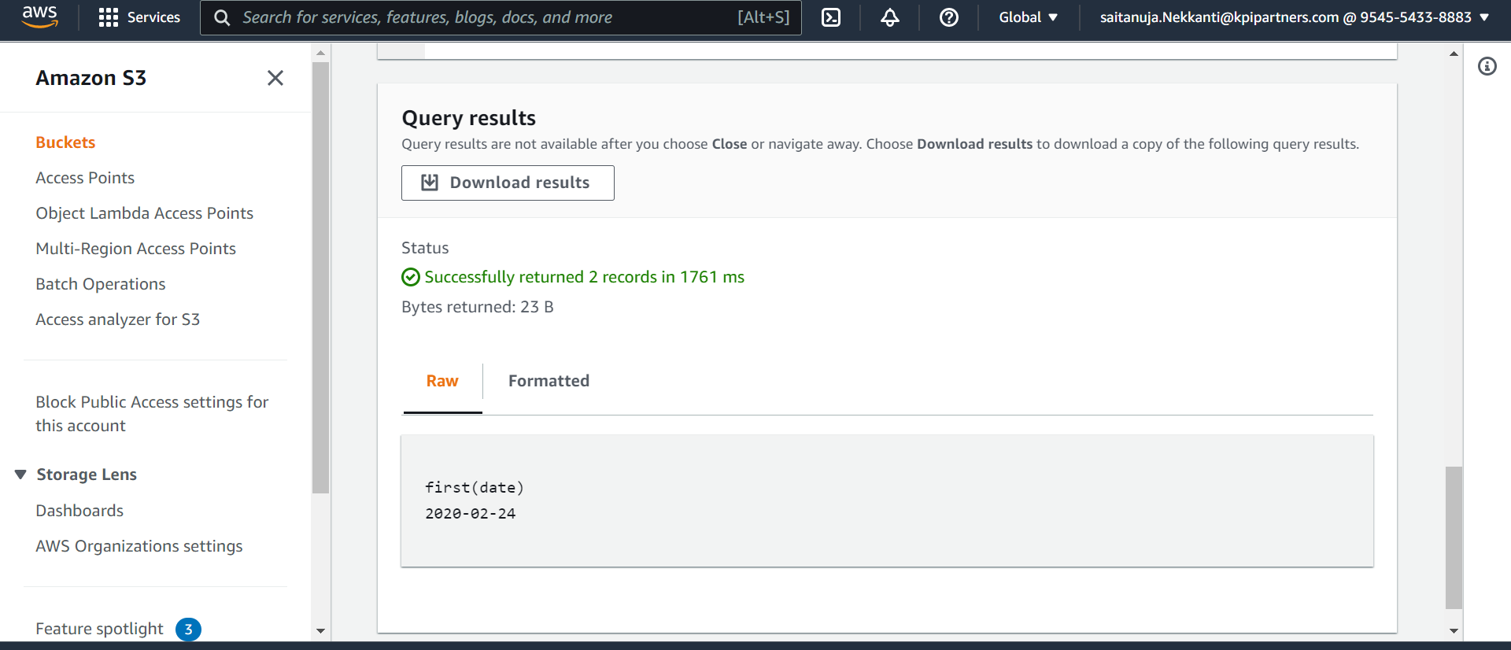
8.OUTPUT

Slide 19
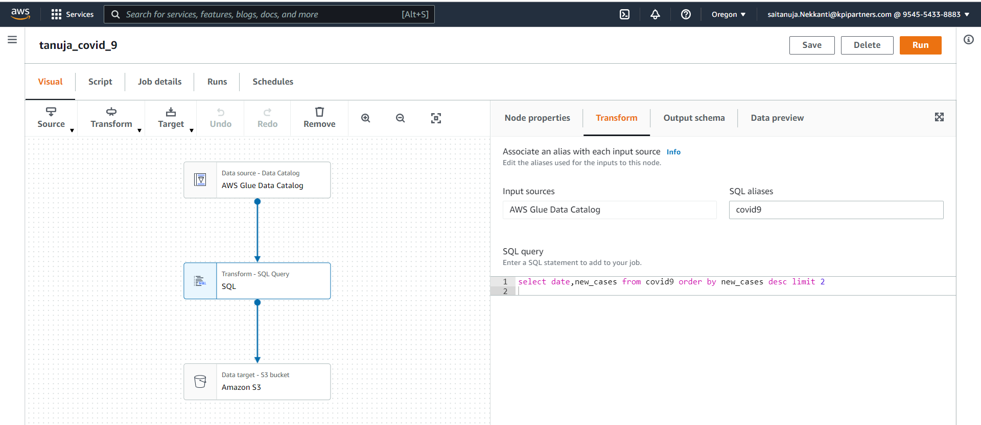
9.Date on which max no. cases were reported in a country. JOB NAME :tanuja_covid_9

Slide 20
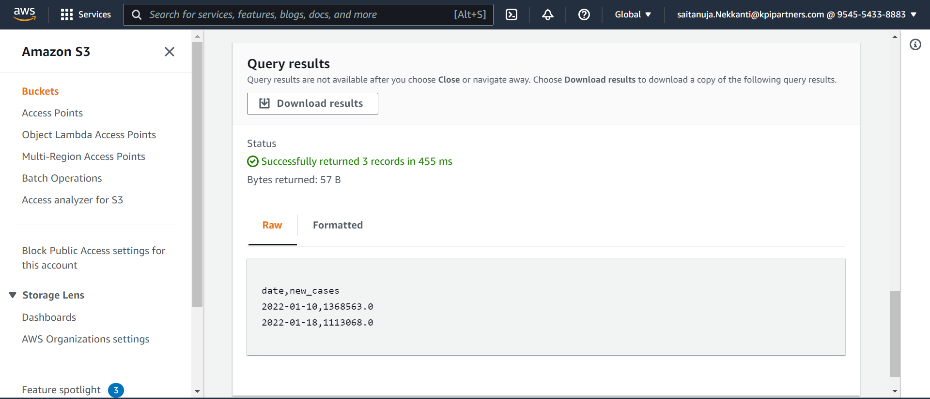
9.OUTPUT

Slide 21
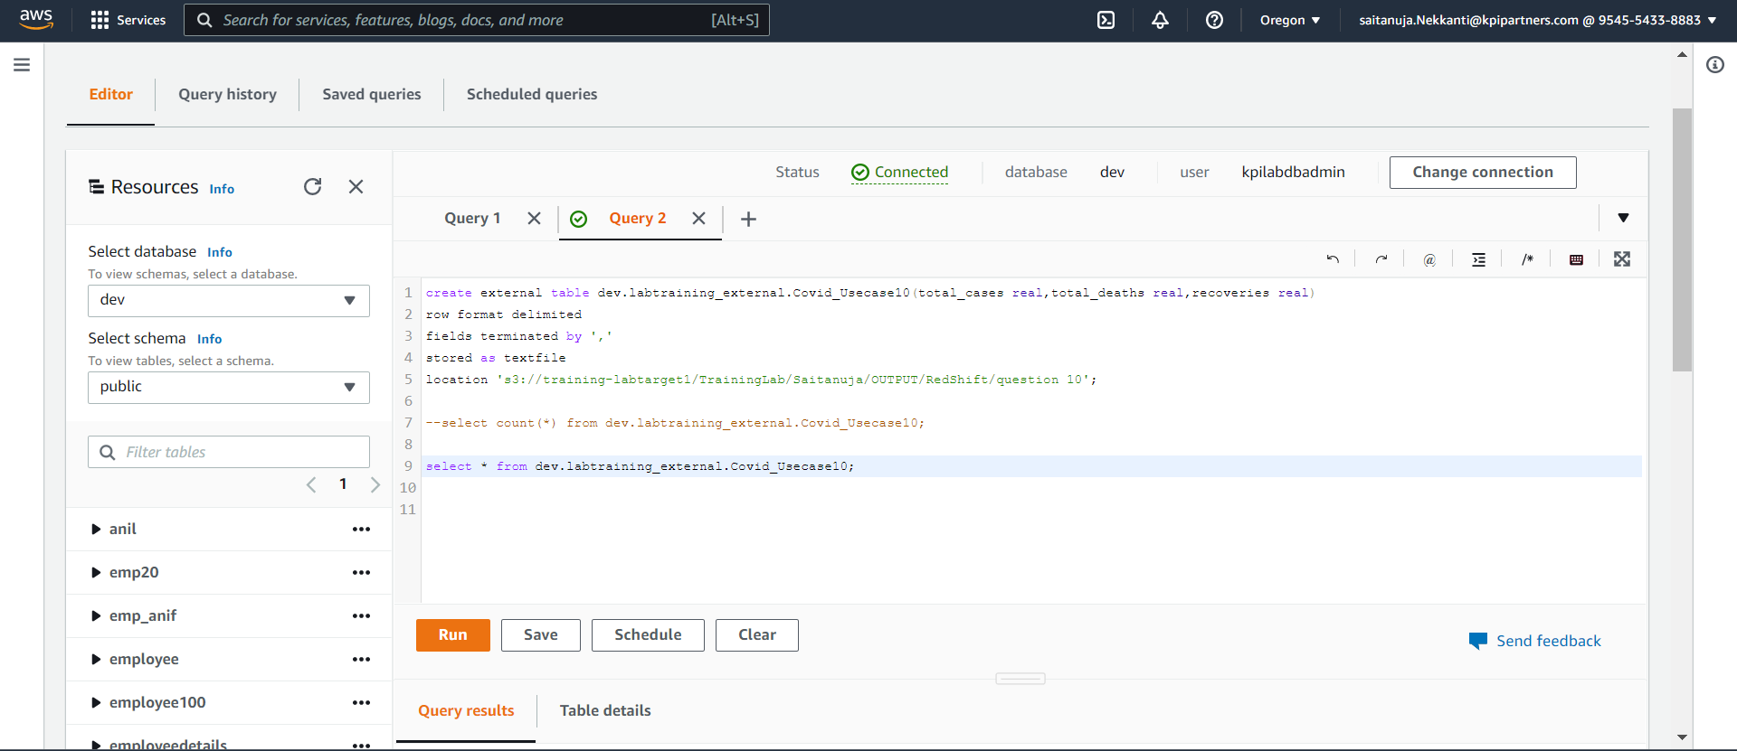
10.Line chart showing total cases, deaths &recoveries of a particular country . Creating external table in Redshift

Slide 22
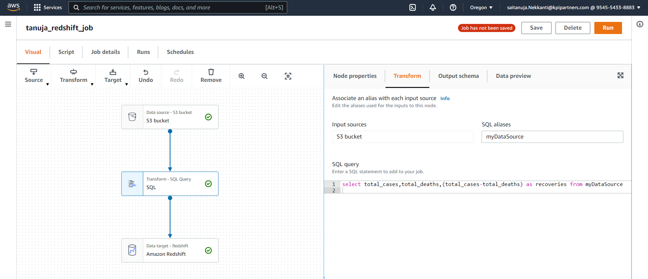
10 . JOB NAME : tanuja_redshift_job

Slide 23
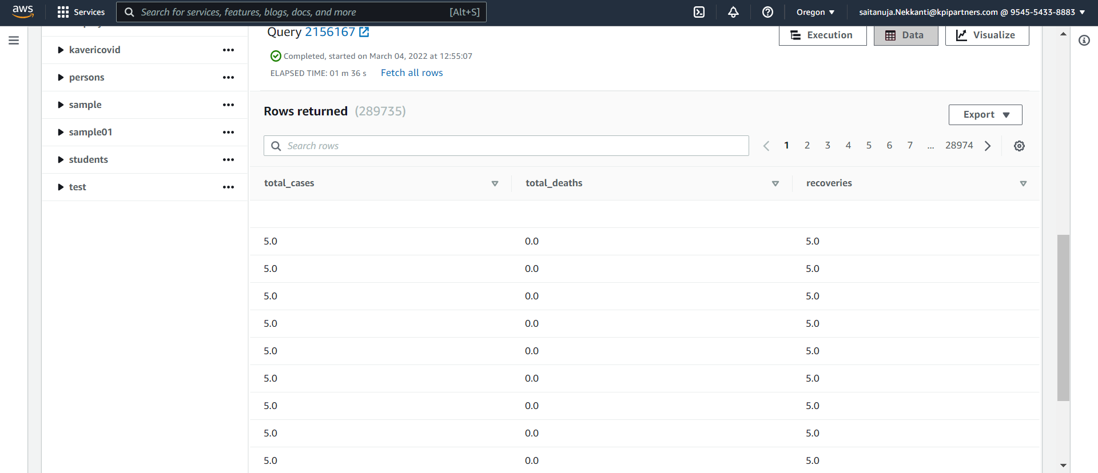
10. OUTPUT

Slide 24
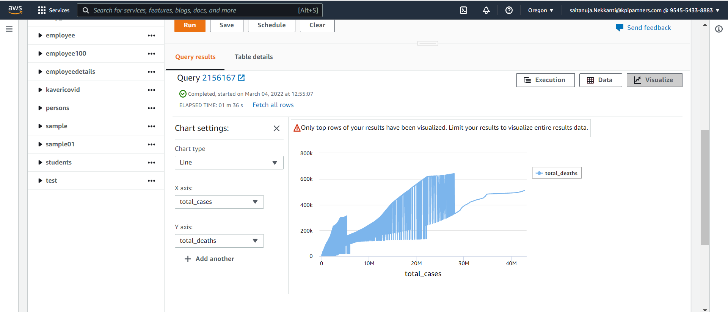
10. Line chart

Slide 25
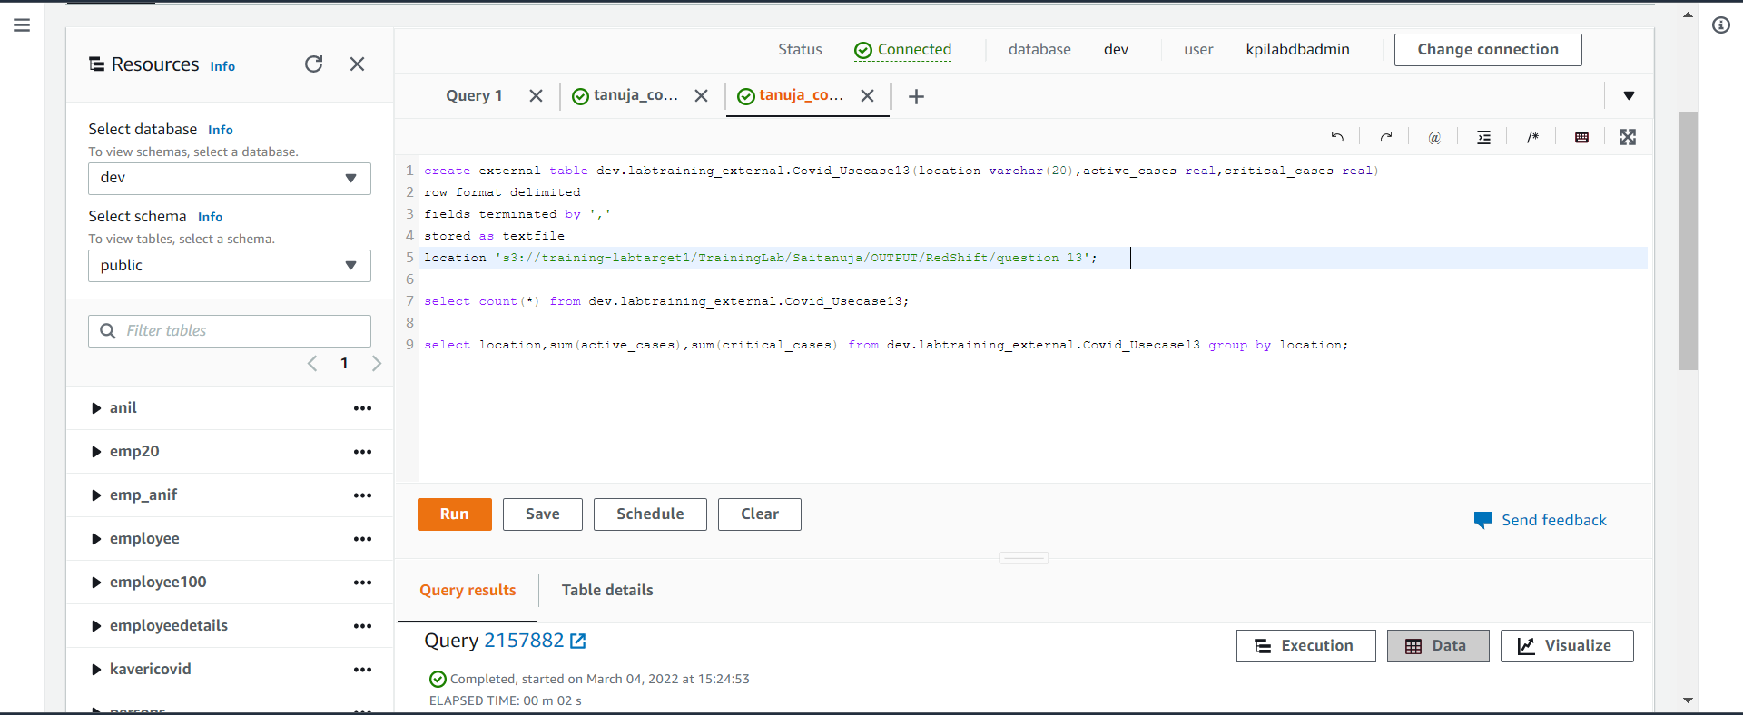
13.No. of active cases vs critical cases of a country. Creating external table in Redshift

Slide 26
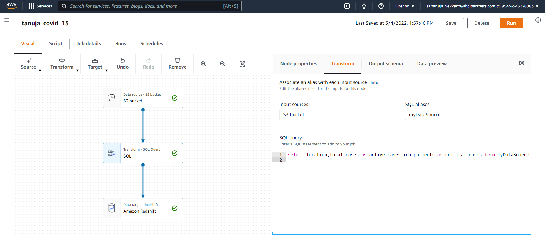
13. JOB NAME : tanuja_covid_13

Slide 27
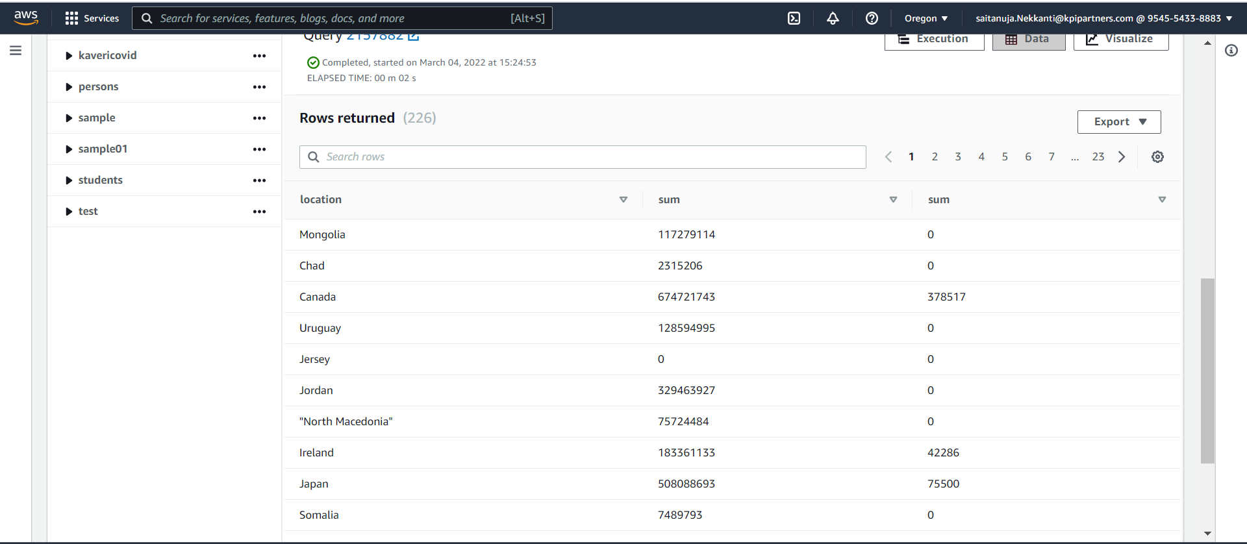
13. OUTPUT

Slide 28
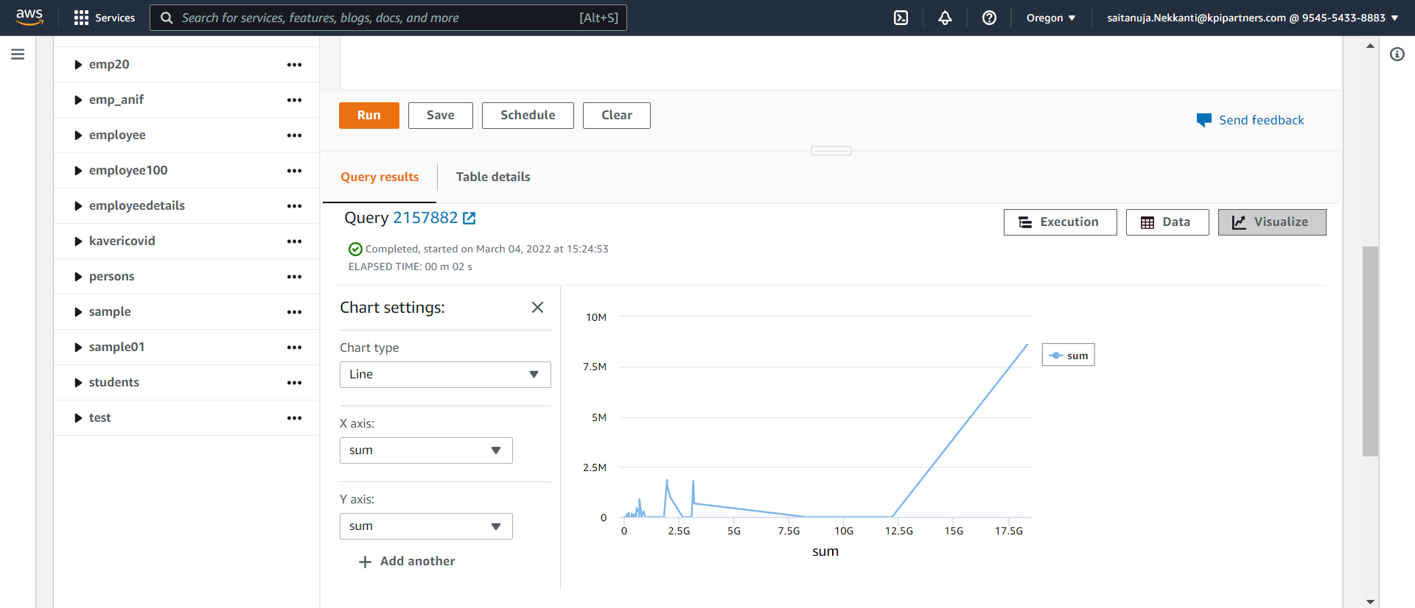
13. Active cases vs Critical cases

Slide 29
THANK YOU

