Slide 1
DESIGNING A TWO PASS ASSEMBLER IMPLEMENTATION AND TESTING
By,
CT - S Batch (2014-2018)
Computer Technology Department
Madras Institute Of Technology
Anna University

Slide 2
CONTENTS:
Introduction
Requirements
Algorithm
Implemented code
Steps to run
Testcases and Output
Conclusion

Slide 3
Introduction:
An assembler is a program that takes basic computer instructions and converts them into a pattern of bits.
Assembler program corresponding bit stream
object code or object program or
machine code.
This object program can then be run.

Slide 4
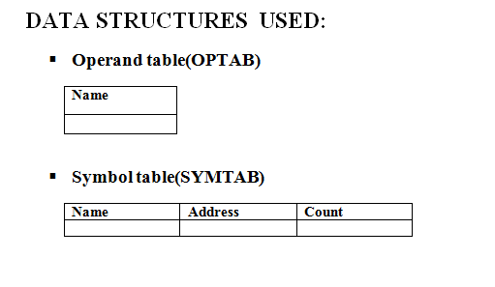
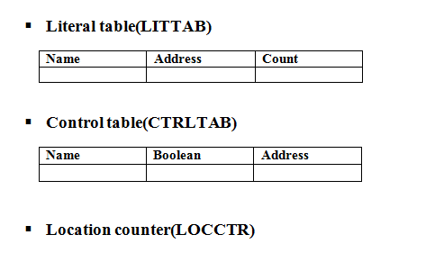
Requirements:

Slide 5
PASS 1 – OVERALL LOOK
In order to calculate the next address, you must check the opcode format,
which you should be storing as part of the precoded opcode table structure.
If (format 1) add 1 byte. // Format 1
If (format 2) add 2 bytes. // Format 2
If (format 3 AND no + present) add 3 bytes.
//Format 3
If (format 3 AND + before opcode) add 4 bytes.
// Format 4

Slide 6
PASS 2- OVERALL LOOK
Along with the mnemonic opcode, the hexadecimal machine code,
and the format number, you should be storing a number indicating expected
number of operands in the opcode table. This allows you to differentiate
between an expected ,X operand, part of a format 2 instruction, such as:
COMPR A,X (Format 2, 2 operands expected)
and an unexpected ,X operand, which indicates indexed addressing, such as:
STCH BUFFER,X (Format 3, 1 operand expected)
For format 2 instructions, you need a hard-coded register correspondence:
A = 0, X = 1, L = 2, B = 3, S = 4, T = 5, F = 6, PC = 8, SW = 9.
4 bits of register 2 are set to 0000 if only one format 2 operand is used.

Slide 7
CONTINUED…
Displacement=(TA-PC) is stored in 12-bit 2s complement form for PC-relative
addressing. You should add 4096 if result is negative to convert quickly.
TA-B below is Target Address - Base Address for base relative addressing.
The flags are shown in binary form and correspond to the six flags nixbpe.

Slide 8
HANDLING THE ADDRESSING MODES
if (format 1) // 8 bit opcode
assemble opcode directly as 1 byte from the opcode table
else if (format 2) // 8 bit opcode + 4 bit R1 + 4 bit R2
assemble opcode + 4 bit register 1 + 4 bit register 2
else if (format 3 or 4)
{ // 6 bit opcode + 6 bit flag + disp.
if (operand is #number)
{ // Immediate numeric (not #address)
if (0 <= number <= 4095) // Can it fit into 12 bits?
assemble opcode + flags 010000 + 12 bit immediate value
else if (4096 <= number <= 1048575 AND + before opcode)
assemble opcode + flags 010001 + 20 bit immediate value
else
error - immediate number out of range
}

Slide 9
CONTINUED..
else if (operand is not blank) // PC, Base relative, Extended
{
if (+ before opcode) // Extended mode address requested
assemble opcode + flags 110001 + 20 bit absolute address
else if (-2048 <= TA-PC <= 2047) // PC AFTER instruction has been read
assemble opcode + flags 110010 + 12 bit disp. // 12 bit 2s comp.
else if (BASE directive set AND 0 <= TA-B <= 4095) // Base relative
assemble opcode + flags 110100 + 12 bit disp. // Disp = TA - BASE
else
error - instruction addressing error
}

Slide 10
CONTINUED..
else // If operand is blank, as with RSUB
assemble opcode + flags 110000 + 12 bits disp = 0 // RSUB = 4F0000
if (# before operand) // # is immediate mode
set n bit to 0 // changes nix from 110 to 010
if (@ before operand) // @ is indirect mode
set i bit to 0 // changes nix from 110 to 100
if (line contains unexpected ,X) // ,X is indexed mode (if unexpected)
set x bit to 1 // changes nix from xx0 to xx1
}

Slide 11
PASS 1 - IMPLEMENTATION
LIST OF VARIABLES USED:
Vector operand- stores the list of operands.
Map littab; - create a map of literals and its count
Map cntrltab; - to handle multiple control sections
Map opcodetab; -opcode of mnemonics
Map symtab; - to store the label and its count
Map registers; - to indicate the registers used in program
Map regtab; - to store the register and its value
Map variabletab; - to store variable in its value
Map symmap; - to map the location counter with its label and count

Slide 12
PASS 1 - FUNCTIONS
To initialize the register values:
void intialregtab(){ regtab["A"]=0; …………………}
To initialize opcode for all mnemonics:
void opcodeinitialize(){ opcodetab["ADD"]="18";
……….}
void pass1()
{
//update the tables according to the input file
}

Slide 13
PASS 2 – FORMAT 1
if(format=="1") //format1{
if(mnemonic=="BYTE"){ reg=name1[2]; reg+=name1[3]; outfile<<"\n"<<reg; } else outfile<<"\n"<<opcodetab[name1];
}

Slide 14
PASS 2 – FORMAT 2
else if(format=="2"){ outfile<<'\n'<<opcodetab[mnemonic]; if(name1.length()==3){
reg1=name1[0]; reg2=name1[2]; outfile<<regtab[reg1]<<regtab[reg2]; } else if(name1.length()==1){ reg1=name1; outfile<<regtab[reg1]<<'0'; }
}

Slide 15
PASS 2 – FORMAT 3 (IMMEDIATE MODE)
else if(format=="3" || format=="4"){ if(name1[0]=='#' && 0<=name1[1]<=9){ if(0<=toInt(name1) && toInt(name1)<=4095){ n=0;i=1;x=0;b=0;p=0;e=0; object_code=assemble_obj(decToBin8(op),n,i,x,b,p,e,decToBin12(toInt(name1))); outfile<<"\n"<<object_code; } else if(4096<=toInt(name1) && toInt(name1)<=1048575 && mnemonic[0]=='+') { n=0;i=1;x=0;b=0;p=0;e=1; object_code=assemble_obj(decToBin8(op),n,i,x,b,p,e,decToBin20(toInt(name1))); outfile<<"\n"<<object_code; } else{ outfile<<"\n.........."; } }

Slide 16
HANDLING THE “*” FOR LITERALS
else if(mnemonic=="*") { for(int k=3;k<name1.length()-1;k++) mn+=name1[k];
outfile<<"\n"; for(int k=0;k<mn.length();k++){ m=mn[k]; val=toDec1(m); outfile<<hex<<val; } mn.clear(); }

Slide 17
HANDLING EXTENDED FORMAT
else if(!name1.empty()){ if(mnemonic[0]=='+'){ n=1;i=1;x=0;b=0;p=0;e=1; object_code=assemble_obj(decToBin8(op),n,i,x,b,p,e,decToBin20(location(name1)));
outfile<<"\n"<<object_code; }
}

Slide 18
HANDLING FORWARD AND BACKWARD REF.
else if((-2048<=(location(name1)-(toDec(copy)+toInt(format)))) && (location(name1)-( toDec(copy)+toInt(format))<=2047)){ n=1;i=1;x=0;b=0;p=1;e=0; if(location(name1)-(toDec(copy)+toInt(format))>0) { object_code=assemble_obj(decToBin8(op),n,i,x,b,p,e,decToBin12(location(name1)- (toDec(copy)+toInt(format)))); outfile<<"\n"<<object_code; } else if(negval<0){ int abs_val=abs(location(name1)-(toDec(copy)+toInt(format))); convdisp=decToBin12(abs_val); convdisp=OnesComp(convdisp); object_code=assemble_obj(decToBin8(op),n,i,x,b,p,e,decToBin12(arrtoint(convdisp))); outfile<<"\n"<<object_code; } }}

Slide 19
Steps to run the Assembler is as follows:
Assembly language program which is the input, should be copied to the “example.txt”.
Assembler.cpp, conv.cpp, example.txt should reside in the same directory.
Compile and Run “Assembler.cpp” file.
“table.txt” will be generated which will contain all the table contents and it’s also displayed in the Terminal.
“intermediate.txt” file will be generated which is the input to pass2() function of the source code.
Object code will be generated in “objectfile.txt”.

Slide 20
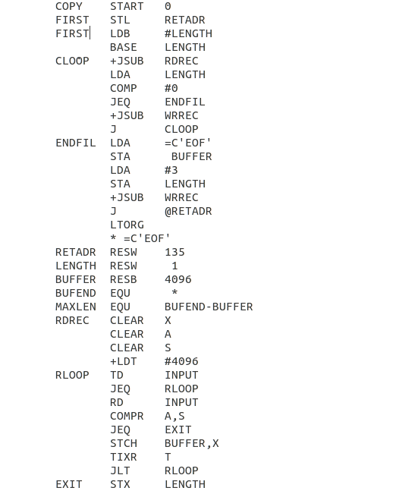

Slide 21
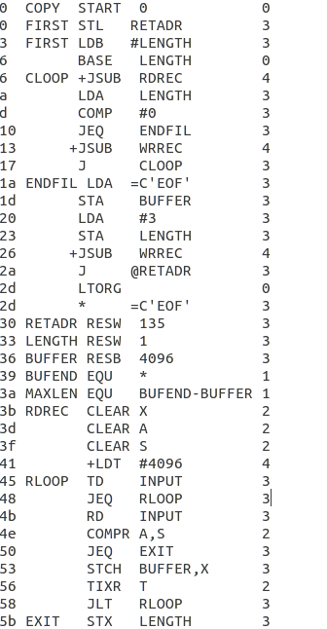
INTERMEDIATE FILE

Slide 22
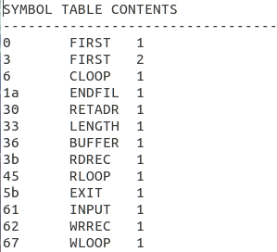

Slide 23
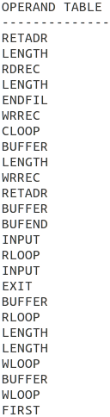
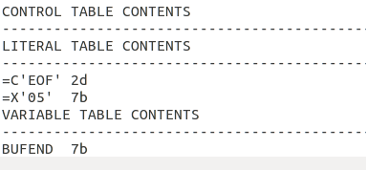

Slide 24
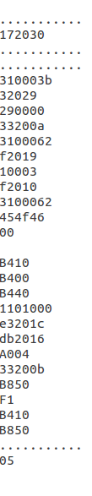
OBJECT FILE

Slide 25
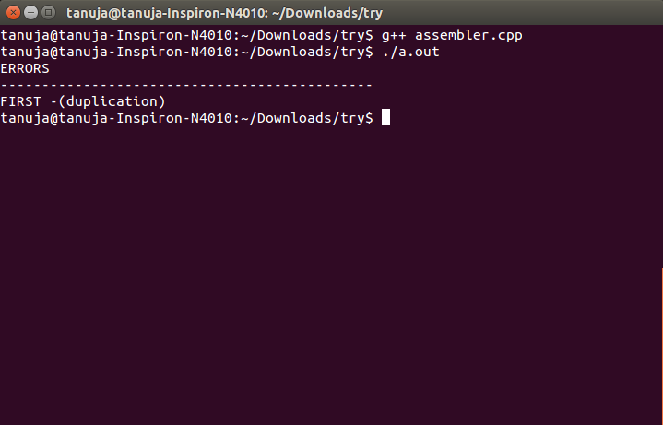

Slide 26
Conclusion:
Thus, this SIC/XE Assembler has been implemented to handle literals, all addressing modes, multiple control sections, duplicate labels, unreferenced labels which are not handled in current Assembler. Pass1 assigns location counter values to all statements, finds which format is used and write in intermediate file. This file is then used in pass2 to generate the object code.

