Slide 1

Shri Vishnu engineering college for women::Bhimavaram (Autonomous)
Detection Of Fatigue in Drivers Using CNN (Batch-6)
IV B.Tech II Sem Project power point presentation
In
Computer Science and Engineering
By
1. Sykam Geetha Bhavya Sri(18B01A0585)
2. Kukkadapu Vyshnavi Tanuja(18B01A0594)
3. Nalabha Jeeshna Sarvani(18B01A05A5)
4. Panja Tulasi Lakshmi(18B01A05A8)
5. Pulavarthi Pranathi (18B01A05B5)
Under the guidance of
Mrs. T.Gayatri
M.Tech(Ph.D.)
REVIEW NO: 3
Date: 12-04-2022
Department of Computer Science and Engineering Slide No:1

Slide 2
Problem Statement
Fatigue, in general, is very difficult to measure or observe unlike alcohol and drugs, which have clear key indicators and tests that are available easily. Probably, the best solutions to this problem are awareness about fatigue-related accidents and promoting drivers to admit fatigue when needed. The former is hard and much more expensive to achieve, and the latter is not possible without the former as driving for long hours is very lucrative.
Fatigue detection system is regarded as an effective tool to reduce the number of road accidents. This project proposes a non-intrusive approach for detecting fatigue in drivers, using Computer Vision. This system tracks the eye for drowsiness.
Department of Computer Science and Engineering Slide No:2

Slide 3
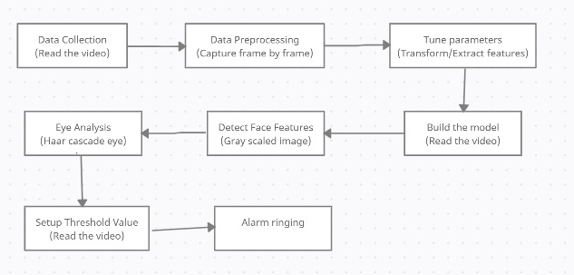
Design
Department of Computer Science and Engineering Slide No:3

Slide 4
UML DIAGRAMS
Department of Computer Science and Engineering Slide No:3

Slide 5
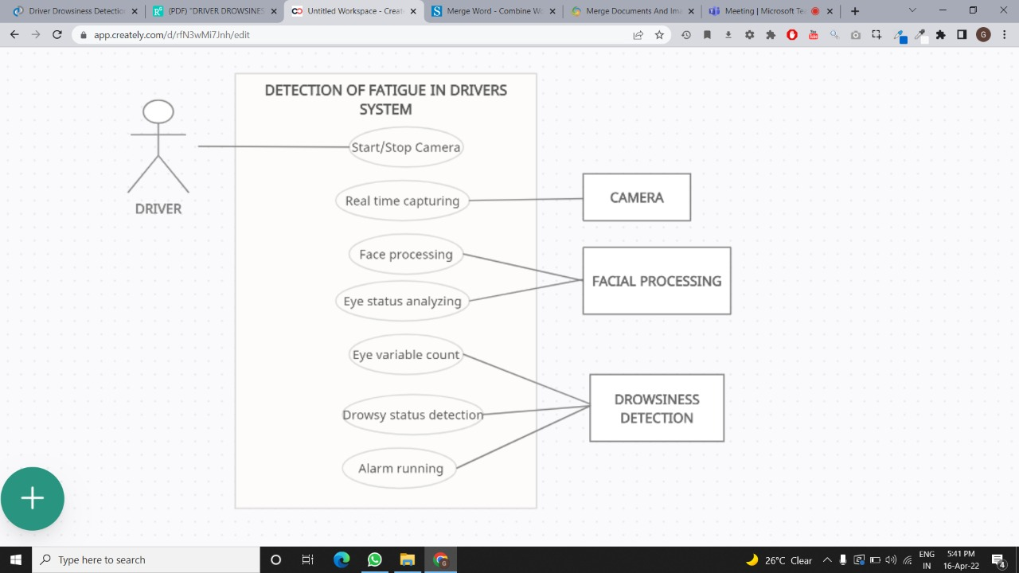
UseCase Diagram
Department of Computer Science and Engineering Slide No:3

Slide 6
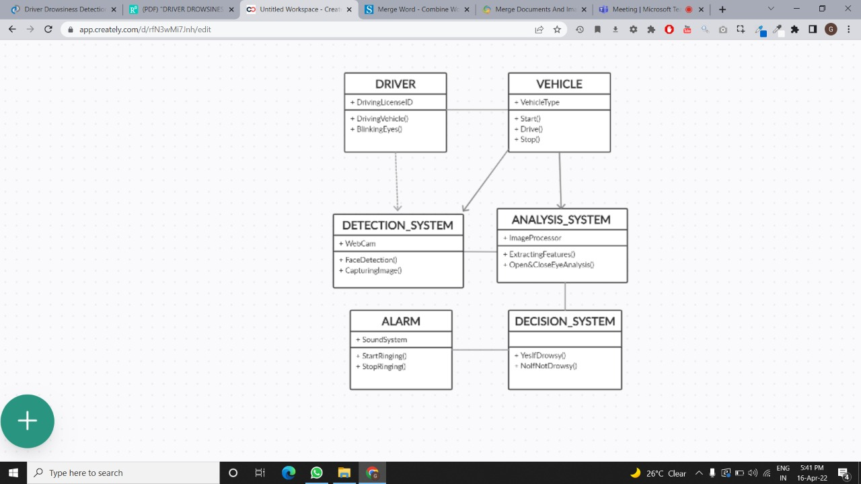
Class Diagram
Department of Computer Science and Engineering Slide No:3

Slide 7
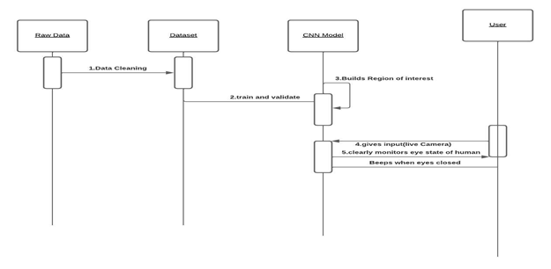
Sequence Diagram
Department of Computer Science and Engineering Slide No:3

Slide 8
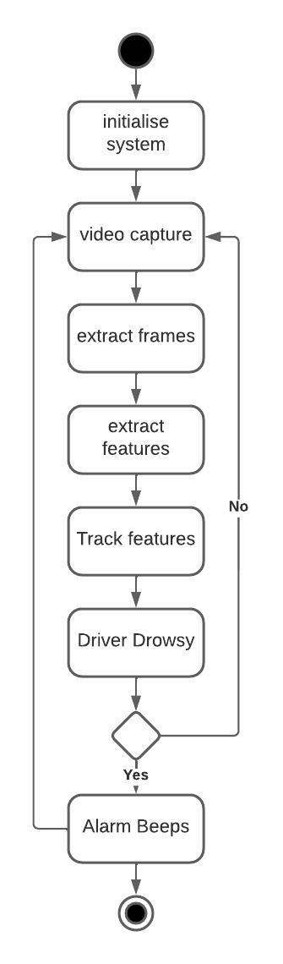
Activity Diagram
Department of Computer Science and Engineering Slide No:3

Slide 9
Functionalities
Image capturing and face detection.
Creation of Region of Interest from the extracted images
Feature extraction of detected facial expressions and eyes for analysis.
Calculation of dynamic threshold from Set-up phase.
Based o obtained values, the designed warning system will alert the driver.
Recapturing the state of person until the threshold minimizes.
Department of Computer Science and Engineering Slide No:4

Slide 10
Technical Skills For System Development
Basic Idea in using Jupyter Notebook
Basic Knowledge on Python to program the code
Knowledge on CNN to classify Images
Basic Knowledge on usage of different types of Libraries in Machine Learning
Department of Computer Science and Engineering Slide No:5

Slide 11
Objectives
Data set Preparation
Preprocessing
Model Building
Training and Testing
Model Evaluation
Department of Computer Science and Engineering Slide No:7

Slide 12
Implementation Modules

Slide 13
DATA SET IMPLEMENTATION
Initially we identify the dataset.
Import libraries such as shutil, glob, os.
We encode the Categorical Data that is 0 for close and 1 for open.
We categorise as open or closed eyes of images in dataset.
We prepare training and testing data.
We analyse the data in our dataset.
Department of Computer Science and Engineering Slide No:8

Slide 14
MODEL TRAINING
We start training our pretrained model using prepared data set.
We import tensorflow and keras to load model.
We use ImageDataGenerator for data augumentation.
We rescale the image in case our image is large in size.
We do this by dividing each pixel in image.
The entire training set is sorted as training data and validation data.
Department of Computer Science and Engineering Slide No:9

Slide 15
DETECTION
We imported our pretrained model to model.h5.
We import libraries like cv2,tensorflow,numpy,pygame.
We use haarcascade_frontalface_default.xml to detect the face.
We use haarcascade_eye.xml to detect the eyes inside the face.
We use inceptionv3 pretrained model to detect the eye states
Department of Computer Science and Engineering Slide No:10

Slide 16
Testing
Take image as input from a camera
We identified if the human face is being detected or not.
By marking face with rectangular box.
By that we get to know it created its region of Interest.
Detect the eyes from ROI and feed it to the classifier.
Classifier will categorize whether eyes are open or closed.
Calculates score to check whether the person is drowsy.
Department of Computer Science and Engineering Slide No:11

Slide 17
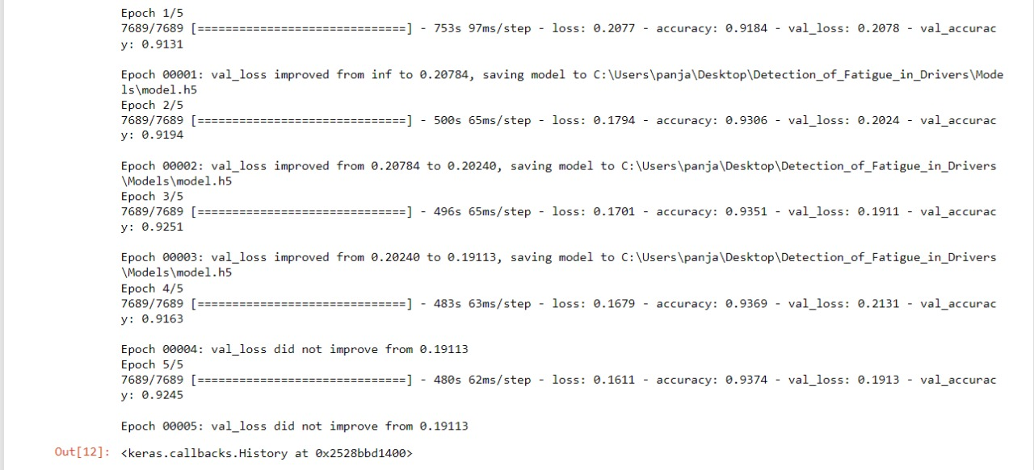
Preliminary Results
We used pretrained model called InceptionV3 to increase accuracy and trained model with our own data set
We fit our model by increasing epoch count to enhance accuracy
Loss decreased and accuracy increased as depicted below:
Department of Computer Science and Engineering Slide No:12

Slide 18
Conclusion
This model completely meets the objectives and requirements of the system. The framework has achieved an unfaltering state where the fact that it takes care of the issue of stressing out for individuals having fatigue-related issues to inform them about the drowsiness level while driving. Future Scope is the model can be improved incrementally by using other parameters like blink rate, yawning, state of the car and a sensor to track the heart rate etc. If all these parameters are used it can improve the accuracy by a lot.
Department of Computer Science and Engineering Slide No:9

Slide 19
Thank you
Department of Computer Science and Engineering Slide No:13

