Slide 1
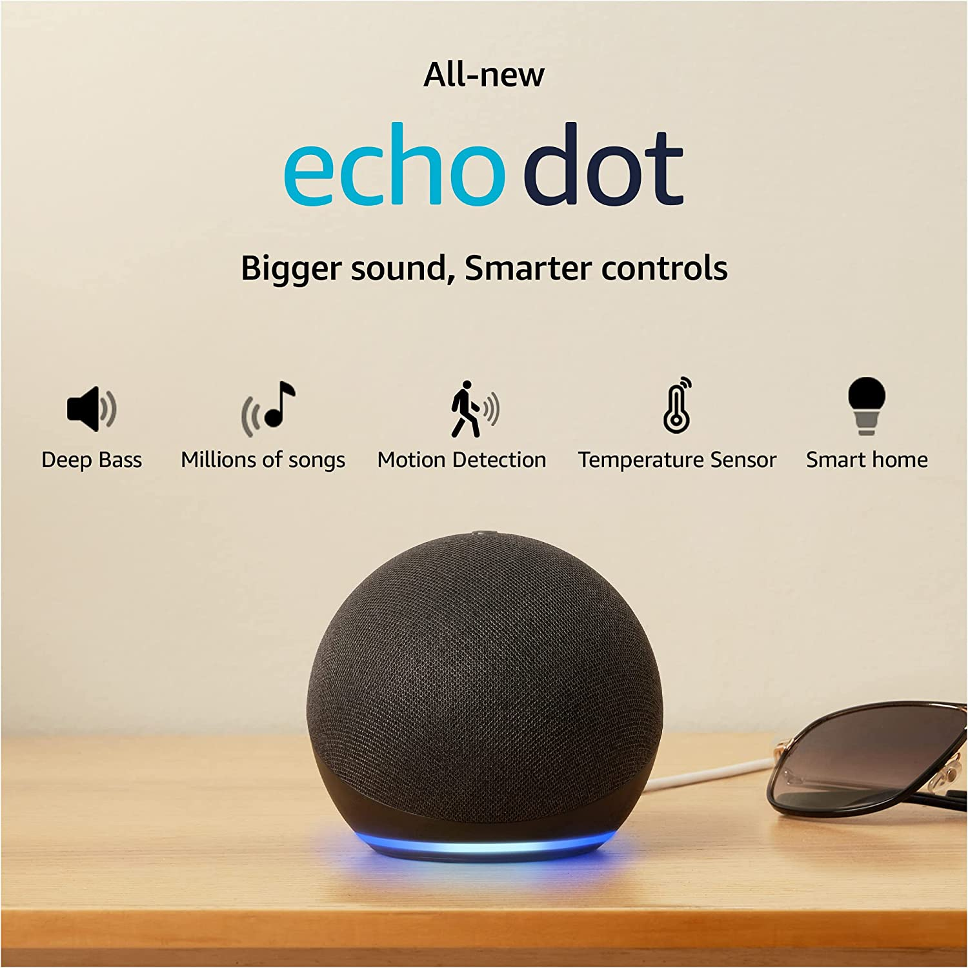
All-new
Echo Dot
(5th Generation)
Bigger sound, Smarter controls
Notes:
Greetings and welcome to this training session! Today, we will be exploring the incredible capabilities of the all-new Echo Dot 5th Generation. With its enhanced sound quality and advanced controls, this device is a game-changer in the world of smart home technology.

Slide 2
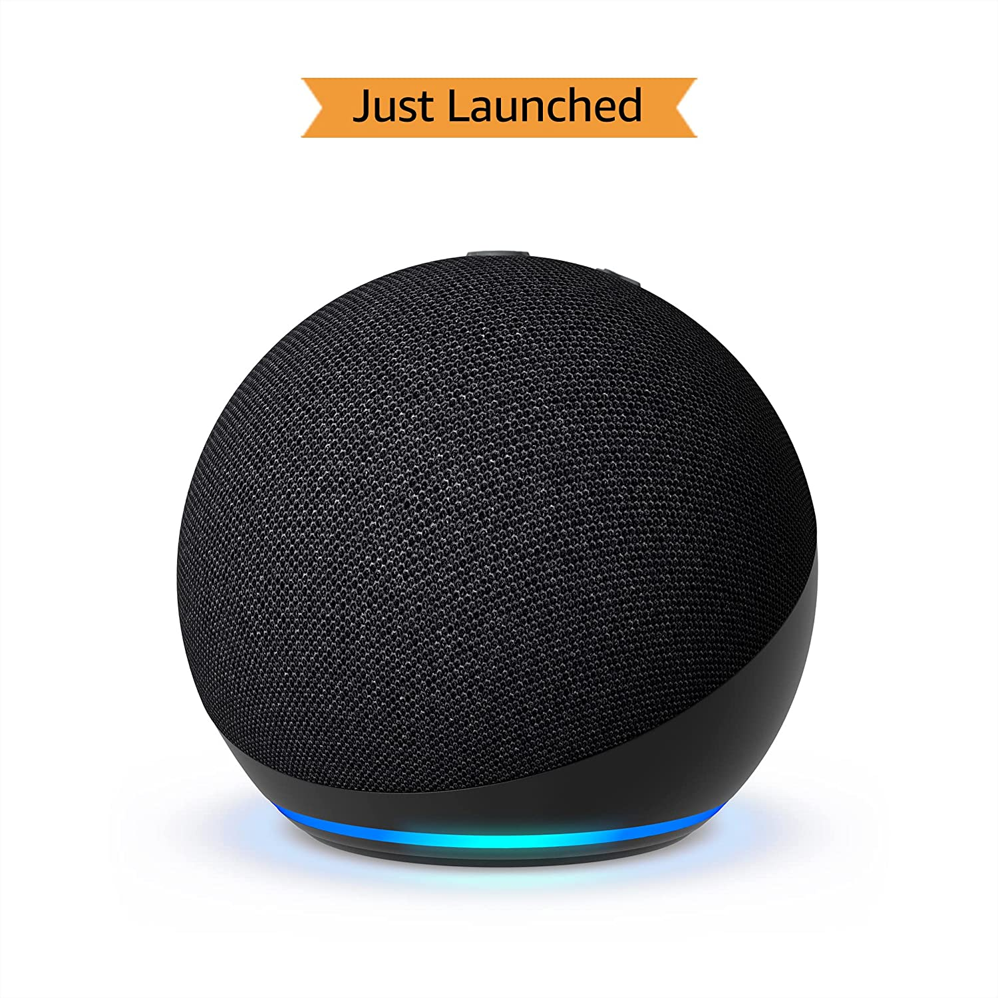
What’s new!
Improved speaker system with 10% larger speaker and up to 2x more bass.
Enable convenient routines with ultrasound motion detection, such as activating the lights when you enter the room.
Create helpful routines with the temperature sensor, like automatically turning on the AC when the temperature rises above a certain threshold. Manage these routines effortlessly in the Alexa app.
Effortlessly pause or resume music or snooze alarms with a simple tap.
Notes:
The Echo Dot 5th-gen comes packed with exciting new features that take your smart speaker experience to a whole new level. With its improved speaker system, you'll enjoy 10% larger speakers and up to 2x more bass for a richer, more immersive audio experience.
But that's not all! The Echo Dot 5th-gen also features ultrasound motion detection that enables convenient routines like automatically activating lights when you enter a room. Plus, the temperature sensor allows you to create helpful routines, such as automatically turning on the AC when the temperature rises above a certain threshold.
Managing these routines is effortless with the Alexa app, where you can easily customize and modify them to fit your needs.
And when it comes to controlling your music and alarms, the Echo Dot 5th Gen makes it easier than ever with a simple tap. Effortlessly pause or resume your music or snooze your alarms without having to fumble for buttons or controls.
Experience the next level of smart home technology with the all-new Echo Dot 5th-gen.

Slide 3
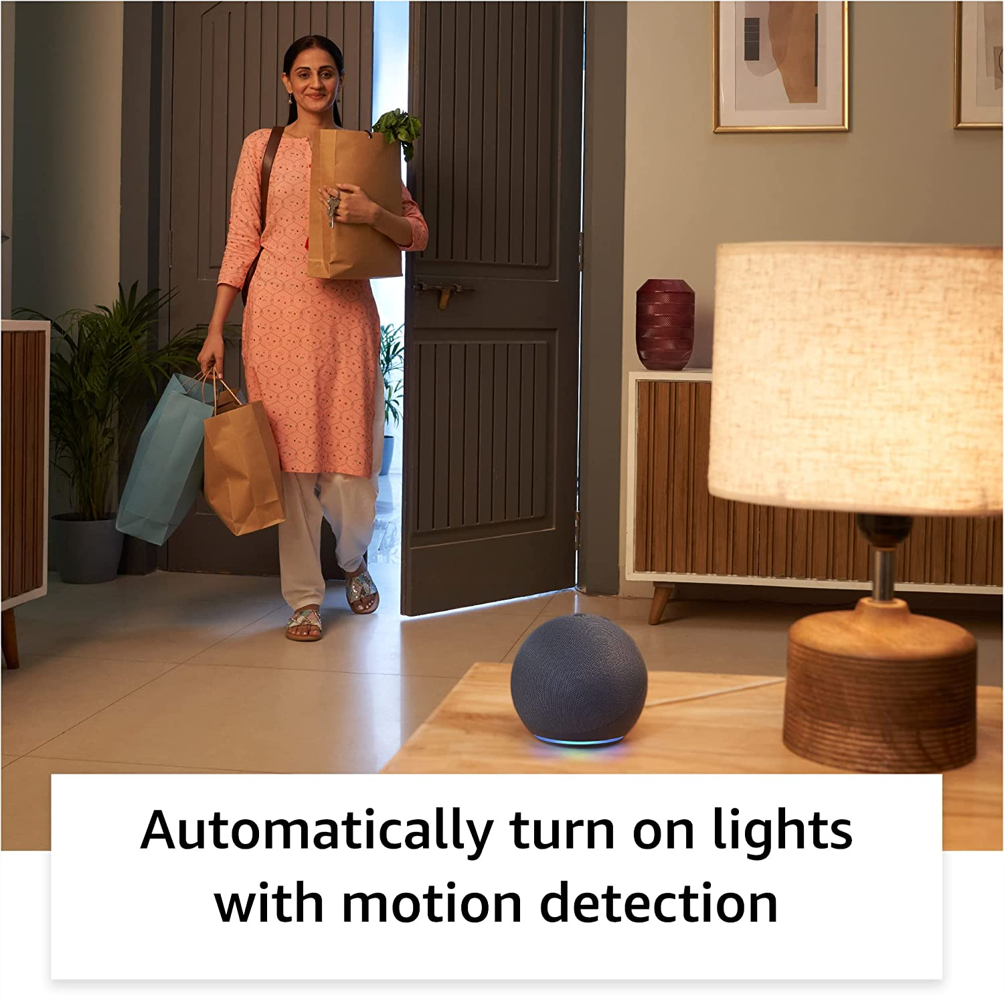
Motion Detection and Temperature sensor
Take your home automation to new level with Motion detection and temperature sensor
The motion detection feature will turn on/off device based on motions around the Echo
The Temperature sensor will turn on/off the AC when it senses change in temperature
Set-up routines by motion detection or change in temperature
Notes:
The Echo Dot 5th-gen takes home automation to the next level with its advanced motion detection and temperature sensor features. With these innovative capabilities, you can create powerful routines that make your home smarter and more efficient than ever before.
The motion detection feature lets you control your devices based on motions around the Echo Dot. Turn your lights on and off automatically when you enter or leave a room, or switch on your TV when you settle down on the couch. It's like having a personal assistant who knows exactly what you need, when you need it.
The temperature sensor is another amazing feature that allows you to set up routines to control your AC or heating system based on changes in temperature. Imagine walking into a perfectly cooled room on a hot summer day or returning to a cozy, warm home in the middle of winter. With the Echo Dot 5th-gen, it's all possible.
With these advanced features, you can effortlessly set up routines that fit your lifestyle and save you time and energy. The Echo Dot 5th-gen truly puts the power of home automation at your fingertips.

Slide 4
What Is Ultrasound Motion Detection?
Echo devices emit ultrasound and use microphones to detect motion near the device.
Motion detection is designed to detect major motion but may not detect minor motion.
Routines can start even when no occupancy is detected, such as turning off lights when the room is empty.
Notes:
Have you heard about ultrasound motion detection? It's an amazing feature of the Echo Dot 5th-gen that allows for even more advanced home automation.
Here's how it works: the Echo Dot emits ultrasound waves and uses its built-in microphones to detect motion near the device. This means that you can set up routines that activate based on your movements around the room. For example, you can have your lights turn on automatically when you enter the room, or turn off when you leave.
While the motion detection feature is designed to detect major movements, it may not pick up on minor ones. However, even without occupancy being detected, routines can still be activated. So, you can have your devices turn off automatically when the room is empty, saving you energy and time.
With ultrasound motion detection, the Echo Dot 5th-gen takes home automation to a whole new level. So, why not try it out and see how it can make your life easier and more convenient?

Slide 5
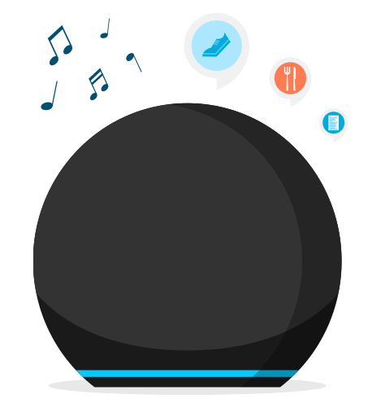
Points to note with Ultrasound motion detection
Motion detection function suppresses routine triggers for 30 minutes after a routine has been activated.
Routines will not activate again for 30 minutes, even if motion is detected during that time.
This feature prevents unnecessary activations of routines and provides a more seamless and efficient experience.
For example, a routine to turn on lights will not activate again for 30 minutes after it has been triggered.
Similarly, a routine to turn off lights will only activate if no motion is detected for at least 30 minutes.
Notes:
Ultrasound motion detection is an incredible feature of the Echo Dot 5th-gen, but there are some points to keep in mind when using it.
One important thing to note is that the motion detection function suppresses routine triggers for 30 minutes after a routine has been activated. This means that if a routine has been activated, it will not activate again for at least 30 minutes, even if motion is detected during that time.
While this may seem like a limitation, it's actually a feature that prevents unnecessary activations of routines and provides a more seamless and efficient experience. For example, if you have a routine to turn on the lights, it won't keep turning them on and off every time you move around the room. Instead, it will only activate once, and then wait for 30 minutes before activating again.
Similarly, if you have a routine to turn off the lights, it will only activate if no motion is detected for at least 30 minutes. This ensures that you're not left in the dark if you're simply moving around the room and not actually leaving.
Overall, ultrasound motion detection is an incredible feature that adds even more convenience and efficiency to your home automation.

Slide 6
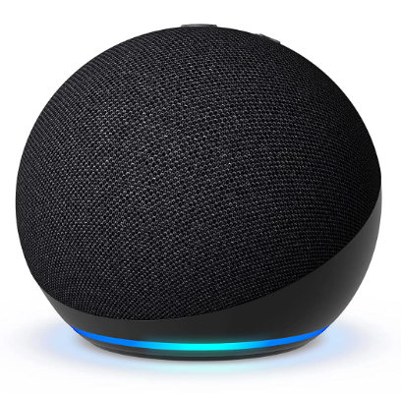
Customer Profile for Echo Dot
5th Generation
Looking for an entry level smart speaker
Wants a smart speaker with improved sound quality and deeper bass
Interested in using the in-built motion detection and temperature sensor for home automation
Wants to easily control music playback and other features with tap gestures
Interested in the latest technology and features offered by Echo Dot 5th gen.
Notes:
The customer profile for Echo Dot 5th Generation includes someone who is looking for an entry-level smart speaker with improved sound quality and deeper bass. They are interested in utilizing the in-built motion detection and temperature sensor for home automation and want to easily control music playback and other features with tap gestures. Additionally, they are interested in exploring the latest technology and features offered by the Echo Dot 5th gen.

Slide 7
60-second pitch for Echo Dot
5th Generation
Introducing the 5th Generation Echo Dot with Alexa, the smart speaker that can do it all. With higher volumes, deeper bass and clearer vocals than all previous generations, you can enjoy your favorite music from Amazon Music, Hungama, Spotify, Jio Saavn, Apple Music and more. Just ask Alexa to play what you want.
But that's not all. You can also voice control your compatible smart appliances like lights, ACs, TVs and geysers with Alexa. And if you have non-smart appliances, you can use smart plugs to make them work with Alexa too.
Create automated routines using ultrasound motion detection to turn on the lights as soon as you enter the room and utilize the temperature sensor to trigger the AC when changes in temperature are detected.
And if you need to pause or resume music, snooze alarms or dismiss timers, you can just tap on the Echo Dot. No need to use your voice every time.
Alexa can also help you manage your day better by setting reminders, paying bills, adding items to shopping list and much more. And Alexa can speak English and Hindi for your convenience.
The Echo Dot 5th Gen is also designed with your privacy in mind. It comes with multiple privacy controls, including a mic off button that disconnects the microphone electronically
Notes:
Here is the 60-second pitch for Echo dot 5th-gen.
Introducing the 5th Generation Echo Dot with Alexa, the smart speaker that can do it all. With higher volumes, deeper bass and clearer vocals than all previous generations, you can enjoy your favorite music from Amazon Music, Hungama, Spotify, Jio Saavn, Apple Music and more. Just ask Alexa to play what you want.
But that's not all. You can also voice control your compatible smart appliances like lights, ACs, TVs and geysers with Alexa. And if you have non-smart appliances, you can use smart plugs to make them work with Alexa too.
Create automated routines using ultrasound motion detection to turn on the lights as soon as you enter the room and utilize the temperature sensor to trigger the AC when changes in temperature are detected.
And if you need to pause or resume music, snooze alarms or dismiss timers, you can just tap on the Echo Dot. No need to use your voice every time.
Alexa can also help you manage your day better by setting reminders, paying bills, adding items to shopping list and much more. And Alexa can speak English and Hindi for your convenience.
The Echo Dot 5th Gen is also designed with your privacy in mind. It comes with multiple privacy controls, including a mic off button that disconnects the microphone electronically

Slide 8
Summary for Echo dot 5th Gen
Improved speaker system with 10% larger driver and up to 2x more bass for a dynamic audio experience
Ultrasound motion detection and temperature sensor to automatically trigger routines, like turning on the lights or AC
Tap gesture controls to pause/resume music, snooze alarms, or dismiss timers with ease
Better mic comprehension for better listening and response compared to previous generations
Built-in Alexa privacy settings for controlling microphone access and deleting voice recordings
Echo Dot 5th Gen delivers a superior audio experience with smart features like motion detection and tap controls, making it the perfect addition to your smart home ecosystem.
Notes:
To summarize our learning, the Echo Dot 5th Gen boasts an improved speaker system with 10% larger driver and up to 2x more bass for a dynamic audio experience. It also features advanced technology such as ultrasound motion detection and temperature sensors to automatically trigger routines, as well as tap gesture controls for ease of use. The better mic comprehension ensures better listening and response, while built-in Alexa privacy settings allow for easy control of microphone access and deletion of voice recordings. Overall, the Echo Dot 5th Gen is a smart and innovative addition to any home.

