Slide 1
Absorption spectra of Chlorophylls
Chem 448 course presentation
By-Tanuj Gupta

Slide 2
Outline
Structures of Chlorophylls
DFT and TD-DFT
Calculated Absorption spectra
Conclusion

Slide 3
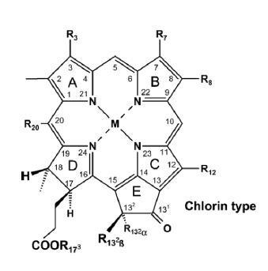
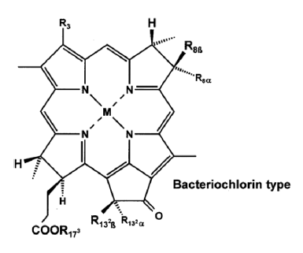
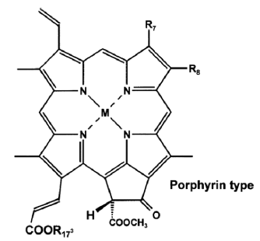
Structure of different Chlorophylls
Ref. Chlorophylls And Bacteriochlorophylls: Biochemistry, Biophysics, Functions and Applications By Bernhard Grimm

Slide 4
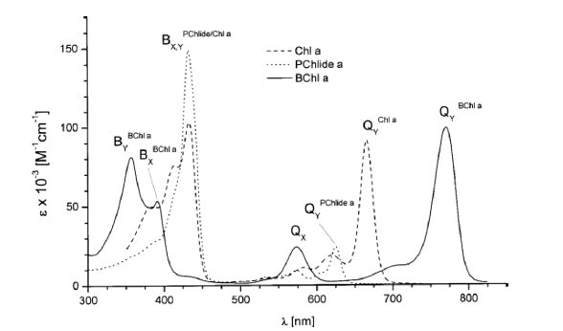
Observed Absorption spectra
Ref. Chlorophylls And Bacteriochlorophylls: Biochemistry, Biophysics, Functions and Applications By Bernhard Grimm

Slide 5
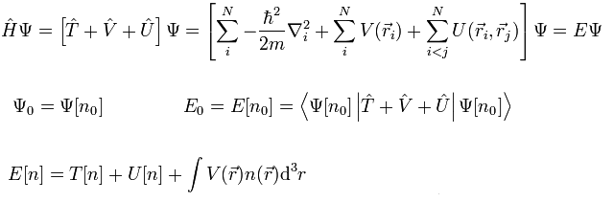
DFT
Ground state properties of a many-electron system can be uniquely determined by using functionals of electron density in 3-D.
Correct ground state electron density minimizes the energy functional
A successful minimization of the energy functional will yield the ground-state density

Slide 6
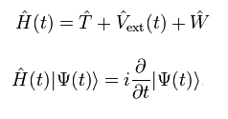
TD-DFT
Used to evaluate properties and dynamics of many-body systems in the presence of time-dependent potentials, such as electric or magnetic fields
Conceptual and computational foundations are analogous to DFT
Based on Runge-Gross theorem which shows that, for a given initial wavefunction, there is a unique mapping between the time-dependent external potential of a system and its time-dependent density.

Slide 7
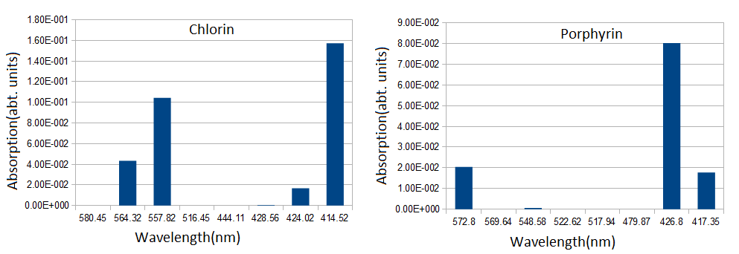
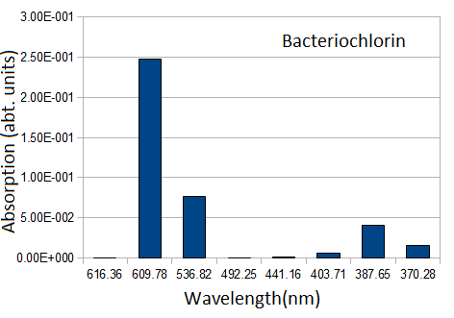
Calculated Absorption spectra

Slide 8
Deviation from observed values
Presence of other molecules and attached groups
Solvent
Approximations

Slide 9
Conclusion
Absorption spectrum shifts in wavelength with slight change in structure of molecules
Absorption spectrum calculated using TD-DFT gives result close to experimental values
Application in dye and pigment industry

Slide 10
Thank You

