Slide 1

COURSERA CAPSTONE PROJECT
IBM
Seattle Road Accident Severity

Slide 2

Introduction
Problem statement
You are driving to another city for work or to visit some friends. It is rainy and windy, and on the way, you come across a terrible traffic jam on the other side of the highway.
It is an accident and there's a helicopter transporting the ones involved in the crash to the nearest hospital.
Now, wouldn't it be great if there is something in place that could warn you, given the weather and the road conditions about the possibility of you getting into a car accident and how severe it would be, so that you would drive more carefully or even change your travel if you are able to.

Slide 3
Introduction
Target Audience
Residents of Seattle can use this model which could aid them in deciding whether or not they should travel along the route under pre-existing weather and road conditions.
Police Department can also use this particular model to predict problem areas and have an immediate response team ready at these locations to lessen the damages to life and property.
Another far-fetched use could be Google Maps using the data to improve time estimations and suggest faster alternative routes for such trips.

Slide 4
Data
The data that we will use to create the model, is the Road Accident Severity Data from the Seattle State Department of Transport.
It is a csv file that contains 194673 entries and 36 attributes.
This file contains data about human factor’s play in these accidents and the details of damage for each instance along with dates and other ‘Yes’ and ‘No’ questions regarding whether the driver was under influence of alcohol or not, or whether the accident involved speeding or not, or whether the pedestrian was granted the right of way to name some.
The file also contains data pertaining to number of pedestrians, number of vehicles, number of bicycles and number of total people involved in each accident.

Slide 5
Data
This dataset has an attribute that classifies the accident into 5 different categories labelled as a number from 0 to 3. SEVERITYCODE is the attribute of interest here. A code that corresponds to the severity of the collision:
• 3- Fatality
• 2b- Serious Injury
• 2- Injury
• 1- Property Damage
• 0- Unknown

Slide 6
Data
Data Extraction
The required columns out of the 38 attributes are ROADCOND, WEATHER, LIGHTCOND, LOCATION, X, Y, INCDTTM, INCDATE and SEVERITYCODE.
These will be the main attributes that we will be using throughout the project
Dropping NaN values from primary attributes before moving to the next step. (We use the dropna function)
Next step is data cleaning where modifications for missing values will be done and modifying contents of certain attributes will take place.

Slide 7
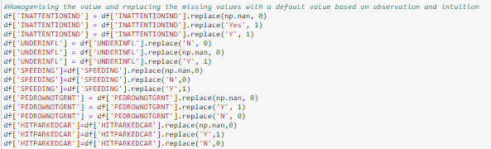
Data
Data Cleaning
For initial stages I considered keeping PERSONCOUNT, PEDCOUNT, PEDCYLCOUNT, VEHCOUNT, INATTENTIONIND, UNDERINFL, PEDROWNOTGRNT, SPEEDING and HITPARKEDCAR
We will try to clean these extra attributes and see if it can be used in the model.
Starting with the extra attributes and homogenizing the data i.e. converting Yes/Y to 1, No/N to 0 and NaN values to 0 as most of the rows are 0 (average of entire column)

Slide 8
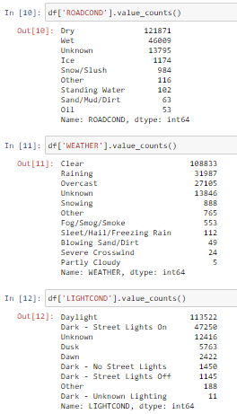
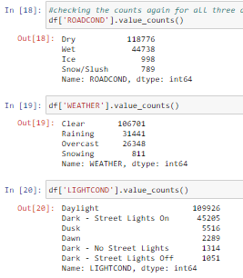
Data
Data Cleaning
Cleaning unnecessary categories in ROADCOND, LIGHTCOND and WEATHER that are insignificant for the model

Slide 9

Data
Data Cleaning
Creating new columns named day and hour from INCDATE and INCDTMM respectively using dt.day_name () and dt.hour functions.
These attributes will be used for visualizations and modelling as this data makes more sense than YYYY-MM-DD HH-MM-SS-TTTT format.
Once all the required data attributes are created and available, next step is to create a separate dataframe df_new using copy () function.
The new dataframe has the following attributes: SEVERITYCODE, X, Y, ROADCOND, WEATHER, LIGHTCOND, DAY, HOUR and LOCATION.

Slide 10
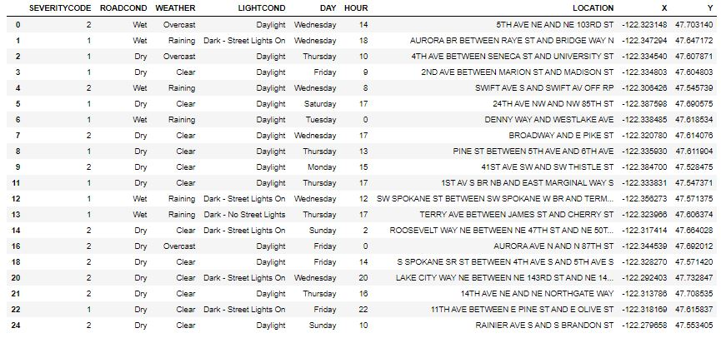
Data
Data Cleaning
df_new dataframe after dropping the unnecessary columns and removing the NaN values from all the primary attributes

Slide 11

Extra Dataframe
df_t dataframe illustrates the value counts of each type of road, weather and light conditions where the attributes are stacked using stack()

Slide 12
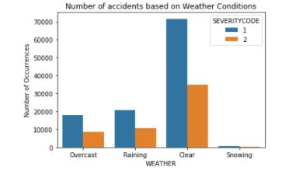
Visualizations
seaborn class to create this visualization of df_new dataframe which shows the distribution of accidents along with the severity index classifications, based on different road conditions.
Clear conditions causes the most number of accidents and the occurrence of injuries is greater than property damage.

Slide 13
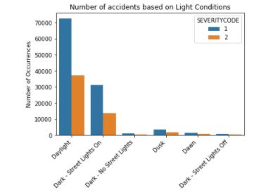
Visualizations
seaborn class is used to create this visualization of df_new dataframe which shows the distribution of accidents along with the severity index classifications, based on different light conditions.
Daylight causes the most number of accidents and the occurrence of injuries is greater than property damage.

Slide 14
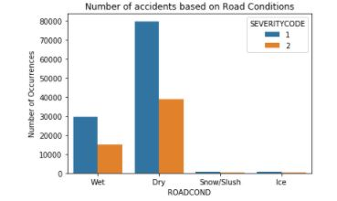
Visualizations
seaborn class to create this visualization of df_new dataframe which shows the distribution of accidents along with the severity index classifications, based on different road conditions.
Dry conditions causes the most number of accidents and the occurrence of injuries is greater than property damage.

Slide 15
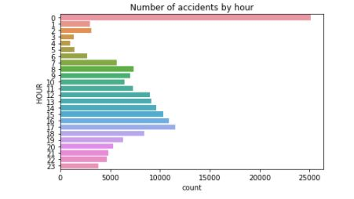
Visualizations
The next two visualizations for accidents occurring on a particular weekday and at a particular hour of the day, which is carried out using seaborn countplot().
It can be seen that 0000 hours have the most number of accidents. Similarly

Slide 16
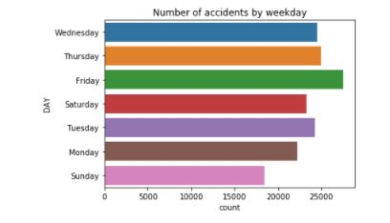
Visualizations
Friday witnessed the maximum number of incidents.
Although the distribution for weekday is not as dramatic as that for accident by hour

Slide 17
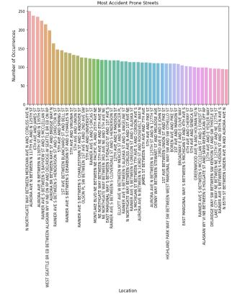
Visualizations
Most accident prone streets and blocks in Seattle
Sns.barplot is used to plot the following graph
The most accident prone street has witnessed 252 accidents

Slide 18
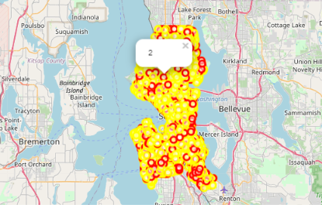
Visualizations
Using Folium and Features a map visualization is created to plot all the accidents in various colors and a pop up marker to indicate the severity of each incident.
Further analysis could be: all the incidents in the past year can be plotted and a grouping can be done for accidents occurring in a particular region.

Slide 19


Predictive Modelling
To apply supervised machine learning algorithm for classification all the data must be numerical.
label encoding is implemented which labels each category within the attribute with a number.
drop the categorical attributes as we have already created the new attributes from label encoding and these old columns are not required for modelling
data imbalance must be ruled out in order to create an unbiased model.
Down-sampling is the best way to proceed with balancing the dataset and this is achieved by importing resample from scikit learn library and writing few lines of code to down-sample the category with more number of instances such that both the categories now have equal number of records.

Slide 20
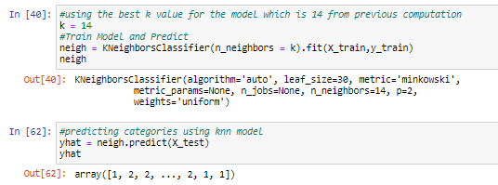
Predictive Modelling
All the required libraries and packages are imported and after normalizing the data using StandardScalar(), this data is split into test and training set with 80% of the dataset being used to train the model.
Starting with the KNN first, using a loop and calculating accuracy for each k value from 1 to 20, I obtained maximum accuracy for the test set for a k value of 14.
Using this value and building the predictor model using KNeighboursClassifier

Slide 21
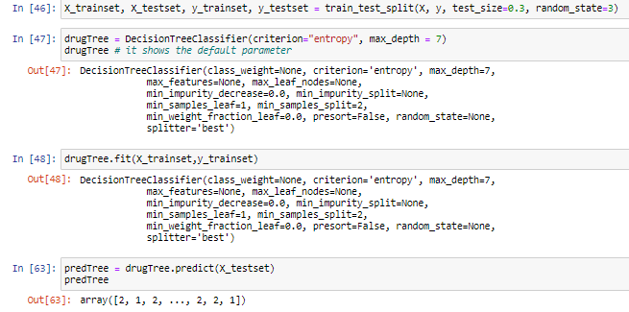
Predictive Modelling
Decision tree, with a test size of 30% and random state of 3 is used to split the preprocessed data.
The classifier is defined with a max depth 7, after calculating trail accuracies with other values ranging between 1 and 20.
Fitting the classifier using the training set before predicting target attribute using the test set.
F1 score and Jaccard score for this model is also evaluated.

Slide 22
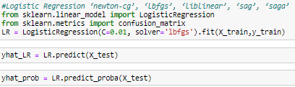
Predictive Modelling
Lastly using Logistic Regression to create a predictor model, I tried implementing various solvers like newton-cg, liblinear and saga but all the solvers had similar accuracy for a C value of 0.01.
The probability for the predicted values is also calculated along with the metric evaluation.

Slide 23

Results and Evaluation
Decision tree would be the best machine learning algorithm for this particular model as indicated by the highest F1 score and Jaccard score of 0.5321.
A score of 0.5321 shows a decent balance between recall and precision.
It also indicates that road, weather and light conditions together with location and time of day can be used to predict severity of accident with an accuracy of 0.5321.
Although, Logistic Regression can also be used as it would work well with binary classification which is the case with our dataset. (As it contains just two categories, injury and property damage)

Slide 24
Conclusion
Based on the dataset provided and the prediction model created using decision tree, we can conclude that particular weather, road and light conditions have some level of impact on whether travel could result in property damage or an injury.
If implemented properly can result in saving many lives and huge sums of money on a yearly basis for the city of Seattle.

Slide 25
THANK YOU

