Slide 1
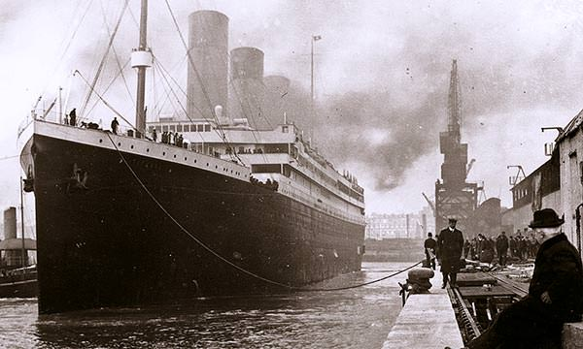
HMS TITANIC: Machine Learning From Disaster

Slide 2
PROBLEM STATEMENT
The competition is based on the infamous ‘HMS Titanic’ ship collision with an iceberg in the Artic Ocean and the loss of over 1500 people out of the 2204 aboard on the vessel.
The ship which was considered to be unsinkable met with it’s fate on it’s maiden voyage.
The people who survived definitely had a great piece of luck but there were several other factors which were the reason behind their survival.
This project aims to better understand and predict the survival of the people by using machine learning techniques.
Based on the features given, we would predict whether an arbitrary would have survived the sinking or not.

Slide 3
MOTIVATION
The motivation to do this project came from the interest of each of the group members into travelling and exploring new places. The love to travel forces us to pick up this project over other interesting projects like the ‘Crypto Price Predictor’ one.
Further, as the project is based on a historic ‘unfortunate’ travel voyage, we were much more enthusiastic to work on this event.
Also, as the problem indicated that several other factors than luck were responsible for affecting the survival rate, we due to our exploring nature decided to work on this project. And find out what all were the factors affecting the survival rate of an individual. This experience as might better prepare us if we were in such situations.

Slide 4
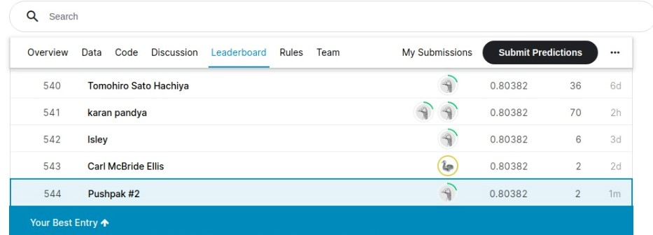
KEY CONTRIBUTIONS
We have created an website through which one can find out whether an arbitrary person would have survived the sink or not.
We had achieved over 80% accuracy on competition test dataset.
We have achieved over 97 percentile as per the Kaggle Leaderboard.
We were able to successfully find out whether an arbitrary person would have survived or not, if he/she were onboard the HMS Titanic.

Slide 5
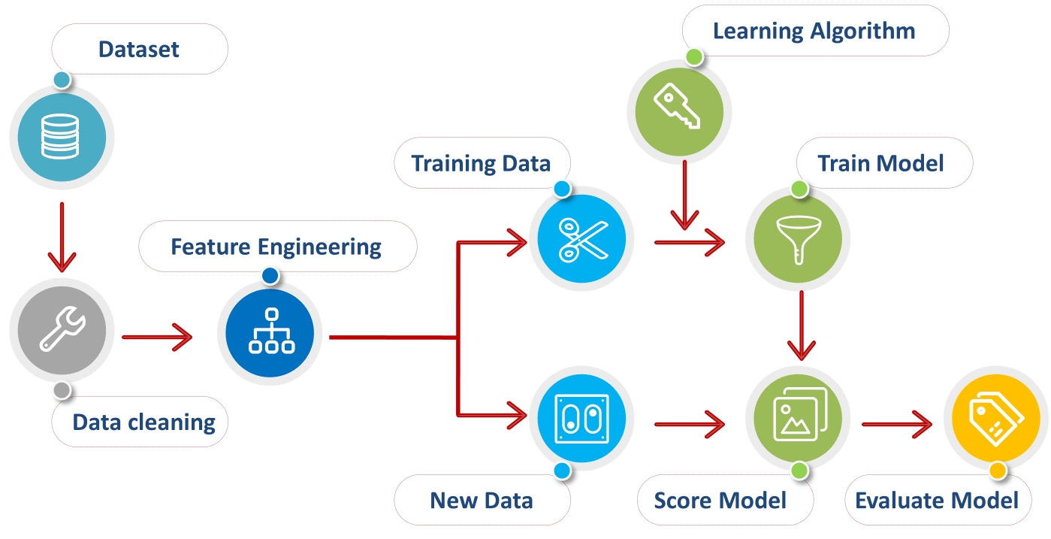
APPROACH TOWARDS THE PROJECT
Analyzing the data:
Before starting to code, we sat down to ask some questions on to how we can make the data given to us in a more precise measure. We then made the dataset more smaller and eligible to work upon.

Slide 6
Data cleaning and Base Models
After analyzing the data, we would cleaning the data and make sure that there exists no empty/false/repeated data entries. Post that we created some base models on the basis of the algos we knew in order to predict the target variable.
Linear Regression Model
After getting scores of the base models, we implemented the Linear Regression Model which had increased our accuracy.

Slide 7
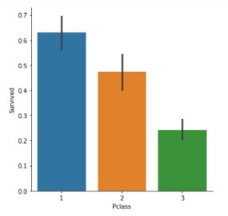
RESULTS
After implementing several models and analyzing their scores, we came to the conclusion that:
Passengers in class-1 had higher rate of survival than the other classes.

Slide 8
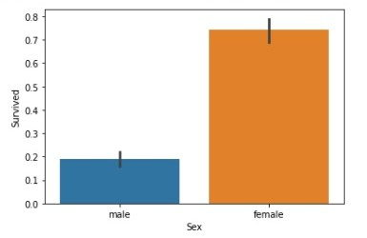
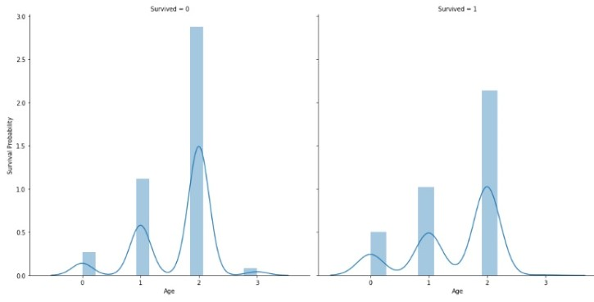
Female passengers had a higher rate of survival from their male counterparts.
Some age groups had better survival chances than the others.

Slide 9
Our team
Tanuj Raghav Pragyan Jaiminy Pushpak Prateek
19/11/EC/027 19/11/EC/028 19/11/EC/039

