Slide 1

Sutra
A local-first workspace for the way students actually work.
Notes · planning · homework · AP prep · review · college · life — woven into one private workspace.
PRIVATE · LOCAL-FIRST · STUDENT-BUILT
Product preview — research/portfolio overview · Built by Tanuj Ranjith · 2026

Slide 2
THE PROBLEM
A student's day is scattered across a dozen tools
Notes app
School portal
Calendar
Task manager
where ideas live
where grades live
where time lives
where to-dos live
AI chatbot
Study tools
Docs & files
20 browser tabs
where answers live
where review lives
where work lives
where focus dies
The cost of fragmentation
Constant context-switching — re-finding where each thing lives
Information lost between apps that never talk to each other
Studying disconnected from the deadlines and notes that drive it
Missed due dates, weak organization, and little ownership of your own data
Sutra — local-first student workspace
2

Slide 3
WHY EXISTING TOOLS FALL SHORT
Point tools solve tasks — not continuity
Each category does one job well, then hands you off. The thread between planning, writing, studying, tracking, and recovering your work breaks at every boundary.
Generic notes app
Task manager
AI chatbot
School LMS
Study app
Great at writing. Blind to your deadlines, classes, and study schedule.
Tracks to-dos. Doesn't hold your notes, exams, or review.
Answers questions. No memory of your workspace; your data leaves your control.
Shows assignments. Read-only, per-school, not your personal system.
Drills flashcards. Disconnected from the material and the calendar.
Students don't need another silo. They need one thread through all of it.
Sutra — local-first student workspace
3

Slide 4
THE SUTRA VISION
One workspace. Every thread.
Sutra is Sanskrit for a thread — the line that holds separate beads into one piece.
A student operating system, concretely:
One private workspace for your whole academic life
Notes, deadlines, classes, studying, and planning that reference each other
Context preserved instead of scattered across unrelated apps
Optional AI assistance that reads your workspace — and only with your approval
Your data on your device, portable in a single file, owned by you
We use the thread metaphor sparingly — inside the app, labels stay literal: Today, Notes, Homework, Timeline.
Sutra — local-first student workspace
4

Slide 5
WHAT SUTRA IS TODAY
An honest snapshot of the product today
Available Today
In Progress
Experimental
Roadmap
Available Today
In Progress
Experimental
Roadmap
Notes + rich editor
Today / Deadline Radar
Timeline calendar
Homework
AP Study + Battle Plan
Review (5 modes)
College / Life / Work
Local-first save + .sutra backup
Themes + CSS overrides
Privacy & CSP hardening
Mobile QA across all surfaces
Testing Hub depth
Onboarding polish
Plugin ecosystem
Header-level security on host
Cram surface
Proactive assistance
Optional opt-in sync
Service-worker offline
Cross-device workflow
Broader student-OS
Sutra — local-first student workspace
5

Slide 6
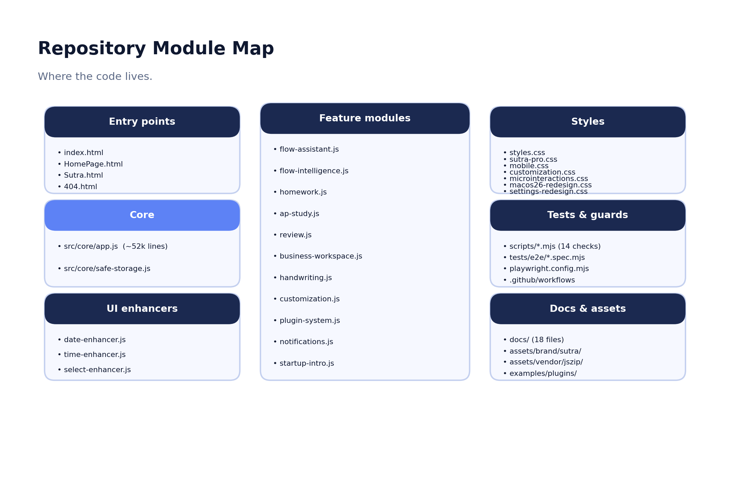
PRODUCT TOUR
How the workspace fits together
A single top tab switcher exposes the workspace; the active Sutra Mode decides which views are primary.
Today — daily command center + one Next Step
Timeline — month/week/day/year planner
Notes — hierarchical tree + rich editor
Homework, AP Study, Testing Hub, Review
College, Life, Projects & Work
Sutra Assistant launcher, bottom-right
Settings — themes, customization, data, modes
Repository module map
Sutra — local-first student workspace
6

Slide 7
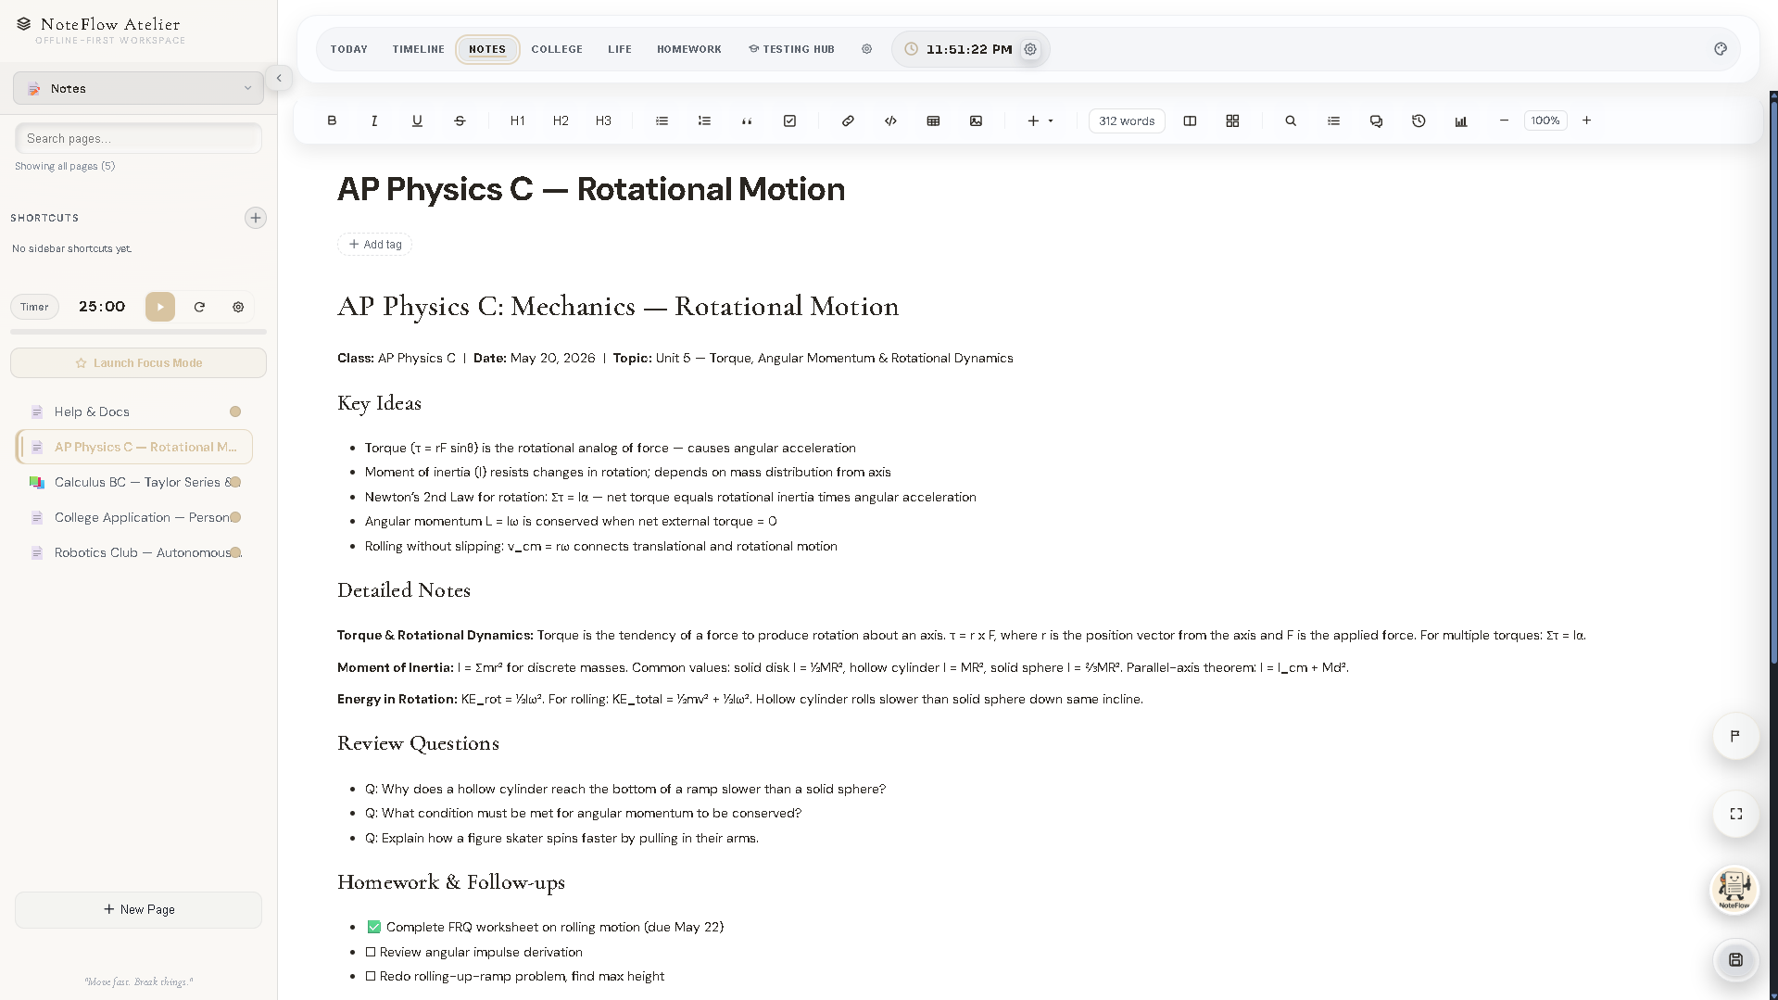
NOTES & ORGANIZATION
A writing surface that organizes itself
Available Today
Hierarchical page tree with :: nesting, search, tags, favorites, drag-reorder
Rich editor: formatting, slash menu, insert menu, tables, embeds, checklists
Page Mode, per-page Document Backgrounds, split view
Handwriting blocks (pen / highlighter / eraser), stored as vectors
Locked pages — PIN as a salted SHA-256 hash, never raw
Version history, and full export inside every .sutra backup
Notes editor — real screenshot (pre-rebrand build)
Every note travels with your workspace and round-trips through backups.
Sutra — local-first student workspace
7

Slide 8
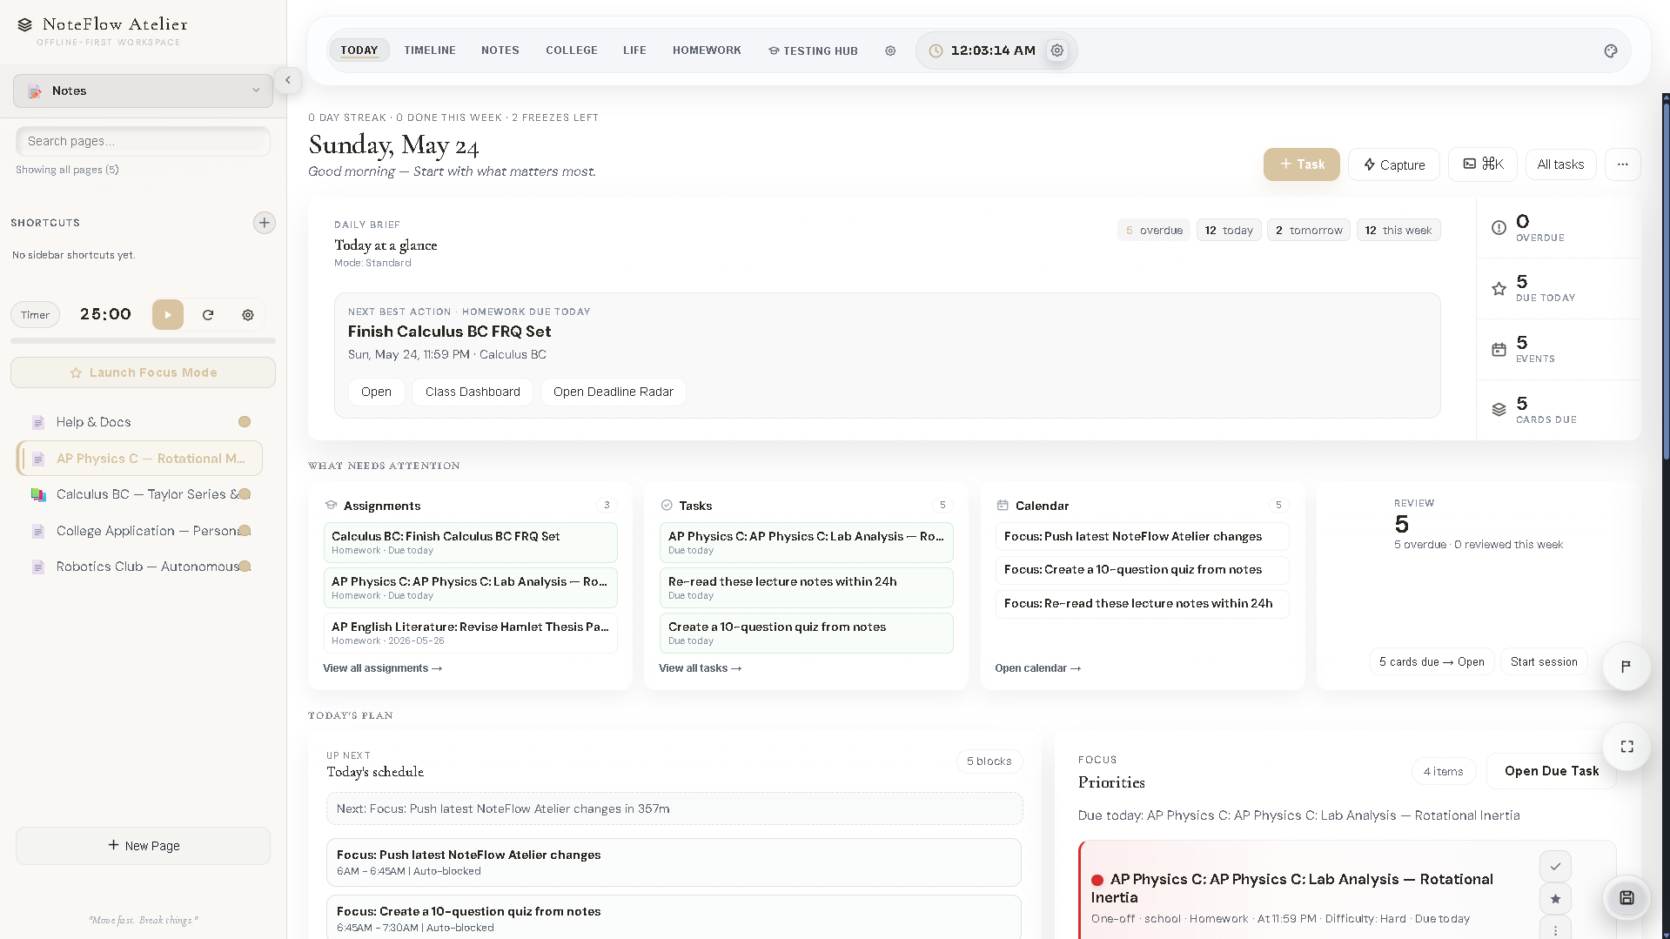
ACADEMIC PLANNING
Deadlines, classes, and time in one place
Available Today
Today: a Daily Thread + a deterministic single Next Step
Deadline Radar groups every deadline by urgency, with Schedule this
Homework lanes for Subjects and Activities, with due-state chips
Import from School Portal parses pasted portal lines
Timeline calendar — month/week/day/year, recurrence, ICS in/out
Quick Capture turns 'Chem essay due Friday hard' into the right item
Today command center (pre-rebrand build)
Sutra — local-first student workspace
8

Slide 9
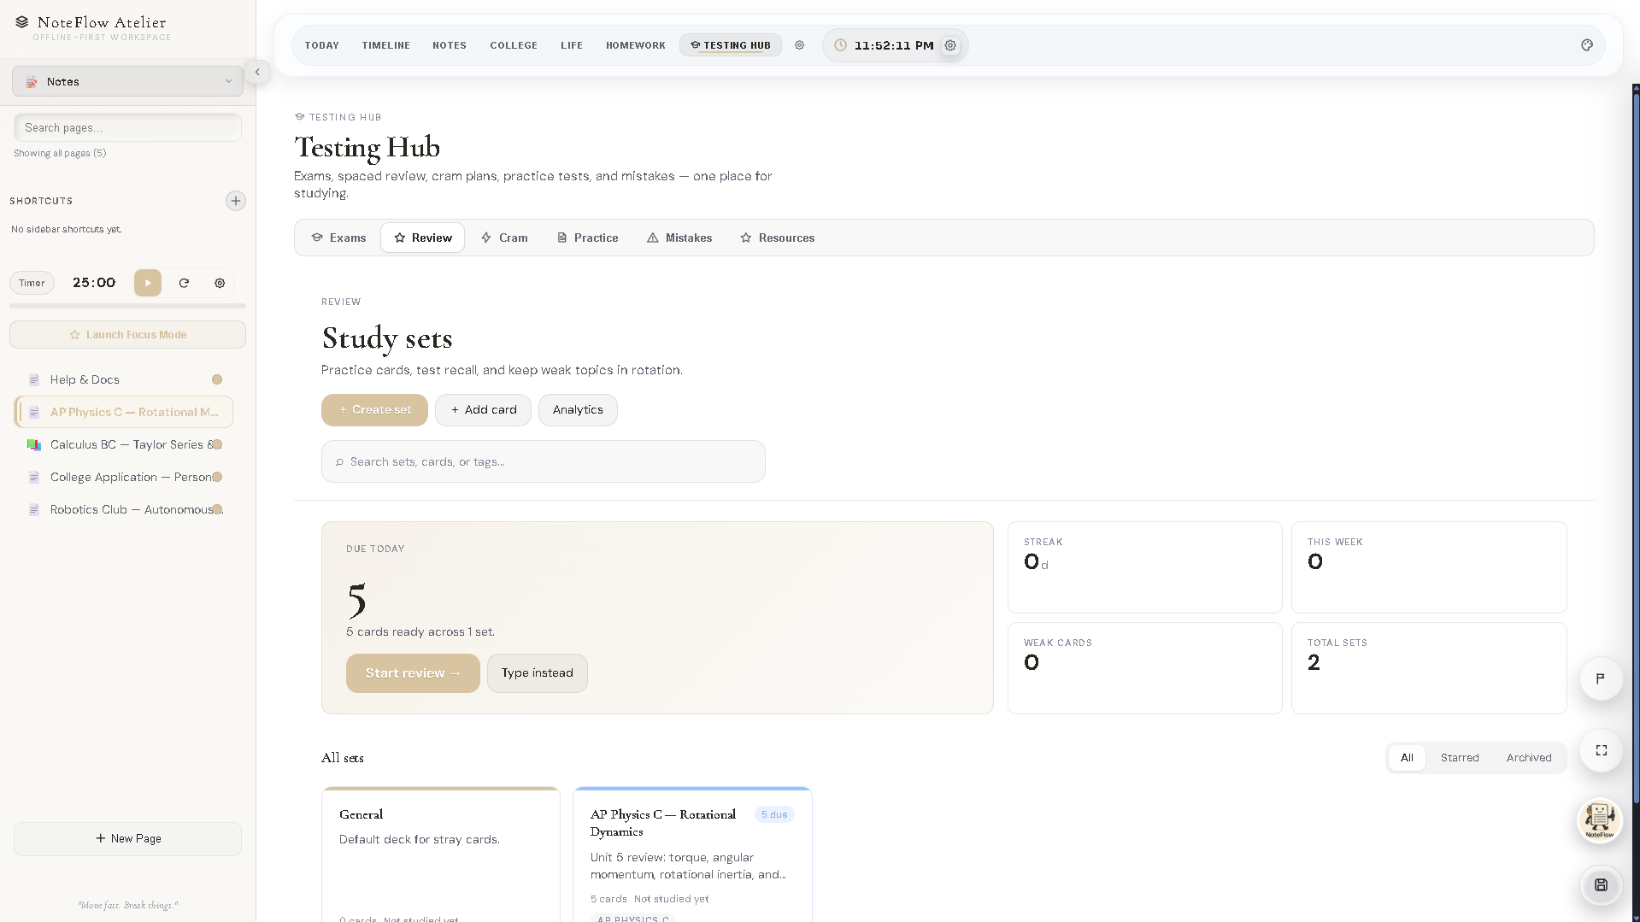
STUDY WORKFLOW
Studying connected to the work that drives it
Available Today
Testing Hub: In Progress
Review — spaced repetition with a local SM-2-lite scheduler, no AI, no backend
Five modes: Flashcards, Learn, Write, Test, Match
AP Study: units, sessions, practice logs, weak-area flags, countdowns
AP Battle Plan recommends a concrete next session with reasoning
Testing Hub: dashboard-first pinned exams (being deepened)
Review due surfaces on Today; decks index into global search
Testing Hub (pre-rebrand build)
Sutra — local-first student workspace
9

Slide 10
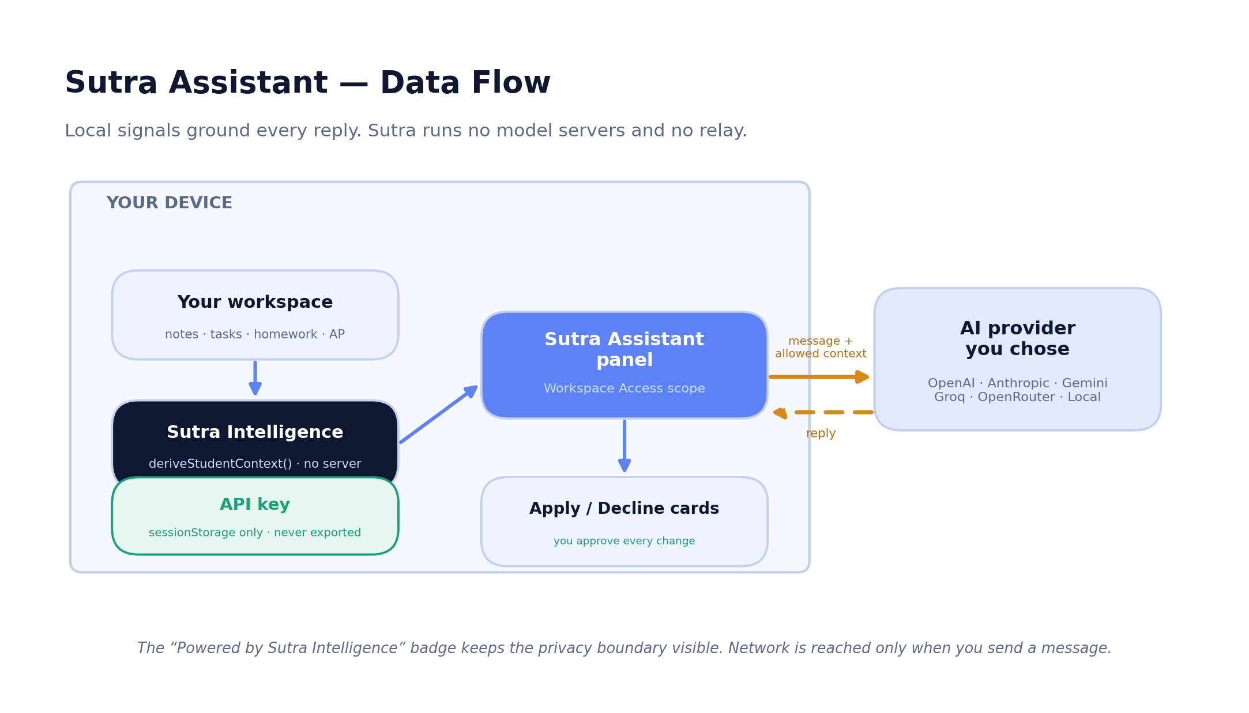
SUTRA ASSISTANT
Optional AI that reads your workspace — with your approval
Available Today
Bring your own key: OpenAI, Anthropic, Gemini, Groq, OpenRouter, or a local endpoint
Sutra Intelligence derives local signals on-device — calls no server
Workspace Access: Current Screen / Area / Full
Single Request vs Conversation Memory
Apply / Decline cards — you approve every change
Keys live in sessionStorage only; never exported
Assistant data flow
Sutra — local-first student workspace
10

Slide 11
WHY THE ARCHITECTURE MATTERS
Local-first by design
1
You own it
2
Fast
3
Private
Your workspace lives in your browser's storage. No login, no Sutra account.
Every data operation is local — no network round-trip to read or edit.
No telemetry, no cloud sync. Nothing is uploaded by the app itself.
4
Resilient
5
Portable
6
Trustworthy
Once loaded, the workspace needs no connection to read or edit.
A single .sutra file is a complete, movable backup of everything.
The privacy boundary is visible and the export is yours to keep.
Grounded in the implementation: IndexedDB workspace, debounced save + lifecycle flush, and a vendored ZIP library so core backups make zero third-party requests.
Sutra — local-first student workspace
11

Slide 12
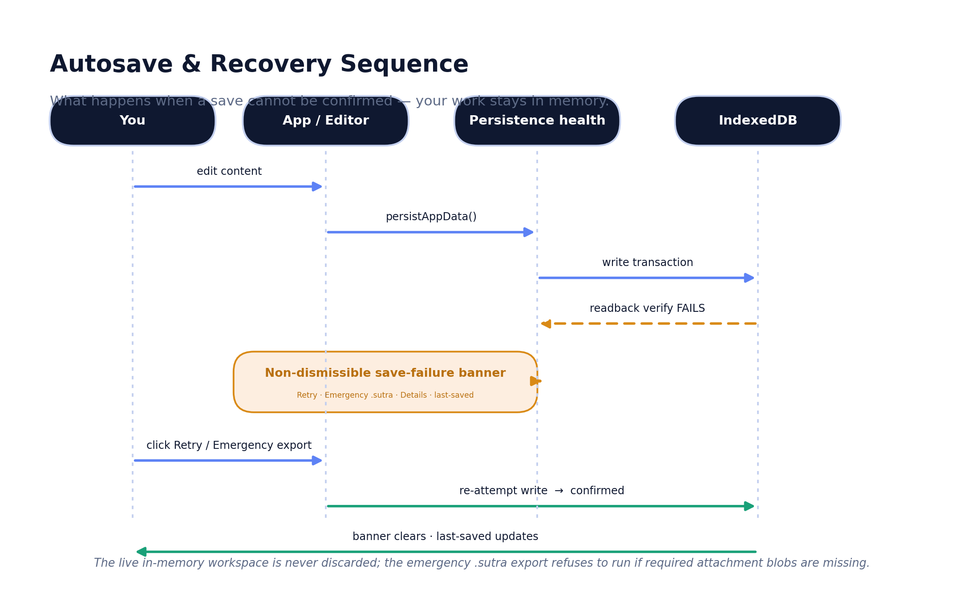
PERSISTENCE & RECOVERY
Your work is hard to lose
Available Today
Debounced autosave + a synchronous flush on page-hide / unload
A persistence-health pipeline classifies quota / serialization / transaction / attachment failures
A non-dismissible banner with Retry + Emergency .sutra export
The live in-memory workspace is always preserved
Pre-import safety snapshot before every import
Emergency export refuses to run if attachment blobs are missing
Autosave & recovery sequence
Sutra — local-first student workspace
12

Slide 13
TRUST BY CONSTRUCTION
Privacy and security posture
Stays on device
Leaves only on your action
Never leaves
Entire workspace in IndexedDB + localStorage
Document backgrounds + inline images local
No telemetry, no required account
AI calls go browser → your chosen provider
Approved media embeds + AP resource links
Optional import/export helper libraries
API keys (sessionStorage only, redacted)
Conversation history (session-local)
Secrets stripped from every export
Known limits: meta-CSP cannot set frame-ancestors (header-only — unavailable on GitHub Pages); script-src uses 'unsafe-inline' for the no-build app; .sutra exports are not encrypted (treat as personal files).
Sutra — local-first student workspace
13

Slide 14
CUSTOMIZATION & PERSONALIZATION
Make it yours — without a marketplace
Available
Available
In Progress
Available
Themes
CSS Overrides
Plugins
Safe Mode
21+ presets incl. the Sutra signature, Retro, macOS 26, Windows 11, and more. Apply to current page, all pages, or a custom subset.
Named snippets with enable/disable, live preview, brace validation, import/export, and a non-destructive reset. Applied after themes.
Local bundles only, sandboxed in an iframe behind a permission allowlist. Install disabled; re-review forced on import.
Loads with no custom CSS and no plugins, and never deletes anything — the safe way back from a bad customization.
Everything is local-first and travels inside your workspace backup. No accounts, no store, no server.
Sutra — local-first student workspace
14

Slide 15
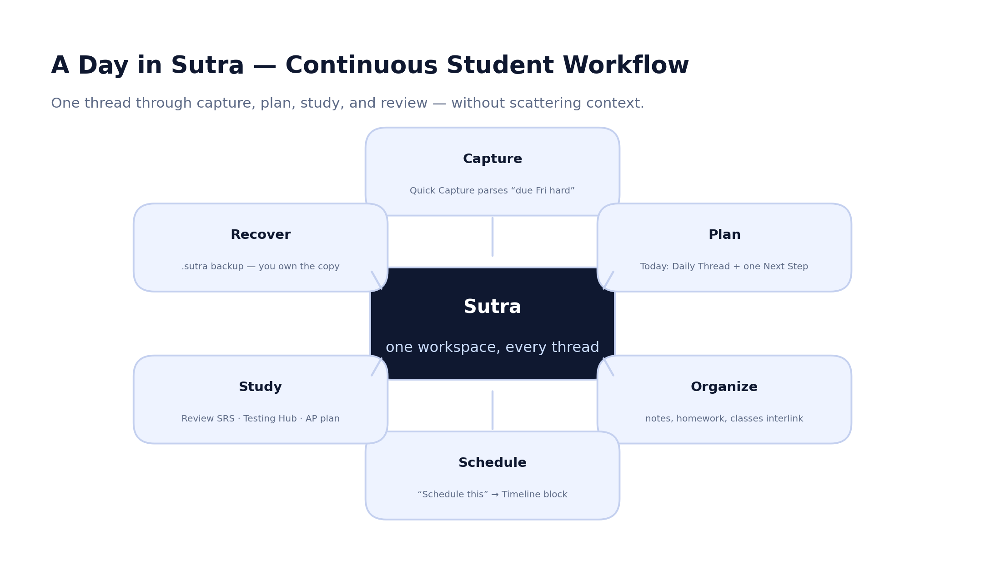
ONE THREAD, END TO END
A complete student workflow
Sutra — local-first student workspace
15

Slide 16
DIFFERENTIATION
Where Sutra is different
Capability | Sutra | Notes app | Task mgr | AI chatbot | School LMS | Study app
Student-specific workflow | Yes | ~ | No | No | Per-school | Partial
Local-first data ownership | Yes | Varies | Varies | No | No | Varies
Academic planning + deadlines | Yes | No | Yes | No | Read-only | No
Notes ↔ study ↔ tasks continuity | Yes | No | No | No | No | No
Spaced-repetition review | Yes | No | No | No | No | Yes
Recoverable single-file backup | Yes | Varies | Varies | No | No | No
Optional, approval-gated AI | Yes | Add-on | No | Core | No | Varies
Deep customization / themes / CSS | Yes | Varies | Limited | No | No | Limited
Categories, not specific competitors. ‘~’ / ‘Varies’ = depends on the product. Sutra's edge is continuity + ownership, not any single feature.
Sutra — local-first student workspace
16

Slide 17
PRODUCT MATURITY
An honest read on maturity
Functional today
Being hardened
Notes, Today, Timeline, Homework, AP Study, Review, College, Life, Work, local-first save, .sutra backup, themes — all shipped, with a 14-check release gate passing.
Mobile QA across every surface, Testing Hub depth, onboarding polish, the plugin ecosystem, and header-level security on the host.
Needs further QA
Experimental / Roadmap
The manual viewport × surface matrix and physical-device testing are not yet signed off; the encoding gate suppresses 22 allowlisted findings.
Cram and proactive assistance are light; opt-in sync, a service worker, and cross-device workflow are roadmap, not present.
Verdict: strong enough for private testing, portfolio, and a controlled student beta; not yet production-critical for users with no backups.
Sutra — local-first student workspace
17

Slide 18
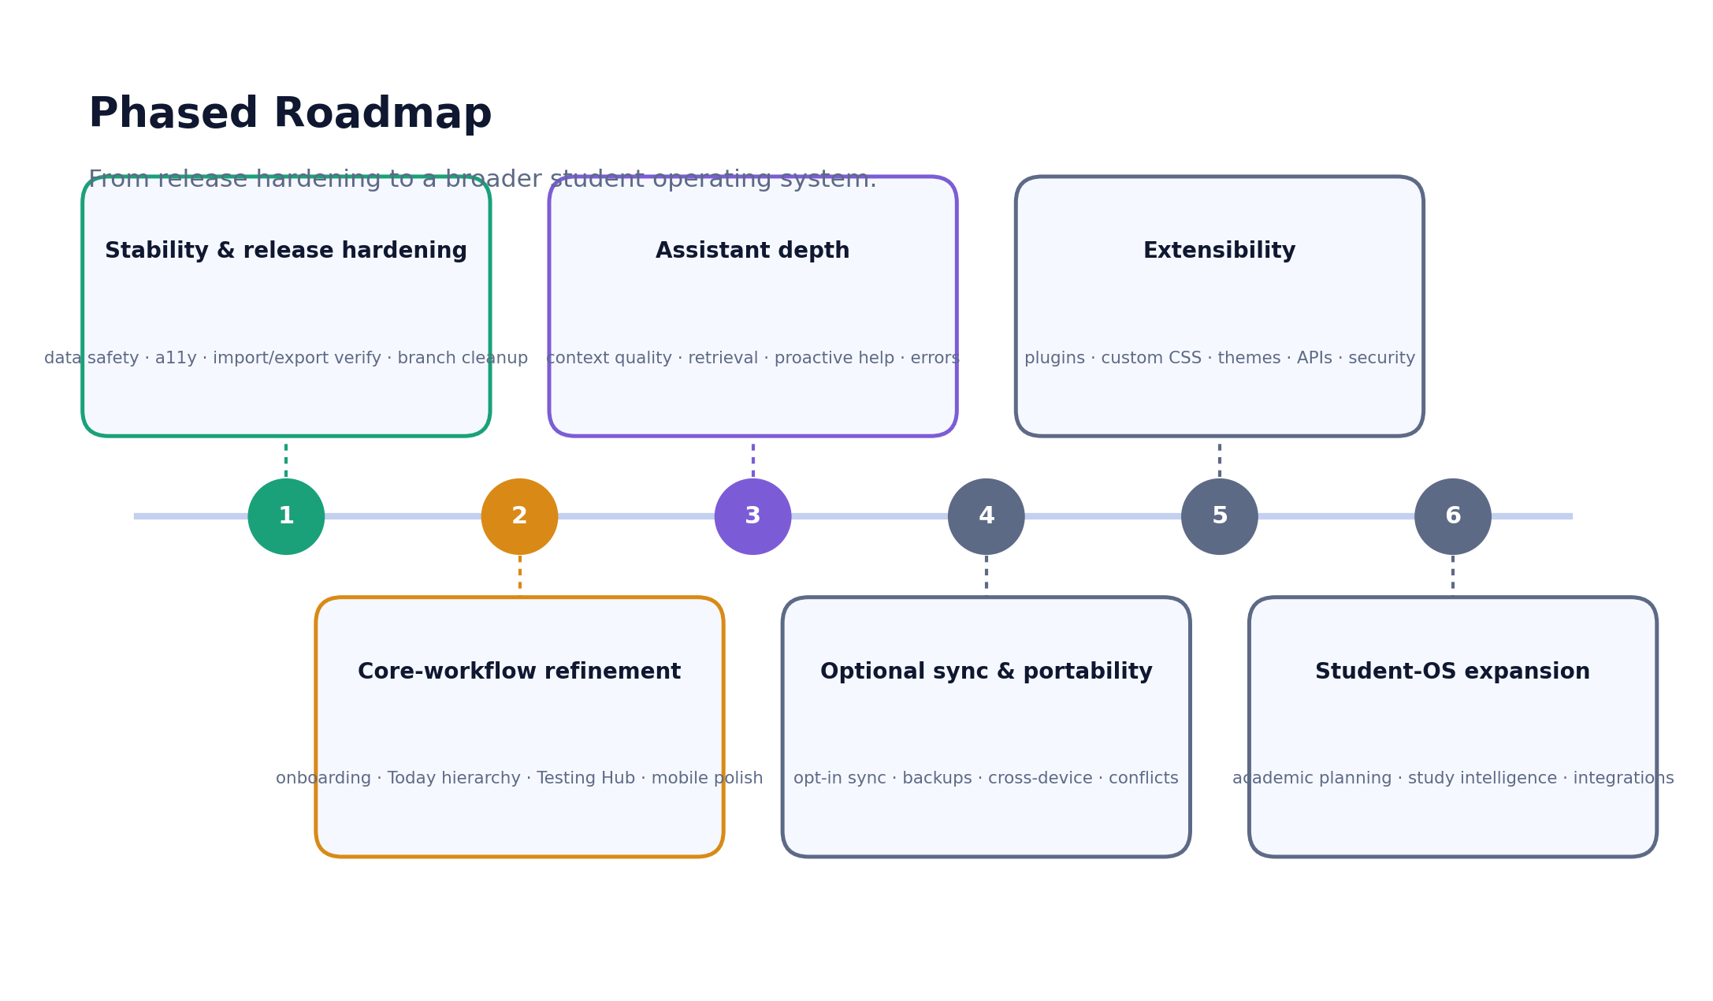
ROADMAP
Where Sutra goes next
Sutra — local-first student workspace
18

Slide 19
Why Sutra matters
Students don't need another isolated app.
They need a workspace that preserves context, protects their work, and turns academic obligations into organized action — while keeping their data their own.
That is the thread Sutra runs through a student's whole academic life.

Slide 20
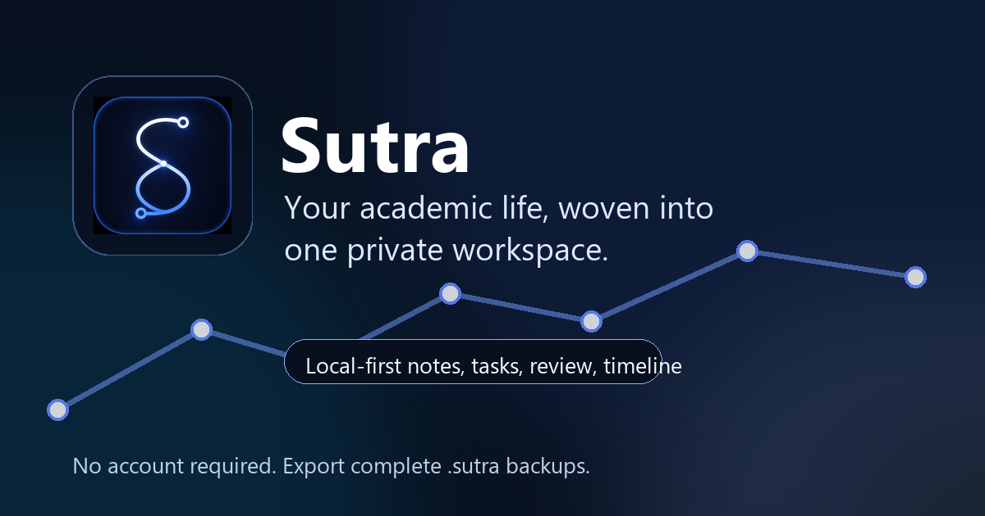
One workspace. Every thread.
github.com/tanujranjith/Sutra · Apache-2.0 · Built by Tanuj Ranjith

Slide 21
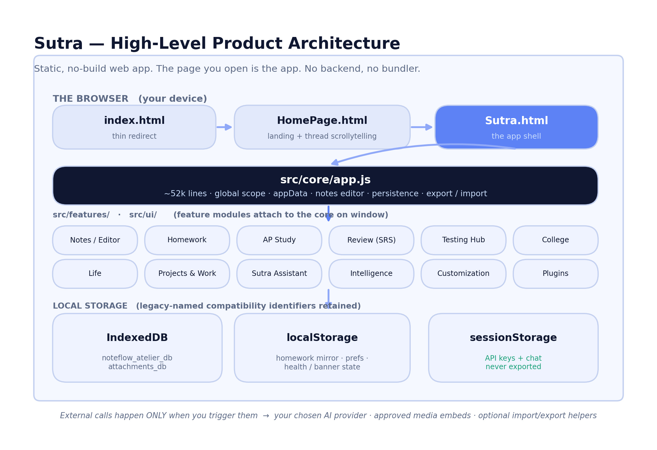
APPENDIX
Technical architecture
Sutra — local-first student workspace
21

Slide 22
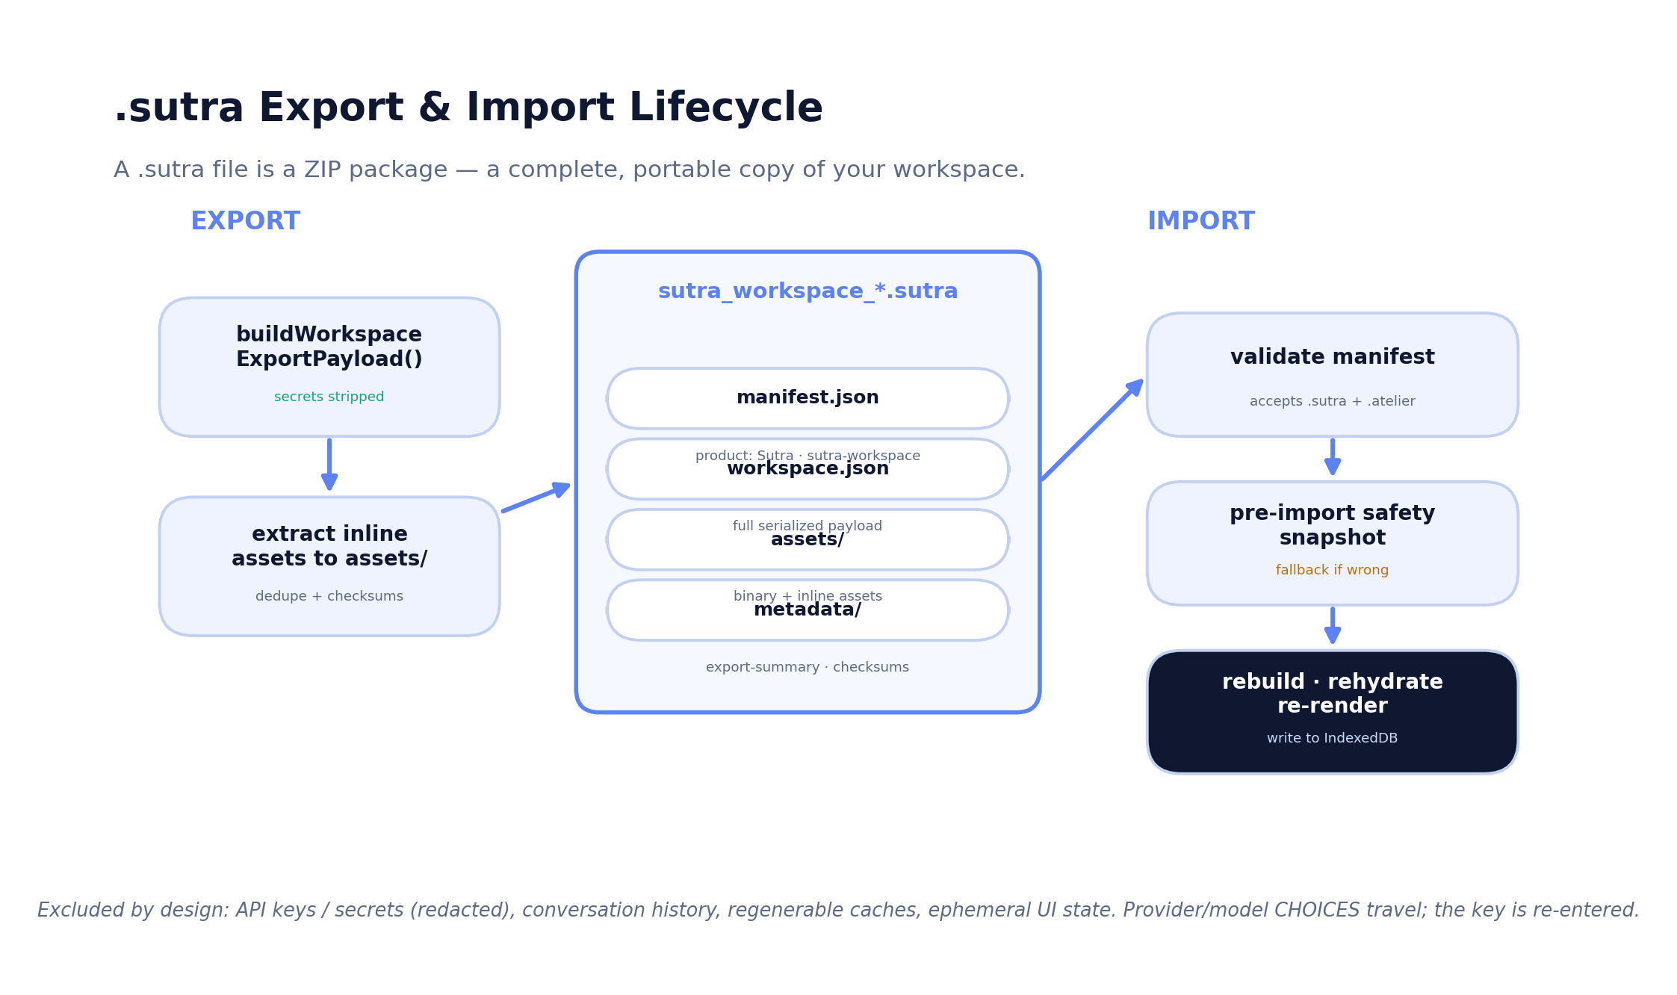
APPENDIX
.sutra export & import lifecycle
Sutra — local-first student workspace
22

Slide 23
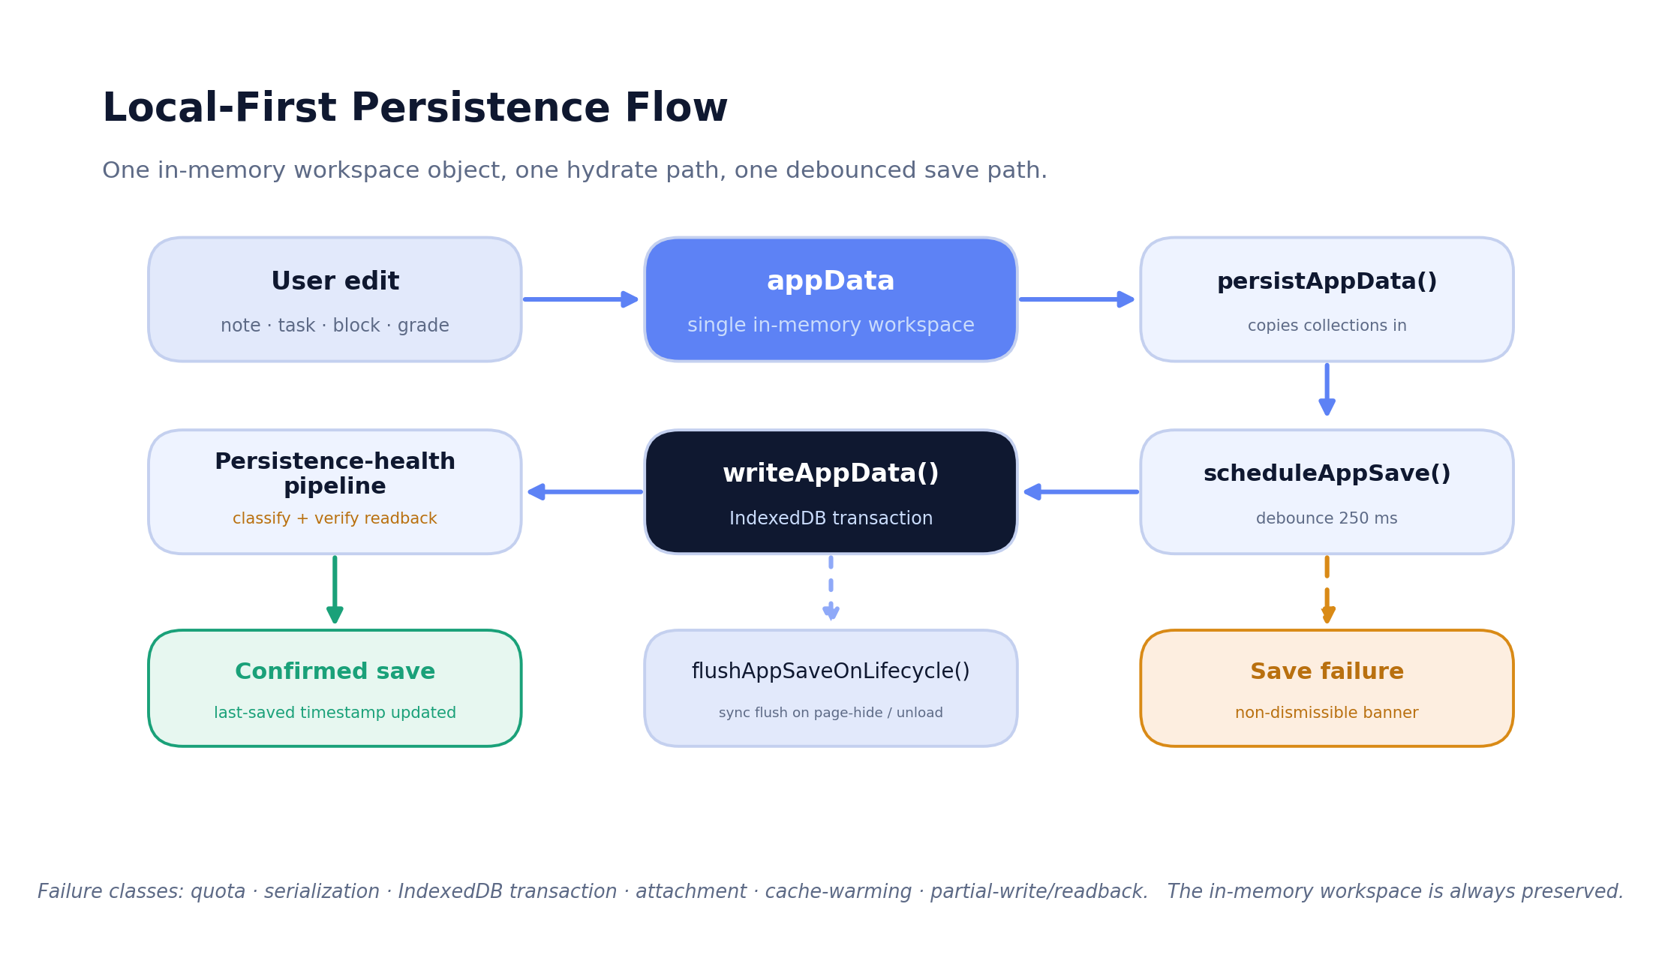
APPENDIX
Persistence flow
Sutra — local-first student workspace
23

Slide 24
APPENDIX
Release-readiness summary
Audience | Ready? | Notes
Private testing | Yes | All 14 static guards pass; persistence + recovery verified.
Portfolio / showcase | Yes | Strong story; recapture Sutra-branded screenshots first.
Hackathon / demo | Yes | Local-first means no server to fail on stage.
Controlled student beta | Yes, with caveats | Walk the device QA matrix; fix the 'Flowy' string.
Wider public beta | Almost | Move to a header-capable host (frame-ancestors); finish mobile QA.
Production-critical use | Not yet | No sync/service worker; users must keep .sutra backups.
Sutra — local-first student workspace
24

