Slide 1
E-Commerce Business Analytics Project
Comprehensive Analysis, Forecasting, Customer Insights & Strategic Recommendations
Notes:
Introduce the project, objective, and overall business impact.

Slide 2
Project Objectives
Analyze monthly and yearly sales performance
Identify high-performing products and regions
Segment customers using RFM analysis
Forecast future sales trends
Generate strategic business recommendations
Notes:
Explain the purpose and scope of the analytics project.

Slide 3
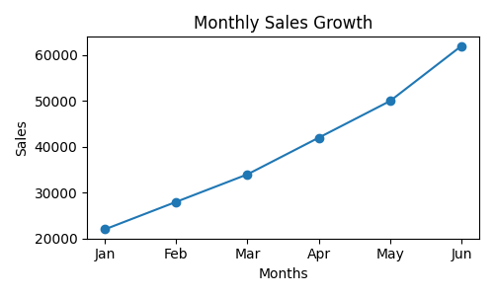
Sales Performance Analysis
Monthly sales demonstrated continuous business growth
Peak sales periods occurred during seasonal promotions
Technology products generated maximum revenue
Western region contributed highest total sales
Notes:
Discuss sales growth trends and peak demand periods.

Slide 4
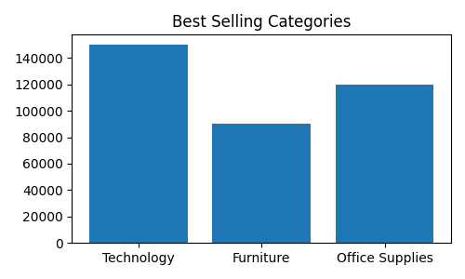
Product Category Insights
Technology category dominated sales revenue
Furniture and Office Supplies showed stable growth
High-demand categories represent inventory expansion opportunities
Category analysis supports marketing optimization
Notes:
Explain best-selling categories and business opportunities.

Slide 5
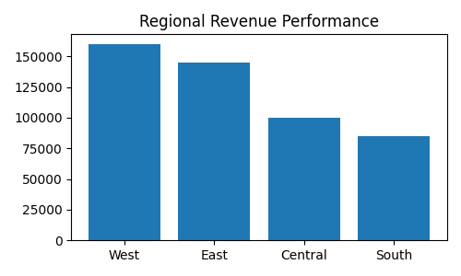
Regional Sales Analysis
West and East regions generated highest revenue
Regional demand patterns varied significantly
High-performing regions require stronger marketing investment
Low-performing regions need targeted promotions
Notes:
Explain geographic sales performance and logistics opportunities.

Slide 6
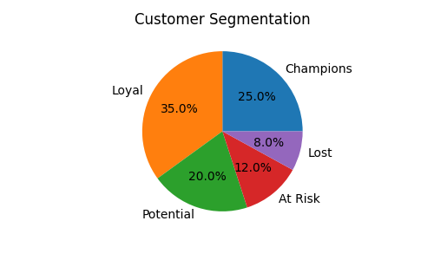
Customer Behavior & RFM Analysis
Champions represented high-value customers
Loyal customers generated repeat revenue
At-risk customers required retention strategies
Customer segmentation improved personalized marketing
Notes:
Discuss customer retention and segmentation strategies.

Slide 7
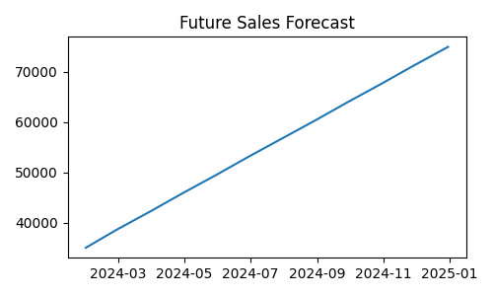
Sales Forecasting
Holt-Winters forecasting model predicted future growth
Seasonal fluctuations and demand patterns identified
Forecasting supports inventory and pricing strategies
Expected revenue growth provides expansion opportunities
Notes:
Explain future forecasting trends and expected business impact.

Slide 8
Business Opportunities
Expand inventory for high-growth categories
Increase marketing investment in top-performing regions
Implement upselling and cross-selling campaigns
Use personalized offers for loyal customers
Launch retention campaigns for at-risk customers
Notes:
Highlight strategic business growth opportunities.

Slide 9
Recommendations & Action Plan
Develop loyalty programs for repeat customers
Optimize inventory using forecasting insights
Improve regional logistics and supply chain
Increase seasonal promotional campaigns
Use analytics for continuous business improvement
Notes:
Explain practical implementation recommendations.

Slide 10
Conclusion & Next Steps
Analytics improved understanding of sales and customers
Forecasting supports future business planning
Customer segmentation improves retention
Data-driven decisions enhance profitability and growth
Notes:
Summarize project outcomes and future improvements.

