Slide 1
Cyclistic Bike-Share: How Does a Bike-Share Navigate a Speedy Success?

Slide 2
Background
In 2016, Cyclistic launched a successful bike-share offering. The program has grown to a fleet of 5,824 bicycles that are geotracked and locked into a network of 692 stations across Chicago. The bikes can be unlocked from one station and returned to any other station in the system anytime.
Moreno has set a clear goal:
Design marketing strategies aimed at converting casual riders into annual members. In order to do that, the marketing analyst team needs to better understand how annual members and casual riders differ, why casual riders would buy a membership, and how digital media could affect their marketing tactics. Moreno and her team are interested in analyzing the Cyclistic historical bike trip data to identify trends.

Slide 3
Background
Key shareholders:
Cyclistic Consumers
Lily Moreno
Cyclistic marketing analytics team
Cyclsitic excutive team

Slide 4
Ask
Three questions that will guide the future marketing program:
How do annual members and casual riders use Cyclistic bikes differently?
Why would casual riders buy Cyclistic annual memberships?
How can Cyclistic use digital media to influence casual riders?
Assigned task:
Determine how do annual members and casual riders use Cyclistic bikes differently?

Slide 5
Prepare
Data is located at: https://divvy-tripdata.s3.amazonaws.com/index.html
Data is organized chronologically
There are no issues in terms of bias/integrity with the data since Cyclistic is a fictional company and the data has been made available by Motivate International Inc. Under the liscense: Data License Agreement | Divvy Bikes. This is public data that can be used to explore how different customer types use Cyclistic bikes.
Data-privacy issues prevent using rider’s personally identifiable information.
Problems amongst the data include:
Blanks
Spelling
Formating

Slide 6
Process
Tools Used:
R Studio
Can handle the large data sets for organizing, cleaning, producing visualizations, and changes are documentable.
Link to R Studio Script:
https://github.com/tanuki6000/Test/blob/main/12_month_Ride.R

Slide 7
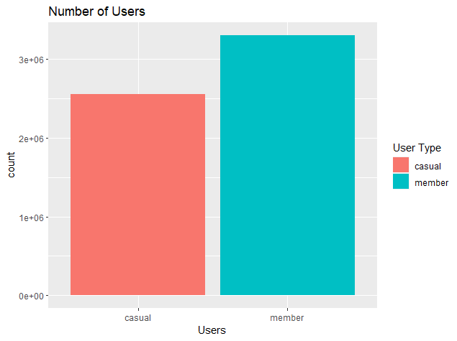
Share
Displays number of Cyclistic users.

Slide 8
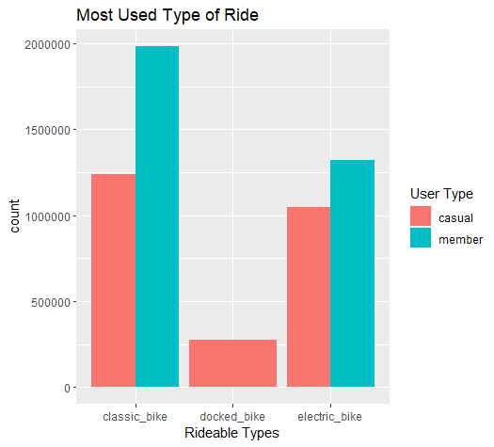
Share
Displays most used Rideable Types amongst member casual riders.

Slide 9
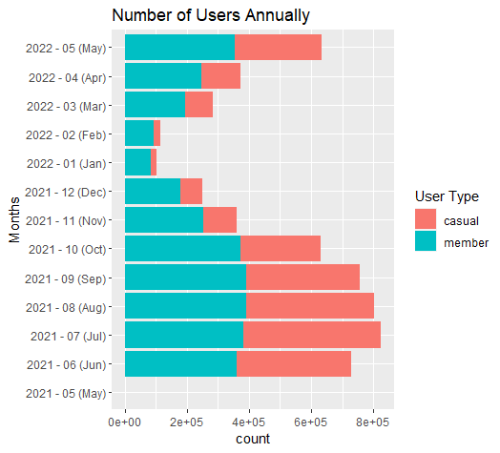
Share
Displays the number of rides annually by user type.

Slide 10
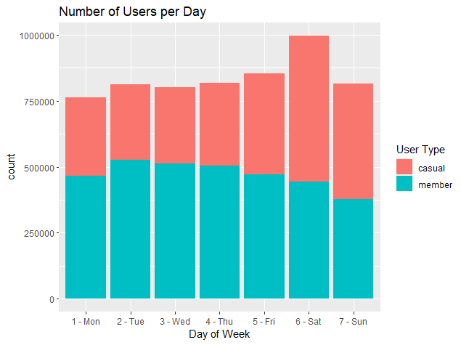
Share
Displays the number of rides per day by user type.

Slide 11
Act
Final Conclusion:
Based on the data analyzed, casual riders have been observed to have longer ride lengths through out the week. However, members are observed to use the service more often throughout the week. It is also observed that during the warmer months, the service is used more often during the warmer months of the year by both users.
Top Three Recommendations:
Increase the cost to ride for casual riders
Use social media to promote the service during the optimal seasons
Offer incentive to remain a member i.e. badges or prizes for distance traveled or ride length via app
Additional Data to Use:
Distance traveled

