Slide 1

MINOR PROJECT-1
QUALITATIVE ASSESSMENT OF EXAMINATION QUESTIONS WITH BLOOM’S TAXONOMY
UNDER THE GUIDANCE OF:
Dr. ANKITA VERMA
TANUPRIYA PATHAK 20103288 B10
PALAK SINGH 20103270 B9
DHRUV TANEJA 20103269 B9

Slide 2
INDEX
SNO. TOPICS PG NO.
OBJECTIVE 03
BLOOM’S TAXONOMY 04
LEVELS OF BLOOM’S TAXONOMY 05
CLASSIFICATION OF VERBS 06
PROJECT METHODOLOGY 07
REFERENCES 09

Slide 3
OBJECTIVE
To develop an automated tool to assist faculty for qualitative assessment of question paper based on Bloom’s Taxonomy
To generate a qualitative assessment report on the basis of different percentages of CO’s , difficulty levels.

Slide 4
BLOOM’S TAXONOMY
Bloom's Taxonomy is a classification of learning objectives within education that educators set for students. The cognitive domain within this taxonomy is designed to verify a student's cognitive level during a written examination. This project proposes an automated analysis of the exam questions to determine the appropriate category based on this taxonomy. This rule-based approach applies Natural Language Processing (NLP) techniques to identify important keywords and verbs, which may assist in the identification of the category of a question.

Slide 5
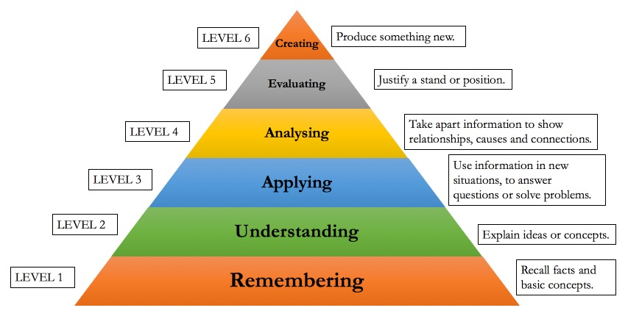
LEVELS OF BLOOM’S TAXONOMY

Slide 6
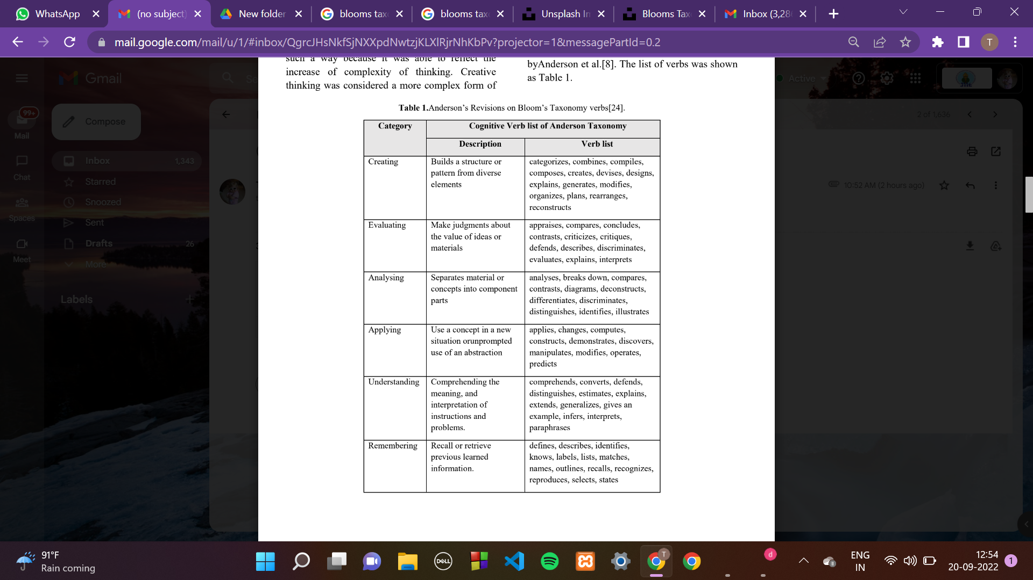

Slide 7
REFERENCES CONSULTED
AUTHORS
TOPIC
Hansaraj S. Wankhede and Arvind W. Kiwelekar
Nazlia Omara,Syahidah Sufi Harisa,Rosilah Hassana, Haslina Arshada,Masura Rahmata, Noor Faridatul Ainun Zainala,Rozli Zulkiflib
Thing Thing Goh,Hassan Mohamed,Nor Azliana Akmal Jamaludin, Mohd Nazri Ismail,H.S. Chua
Qualitative Assessment of Software Engineering Examination Questions with Bloom’s Taxonomy
Automated analysis of exam questions according to bloom’s taxonomy
Questions Classification According to Bloom’s
Taxonomy using Universal Dependency and WordNet

Slide 8
PROJECT METHODOLOGY
In this work, a rule-based approach is adopted in classifying the question items into their corresponding Bloom’s cognitive level. The system will classify each of questions automatically to their corresponding verbs from the Taxonomy with the assistance of the developed rules.
IMPLEMENTATION TOOLS:
NLTK library for NLP
Django for integration of website
Matplotlib for assessment report

Slide 9
PROJECT METHODOLOGY
PRE-PROCESSING:
Text pre-processing is a method in natural language processing to make the computer understand the structure or content of the text. It will allow us to make the text more readable and easy to use for later process. Text pre-processing involves processes such as stop words removal, tokenization, lemmatization and POS tagging.
RULES DEVELOPMENT:
LSI (LATENT SEMANTIC INDEXING) algorithm will be used to classify questions into various Bloom’s levels. With the help of NLTK library and LSI algorithm the words in the question statement will be analysed and categorized into their levels.

Slide 10
REFERENCES
[1] Goh, T. T., Mohamed, H., Jamaludin, N. A. A., Ismail, M. N., & Chua, H. S. (2020). Questions Classification According to Bloom’s Taxonomy using Universal Dependency and Word Net. Test Engineering and Management, 82, 4374-4385.
[2] Omar, N., Haris, S. S., Hassan, R., Arshad, H., Rahmat, M., Zainal, N. F. A., & Zulkifli, R. (2012). Automated analysis of exam questions according to Bloom's taxonomy. Procedia-Social and Behavioral Sciences, 59, 297-303.
[3] Wankhede, H. S., & Kiwelekar, A. W. (2016). Qualitative assessment of software engineering examination questions with bloom’s taxonomy. Indian Journal of Science and Technology, 9(6), 1-7.

