Slide 1
The Indian budget and finance
DBMS PROJECT

Slide 2
Presented by
SHUBHAM RAI 21CSB0A53
(SECTION A)
TANU PRIYA 21CSB0A58
(SECTION A)

Slide 3
INDEX
TABLE NAMES
ER MODEL
RELATIONAL SCHEMA
PROBLEM STATEMENT​
RELATIONSHIPS
FUNCTIONAL DEPENDENCIES
​INSERT QUERIES
TABLE AFTER NORMALIZATION
SUB QUERIES

Slide 4
Need to normalize tables into different normal forms
Normalization is used to minimize the redundancy from a relation or set of relations. It is also used to eliminate undesirable characteristics like Insertion, Update, and Deletion Anomalies. Normalization divides the larger table into smaller and links them using relationships.

Slide 5
Table names
budget
countries
program
scheme
beneficiary
Provides_for
states
department
administers
expenditure
taxation
Expenditure_category

Slide 6
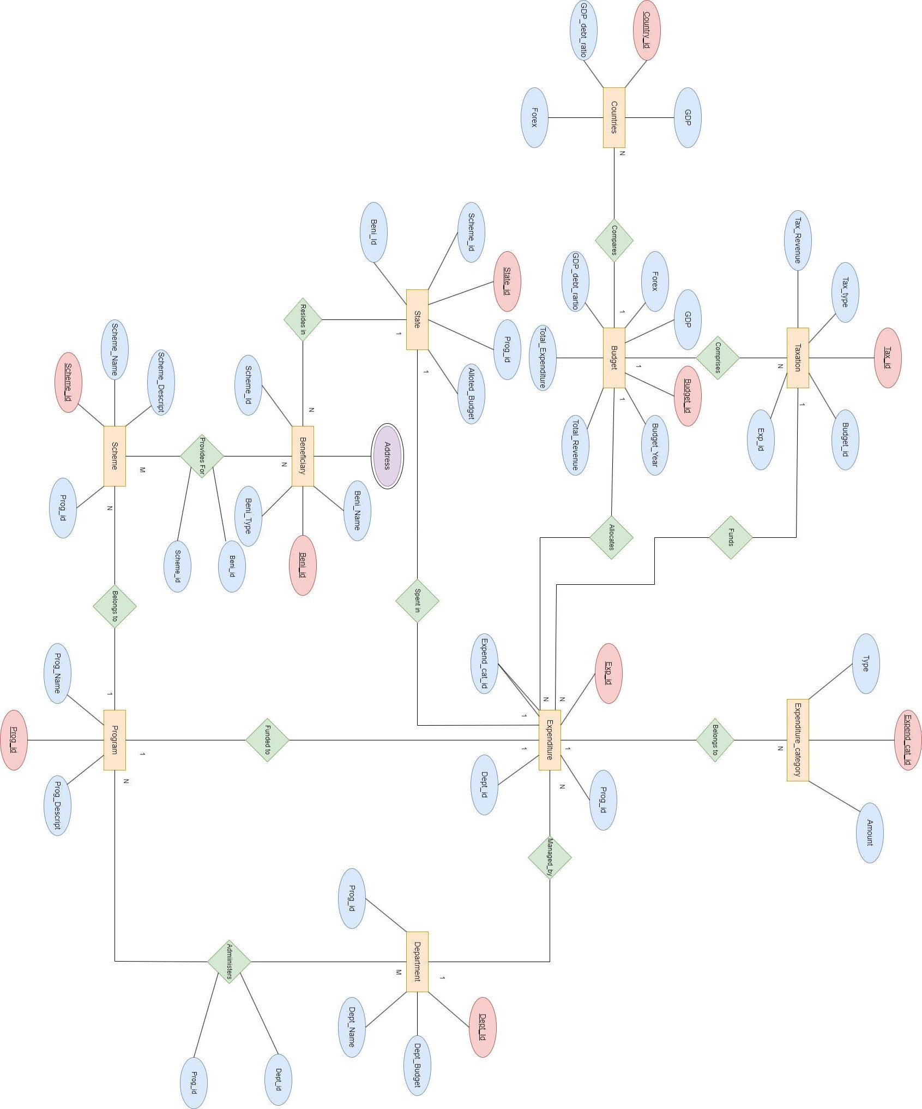
Er model

Slide 7
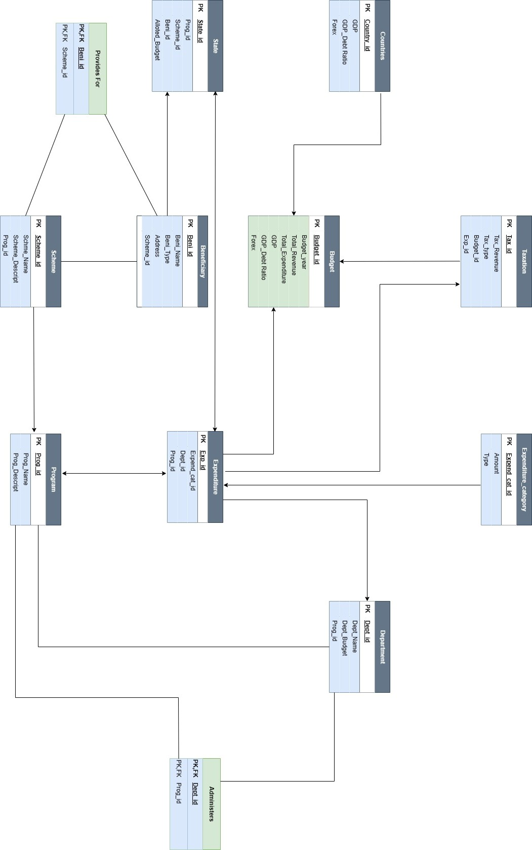
Relational schema

Slide 8
Problem statement
This Indian budget and finance database is modelled such a way that :
budget
countries
The Budget entity determines the budget of our Country from year 2001 till expected 2024.It includes attributes such as Budget_Id which tells the Budget Year, Total_Revenue and Total_Expenditure which tells about the country’s Total Revenue Cost and Expenditure Cost of our Country.
The Countries entity determines the Total GDP with its Total Debt Ratio and Forex value of different Countries. It includes the attributes like Country_Id, Total_GDP, Total Debt_Ratio and Forex.
program
scheme
The Program entity represents the different programs or initiatives undertaken by the government as part of its budget. Examples of programs could include Swachh Bharat Abhiyan, Ayushman Bharat, Pradhan Mantri Jan Dhan Yojana, etc.
The Stats entity represents the various states in India. It includes attributes such as Prog_Id and Prog_Name.

Slide 9
Problem statement
beneficiary
Provides_for
The Beneficiary entity represents the individuals or groups who benefit from the various schemes or programs implemented by the government. Examples of beneficiaries could include farmers, students, women, etc.
The Provides_For entity includes the attributes like Bene_Id and Scheme_Id.
states
department
The States entity represents the various states in India. It includes attributes such as Prog_Id and Prog_Name.
The Department entity represents the various government departments responsible for managing and executing the budget. The attributes of Department includes Dept_Id, Dept_Name, Dept_Budget and Prog_Id.

Slide 10
Problem statement
administers
expenditure
The Administers entity includes attributes like Dept_Id, Prog_Id which acts as a foreign key in this entity.
The Expenditure entity determines the different Expenditure Category of Indian Government and the various expenses incurred by the government in a given fiscal year.. It includes attributes like Exp_Id, Expenditure_Cat_Id, Dept_Id, Prog_Id.
Expenditure_category
taxation
This entity represents the different categories or types of expenditures made by the government. It consists of the attributes like Expenditure_Cat_Id, Amount and Type.
The Taxation entity represents the various taxes imposed by the government to generate revenue. It includes attributes like Tax_Id, Tax_Revenue, Tax_Type and Exp_Id.

Slide 11
RELATIONSHIPS
Budget has a ONE-TO-MANY relationship with Expenditure.
Expenditure has a ONE-TO-MANY relationship with Expenditure Category.
Expenditure has a MANY-TO-ONE relationship with Department.
Program has a MANY-TO-MANY relationship with Department.
Scheme has a MANY-TO-ONE relationship with Program.
Beneficiary has a MANY-TO-MANY relationship with Scheme.
State has a ONE-TO-MANY relationship with Beneficiary.
Countries has a MANY TO ONE relationship with Budget.

Slide 12
Functional dependencies
Following are the functional Dependencies for the created table :
1. BUDGET: (IN BCNF)
- BUDGET_ID -> TOTAL_REVENUE, TOTAL_EXPENDITURE, GDP_GROWTH_RATE, DEBT_GDP_RATIO, FOREX
2. COUNTRIES: (IN BCNF)
- COUNTRY_ID -> TOTAL_GDP, DEBT_GDP_RATIO_RATIO, FOREX
3. PROGRAM: (IN BCNF)
- PROG_ID -> PROG_NAME
4. SCHEME: (IN BCNF)
- SCHEME_ID -> SCHEME_NAME, PROG_ID
5. BENEFICIARY: (IN BCNF)
- BENI_ID -> BENI_NAME, BENI_TYPE, ADDRESS, SCHEME_ID
6. PROVIDES_FOR: (IN BCNF)
- BENI_ID, SCHEME_ID -> (No additional dependencies)

Slide 13
Functional dependencies
7. STATES: (IN BCNF)
- STATE_ID -> PROG_ID, SCHEME_ID, BENI_ID, ALLOTED_BUDGET
8. DEPARTMENT: (IN BCNF)
- DEPT_ID -> DEPT_NAME, DEPT_BUDGET, PROG_ID
9. ADMINISTERS: (IN BCNF)
- DEPT_ID, PROG_ID -> (No additional dependencies)
10. EXPENDITURE: (IN BCNF)
- EXP_ID -> EXPENDITURE_CAT_ID, DEPT_ID, PROG_ID
11. EXPENDITURE_CATEGORY: (IN BCNF)
- EXPENDITURE_CAT_ID -> AMOUNT, TYPE
12. TAXATION: (IN BCNF)
- TAX_ID -> TAX_REVENUE, TAX_TYPE, EXP_ID

Slide 14
CREATION OF TABLES
--BUDGET
CREATE TABLE BUDGET(
BUDGET_ID VARCHAR(20) NOT NULL PRIMARY KEY, TOTAL_REVENUE VARCHAR(20), TOTAL_EXPENDITURE VARCHAR(20), GDP_GROWTH_RATE FLOAT,
DEBT_GDP_RATIO FLOAT,
FOREX FLOAT
);
--COUNTRIES
CREATE TABLE COUNTRIES(
COUNTRY_ID VARCHAR(20) NOT NULL PRIMARY KEY, TOTAL_GDP VARCHAR(20), DEBT_GDP_RATIO_RATIO FLOAT,
FOREX FLOAT
);

Slide 15
CREATION OF TABLES
--PROGRAM
CREATE TABLE PROGRAM(
PROG_ID VARCHAR(20) NOT NULL PRIMARY KEY, PROG_NAME VARCHAR(20)
);
--SCHEME
CREATE TABLE SCHEME(
SCHEME_ID VARCHAR(20) NOT NULL PRIMARY KEY, SCHEME_NAME VARCHAR(140),
PROG_ID VARCHAR(20),
FOREIGN KEY(PROG_ID) REFERENCES PROGRAM(PROG_ID)
);

Slide 16
CREATION OF TABLES
--BENEFICIARY
CREATE TABLE BENEFICIARY(
BENI_ID VARCHAR(20) NOT NULL PRIMARY KEY, BENI_NAME VARCHAR(100),
BENI_TYPE VARCHAR(100),
ADDRESS VARCHAR(100),
SCHEME_ID VARCHAR(20),
FOREIGN KEY(SCHEME_ID) REFERENCES SCHEME(SCHEME_ID)
);
PROVIDES_FOR
CREATE TABLE PROVIDES_FOR(
BENI_ID VARCHAR(20),
SCHEME_ID VARCHAR(20),
FOREIGN KEY(BENI_ID) REFERENCES BENEFICIARY(BENI_ID),
FOREIGN KEY(SCHEME_ID) REFERENCES SCHEME(SCHEME_ID),
PRIMARY KEY(BENI_ID,SCHEME_ID));

Slide 17
CREATION OF TABLES
STATES
CREATE TABLE STATES(
STATE_ID VARCHAR(20) NOT NULL PRIMARY KEY, PROG_ID VARCHAR(20),
SCHEME_ID VARCHAR(20),
BENI_ID VARCHAR(20),
ALLOTED_BUDGET VARCHAR(40),
FOREIGN KEY(PROG_ID) REFERENCES PROGRAM(PROG_ID),
FOREIGN KEY(SCHEME_ID) REFERENCES SCHEME(SCHEME_ID),
FOREIGN KEY(BENI_ID) REFERENCES BENEFICIARY(BENI_ID) );
DEPARTMENT
CREATE TABLE DEPARTMENT(
DEPT_ID VARCHAR(20) NOT NULL PRIMARY KEY, DEPT_NAME VARCHAR(100),
DEPT_BUDGET VARCHAR(40),
PROG_ID VARCHAR(20),
FOREIGN KEY(PROG_ID) REFERENCES PROGRAM(PROG_ID));

Slide 18
CREATION OF TABLES
ADMINISTERS
CREATE TABLE ADMINISTERS(
DEPT_ID VARCHAR(20),
PROG_ID VARCHAR(20),
FOREIGN KEY(DEPT_ID) REFERENCES DEPARTMENT(DEPT_ID),
FOREIGN KEY(PROG_ID) REFERENCES PROGRAM(PROG_ID), PRIMARY KEY(DEPT_ID,PROG_ID));
EXPENDITURE
CREATE TABLE EXPENDITURE(
EXP_ID VARCHAR(100) NOT NULL PRIMARY KEY,
EXPENDITURE_CAT_ID VARCHAR(20),
DEPT_ID VARCHAR(20),
PROG_ID VARCHAR(20),
FOREIGN KEY(DEPT_ID) REFERENCES DEPARTMENT(DEPT_ID),
FOREIGN KEY(PROG_ID) REFERENCES PROGRAM(PROG_ID),
FOREIGN KEY(EXPENDITURE_CAT_ID) REFERENCES EXPENDITURE_CATEGORY(EXPENDITURE_CAT_ID));

Slide 19
CREATION OF TABLES
EXPENDITURE_CATEGORY
CREATE TABLE EXPENDITURE_CATEGORY( EXPENDITURE_CAT_ID VARCHAR(20) NOT NULL PRIMARY KEY,
AMOUNT VARCHAR(100),
TYPE VARCHAR(100));
TAXATION
CREATE TABLE TAXATION(
TAX_ID VARCHAR(20) NOT NULL PRIMARY KEY, TAX_REVENUE VARCHAR(100),
TAX_TYPE VARCHAR(100),
EXP_ID VARCHAR(100),
FOREIGN KEY(EXP_ID) REFERENCES EXPENDITURE(EXP_ID) );

Slide 20
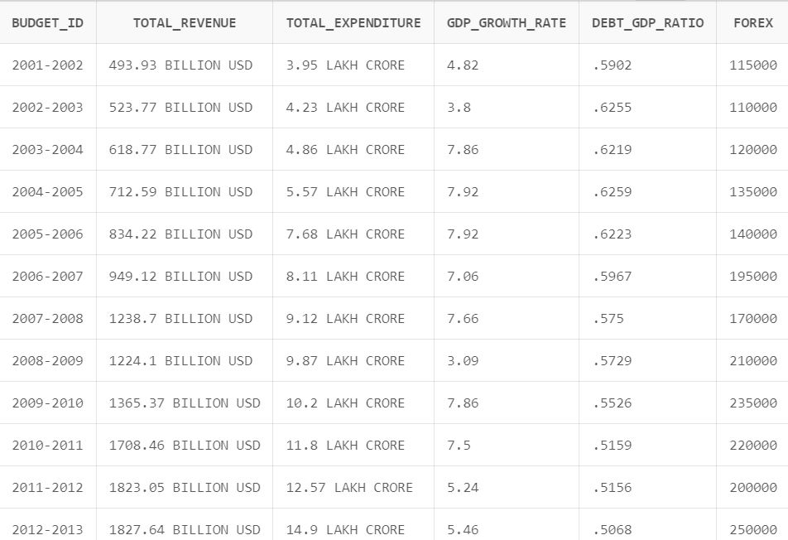
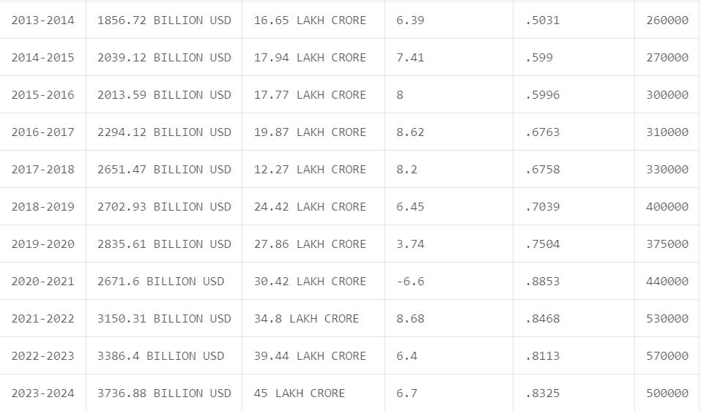
Table after normalization
BUDGET
BUDGET

Slide 21
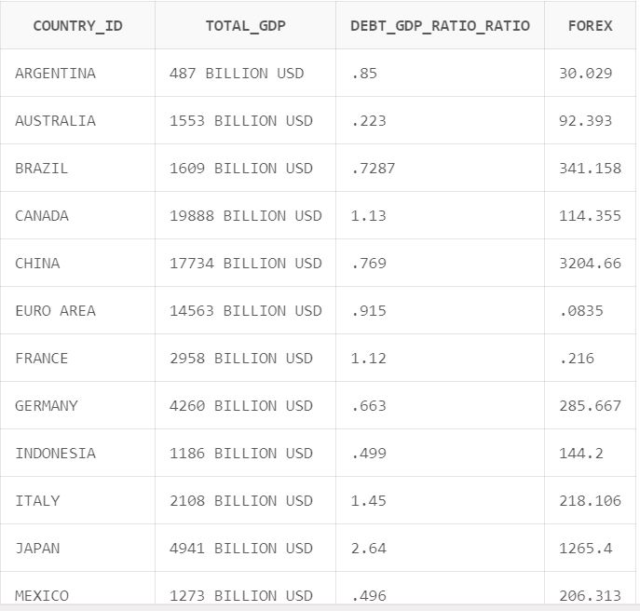
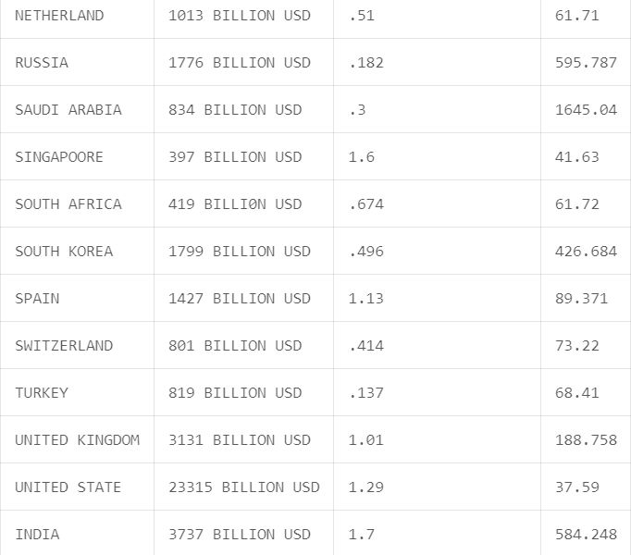
COUNTRIES
COUNTRIES

Slide 22
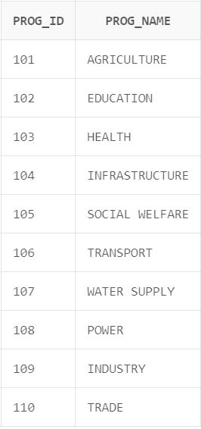
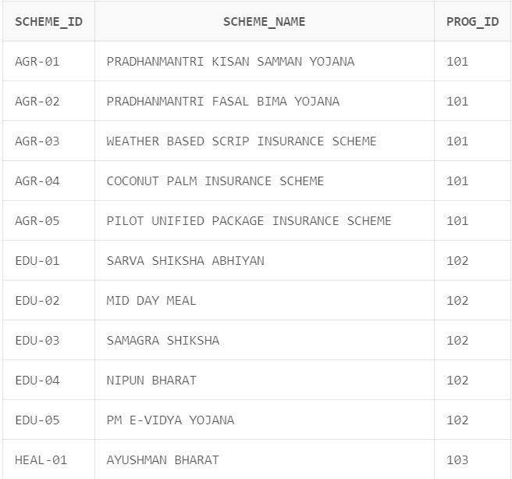
PROGRAM
SCHEME

Slide 23
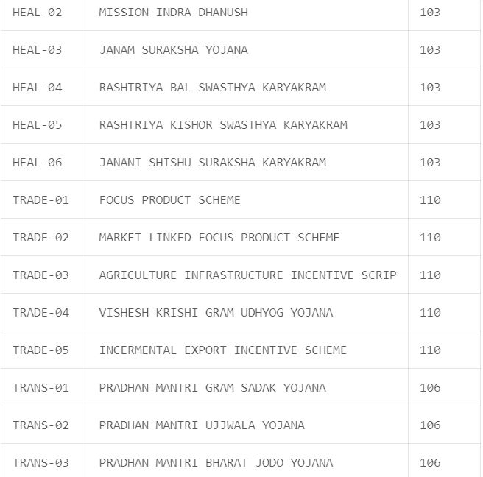
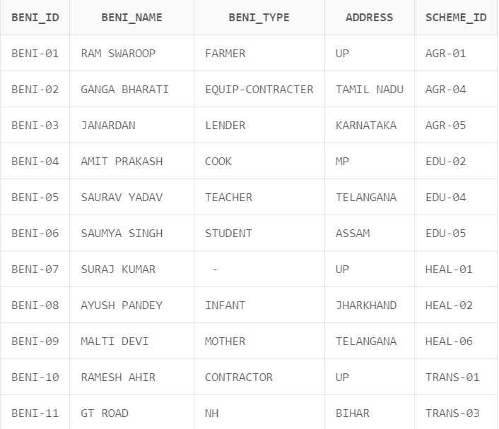
SCHEME
BENEFICIARY

Slide 24
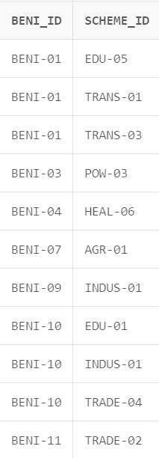
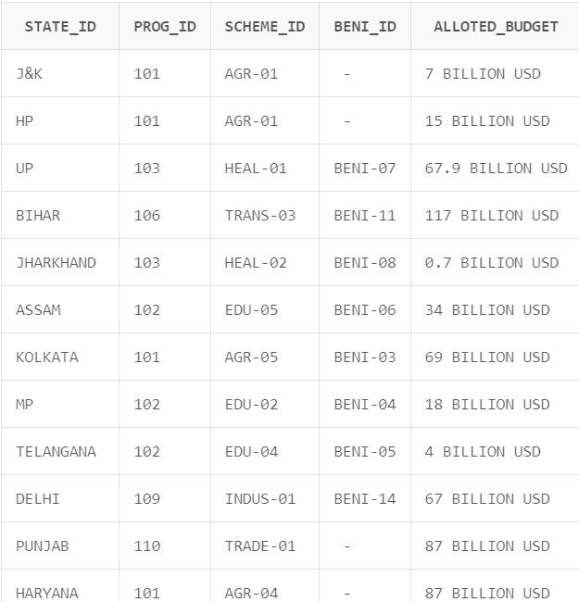
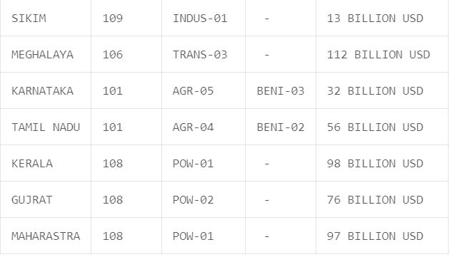
PROVIDES_FOR
STATES
STATES

Slide 25
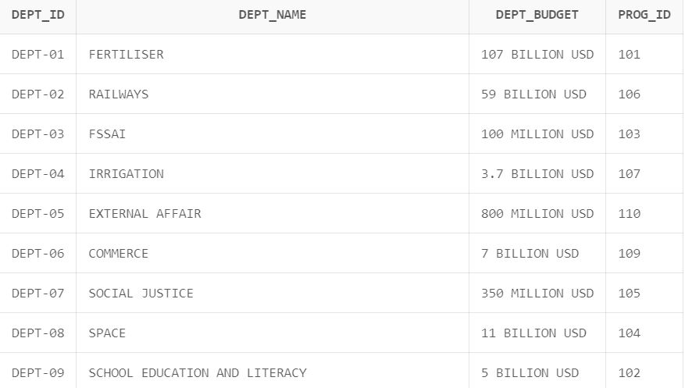
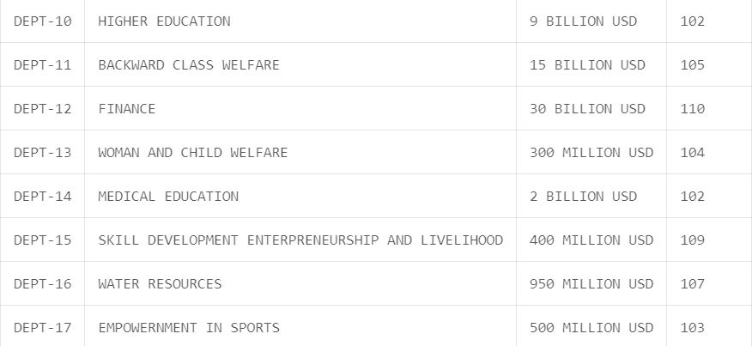
DEPARTMENT
DEPARTMENT

Slide 26
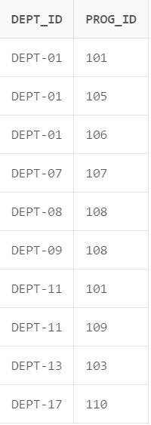
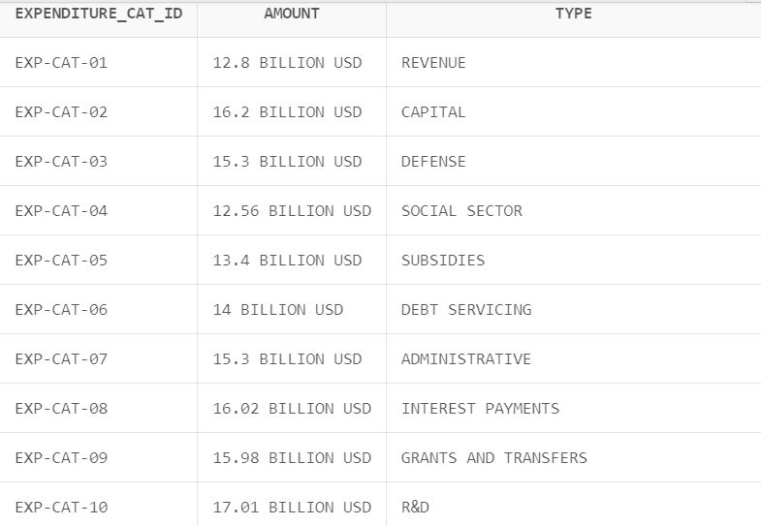
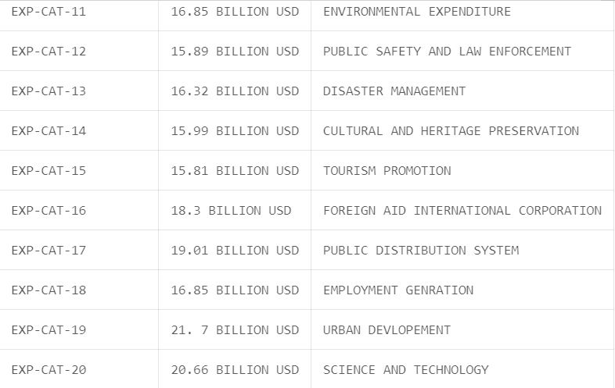
ADMINISTERS
EXPENDITURE_CATEGORY
EXPENDITURE_CATEGORY

Slide 27
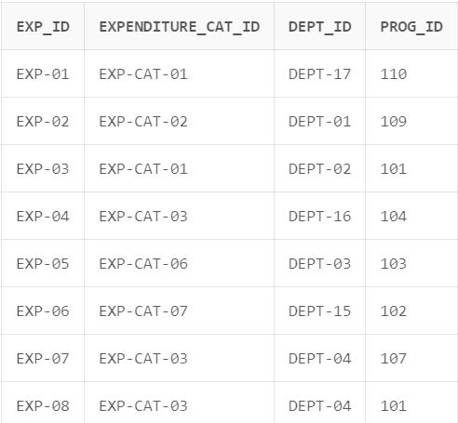
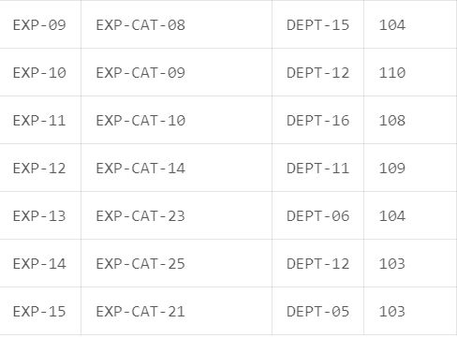
EXPENDITURE
EXPENDITURE

Slide 28
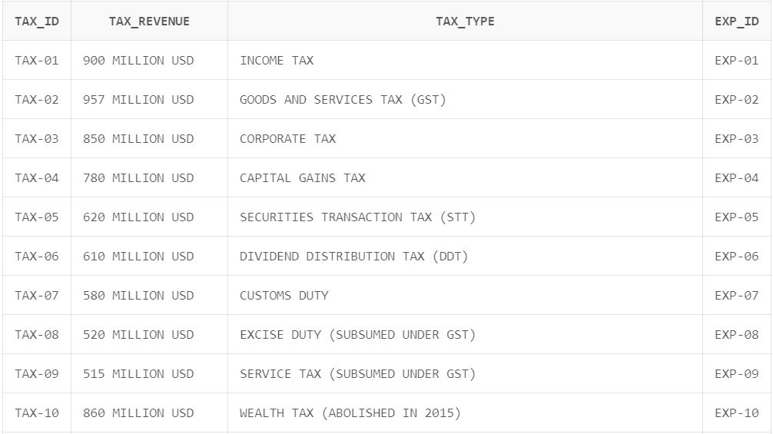
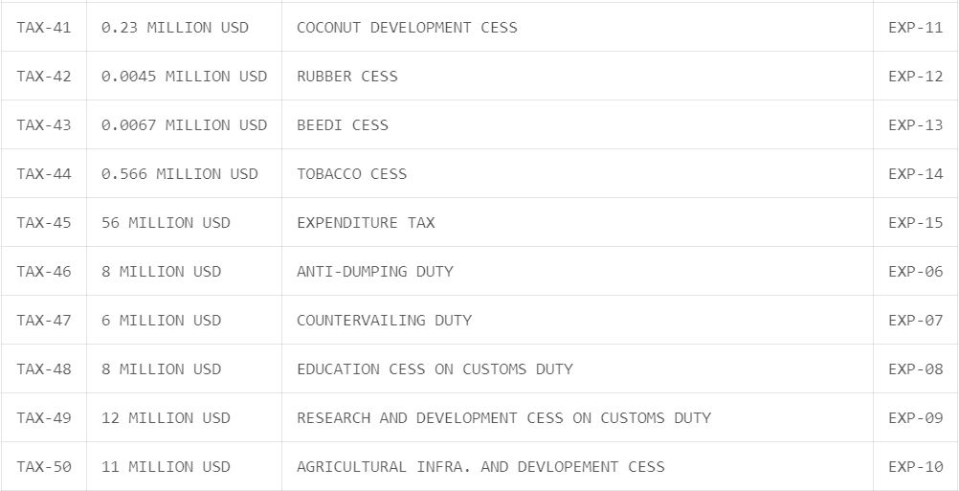
TAXATION
TAXATION

Slide 29
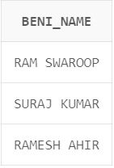
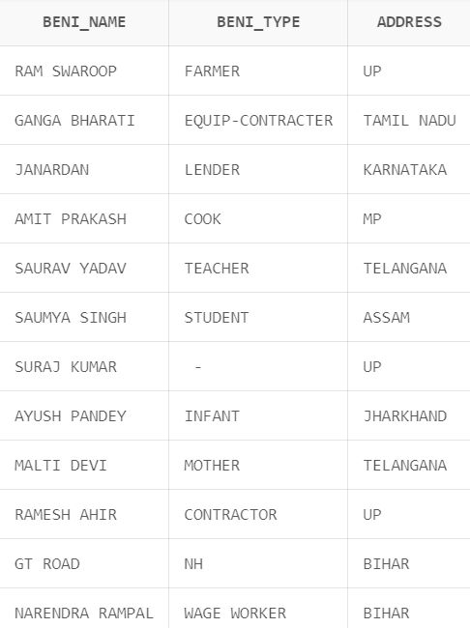
Sub queries
SELECT BENI_NAME FROM BENEFICIARY WHERE ADDRESS='UP';
SELECT BENI_NAME,BENI_TYPE,ADDRESS FROM BENEFICIARY INNER JOIN STATES ON STATE_ID=ADDRESS;

Slide 30
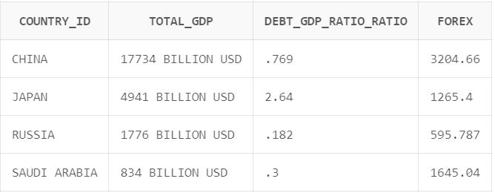
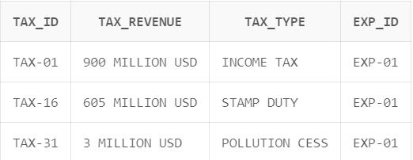
Sub queries
SELECT C1.COUNTRY_ID,C1.TOTAL_GDP,C1.DEBT_GDP_RATIO_RATIO,C1.FOREX FROM COUNTRIES C1,COUNTRIES C2 WHERE C2.COUNTRY_ID='INDIA' AND C1.FOREX>C2.FOREX;
SELECT * FROM TAXATION WHERE EXP_ID='EXP-01';

Slide 31
THANK YOU

