Slide 1






































$$b_{mean1}^{2}$$
$$b_{var1}^{2}$$
$$b^{3}$$
$$x_{1}$$
$$W_{mean}^{2}$$
$$z_{1}^{3}$$
$$a_{1}^{3}$$
$$Z_{mean1}^{2}$$
$$a_{mean1}^{2}$$
$$W^{3}$$
$$x_{2}$$
$$z_{2}^{3}$$
$$a_{2}^{3}$$
$$z_{1}^{2}$$
$$x_{3}$$
+
$$Z_{var1}^{2}$$
$$a_{var1}^{2}$$
$$ε_{1}$$
$$z_{3}^{3}$$
$$a_{3}^{3}$$
$$z_{254}^{3}$$
$$a_{254}^{3}$$
$$x_{254}$$
$$Z_{mean16}^{2}$$
$$a_{mean16}^{2}$$
+
$$z_{16}^{2}$$
$$x_{255}$$
$$z_{255}^{3}$$
$$a_{255}^{3}$$
$$x_{256}$$
$$Z_{var16}^{2}$$
$$a_{var16}^{2}$$
$$ε_{16}$$
$$W_{var}^{2}$$
16 dimensions
$$z_{256}^{3}$$
$$a_{256}^{3}$$
256 dimensions
$$b_{mean16}^{2}$$
$$b_{var16}^{2}$$
256 dimensions

Slide 2
活性化関数
活性化関数
+
256個
16層
256個
+

Slide 3
Range of operations in a single FPGA
Output 2 dimensions
Output 2 dimensions
+
Input 16 dimensions
Input 16 dimensions
+
256 dimensions
16 dimensions
256 dimensions

Slide 4
+
+

Slide 5
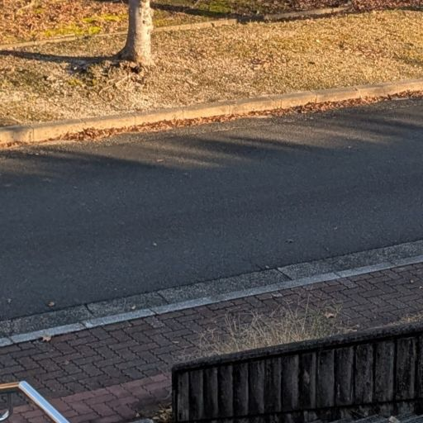
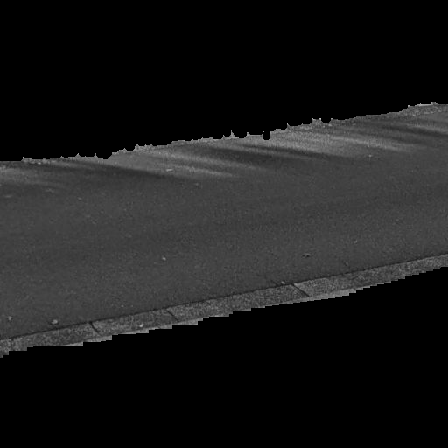
Extract road sections
VAE
+
16 Pixels
+
16 Pixels
learning condition eta: 0.005
epoch: 10000

